Slide 1

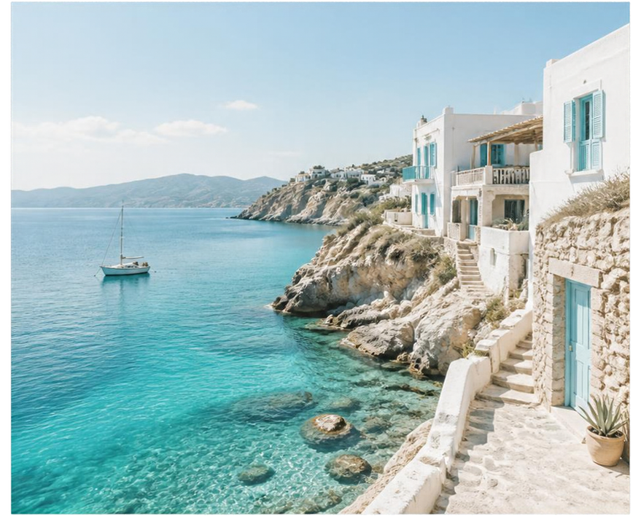


TRAVEL
2025 AUGUST
BROOKE & ROBIN
202508

Slide 2

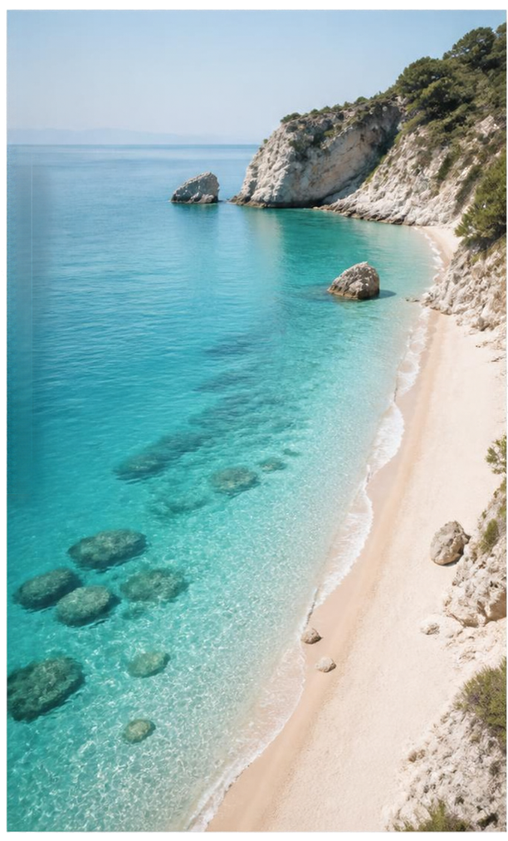





TRAVEL
2025 AUGUST
Greece
BROOKE & ROBIN

Slide 3

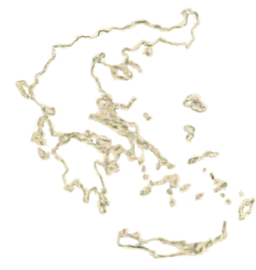


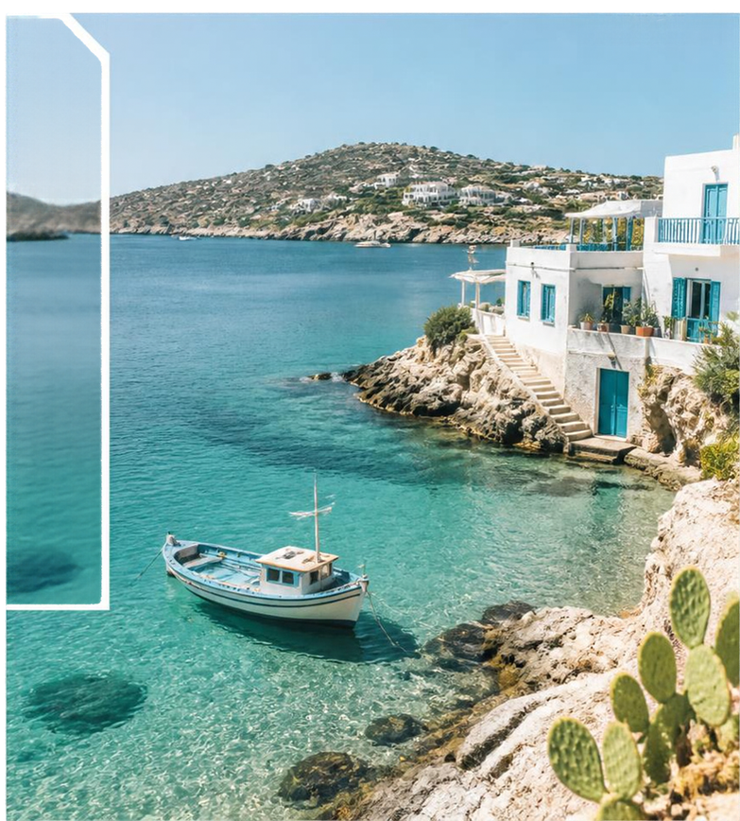

TRAVEL
AUGUST 2025
TRAVEL
2025 AUGUST
BROOKE & ROBIN
Island
Moments
SALTY AIR, SUNNY DAYS AND ENDLESS VIEWS.
Our favourite places, little adventures and lasting memories
from Greece.

Slide 4

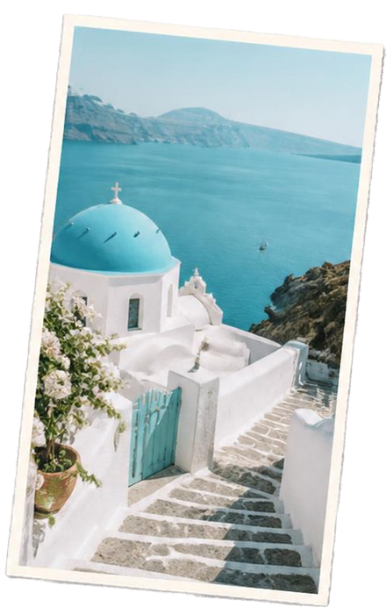

CON
Brooke & Robin
Greece, August 2025
TENTS
05
06
10
13
16
19
22
25
28
30
34
38
42
LETTER FROM THE EDITOR
THE TRAVEL ROUTE
FIRST DAY MEMORIES
SECOND DAY
THIRD DAY
FOURTH DAY
FIFTH DAY
LAST DAY
SEA & SUPPERS
LOOKS & ESSENTIALS
CULTURE & KEEPSAKES
FAVOURITES & PAPER FINDS
MOMENTS & MEMORIES

Slide 5

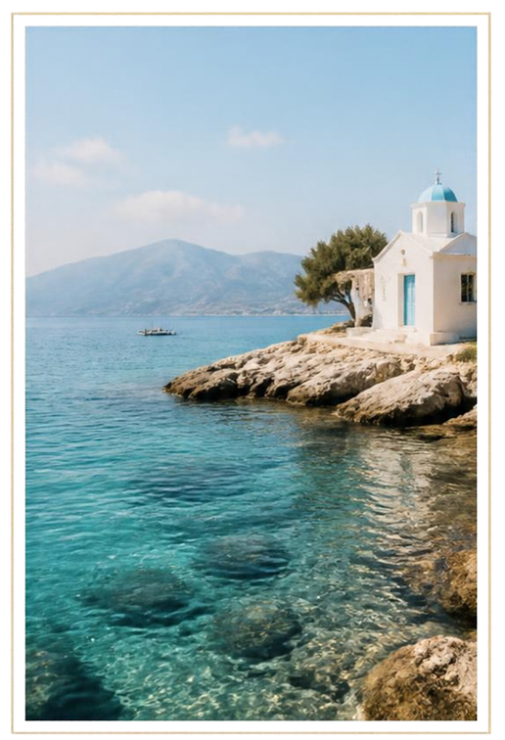


AUGUST 2025
LETTER FROM
THE EDITOR
B
Some trips stay with you long before the suitcase is unpacked. Greece in August 2025 was one of those rare adventures.
Brooke & Robin set out with an open plan and a shared sense of wonder, following the ferry routes and the sun—hopping from island to island, each one more beautiful in its own way.
We wandered whitewashed villages, chased quiet coves, swam in water that shimmered every shade of blue, and lingered over late dinners with locals who felt like old friends.
This magazine is our love letter to those moments—and to the magic of traveling together.
Brooke & Robin
Morning light in Naxos.
5

Slide 6

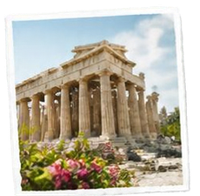




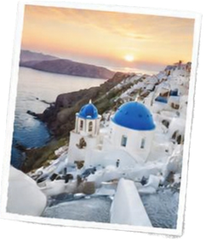
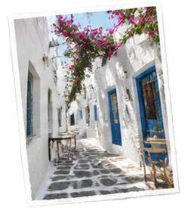



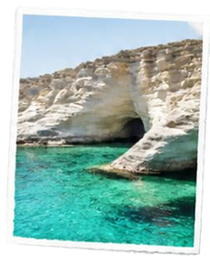

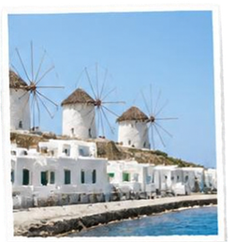


BROOKE & ROBIN’S GREECE JOURNEY
AUGUST 2025
06
THE TRAVEL ROUTE
ATHENS
Our adventure begins in ancient Athens.
Five unforgettable stops, countless blue views, and one incredible Greek summer.
SANTORINI
Whitewashed dreams and sunsets that take your breath away.
PAROS
Charming villages, golden beaches,
island slow living.
MILOS
Surreal landscapes
and turquoise
waters to explore.
MYKONOS
The perfect finale—sun, style, and
island energy.

Slide 7
BROOKE & ROBIN / A SUMMER JOURNEY
THE WAY
we went
A few stops. A thousand little
details.
Follow the places that mattered to you. Add the
journeys between them, the unexpected detours
and the view that made you stop.
7
Notes:
Travel Magazine V2. Editable photo-led scrapbook layout. Source images used on the basis of the user-confirmed resale rights. Additional illustrative AI images are documented in the asset list. Replace images using Change Picture and review the crop. All narrative copy is sample content.

Slide 8
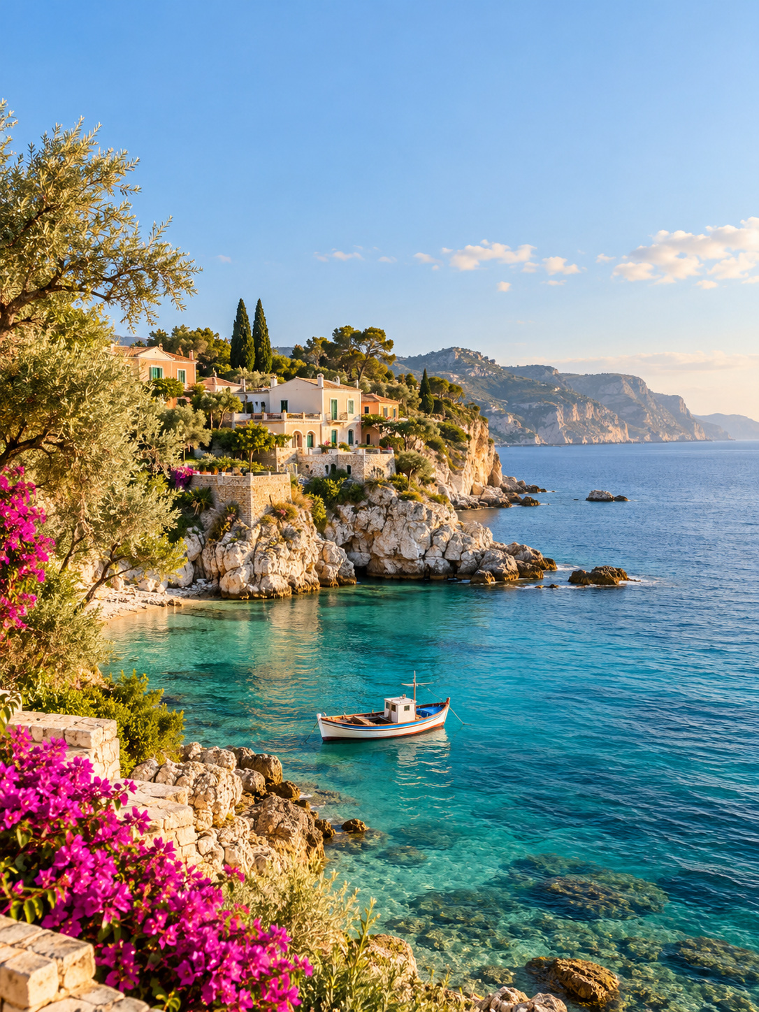
BEFORE THE
JOURNEY
begins
There is a moment when the bags are packed, the plans
are made, and every possibility still lies ahead.
A JOURNEY TO REMEMBER
AWAY
YOU / ME
MEMORIES
DESTINATION: SOMEWHERE GOOD
MEMORY NO. 01 • KEEPSAKE ONLY
A JOURNEY TO REMEMBER
YOU / ME
DESTINATION: SOMEWHERE GOOD
MEMORY NO. 01 • KEEPSAKE ONLY
Notes:
Travel Magazine V2. Editable photo-led scrapbook layout. Source images used on the basis of the user-confirmed resale rights. Additional illustrative AI images are documented in the asset list. Replace images using Change Picture and review the crop. All narrative copy is sample content.

Slide 9
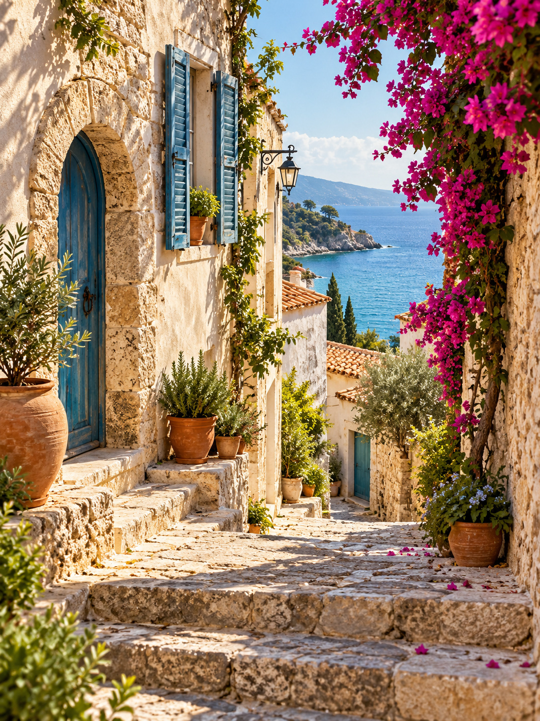
The first glimpse
A different light. A slower rhythm.
A whole journey waiting to happen.
Notes:
Travel Magazine V2. Editable photo-led scrapbook layout. Source images used on the basis of the user-confirmed resale rights. Additional illustrative AI images are documented in the asset list. Replace images using Change Picture and review the crop. All narrative copy is sample content.

Slide 10
AUGUST 2025 / DAY 01
FIRST DAY
memories
Our first afternoon belonged to the water. We left the bags behind and
followed a narrow lane until the sea came into view. The rest of the day
unfolded from there: a shaded table, a shared plate and the happy feeling
that we had finally arrived.
DAY 1
MEMORIES
10
Notes:
Travel Magazine V2. Editable photo-led scrapbook layout. Source images used on the basis of the user-confirmed resale rights. Additional illustrative AI images are documented in the asset list. Replace images using Change Picture and review the crop. All narrative copy is sample content.

Slide 11
A MOMENT FROM DAY 1
Arrival in blue
What we want to remember
Our first afternoon belonged to the water. We left the bags
behind and followed a narrow lane until the sea came into
view. The rest of the day unfolded from there: a shaded
table, a shared plate and the happy feeling that we had
finally arrived.
11
Notes:
Travel Magazine V2. Editable photo-led scrapbook layout. Source images used on the basis of the user-confirmed resale rights. Additional illustrative AI images are documented in the asset list. Replace images using Change Picture and review the crop. All narrative copy is sample content.

Slide 12
More than a photograph.
The light, the laughter, the little details.
A few frames from a day we want to keep.
Notes:
Travel Magazine V2. Editable photo-led scrapbook layout. Source images used on the basis of the user-confirmed resale rights. Additional illustrative AI images are documented in the asset list. Replace images using Change Picture and review the crop. All narrative copy is sample content.

Slide 13
AUGUST 2025 / DAY 02
SECOND DAY
memories
The morning began without a timetable.
We walked while the streets were still
quiet, stopped for coffee and let one
small discovery lead to the next. By
evening, the unfamiliar corners were
beginning to feel like places we knew.
Finding our rhythm
13
Notes:
Travel Magazine V2. Editable photo-led scrapbook layout. Source images used on the basis of the user-confirmed resale rights. Additional illustrative AI images are documented in the asset list. Replace images using Change Picture and review the crop. All narrative copy is sample content.

Slide 14
A MOMENT FROM DAY 2
Finding our rhythm
The morning began without a timetable. We
walked while the streets were still quiet, stopped
for coffee and let one small discovery lead to the
next. By evening, the unfamiliar corners were
beginning to feel like places we knew.
The moments
in between.
14
Notes:
Travel Magazine V2. Editable photo-led scrapbook layout. Source images used on the basis of the user-confirmed resale rights. Additional illustrative AI images are documented in the asset list. Replace images using Change Picture and review the crop. All narrative copy is sample content.

Slide 15
small scenes,
big memories
DAY 2 / OUR PHOTO NOTES
Notes:
Travel Magazine V2. Editable photo-led scrapbook layout. Source images used on the basis of the user-confirmed resale rights. Additional illustrative AI images are documented in the asset list. Replace images using Change Picture and review the crop. All narrative copy is sample content.

Slide 16
AUGUST 2025 / DAY 03
THIRD DAY
memories
We took the route that promised a view and
discovered that the best part was everything along
the way. There were steps down to the water, a little
shop we nearly missed and plenty of reasons to
arrive later than planned.
16
Notes:
Travel Magazine V2. Editable photo-led scrapbook layout. Source images used on the basis of the user-confirmed resale rights. Additional illustrative AI images are documented in the asset list. Replace images using Change Picture and review the crop. All narrative copy is sample content.

Slide 17
A MOMENT FROM DAY 3
The longer way
What we want to remember
We took the route that promised a view and discovered
that the best part was everything along the way. There
were steps down to the water, a little shop we nearly
missed and plenty of reasons to arrive later than planned.
17
Notes:
Travel Magazine V2. Editable photo-led scrapbook layout. Source images used on the basis of the user-confirmed resale rights. Additional illustrative AI images are documented in the asset list. Replace images using Change Picture and review the crop. All narrative copy is sample content.

Slide 18
More than a photograph.
The light, the laughter, the little details.
A few frames from a day we want to keep.
Notes:
Travel Magazine V2. Editable photo-led scrapbook layout. Source images used on the basis of the user-confirmed resale rights. Additional illustrative AI images are documented in the asset list. Replace images using Change Picture and review the crop. All narrative copy is sample content.

Slide 19
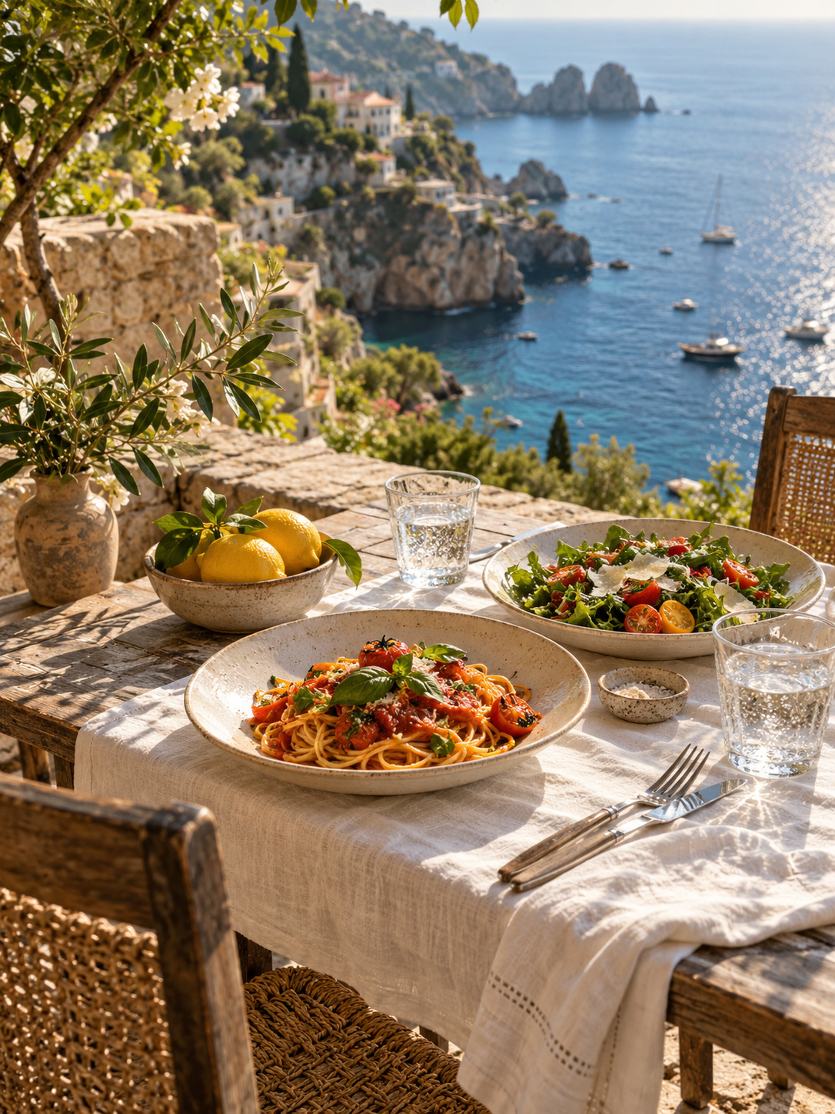
AUGUST 2025 / DAY 04
FOURTH DAY
memories
Some places make it easy to stay. We found ours beside the water, where
lunch stretched into the afternoon and nobody seemed in a hurry. We
talked, watched the light change and decided that doing very little could be
a very good plan.
DAY 4
MEMORIES
19
Notes:
Travel Magazine V2. Editable photo-led scrapbook layout. Source images used on the basis of the user-confirmed resale rights. Additional illustrative AI images are documented in the asset list. Replace images using Change Picture and review the crop. All narrative copy is sample content.

Slide 20
A MOMENT FROM DAY 4
Places to linger
Some places make it easy to stay. We found ours
beside the water, where lunch stretched into the
afternoon and nobody seemed in a hurry. We
talked, watched the light change and decided
that doing very little could be a very good plan.
The moments
in between.
20
Notes:
Travel Magazine V2. Editable photo-led scrapbook layout. Source images used on the basis of the user-confirmed resale rights. Additional illustrative AI images are documented in the asset list. Replace images using Change Picture and review the crop. All narrative copy is sample content.

Slide 21
small scenes,
big memories
DAY 4 / OUR PHOTO NOTES
Notes:
Travel Magazine V2. Editable photo-led scrapbook layout. Source images used on the basis of the user-confirmed resale rights. Additional illustrative AI images are documented in the asset list. Replace images using Change Picture and review the crop. All narrative copy is sample content.

Slide 22
AUGUST 2025 / DAY 05
FIFTH DAY
memories
Today was made of small surprises: a
doorway full of flowers, a taste we had
never tried and a conversation that
changed our plans. We collected them
quietly, one after another, until an
ordinary day had become one of our
favourites.
Little discoveries
22
Notes:
Travel Magazine V2. Editable photo-led scrapbook layout. Source images used on the basis of the user-confirmed resale rights. Additional illustrative AI images are documented in the asset list. Replace images using Change Picture and review the crop. All narrative copy is sample content.

Slide 23
A MOMENT FROM DAY 5
Little discoveries
What we want to remember
Today was made of small surprises: a doorway full of
flowers, a taste we had never tried and a conversation that
changed our plans. We collected them quietly, one after
another, until an ordinary day had become one of our
favourites.
23
Notes:
Travel Magazine V2. Editable photo-led scrapbook layout. Source images used on the basis of the user-confirmed resale rights. Additional illustrative AI images are documented in the asset list. Replace images using Change Picture and review the crop. All narrative copy is sample content.

Slide 24
More than a photograph.
The light, the laughter, the little details.
A few frames from a day we want to keep.
Notes:
Travel Magazine V2. Editable photo-led scrapbook layout. Source images used on the basis of the user-confirmed resale rights. Additional illustrative AI images are documented in the asset list. Replace images using Change Picture and review the crop. All narrative copy is sample content.

Slide 25
AUGUST 2025 / DAY 06
LAST DAY
memories
On the last morning, everything seemed worth
another look. We revisited a favourite street, sat a
little longer over coffee and took a photograph of
the view we already knew by heart. Leaving made
us notice how much we wanted to keep.
25
Notes:
Travel Magazine V2. Editable photo-led scrapbook layout. Source images used on the basis of the user-confirmed resale rights. Additional illustrative AI images are documented in the asset list. Replace images using Change Picture and review the crop. All narrative copy is sample content.

Slide 26
A MOMENT FROM DAY 6
One more look
On the last morning, everything seemed worth
another look. We revisited a favourite street, sat a
little longer over coffee and took a photograph of
the view we already knew by heart. Leaving made
us notice how much we wanted to keep.
The moments
in between.
26
Notes:
Travel Magazine V2. Editable photo-led scrapbook layout. Source images used on the basis of the user-confirmed resale rights. Additional illustrative AI images are documented in the asset list. Replace images using Change Picture and review the crop. All narrative copy is sample content.

Slide 27
small scenes,
big memories
DAY 6 / OUR PHOTO NOTES
Notes:
Travel Magazine V2. Editable photo-led scrapbook layout. Source images used on the basis of the user-confirmed resale rights. Additional illustrative AI images are documented in the asset list. Replace images using Change Picture and review the crop. All narrative copy is sample content.

Slide 28
SEA &
suppers
A taste of the
journey
Long lunches, local flavours and tables with a view. Some memories begin with the first bite.
28
Notes:
Travel Magazine V2. Editable photo-led scrapbook layout. Source images used on the basis of the user-confirmed resale rights. Additional illustrative AI images are documented in the asset list. Replace images using Change Picture and review the crop. All narrative copy is sample content.

Slide 29
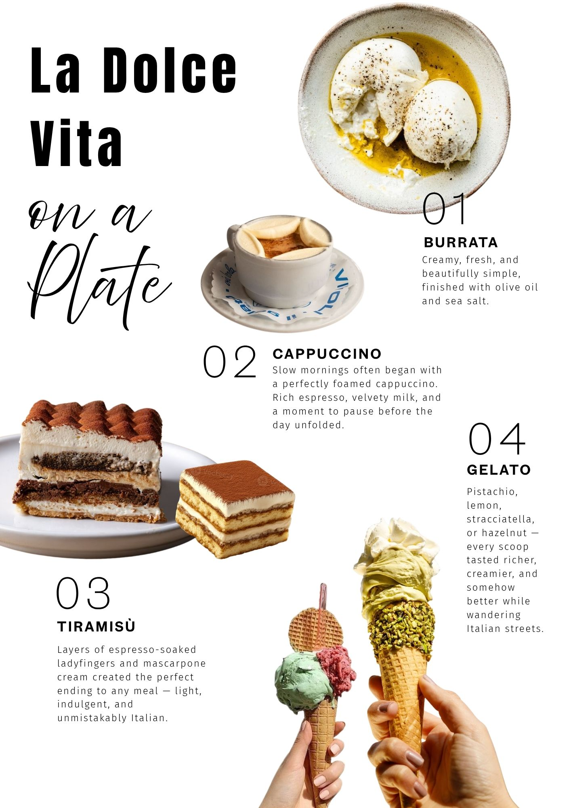
A TASTE
of summer
01
Morning coffee
A quiet start, a favourite cup and nowhere we had
to hurry.
02
A sweet ending
Something to share, and the perfect reason to stay a
little longer.
At our favourite table
29
Notes:
Travel Magazine V2. Editable photo-led scrapbook layout. Source images used on the basis of the user-confirmed resale rights. Additional illustrative AI images are documented in the asset list. Replace images using Change Picture and review the crop. All narrative copy is sample content.

Slide 30
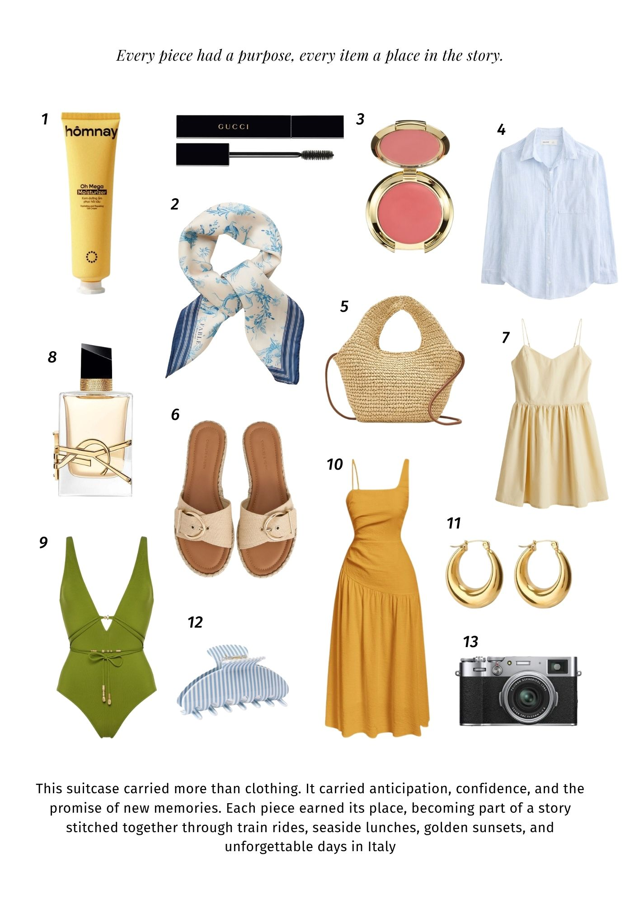
LOOKS FROM
the trip
Light days, easy pieces.
The clothes we reached for again and again: comfortable,
useful and just right for a day that could go anywhere.
Our summer wardrobe
30
Notes:
Travel Magazine V2. Editable photo-led scrapbook layout. Source images used on the basis of the user-confirmed resale rights. Additional illustrative AI images are documented in the asset list. Replace images using Change Picture and review the crop. All narrative copy is sample content.

Slide 31
FROM MORNING
to evening
Sunlit hours
A light dress, a slow walk
and a day by the water.
The evening edit
31
Notes:
Travel Magazine V2. Editable photo-led scrapbook layout. Source images used on the basis of the user-confirmed resale rights. Additional illustrative AI images are documented in the asset list. Replace images using Change Picture and review the crop. All narrative copy is sample content.

Slide 32
INSIDE THE
suitcase
A few favourites, a little space for memories.
32
Notes:
Travel Magazine V2. Editable photo-led scrapbook layout. Source images used on the basis of the user-confirmed resale rights. Additional illustrative AI images are documented in the asset list. Replace images using Change Picture and review the crop. All narrative copy is sample content.

Slide 33
Pack light, remember more.
Travel documents
Tickets and bookings
A camera or phone
Chargers and adapters
A small everyday bag
Comfortable shoes
Swimwear and a towel
A notebook for the little things
33
Notes:
Travel Magazine V2. Editable photo-led scrapbook layout. Source images used on the basis of the user-confirmed resale rights. Additional illustrative AI images are documented in the asset list. Replace images using Change Picture and review the crop. All narrative copy is sample content.

Slide 34
LIVING
the culture
Look beyond the postcard.
We began to notice the ordinary things: the rhythm of
the morning, the places where people gathered, the
doors left open to the sea breeze. They told a different
story from the landmarks, and we wanted to remember
both.
34
Notes:
Travel Magazine V2. Editable photo-led scrapbook layout. Source images used on the basis of the user-confirmed resale rights. Additional illustrative AI images are documented in the asset list. Replace images using Change Picture and review the crop. All narrative copy is sample content.

Slide 35
A closer look
Stone worn smooth by footsteps. A doorway
painted blue. A familiar gesture in an unfamiliar
place. These were the details that invited us to
slow down.
35
Notes:
Travel Magazine V2. Editable photo-led scrapbook layout. Source images used on the basis of the user-confirmed resale rights. Additional illustrative AI images are documented in the asset list. Replace images using Change Picture and review the crop. All narrative copy is sample content.

Slide 36
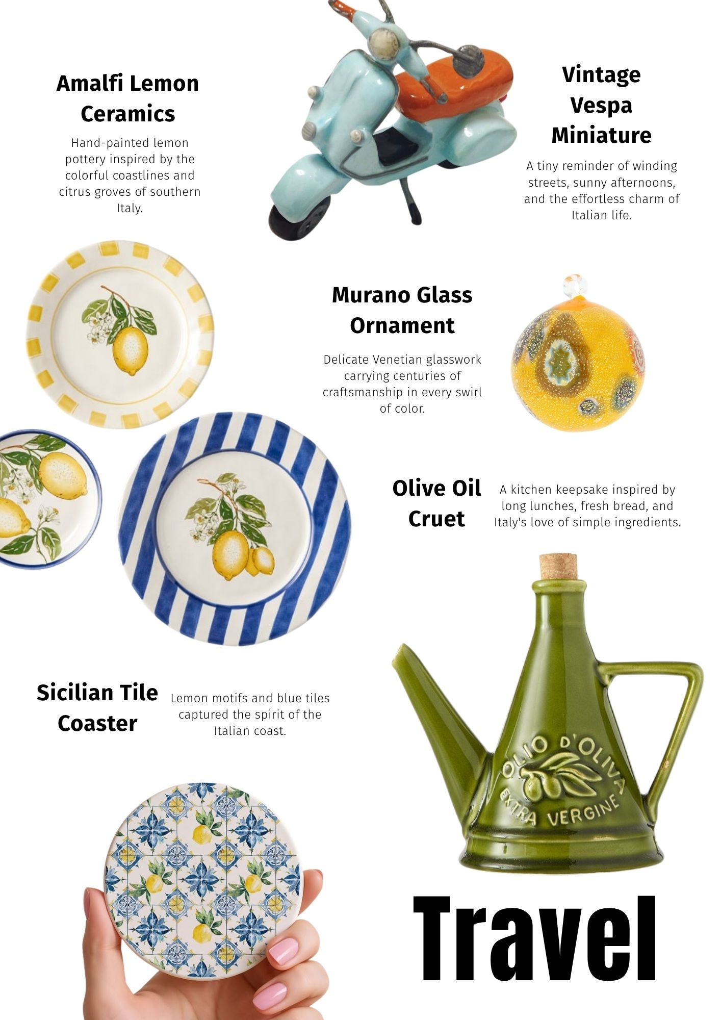
TRAVEL
keepsakes
01 / Hand-painted colour
A little piece of the coast, ready to find a place at home.
02 / Something delicate
A small object with a memory held inside.
03 / Made for everyday
The useful souvenir that brings the journey back to an
ordinary day.
36
Notes:
Travel Magazine V2. Editable photo-led scrapbook layout. Source images used on the basis of the user-confirmed resale rights. Additional illustrative AI images are documented in the asset list. Replace images using Change Picture and review the crop. All narrative copy is sample content.

Slide 37
Collected
along the way
Small things that bring the whole journey back.
37
Notes:
Travel Magazine V2. Editable photo-led scrapbook layout. Source images used on the basis of the user-confirmed resale rights. Additional illustrative AI images are documented in the asset list. Replace images using Change Picture and review the crop. All narrative copy is sample content.

Slide 38
Favourites
OUR PERSONAL PHOTO ALBUM
SELECTED MOMENTS / AUGUST 2025
38
Notes:
Travel Magazine V2. Editable photo-led scrapbook layout. Source images used on the basis of the user-confirmed resale rights. Additional illustrative AI images are documented in the asset list. Replace images using Change Picture and review the crop. All narrative copy is sample content.

Slide 39
A summer to remember
Not because every moment was perfect,
but because these moments were ours.
Notes:
Travel Magazine V2. Editable photo-led scrapbook layout. Source images used on the basis of the user-confirmed resale rights. Additional illustrative AI images are documented in the asset list. Replace images using Change Picture and review the crop. All narrative copy is sample content.

Slide 40
POSTCARD
Dear you,
TO / YOUR FAVOURITE PERSON
There is a table here with a view of the water, a
little lane full of flowers and a hundred things
we wish we could show you. For now, this
postcard will have to do.
40
Notes:
Travel Magazine V2. Editable photo-led scrapbook layout. Source images used on the basis of the user-confirmed resale rights. Additional illustrative AI images are documented in the asset list. Replace images using Change Picture and review the crop. All narrative copy is sample content.

Slide 41
THE PAPER TRAIL
BOARDING PASSES
& little papers
A JOURNEY TO REMEMBER
YOU / ME
JOURNEY
MEMORIES
DESTINATION: SOMEWHERE GOOD
MEMORY NO. 01 • KEEPSAKE ONLY
A JOURNEY TO REMEMBER
YOU / ME
DESTINATION: SOMEWHERE GOOD
MEMORY NO. 01 • KEEPSAKE ONLY
Some of the best souvenirs
were never meant to be kept.
41
Notes:
Travel Magazine V2. Editable photo-led scrapbook layout. Source images used on the basis of the user-confirmed resale rights. Additional illustrative AI images are documented in the asset list. Replace images using Change Picture and review the crop. All narrative copy is sample content.

Slide 42
BROOKE & ROBIN
Together, somewhere new.
This was our time to step outside the everyday. To share
the discoveries, the wrong turns, the quiet moments and
the view from the end of the road.
42
Notes:
Travel Magazine V2. Editable photo-led scrapbook layout. Source images used on the basis of the user-confirmed resale rights. Additional illustrative AI images are documented in the asset list. Replace images using Change Picture and review the crop. All narrative copy is sample content.

Slide 43
THE TWO
of us
Replace these frames with your favourite portraits together.
The best part was sharing it.
43
Notes:
Travel Magazine V2. Editable photo-led scrapbook layout. Source images used on the basis of the user-confirmed resale rights. Additional illustrative AI images are documented in the asset list. Replace images using Change Picture and review the crop. All narrative copy is sample content.

Slide 44
MOMENTS
that mattered
The photographs tell part of the story. The rest lives in the
conversations, the laughter and the moments we almost
forgot to notice. This is a page for those memories.
44
Notes:
Travel Magazine V2. Editable photo-led scrapbook layout. Source images used on the basis of the user-confirmed resale rights. Additional illustrative AI images are documented in the asset list. Replace images using Change Picture and review the crop. All narrative copy is sample content.

Slide 45
More than places,
we remember the feeling.
45
Notes:
Travel Magazine V2. Editable photo-led scrapbook layout. Source images used on the basis of the user-confirmed resale rights. Additional illustrative AI images are documented in the asset list. Replace images using Change Picture and review the crop. All narrative copy is sample content.

Slide 46
SUMMER
essentials
The everyday favourites
Something light. Something useful. Something
that made us smile. A few well-chosen things
were all we needed.
Your own edit
46
Notes:
Travel Magazine V2. Editable photo-led scrapbook layout. Source images used on the basis of the user-confirmed resale rights. Additional illustrative AI images are documented in the asset list. Replace images using Change Picture and review the crop. All narrative copy is sample content.

Slide 47
Every piece has a story.
The little things that came along for the adventure.
47
Notes:
Travel Magazine V2. Editable photo-led scrapbook layout. Source images used on the basis of the user-confirmed resale rights. Additional illustrative AI images are documented in the asset list. Replace images using Change Picture and review the crop. All narrative copy is sample content.

Slide 48
AT OUR
favourite table
We stayed for one more glass of water, then one more story. The food
was lovely, but the setting and the company made the meal. It
became one of the places we would talk about long after we returned
home.
A place worth returning to.
48
Notes:
Travel Magazine V2. Editable photo-led scrapbook layout. Source images used on the basis of the user-confirmed resale rights. Additional illustrative AI images are documented in the asset list. Replace images using Change Picture and review the crop. All narrative copy is sample content.

Slide 49
THE LITTLE
address book
01
Morning coffee
Name / place / a note for next time
02
A long lunch
Name / place / a note for next time
03
Something sweet
Name / place / a note for next time
04
Dinner by the sea
Name / place / a note for next time
05
One hidden favourite
Name / place / a note for next time
49
Notes:
Travel Magazine V2. Editable photo-led scrapbook layout. Source images used on the basis of the user-confirmed resale rights. Additional illustrative AI images are documented in the asset list. Replace images using Change Picture and review the crop. All narrative copy is sample content.

Slide 50
LAST DAY
memories
On the last morning, everything seemed worth
another look. We revisited a favourite street, sat a
little longer over coffee and took a photograph of
the view we already knew by heart. Leaving made
us notice how much we wanted to keep.
Just one
more look.
50
Notes:
Travel Magazine V2. Editable photo-led scrapbook layout. Source images used on the basis of the user-confirmed resale rights. Additional illustrative AI images are documented in the asset list. Replace images using Change Picture and review the crop. All narrative copy is sample content.

Slide 51
WHAT WE WILL
remember
A favourite place
The corner we would find again.
A little surprise
The moment that changed the day.
Something to keep
A feeling we want to carry home.
51
Notes:
Travel Magazine V2. Editable photo-led scrapbook layout. Source images used on the basis of the user-confirmed resale rights. Additional illustrative AI images are documented in the asset list. Replace images using Change Picture and review the crop. All narrative copy is sample content.

Slide 52
A few things
we brought home
A slower pace.
A new favourite view.
A story we can tell together.
Notes:
Travel Magazine V2. Editable photo-led scrapbook layout. Source images used on the basis of the user-confirmed resale rights. Additional illustrative AI images are documented in the asset list. Replace images using Change Picture and review the crop. All narrative copy is sample content.

Slide 53
AUGUST 2025
This is how we will remember it.
Notes:
Travel Magazine V2. Editable photo-led scrapbook layout. Source images used on the basis of the user-confirmed resale rights. Additional illustrative AI images are documented in the asset list. Replace images using Change Picture and review the crop. All narrative copy is sample content.

Slide 54
Until the next adventure.
BROOKE & ROBIN / GREECE / AUGUST 2025
Notes:
Travel Magazine V2. Editable photo-led scrapbook layout. Source images used on the basis of the user-confirmed resale rights. Additional illustrative AI images are documented in the asset list. Replace images using Change Picture and review the crop. All narrative copy is sample content.

Slide 55
One last note…
There will be other journeys. For now, there is this one: the places we saw, the people we met and the
little moments we chose to keep.
With love, Brooke & Robin
55
Notes:
Travel Magazine V2. Editable photo-led scrapbook layout. Source images used on the basis of the user-confirmed resale rights. Additional illustrative AI images are documented in the asset list. Replace images using Change Picture and review the crop. All narrative copy is sample content.

Slide 56
Our kind of
summer
BROOKE & ROBIN / AUGUST 2025
Notes:
Travel Magazine V2. Editable photo-led scrapbook layout. Source images used on the basis of the user-confirmed resale rights. Additional illustrative AI images are documented in the asset list. Replace images using Change Picture and review the crop. All narrative copy is sample content.

