Slide 1
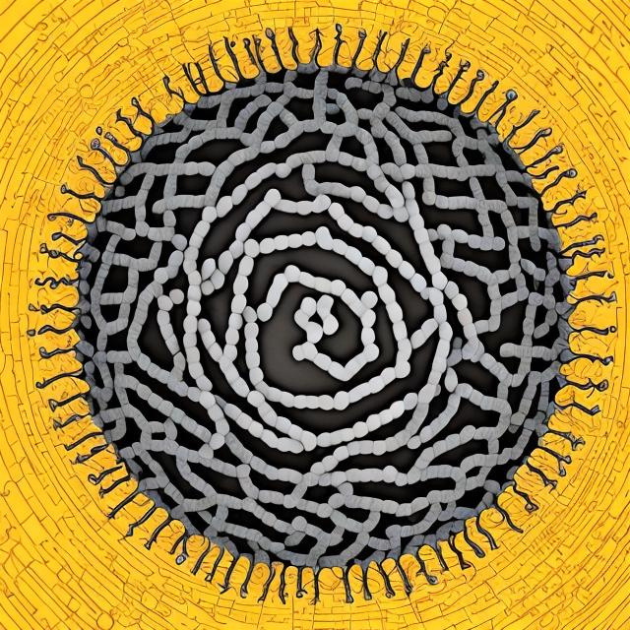
FINDING VIRAL GENES WITH HMM’S
Alexandre de Carvalho Assunção

Slide 2
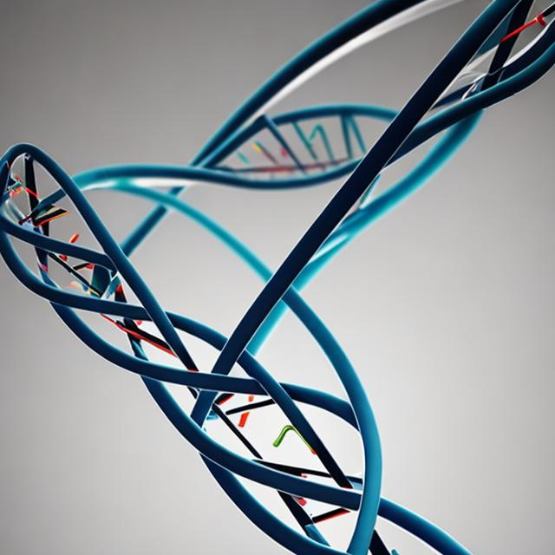
Why Look for Genes?
There are Several Applications:
Vaccine Manufacturing
Study Mutations
Drug Discovery
Disease Research

Slide 3

Implement a HMM model in Python | Use The Viterbi Expectation-Maximization Algorithm to train the model
Apply the model to the SARS-CoV2 genome | Alphafold the proteins it finds.
Blow up the Alphafold collab RAM | Just do it with the smaller proteins.
Project Objectives

Slide 4
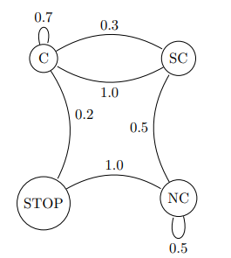
HMM
EASY TO IMPLEMENT
Can be trained with Dynamic Programming
POWERFUL ENOUGH TO CAPTURE MAJOR PATTERNS
Tried and tested in several biological applications
SEVERAL WAYS TO TRAIN
Supervised and Unsupervised (Maximum Likelihood or Viterbi/Baum-Welch)

Slide 5
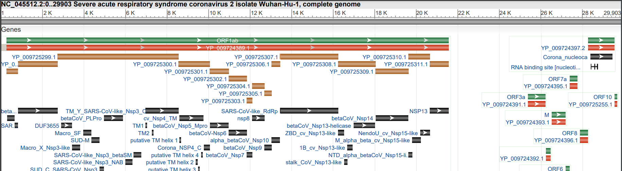
The SARS-CoV2 Genome
Source: National Center for Biotechnology Information

Slide 6
Challenges
SAME STRETCH OF THE GENOME CAN ENCODE MORE THAN ONE PROTEIN
DIFFERENT READING FRAMES RESULT IN DIFFERENT PROTEINS
GENE SIZE DISTRIBUTION HAS HIGH VARIANCE

Slide 7

Good Therapeutic Targets
ENVELOPE (E)
MEMBRANE (M)
NUCLEOCAPSID (N)
Helps the virus to escape from a host cell and spread
Plays a crucial role in the virus’ assembly.
Fundamental for RNA synthesis and assembly.
SPIKE (S)
Mediates entry into host cell.

Slide 8
The Model
The Markov Chain

Slide 9
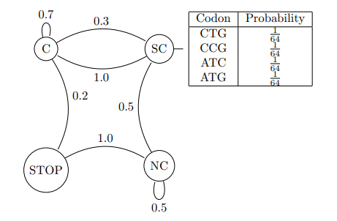
Model Emissions
Emissions
Hidden States

Slide 10

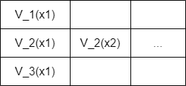

E Step
1-Run Viterbi Algorithm:
Viterbi EM
training

Slide 11


E Step
2-Calculate Log-Likelihood:
Viterbi EM
training

Slide 12
M Step
Viterbi EM
training
1-Update Emission Probabilities.
2-Update Transition Matrix.

Slide 13
SARS-CoV2
Spike | 1273
Envelope | 109
Membrane | 222
Nucleocapsid | 419
Orf1a | 4419
Orf3a | 275
Orf6 | 61
Orf7a | 121
Orf7b | 43
Orf8 | 121
Orf9b | 97
Known Proteins
Lengths

Slide 14
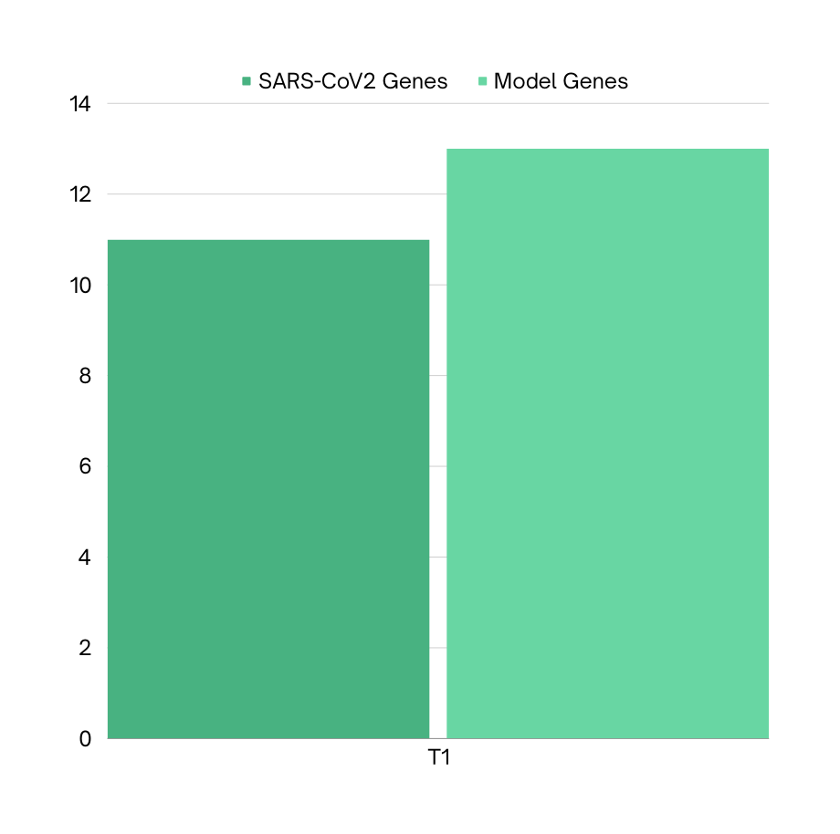
Results
Graph One: Number of genes found by HMM model vs. Known SARS-CoV 2 genes.

Slide 15
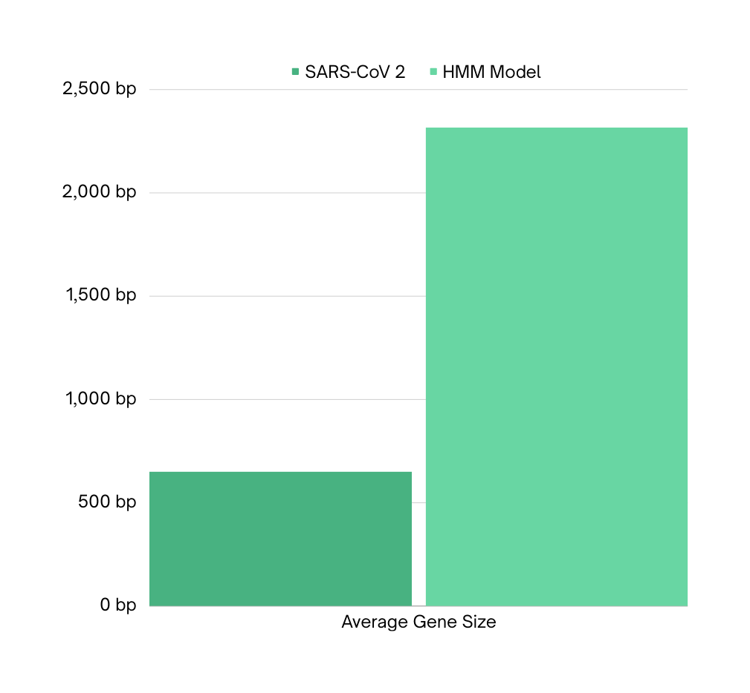
Results
Graph 2: Average size of genes found by the HMM model vs. average length of known SARS-CoV 2 genes.

Slide 16
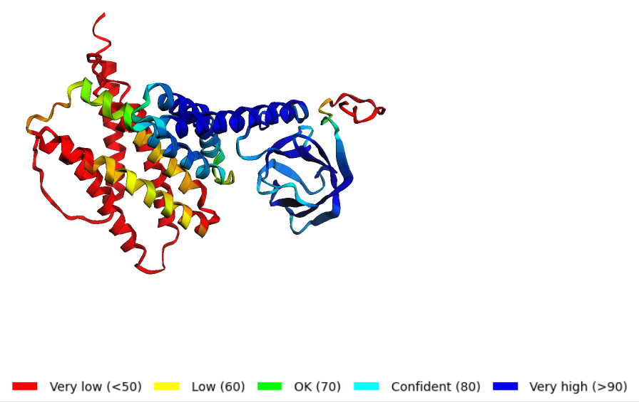
“Alphapholding” the results:

Slide 17
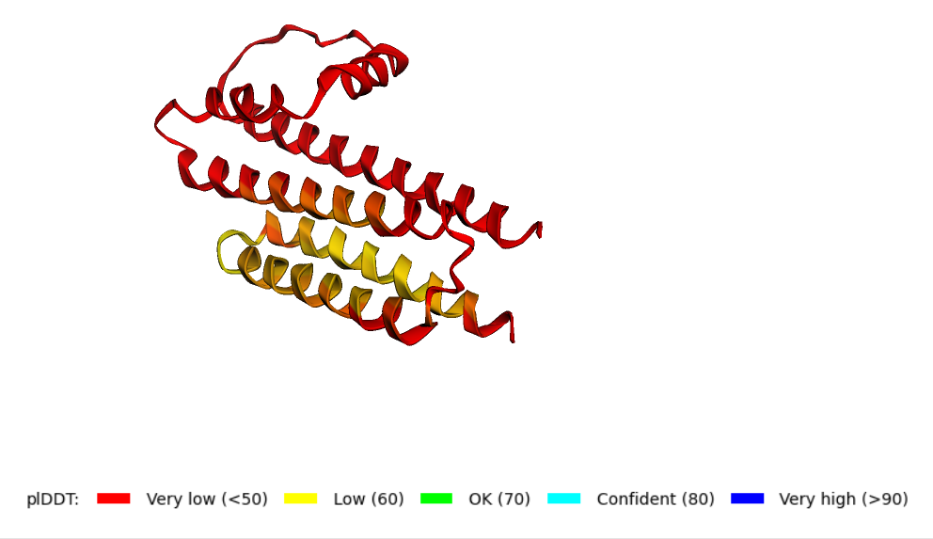
“Alphapholding” the results:

Slide 18
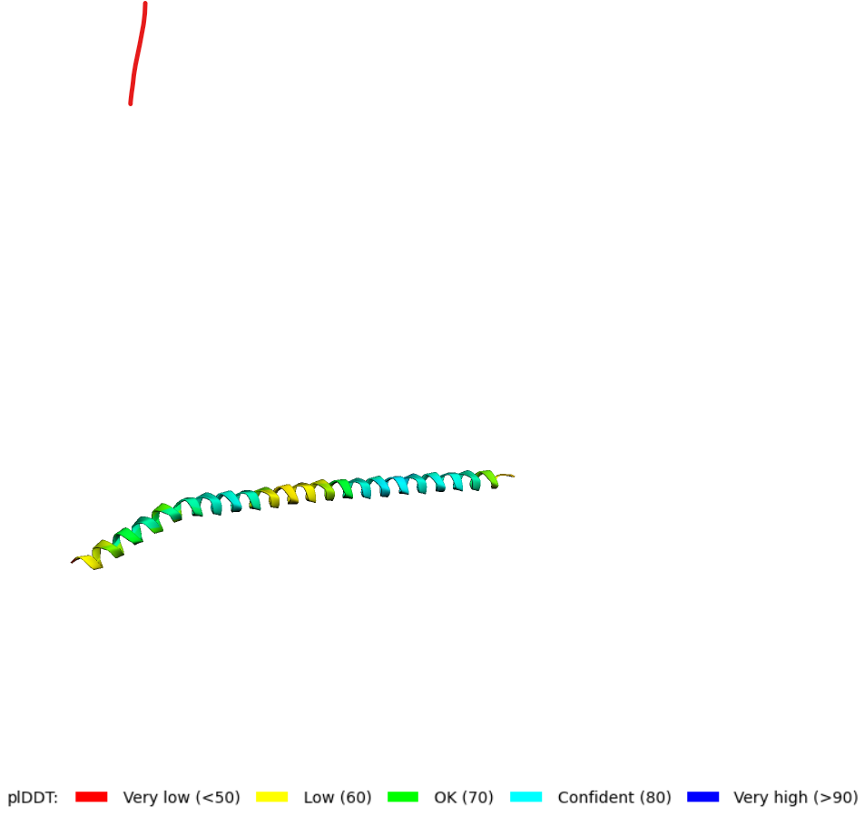
“Alphapholding” the results:

Slide 19
Future Plans
GET A BETTER GRASP ON MOLECULAR BIOLOGY AND THE STRUCTURE OF GENES.
FIND MORE DATA TO TRY AND FIT A BETTER MODEL.
IMPLEMENT BETTER METRIC TO EVALUATE RESULTS.

Slide 20

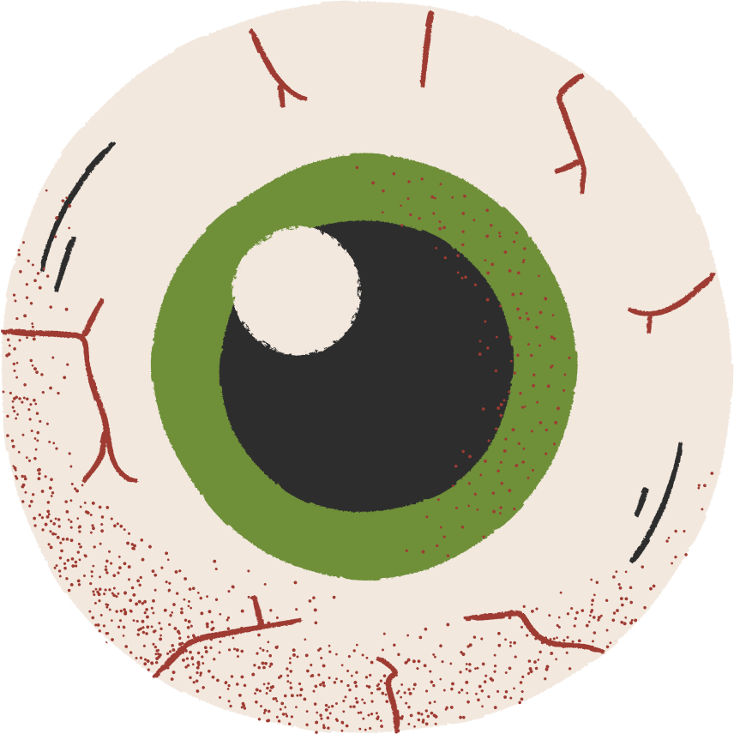
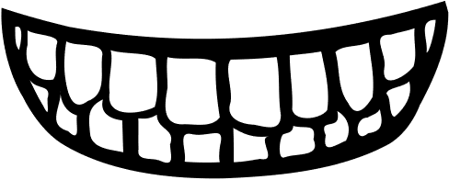
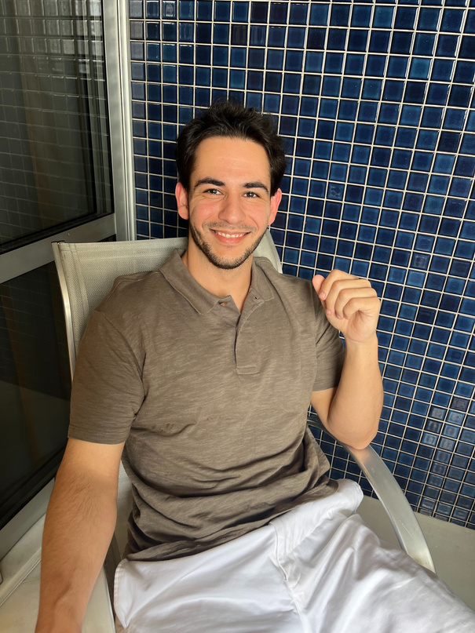
Kill me!
Thank You
ALEXANDRE DE CARVALHO ASSUNÇÃO
alexcarssuncao@gmail.com

