Slide 1
Project

Slide 2
FROM DB TO APP
Up until now, we’ve been working with:
modeling databases (ERDs)
querying databases(PhpMyAdmin, etc)
This works for us taking the class, but not for normal users!
We need to create a Front-end to access the database

Slide 3
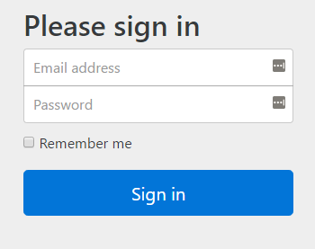
EXAMPLE
SELECT * FROM users
WHERE email=$email
AND password=$password

Slide 4
HOW DO WE CODE THIS?
You’ll need:
A Front-end (also known as a View)
e.g. HTML, Native mobile app, desktop app
A Back-end (also known as a Controller, or a Data Access Layer)
using PHP, ASP, Python, Java, etc. ( a server-side programming language)
(If, you’d like, you can have a Model)
Notes:
View is what the user is shown -> No database queries should be shown to the user (and get rid of default column names, etc)

Slide 5
STEPS
user visits front-end login.php, types their info and hits enter
that page POSTs the information back to the server (process.php)
the server receives the information
server checks info against database (using the backend)
if the user and password are good, send back welcome page
else, send back original form again.

Slide 6
THIS WORKS FOR CRUD ALSO
CRUD?
Create
Read
Update
Delete
Web apps use this term to describe apps that provide these operations to data (in a database)

Slide 7
CRUD STEPS
user visits front-end getstudent.php, types the requested info (e.g. which student to get info about) hits enter
that page POSTs the information back to the server (process.php)
the backend server receives the information
server formulate the correct query (SELECT, INSERT, UPDATE, DELETE) based on the input
server runs query against database, and gets the resulting records
server displays a new page with the requested records (or errors)

Slide 8
PROJECT
Will involve create a CRUD app
In groups
Create front-end, back-end, queries

Slide 9
Assigned Groups
Groups of 3
Required to keep track of who does what. Will have to at the end evaluate each others contribution

Slide 10
Project requirements
project specifcs

Slide 11
LET’S BUILD A SAMPLE TOGETHER example
We’ll use PHP and MySQL, but you’re welcome to use other things
Make sure you have your web server installed (XAMPP, etc)
Find the document root (within xampp - use htdocs)
Let’s put in a first PHP script to test it works
Notes:
document root – when you go to the website, whatever pages are here are visible (it looks for an index file)
php scripts start with <?php and end with ?>, everything else is HTML

Slide 12
PHP
Code starts with <?php
Ends with ?>
needs to be named something.php
variables always have a $ in the front (e.g. $amount, $name)
Notes:
https://ss23.github.io/php-tutorial/index.html
http://www.cs.utsa.edu/~cs4413/lectures/topic5PhP.html

Slide 13
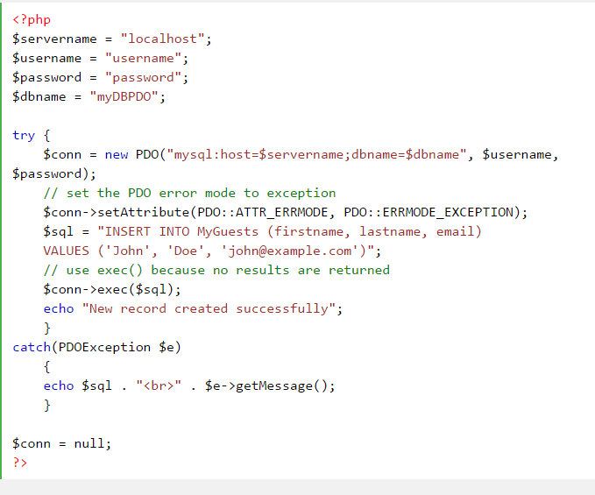
USING MYSQL FROM PHP (SEE here)
When doing an operation that doesn’t have any results, use $conn->exec .
It is good practice to but everything in a try-catch block to know if anything goes wrong
Notes:
http://www.phptherightway.com/#pdo_extension
http://www.w3schools.com/php/php_mysql_create.asp (use the pdo piece)

Slide 14
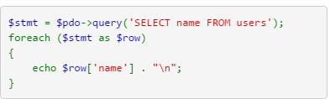
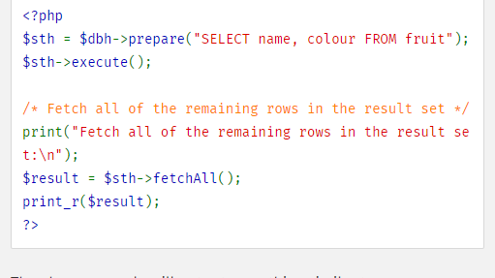
DISPLAYING THE OUTPUT
many ways to get and iterate over the results. test, test, test!

Slide 15
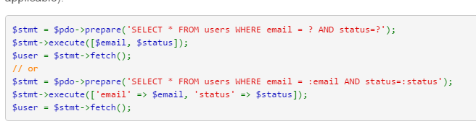
USING PARAMETERS (SAFELY)

Slide 16
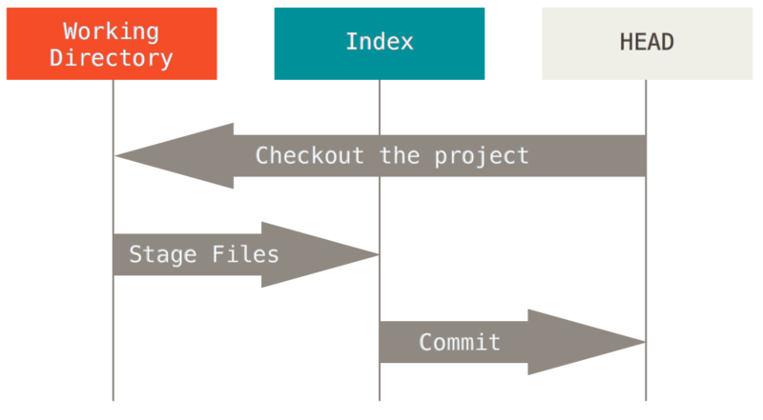
VERSION CONTROL BASICS
https://try.github.io/levels/1/challenges/1
Version control is a sophisticated way of saving and working on files
“unsaved” “quick save” “make a backup at this point”

Slide 17
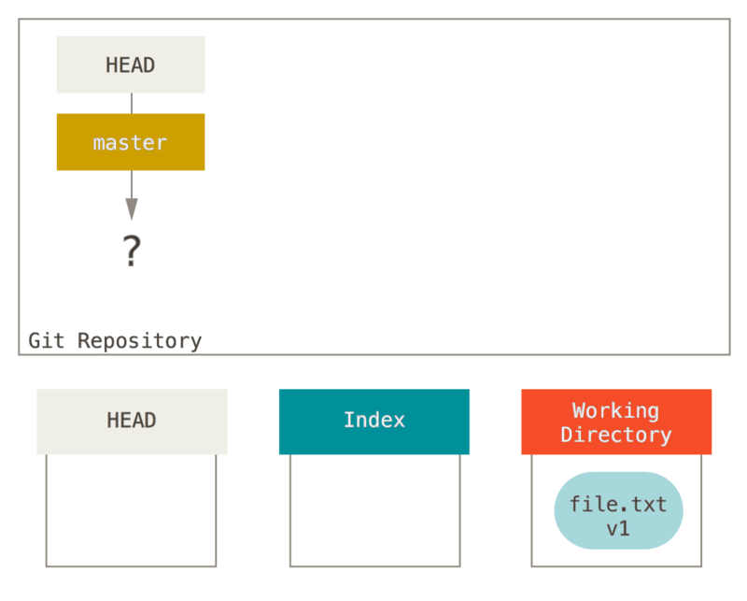
git init

Slide 18
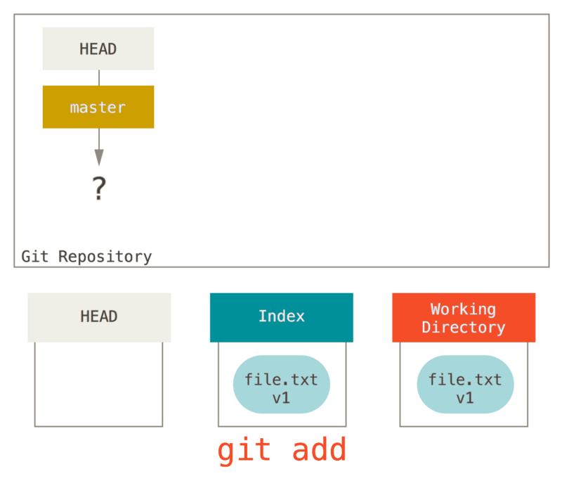

Slide 19
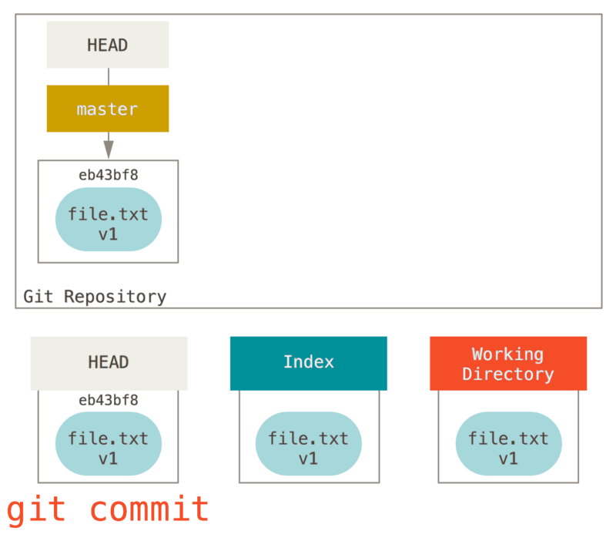

Slide 20
GIT BASICS – CREATING REPO, SAYING WHO YOU ARE
two ways to use git: command line, and graphical
https://help.github.com/articles/set-up-git/
later, you’ll figure out how to use git and github

Slide 21
GITHUB – WHAT IS IT? WHY USE IT? HOW WILL WE USE IT HERE?
github is remote storage for git repositories (in the “cloud”)
saves your files even if your computer dies
lets you collaborate with other people, both posting code and integrating their changes with yours (automatically if possible)
each group will have a github for their project, which we will check to see who is contributing

