Slide 1
Does the Weather in Atlanta make us Crazy in Traffic!?
Iteration Station:
Amber Pizzo
Alex Caughman
John Shows
Steven White

Slide 2
Motivation/Questions to Answer
Atlanta consistently ranks as one of the worst cities in the United States for traffic congestion
As residents of Atlanta (and thus, part of the traffic problem), we wanted to know: “Can we blame something but ourselves?”
Questions to answer:
How does precipitation impact traffic incidents?
What type of traffic incidents are affected by precipitation?
What other weather factors play a role in traffic incidents, and how much of a role?
Do specific locations in Atlanta see higher correlation of traffic incidents to precipitation?
If so, why?

Slide 3

Data Sources
Traffic Data:
Kaggle - US Accidents (3.5 million records) A Countrywide Traffic Accident Dataset (2016 - 2020)
Acknowledgements
Moosavi, Sobhan, Mohammad Hossein Samavatian, Srinivasan Parthasarathy, and Rajiv Ramnath. “A Countrywide Traffic Accident Dataset.”, 2019.
Moosavi, Sobhan, Mohammad Hossein Samavatian, Srinivasan Parthasarathy, Radu Teodorescu, and Rajiv Ramnath. "Accident Risk Prediction based on Heterogeneous Sparse Data: New Dataset and Insights." In proceedings of the 27th ACM SIGSPATIAL International Conference on Advances in Geographic Information Systems, ACM, 2019.
Accident records include accident severity, start time, end time, latitude and longitude of accident, city, state, zip code, description of accident, length of road extant affected by accident, street address.
Weather Data:
Visual Crossing Weather API (Worldwide weather history reports & global 15-day weather forecasts via CSV download, API, & Excel)
Notes:
* Questions & Data * Elaborate on the questions you asked, describing what kinds of data you needed to answer them, and where you found it

Slide 4
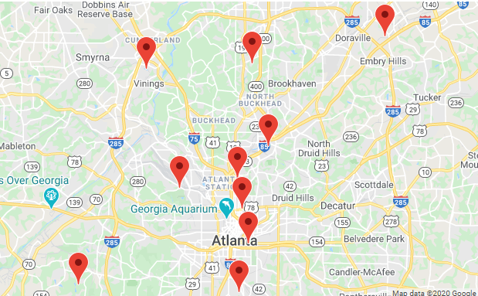
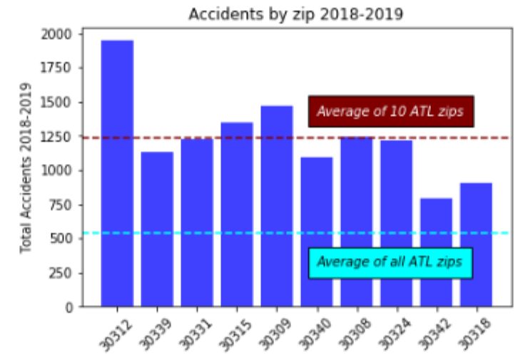
Atlanta Traffic: Narrowing the Data
Regions of Interest
Based on the initial analysis of traffic dataset, we chose the 10 zip codes with the highest number of accidents over the last 2 year
Notes:
Traffic Data – Discuss the way the traffic was cleaned up and applied…..talk about how we determined the 10 zips we included in our analysis…..
Data Cleanup & Exploration * Describe the exploration and cleanup process * Discuss insights you had while exploring the data that you didn't anticipate * Discuss any problems that arose after exploring the data, and how you resolved them * Present and discuss interesting figures developed during exploration, ideally with the help of Jupyter Notebook

Slide 5
Data Exploration and Cleanup
Continuing the data exploration, we took the following steps:
Pulled weather info from weather API for our 10 zip codes
Collected accident data from Kaggle dataset for our 10 zip codes
Cleaned up accident dataset to format zip code and condense to show one row with date and all relevant accident info
Realized accident data was quite limited
Merged accident and weather data on date
Used this merged data to look for trends and correlations in each zip code
Notes:
Data Analysis * Discuss the steps you took to analyze the data and answer each question you asked in your proposal * Present and discuss interesting figures developed during analysis, ideally with the help of Jupyter Notebook

Slide 6
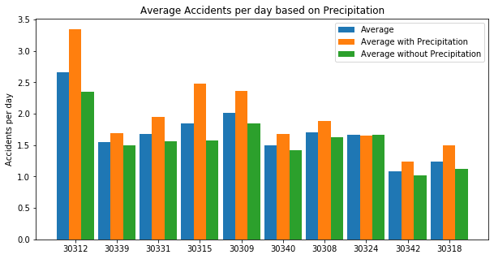
Initial Data Analysis
During the two year period (2018-2019) the 10 zip codes in Atlanta with the highest accident counts experience more accidents on average when it rains
Notes:
Motivation & Summary Slide * Define the core message or hypothesis of your project. * Describe the questions you asked, and _why_ you asked them * Describe whether you were able to answer these questions to your satisfaction, and briefly summarize your findings.

Slide 7
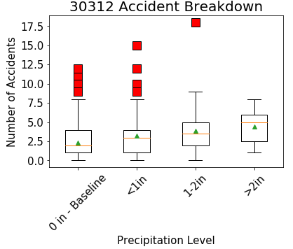
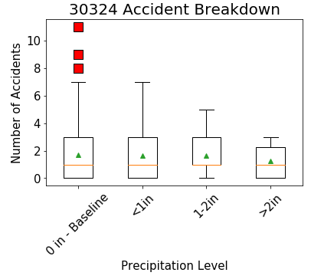
Comparing Precipitation Data to “Baseline”
Since our mission was to determine precipitation’s effect on traffic incidents, we decided to create a “baseline” to compare to
Some zip codes show a clear increase in accidents as precipitation increases, while others do not reflect this
Notes:
Discussion * Discuss your findings. Did you find what you expected to find? If not, why not? What inferences or general conclusions can you draw from your analysis?

Slide 8
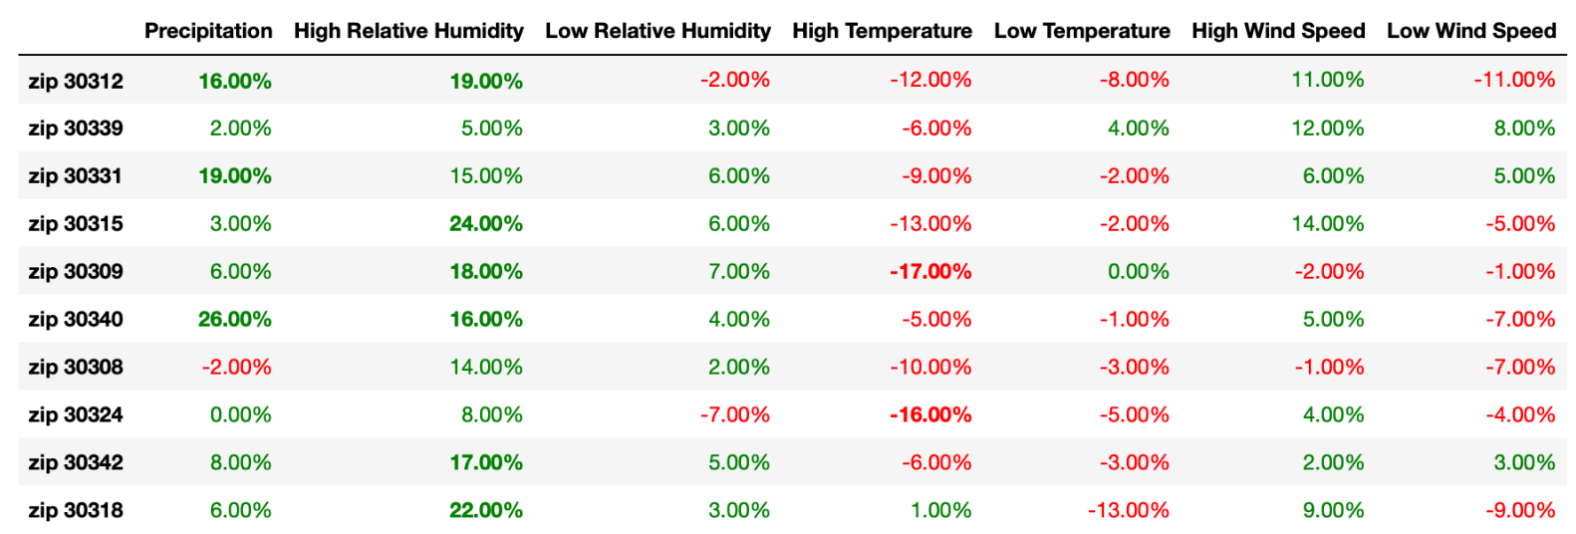
Examining Other Weather Factors
After performing regression analysis on our weather factors, we were able to compare where highest and lowest correlations can be seen
Notes:
Weather Data – Discuss the way the weather was cleaned up and applied…..

Slide 9
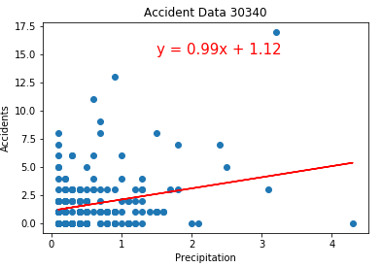
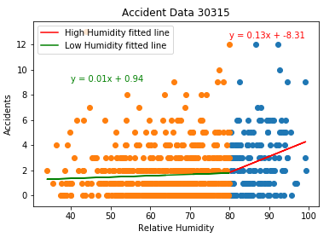
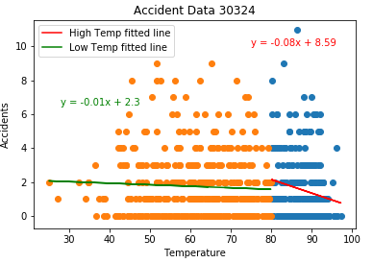
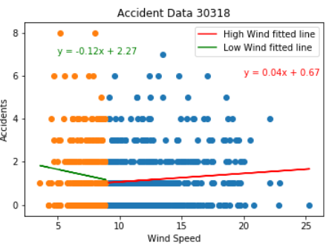
Examining Other Weather Factors continued..
Precipitation
Humidity
Temperature
Wind Speed

Slide 10
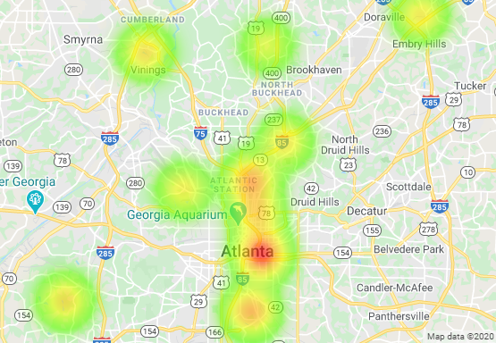
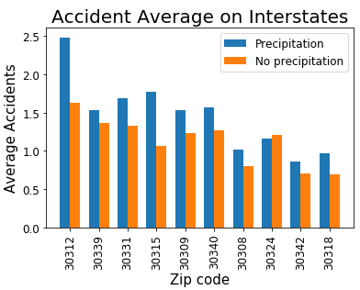
Atlanta Traffic and Weather - Findings
Analyzing the locations we chose further, we noticed that many of them were centered around large interstates, known for frequent congestion
Heat map of accidents on precipitation days
Notes:
Discussion * Discuss your findings. Did you find what you expected to find? If not, why not? What inferences or general conclusions can you draw from your analysis?

Slide 11
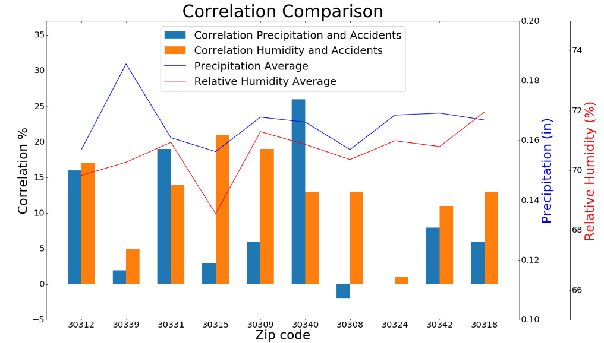
Atlanta Traffic and Weather - Conclusions
As expected, it can be seen that there is a higher average of accidents on precipitation days in most zip codes
Surprisingly the correlation of precipitation to number of accidents was weak in all zip codes
Humidity also appears to show a similar, if not higher, correlation to number of accidents

Slide 12
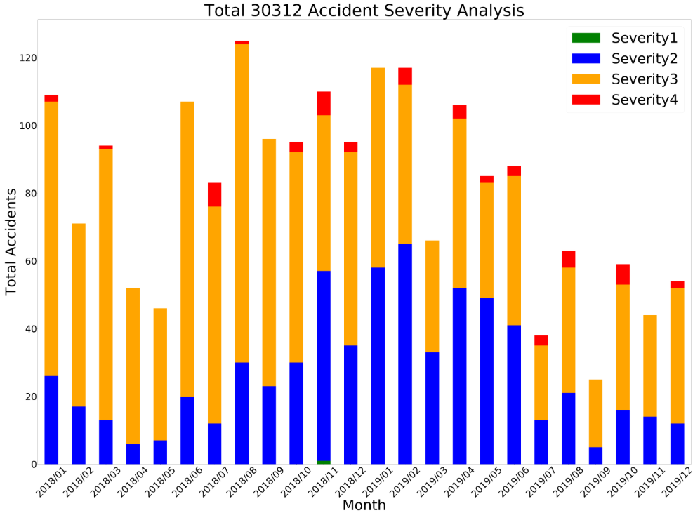
Considerations/Limitations
Considerations:
Difficult to find historical traffic data through API - used Kaggle dataset instead
This resulted in limited data available
Required us to analyze only number of accidents without inclusion of congestion or accident type
Many other factors can cause traffic incidents
Notes:
Post Mortem * Discuss any difficulties that arose, and how you dealt with them * Discuss any additional questions that came up, but which you didn't have time to answer: What would you research next, if you had two more weeks?

Slide 13
Future Analyses
Future Analyses:
Compare Atlanta accident data with other cities around the US
Calculate and compare heat index to determine any possible correlation to accidents
Utilize other traffic datasets or available APIs to analyze other traffic incidents such as congestion, impact to commute time, and weekday vs weekend impact

Slide 14
QUESTIONS?
Iteration Station
Amber Pizzo
Alex Caughman
John Shows
Steven White

