Slide 1

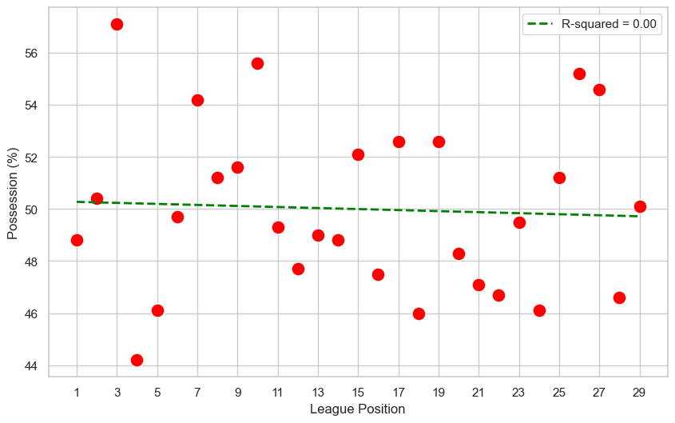

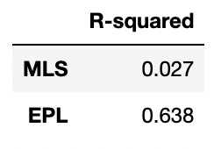

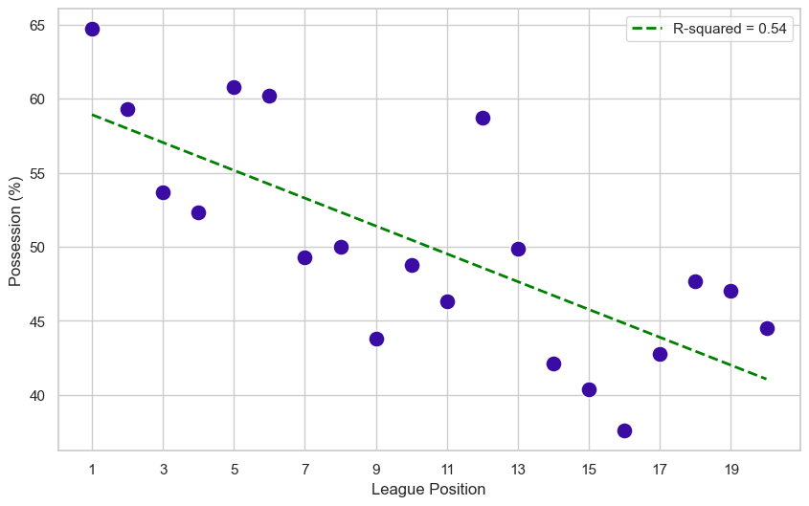
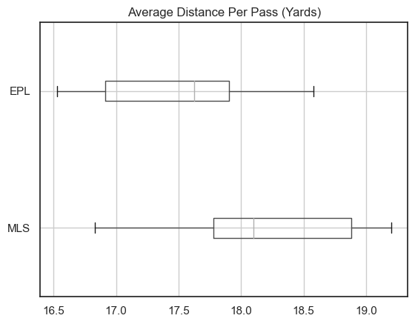
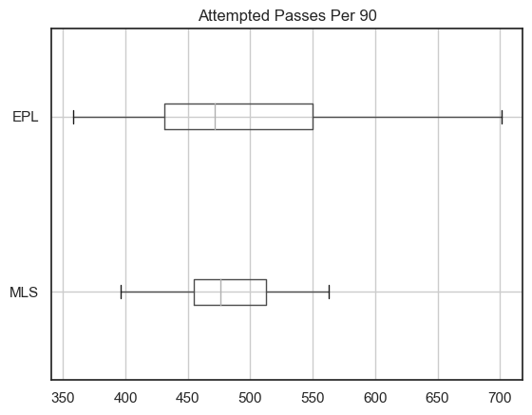
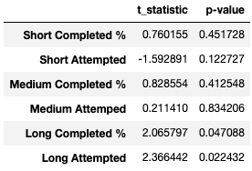
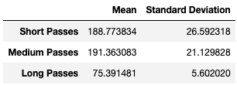
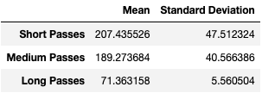

,
English premier league vs major league soccer: Passing Statistics
Alex Chan, Applied Data Science (M.S.)
Abstract
Multivariate Regression
Visualizations
The English Premier League (EPL), based in England, is often regarded as the best soccer league in the world. It boasts some of the best players from around the world who have won the most prestigious competitions a player can win such as the UEFA Champions League, FIFA World Cup, and Copa America.
Major League Soccer (MLS), based in the United States of America, is an up-and-coming league that is often criticized for being unentertaining and a ‘retirement home’ for Europe-based players past their best. Despite this, some players have been able to develop their skills and make the move to some of the top leagues in the world, including the EPL.
This research aims to explore the differences between the EPL and MLS with regards to a very basic skill in soccer: Passing. As the sport has progressed over the years, passing metrics have grown as an important measurement for how teams play. Analyzing these metrics can provide a deeper understanding of what differentiates the EPL and MLS in terms of quality.
A multivariate regression model was utilized to explore the relationship between different passing metrics and league position in both the EPL and MLS. In this model, the independent variables were Completed Passes, Attempted Passes, Completed %, Total Distance, and Progressive Distance. The dependent variable was League Position.
League Position
vs
Average Possession
Hypothesis Testing
Hypothesis testing was conducted to determine any statistically significant difference between the means of different passing metrics in the EPL and MLS. The metrics being observed for these tests were Short Passes Attempted (<15 yards), Medium Passes Attempted (16-30 yards), Long Passes Attempted (>30 yards), Short Completed %, Medium Completed %, and Long Completed %. Welch’s t-test was used for each test. This test is like a standard Student’s test; however, it allows for the assumption that the variance is different between two groups. An alpha of 0.05 was used.
For each hypothesis test, the statistical hypotheses were as follows:
- Null Hypothesis (H_{O}): There is no significant difference in mean {passing metric} between the EPL and MLS
- Alternative Hypothesis (H_{A}): There is a significant difference in mean {passing metric} between the EPL and MLS
Methods
Import and Install Libraries: essential libraries needed for data manipulation and visualization were imported and installed, such as pandas, numpy, sklearn, seaborn, and matplotlib
Load Data: The datasets were loaded using pandas.read_html. Every dataset was embedded as an html table which allowed for easy import
Clean Data: Datasets were cleaned after import. Many of the datasets had multi-leveled headers that had to be reduced to a single level. Also, many columns were renamed for clarity
Data Type Conversion: Data types of columns were converted, mainly from strings to integers, to allow for easy merging or analysis
Merge Data: Different datasets were merged in order to gather all necessary variables
MLS
EPL
Conclusions
Future Work
References
- After conducting exploratory data analysis (EDA), it’s clear that passing is very different between the EPL and MLS. As seen by the results of the regression model and the two scatterplots of league position vs possession, passing metrics have a significant correlation with performance in the EPL and almost no correlation in MLS
- The range of passes attempted is significantly larger in the EPL compared to the MLS. This shows how large the gap in quality is between the top and bottom teams in the EPL whereas teams are closer together in MLS
- As seen in the box plot for average distance per pass and the results of the hypothesis test for Long Attempted, MLS teams tend to play longer passes
There are numerous factors that play into the success of a soccer team no matter what league they are in. Although passing is a very important aspect of the game, other areas like shooting and defending could be analyzed to determine any effects on performance like the relationships observed in this research with regards to passing
2023 MLS Squad Standard Stats. Retrieved from
https://fbref.com/en/comps/22/2023/2023-Major-League-Soccer-Stats
2. 2023 MLS Passing Stats. Retrieved from
https://fbref.com/en/comps/22/2023/passing/2023-Major-League-Soccer-Stats
3. 2023 MLS Overall Standings. Retrieved from https://en.wikipedia.org/wiki/Template:2023_Major_League_Soccer_season_table
4. 2022 - 2023 EPL Squad Standard Stats. Retrieved from
https://fbref.com/en/comps/9/2022-2023/2022-2023-Premier-League-Stats
5. 2022 - 2023 EPL Passing Stats. Retrieved from
https://fbref.com/en/comps/9/2022-2023/passing/2022-2023-Premier-League-Stats
Data Source
All of the data sets for this research were collected from fbref.com. This site, created for soccer, contains statistics, scores, and history for 100+ men’s and women’s club and national competitions.

