Slide 1
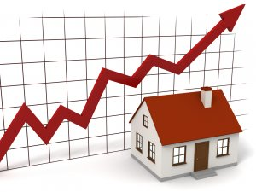
HOUSING MARKET | NC
Housing Data Analysis in North Carolina by County
Project Group 5 | Carlos, Mohamed, Alex, Rima

Slide 2



Why the Real Estate Market ? & Why NC??
If yo

Slide 3
What did we try to answer?
Most Expensive & Least Expensive County based on Median Housing cost
Counties showing highest increase in Housing prices over the years
Which counties sell the fastest on Zillow?
Correlation between Number of Houses in the market Vs Pricing & Sales

Slide 4
The Data | Source & Cleanup

Slide 5

The Data Source & Cleanup Process
List Price Data
Final Cleaned File
County Info | State | Metadata, etc. | 2010-01 | 2010-02 | …
Los Angeles County | CA | Los Angeles-Long Beach-Anaheim | 399000 | 389000 | …
Cook County | IL | Chicago-Naperville-Elgin | 244900 | 249000 | …
Harris County | TX | Houston-The Woodlands-Sugar Land | 149900 | 152900 | …
Maricopa County | AZ | Phoenix-Mesa-Scottsdale | 179900 | 175900 | …
… | … | … | ... | ... | …
Date | Wake County Price | Wake County Sales | Wake County Days | Durham County Price | …
2010-01 | 248000 | 657 | 185 | 178440 | …
2010-02 | 245000 | 713 | 169 | 179900 | …
2010-03 | 239900 | 1108 | 156 | 185000 | …
2010-04 | 239999 | 1376 | 158 | 184900 | …
2010-05 | 244900 | 1400 | 157 | 182000
… | … | … | ... | ... | …
Sales Data
Days before Sale Data
•Monthly median price for housing by county | Zillow (2010-01 to 2019-05)
•Monthly avg days in market for houses by county | Zillow (2010-01 to 2019-05)
•Monthly total number of houses for sale by county | Zillow (2010-01 to 2019-04)
https://www.zillow.com/research/data/
Notes:
Select for NC counties
Eliminate metadata columns
Merge 3 data sets into one on county name
Add data type to each county column header
Transpose rows and columns

Slide 6
Most expensive Counties to live in | NC
#1 Chatham, #2 Dare, #3 Orange, #4 Jackson, #5 Transylvania

Slide 7
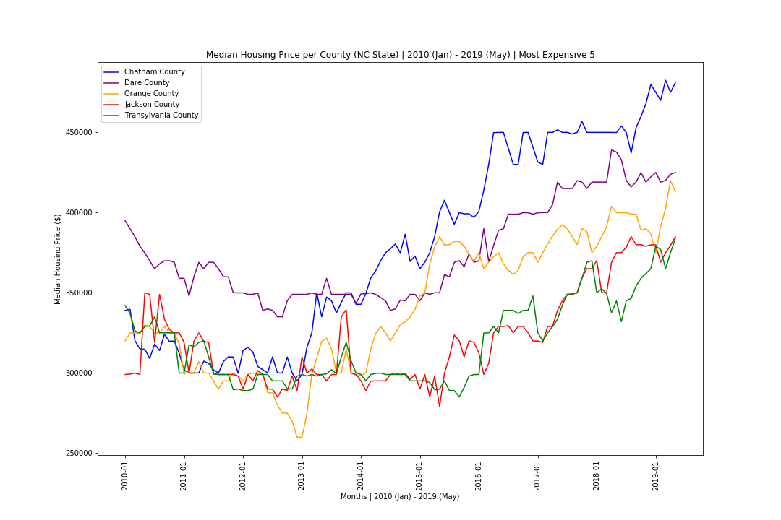

Slide 8
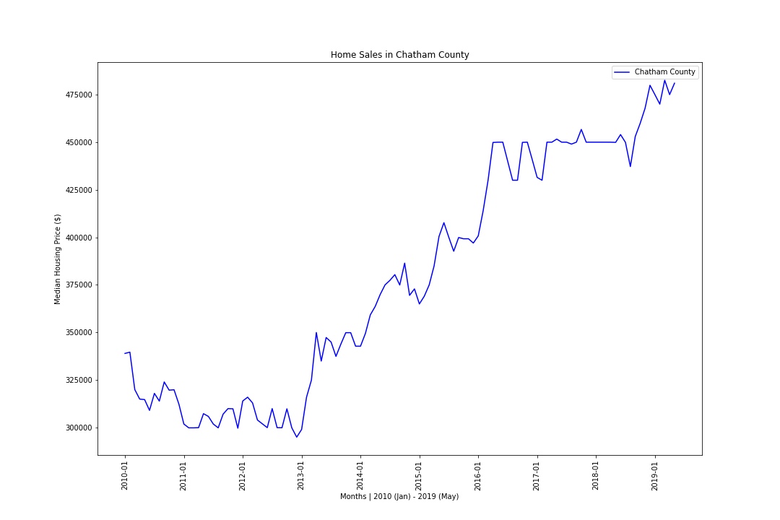
#1 CHATHAM COUNTY DURHAM-CHAPEL HILL AREA
Lowest Median Price : $295,000 in 2012-Dec
Highest Median Price: $482,545 in 2019-Mar
Showed steep rate of growth from 2013 to 2016

Slide 9
Least expensive Counties to live in | NC
#89 Edgecombe, #88 Martin, #87 Bertie, #86 Washington, #85 Richmond

Slide 10
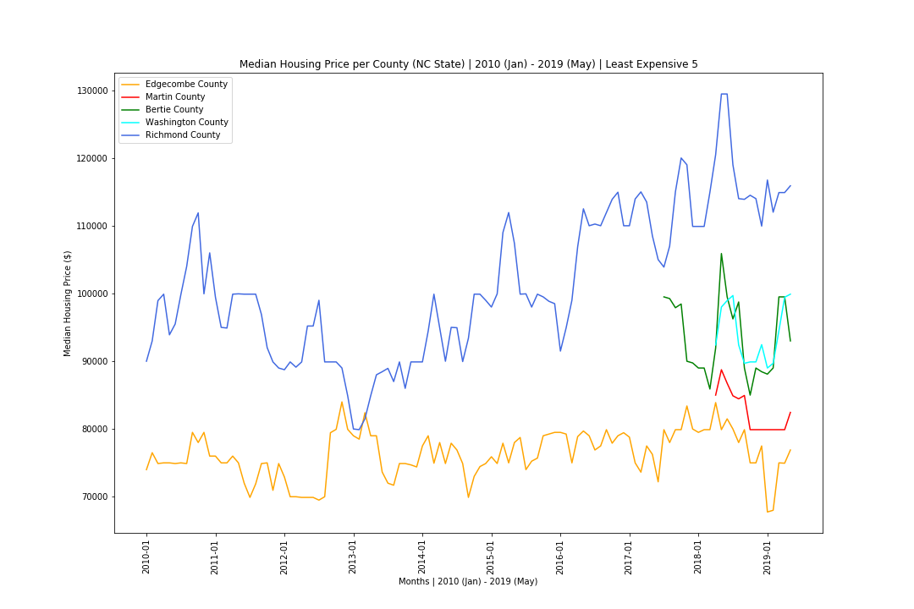

Slide 11
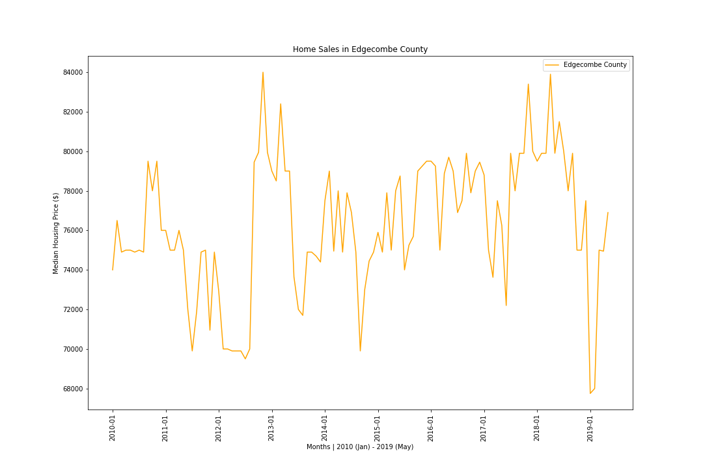
#89 EDGECOMBE COUNTY ROCKY MOUNT AREA
Lowest Median Price : $67,750 in 2019-Jan
Highest Median Price: $84,000 in 2012-Nov
Has showed consistent low median prices

Slide 12
Counties showing highest change in prices over the years

Slide 13
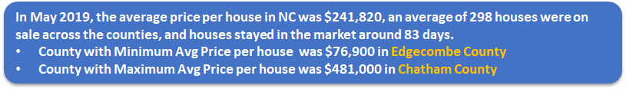
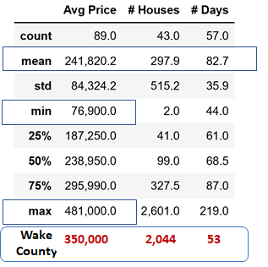
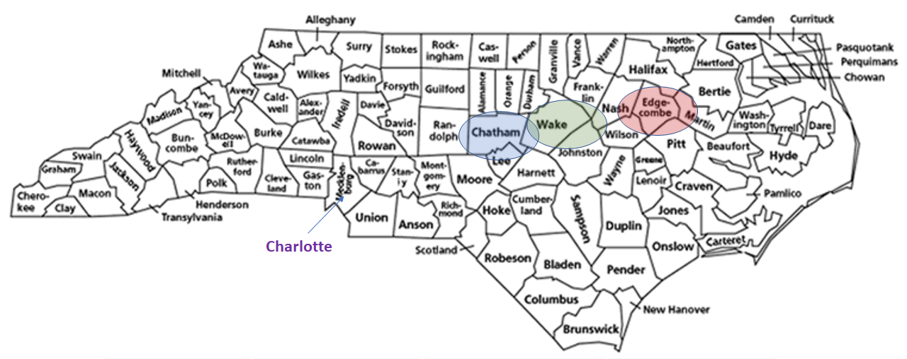
North Carolina in May 2019: Housing Data

Slide 14
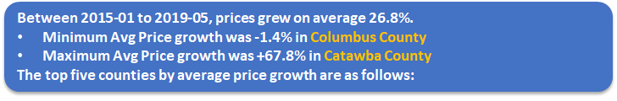
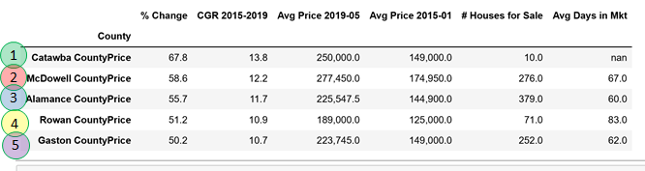
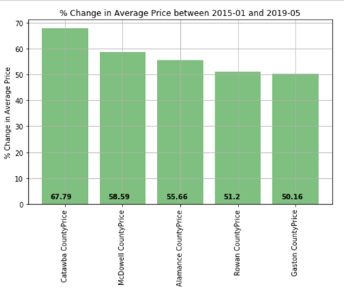
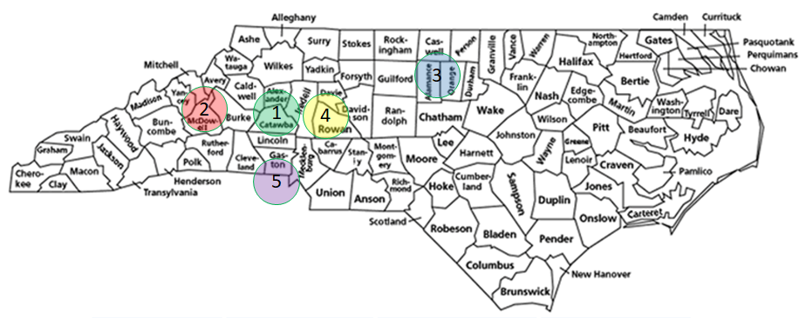
If you are planning to invest in a property in NC, which counties have the greatest potential for growth based on historic trends?

Slide 15

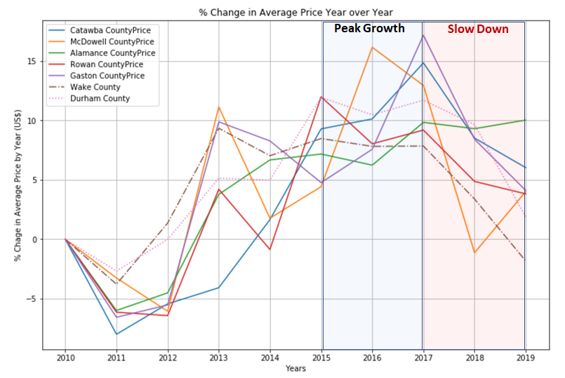
Average Price Increase Year over Year:

Slide 16
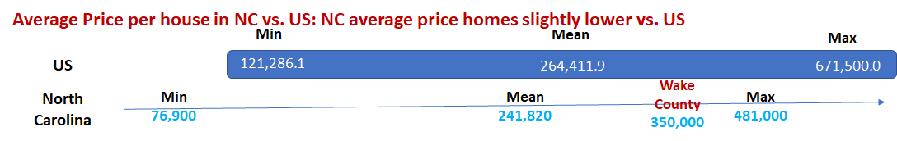
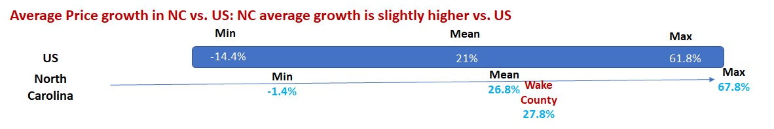
North Carolina vs. US:

Slide 17
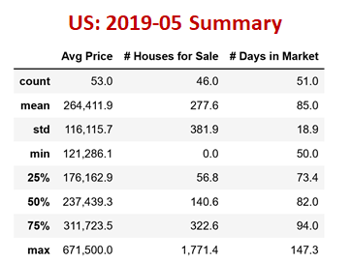
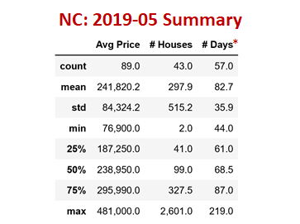
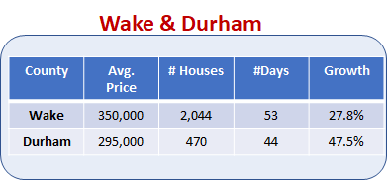
Backup

Slide 18
Counties selling the fastest based on the number of days listed.

Slide 19
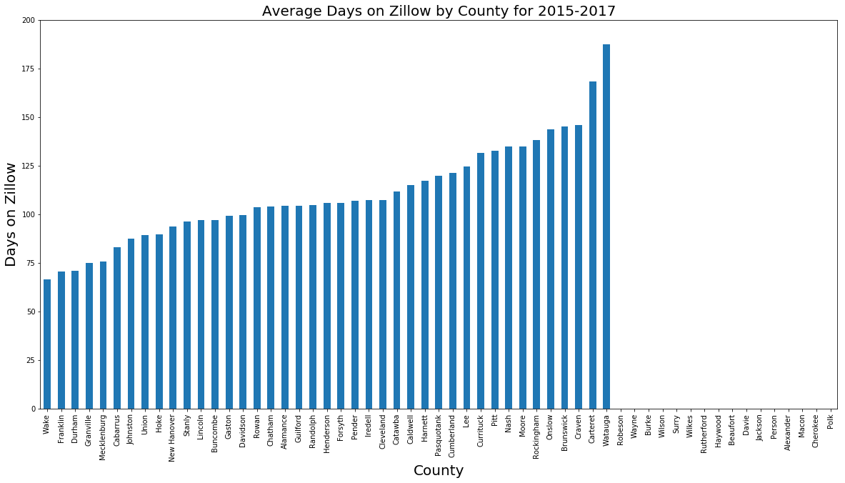

Slide 20
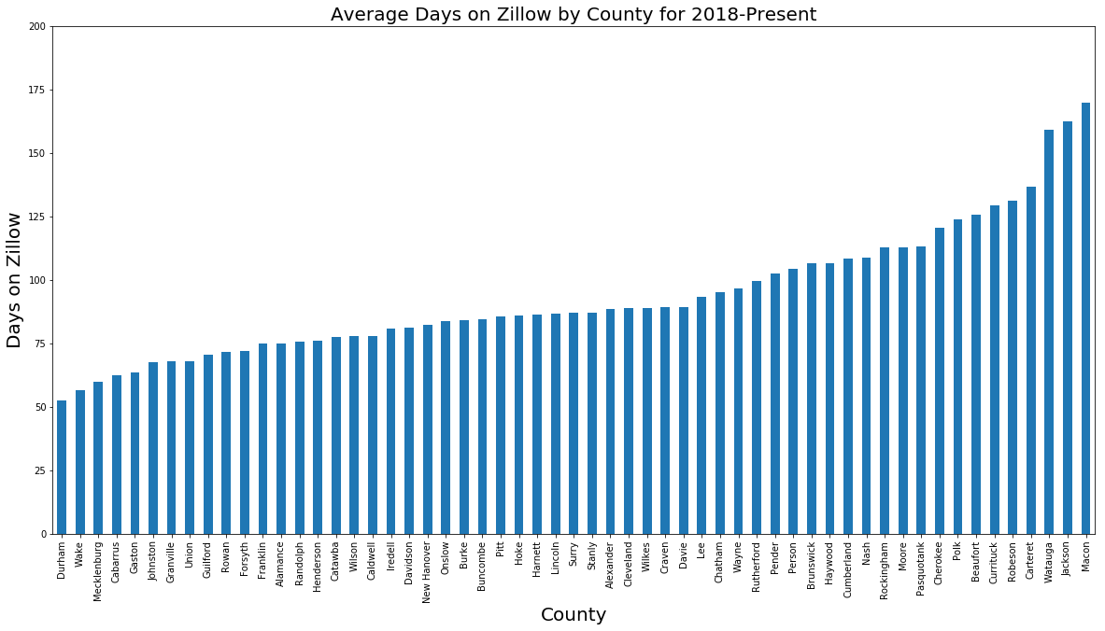

Slide 21
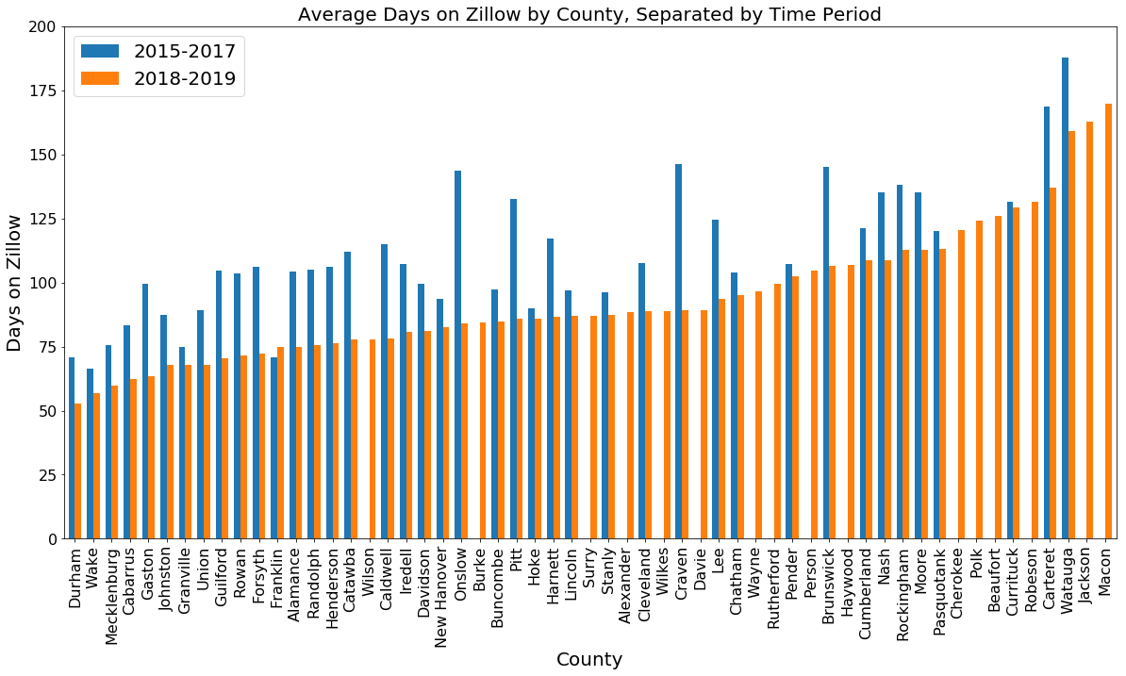

Slide 22
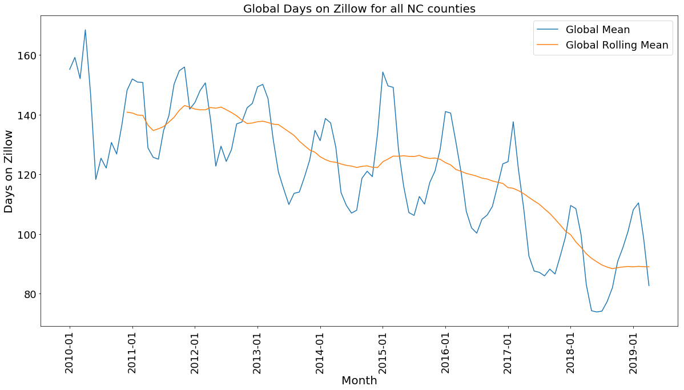

Slide 23
Correlation between Number of Houses in the market Vs Pricing & Sales

Slide 24
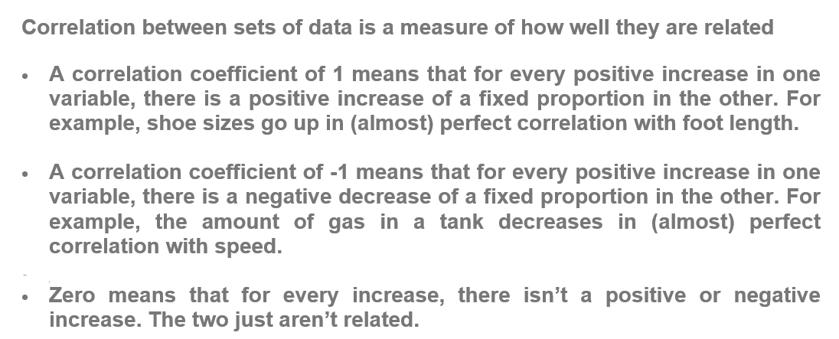
Correlation between Number of Houses in the market Vs Pricing & Sales | Top 5 Counties
Correlation:

Slide 25
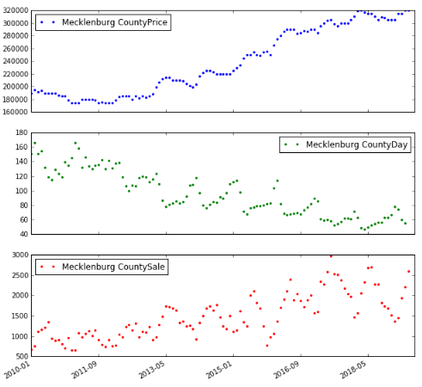
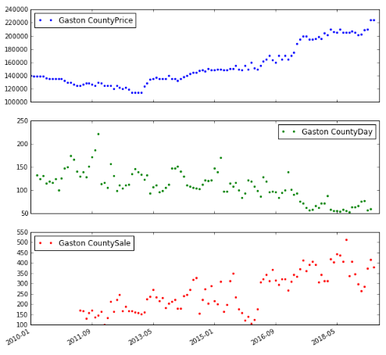
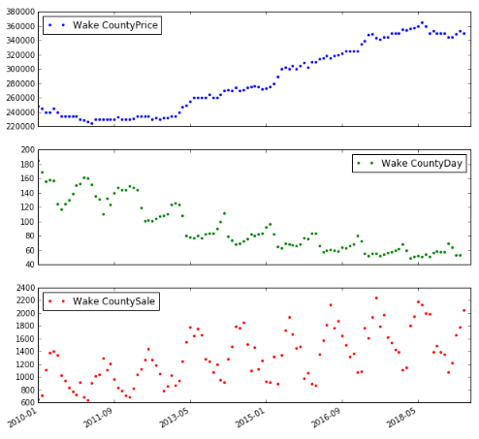
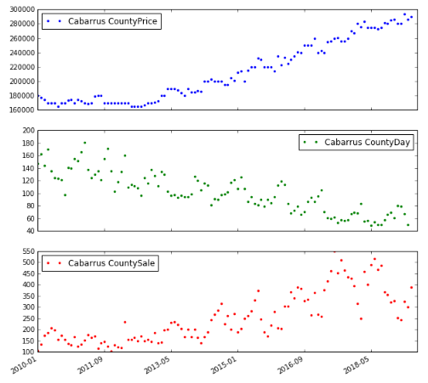
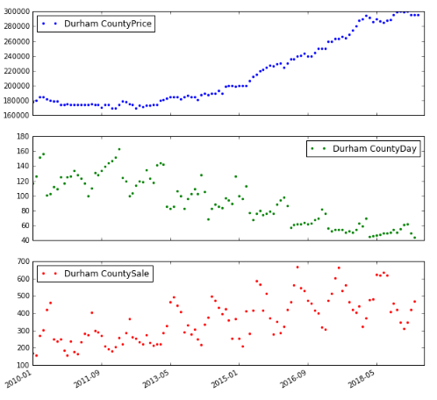
Tap 5 county with fastest days to sale

Slide 26
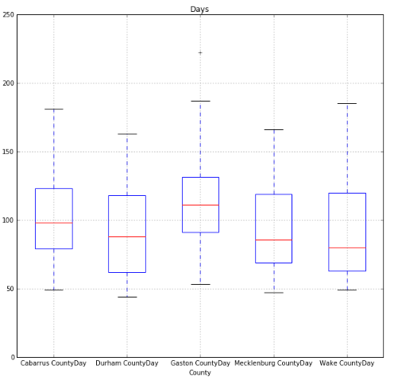
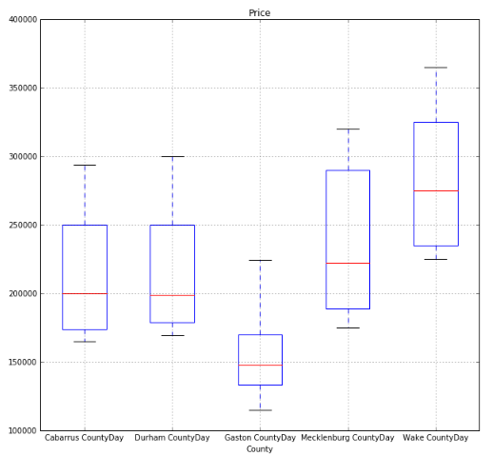
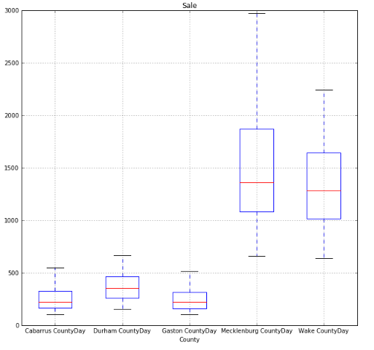
Distribution of Property Sale, Price & Number of days in the Market | Box Plot

Slide 27
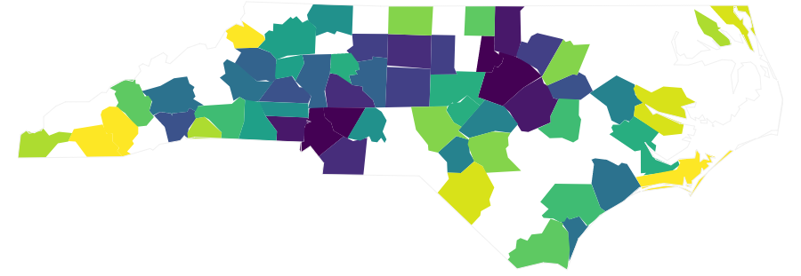
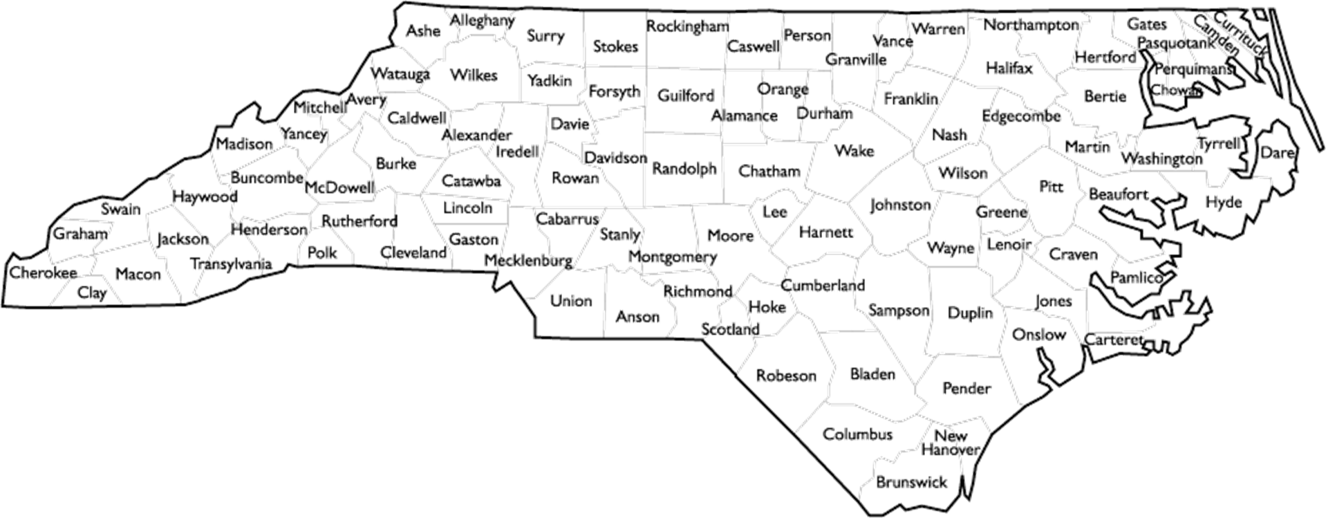
Average Days on Zillow for NC Counties (2018-Present)
Lowest Number of Days
Highest Number of Days

Slide 28
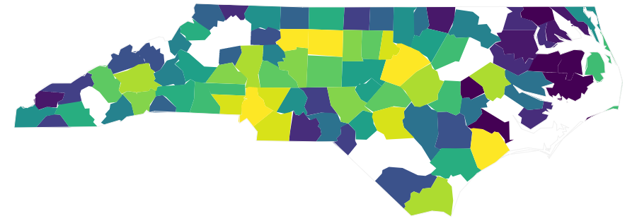
Average Sales on Zillow for NC Counties (2018-Present)
Lowest Sales
Highest Sales

Slide 29
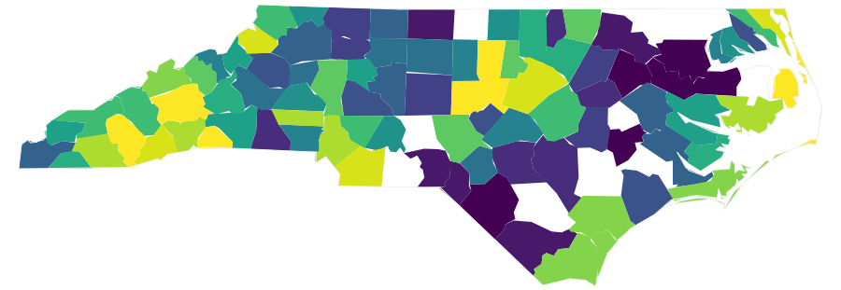
Average Price on Zillow for NC Counties (2018-Present)
Lowest Price
Highest Price

Slide 30
Conclusion | Trend of the Housing Market in North Carolina
Housing Price
Most Expensive counties are Chatham (~$480k) , Dare (~$425k), Orange (~$413k).
Least Expensive counties are Edgecombe (~$76k), Martin (~$82k) , Bertie (~$93k)
Price Growth
Counties with highest price increase are Catawba (67.8%), McDowell (58.6%), Alamance (55.7%)
Peak growth was recorded from 2015-2017
The price growth is slowing down from 2017
Time in the Market
Currently, the fastest selling counties are Durham, Wake, Mecklenberg (~50-60 days)
Time on market is decreasing over the entire state
Best time to sell is the Spring, best time to buy is the Winter
Correlation between the Number of Houses in the market Vs Pricing & Sales
Strong direct correlation between the Sales & Price and inverse correlation with the Number of days in the market.

Slide 31
Thank You
Questions??

