Slide 1
Soccer Analytics: EPL & La Liga (2014/15–2015/16)
A Comparative Analysis of Team Performance and Tactical Styles

Slide 2
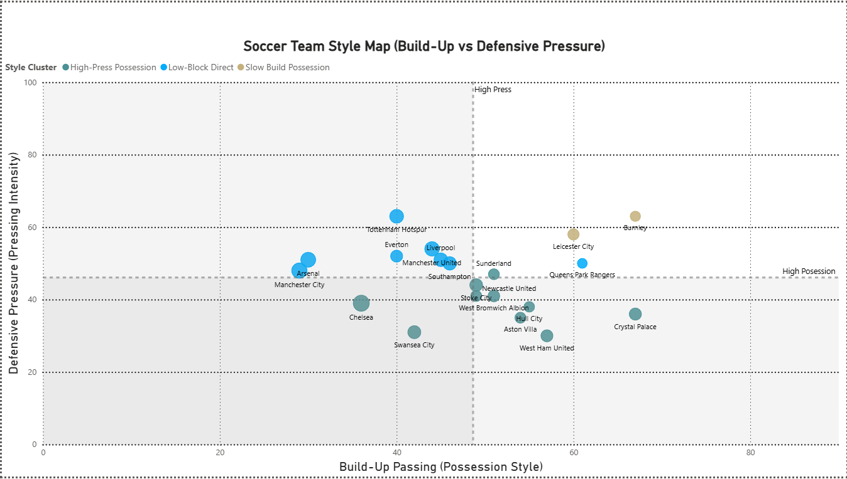
EPL 2014/15 – Overview & Standings
Chelsea led the league with consistency.
Top 6 showed narrow point gaps compared to La Liga.
Greater balance across mid-table sides.

Slide 3
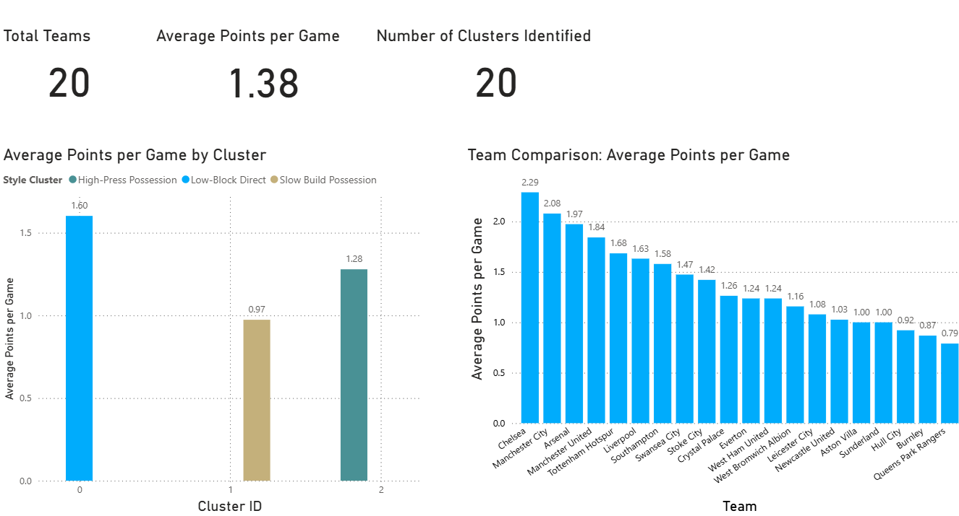
EPL 2014/15 – Offensive Metrics
Insights:
- Manchester City scored most goals.
- Arsenal showed possession dominance.
- Counterattacking sides like Southampton efficient despite lower possession.

Slide 4
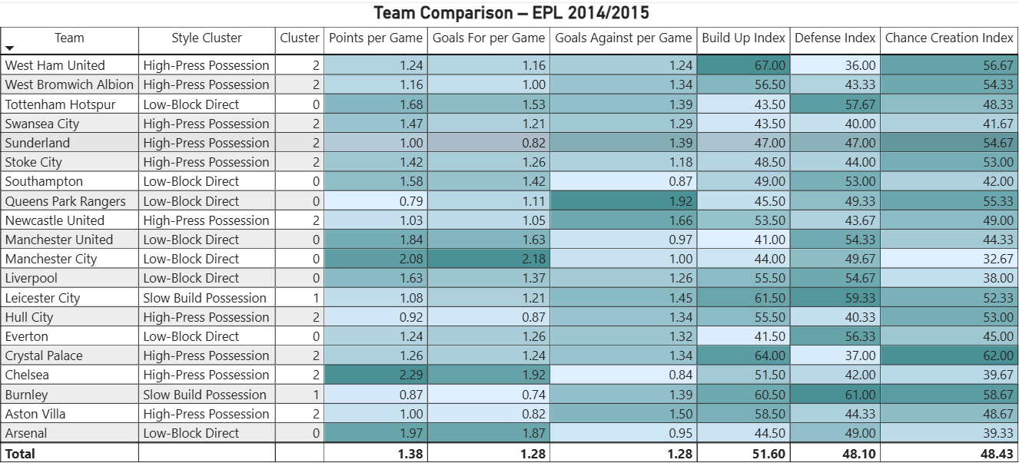
EPL 2014/15 – Defensive Metrics
Insights:
- Chelsea strongest defensive record.
- Mid-table clubs conceded heavily.
- Few teams balanced strong attack and defense.

Slide 5
EPL 2014/15 – Key Insights
Takeaways:
- Competitive depth across EPL.
- Possession not always linked to points.
- Defensive solidity key to top 4 finish.

Slide 6
EPL 2015/16 – Overview & Standings
Leicester City shocked the football world with their title win.
Traditional powers underperformed relative to expectations.

Slide 7
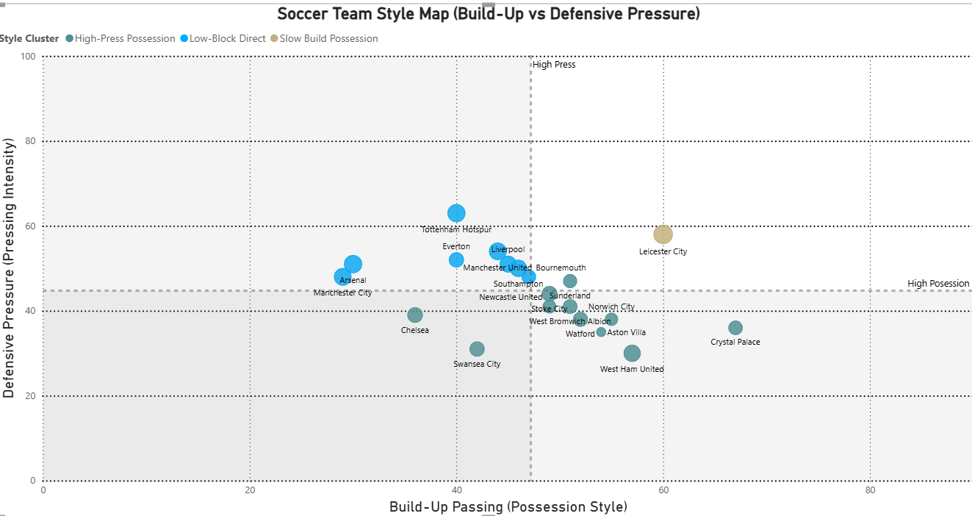
EPL 2015/16 – Offensive Metrics
Insights:
- Leicester relied on counterattacking efficiency (Vardy, Mahrez).
- Arsenal had higher possession but less conversion.
- Spurs displayed balance in attack.

Slide 8
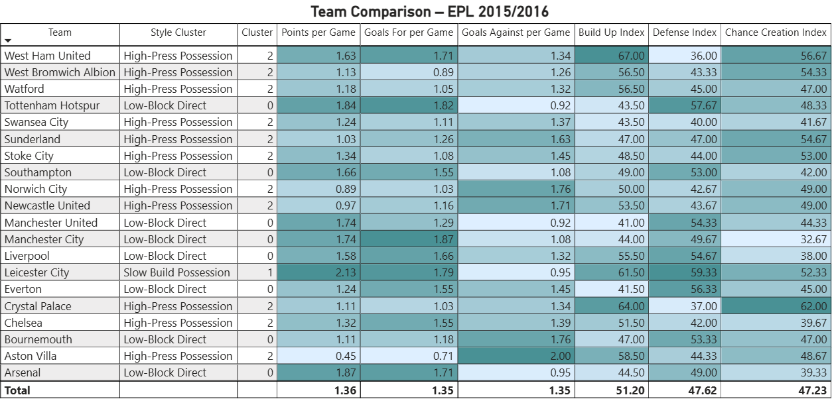
EPL 2015/16 – Defensive Metrics
Insights:
- Leicester's compact defense limited goals against.
- Spurs conceded fewest goals, showing balance.
- Mid-table sides again inconsistent defensively.

Slide 9
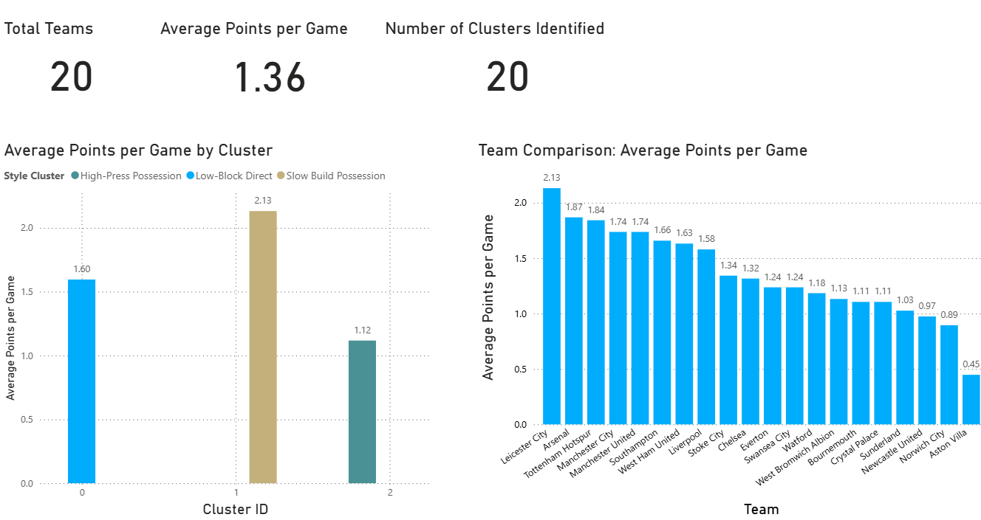
EPL 2015/16 – Key Insights
Takeaways:
- Counterattacking efficiency outperformed possession.
- Leicester’s rise showcased tactical discipline.
- Spurs closest challenger due to balance.

Slide 10

La Liga 2014/15 – Overview & Standings
Barcelona won the league with Real Madrid close behind.
Atlético remained defensively strong but fell short in attack.

Slide 11
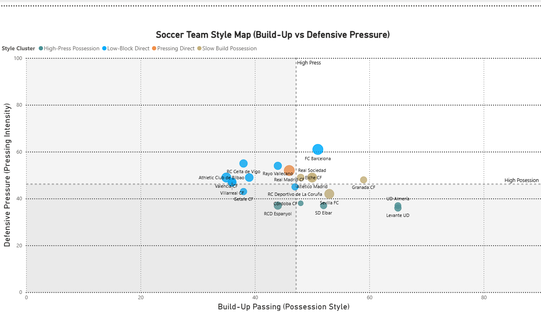
La Liga 2014/15 – Offensive Metrics
Insights:
- Barcelona’s MSN trio dominated scoring.
- Real Madrid high possession and goals.
- Sevilla and Valencia overperformed expectations.

Slide 12
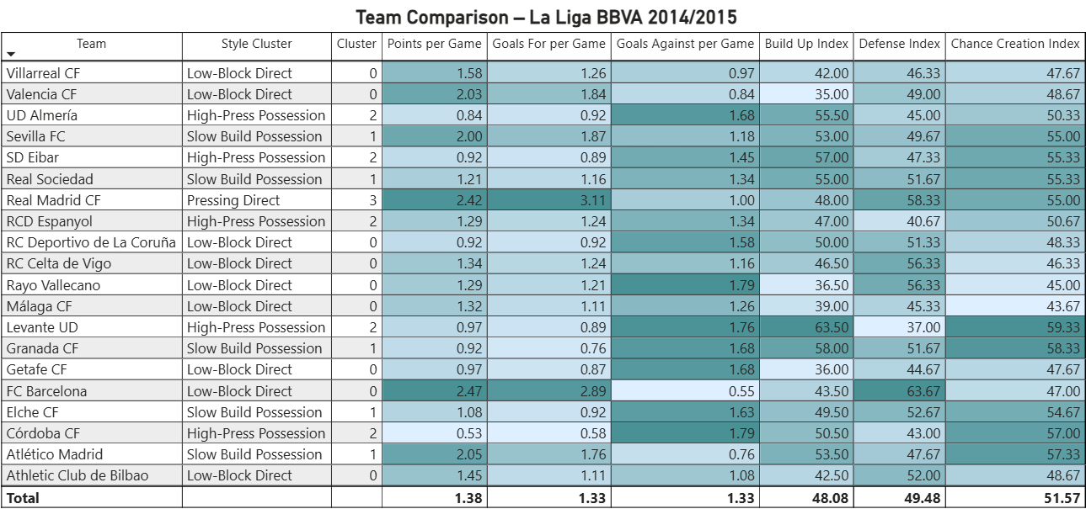
La Liga 2014/15 – Defensive Metrics
Insights:
- Atlético conceded the fewest goals.
- Mid-table defenses stronger than EPL equivalents.
- Barcelona outscored defensive weaknesses.

Slide 13
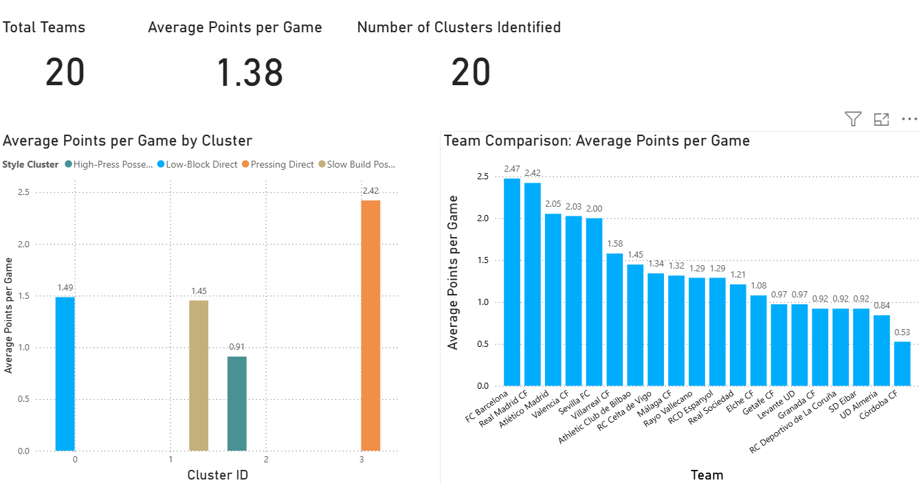
La Liga 2014/15 – Key Insights
Takeaways:
- Top 2 dominated via attacking power.
- Atlético’s defense notable despite finishing 3rd.
- League less balanced than EPL.

Slide 14
La Liga 2015/16 – Overview & Standings
Barcelona again won narrowly over Real Madrid.
Tighter race at the top compared to 2014/15.

Slide 15
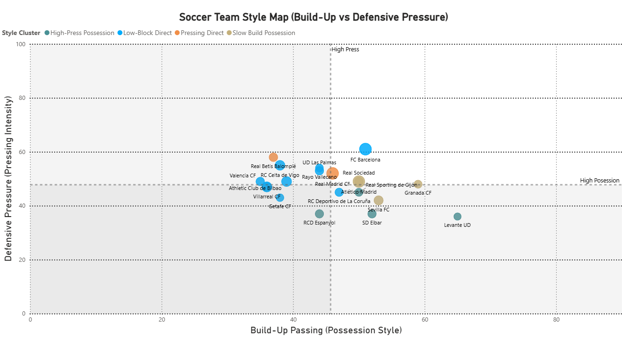
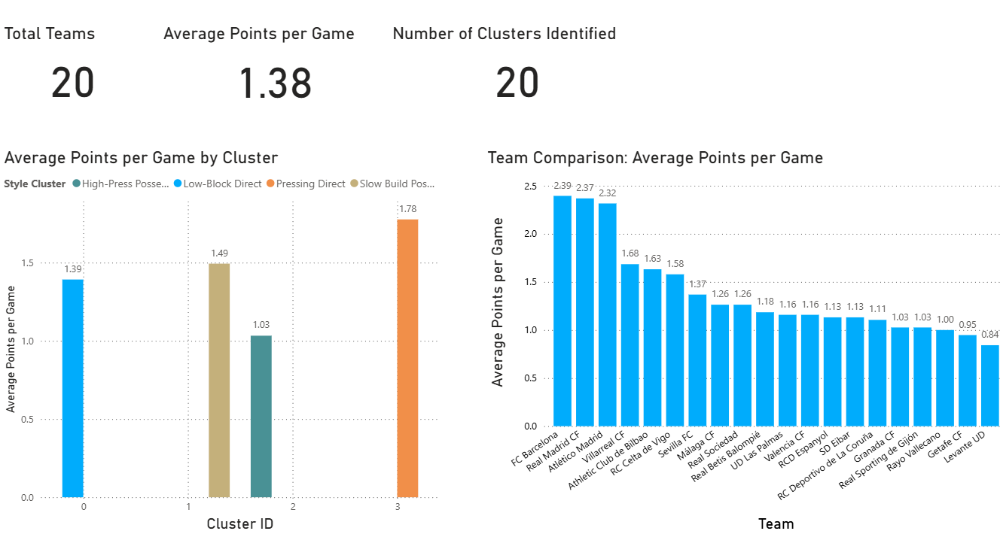
La Liga 2015/16 – Offensive Metrics
Insights:
- Barcelona top scorers, driven by Messi, Suárez, Neymar.
- Real Madrid also prolific.
- Mid-table clubs less effective in attack.

Slide 16
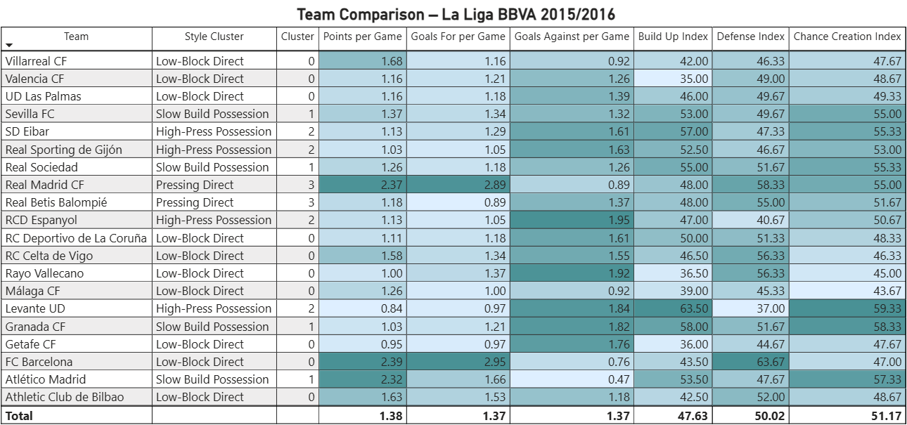
La Liga 2015/16 – Defensive Metrics
Insights:
- Atlético again conceded the fewest goals.
- Barcelona and Real conceded more but compensated with scoring.
- Stronger average defenses than EPL.

Slide 17
La Liga 2015/16 – Key Insights
Takeaways:
- Tight battle at the top.
- Atlético continued as best defensive unit.
- Barcelona combined high attack and possession.

Slide 18
Cross-League Comparison
EPL:
- Greater competitive balance.
- Counterattacking strategies succeeded.
La Liga:
- More possession-oriented.
- Top clubs dominant, mid-table gap larger.

Slide 19
Clustering of Styles of Play
Clusters identified:
- Possession-dominant (Barcelona, Arsenal).
- Counterattacking (Leicester, Atlético).
- Balanced (Spurs).
- Defensive (Stoke City).

Slide 20
Key Takeaways & Conclusion
Clubs succeed by maximizing unique strengths.
EPL favored tactical diversity.
La Liga highlighted technical possession.
Both leagues showcased varied paths to success.

