Slide 1
ADIO: 數位影像技術知識圖
可以廣泛使用的Ontology
整理個人電影相關經歷
專注「Digital Imaging」
Alex Chen 陳澤宇

Slide 2
電影理論
電影知識
電影美術
電影技術
電影攝影
場面調度
電影工業
電影表演
數位
影像
技術
鏡頭運動
電影錄音
電影歷史

Slide 3
知識
技術
具體物件
攝影機
訊號處理
編碼
解析度
燈光
鏡頭
感光元件
色彩空間
伽馬曲線
影像作品
鏡頭接環
色彩濾鏡

Slide 4
Int
float
boolean
date
ADIO:class
:Property
:Subject
Fundemental Knowledges | Technologies | Physical Objects
CameraSensor | Codec | CinemaCamera
CameraSignalProcessing | Resolution | Movie
ColorFilterArray | ColorSpace | Lens
 | Gamma | LensMount
 |  | Lighting

Slide 5
Property Name | Expected Type | Description
Manufacturer | xsd:string | The company making the camera.
Model | xsd:string | The specific model of the camera.
ReleaseYear | xsd:gYear | The date on which camera is being released.
Sensor | :CameraSensor | The part of camera which transform light rays into electronic signals.
SignalProcessingType | :CameraSignalProcessing | Knowledge regarding the how camera output image signals.
MaxFramerate | xsd:int | Max possible frame per second recorded with the maxium resolution.
MaxDataRate | xsd:int | Maxium possible data rate of the image recorded.
Codec | :Codec | The method of which image is being recorded and encoded as digital files.
LensMount | :LensMount | The mount connecting cameras and lenses.
NativeISO | xsd:int | Base ISO of which the camera has maximum dynamic range.
DynamicRange | xsd:int | Range of luminance of which the camera is capable of recording.(in stops)
ColorSpace | :ColorSpace | The volumn of color of which the image is capable of displaying.
Gamma | :Gamma | The way luminance in real world converted to luminance level on the image.
CinemaCamera
Camera used in cinema production.
ADIO_Specification.md

Slide 6
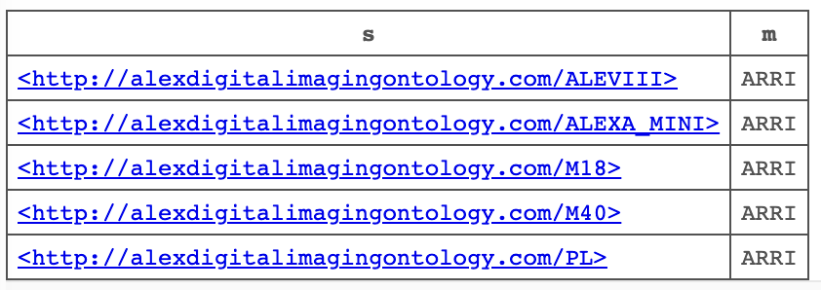
SPARQL查詢
#Find all objects made by ARRI
PREFIX xsd: <http://www.w3.org/2001/XMLSchema#>
PREFIX rdf: <http://www.w3.org/1999/02/22-rdf-syntax-ns#>
PREFIX : <http://alexdigitalimagingontology.com/>
SELECT ?s ?m
WHERE {
?s :Manufacturer ?m .
FILTER(?m="ARRI")
}

Slide 7
SPARQL查詢
Blaze Endpoint
#All the compatible lenses for each cinema cameras.
PREFIX xsd: <http://www.w3.org/2001/XMLSchema#>
PREFIX rdf: <http://www.w3.org/1999/02/22-rdf-syntax-ns#>
PREFIX : <http://alexdigitalimagingontology.com/>
SELECT DISTINCT ?cam ?width ?s1
WHERE {
?s1 a :Lens ;
:FullFrameCompatible ?f ;
:S35Compatible ?s35c .
?s2 a :CinemaCamera ;
:Model ?cam ;
:Sensor ?sensor .
?s3 a :CameraSensor ;
:Width ?width.
FILTER((?sensor=?s3 && ?width>=36 && ?f=true)||(?sensor=?s3 && ?width<36 && ?s35c=true))
} ORDER BY ASC (?cam)

Slide 8
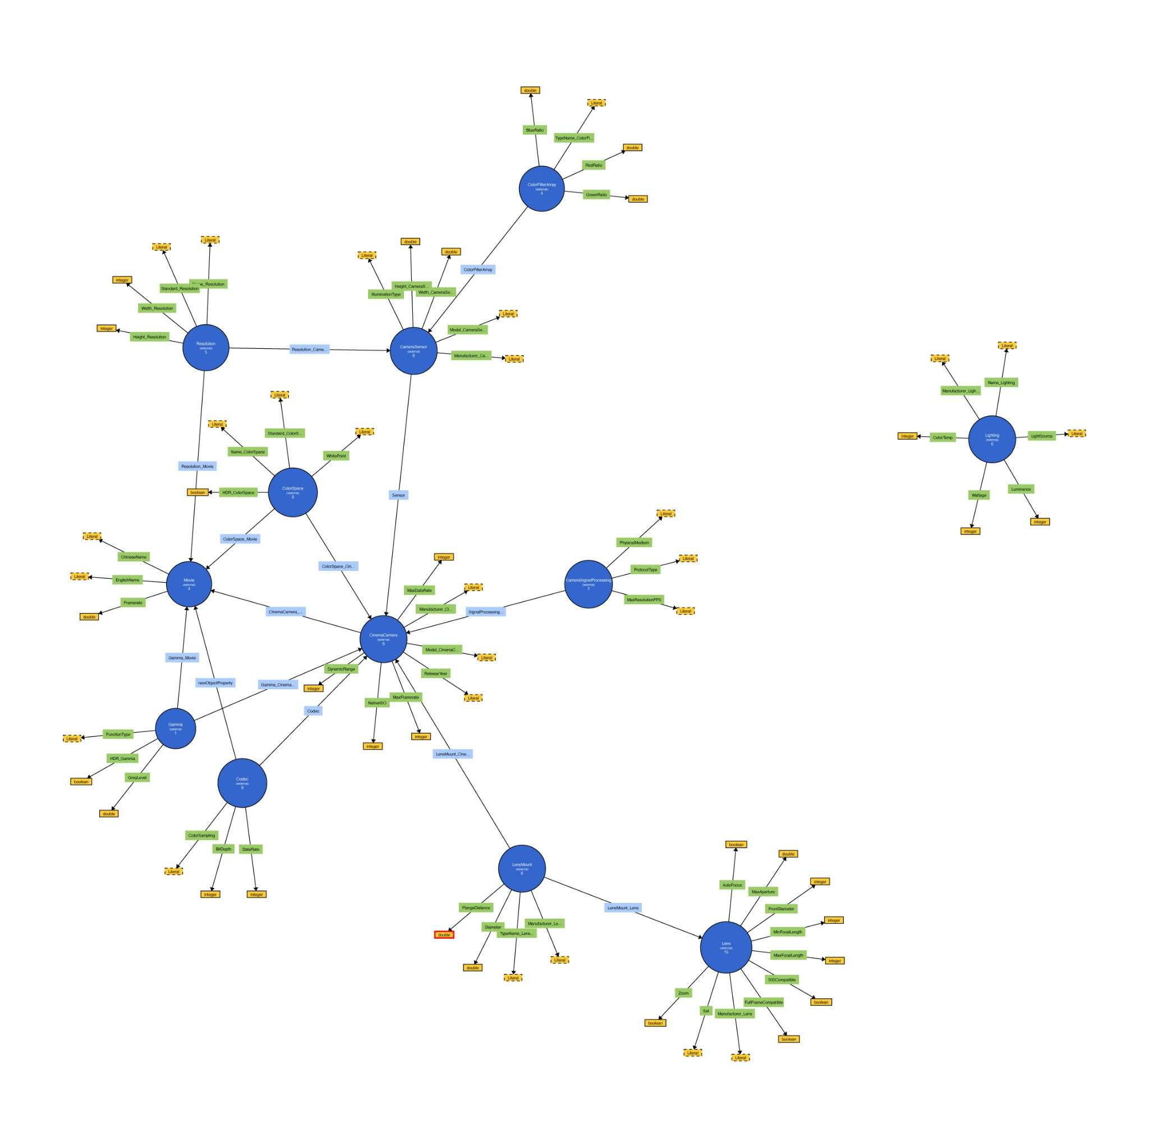
視覺呈現
WebVOWL

Slide 9
External Vocabulary
xsd:int: 所有整數的參數
xsd:float: 非整數的參數
xsd:boolean: 是否具有「某項功能/特質」
xsd:string: 廠商/名字/非結構化的參數
xsd:gYear: 發佈年份

