Slide 1
iOS 7 SDK (from Tech Talk for CocoaHeadsMSK)
Pokrovskaya Ksenia, Parallels

Slide 2
1. Architecting Modern Apps and integrating iOS 7 Technologies 2. Security and Privacy 3. Hidden iOS 7 Developing Gem 4. App Store Distribution and Marketing

Slide 3
- UIDynamics, custom transitions - Text - App Switcher Snapshot - Remote Notifications
Integrating iOS 7 Technologies

Slide 4
- be convenient in using types, for example don't mix up int/NSInteger - pay attention in what mode you write and read data or include some metadata - what about memory?
To build 64-bit code compatible

Slide 5
- iOS 7 frameworks should be optional - using new only iOS 7 objects is totally safe as they are nil on iOS 6 - check notification name before observing it (if (&notificationName != nil)) - use respondToSelctor for new methods - background fetch - callback do noting on iOS 6 - remote notification: send silent pushes to only iOS 7 as they will be ignored on iOS 6
iOS 7 features comparability with iOS 6 technics

Slide 6
- max size of application can be downloaded from App Store over 3G 100MB - take inventory - use compression - download some information later
To reduce application size

Slide 7
- protect all data that you write (keychain, NSFileManager, NSdata) - Position Independent Executable - set secureTextEntry when it is required and hide sensitive information before going background - keep in mind there is no 100% truth check on jailbreak using
Security and Privacy

Slide 8
- protect all data that you write (keychain, NSFileManager, NSdata) - Position Independent Executable - set secureTextEntry when it is required and hide sensitive information before going background - keep in mind there is no 100% truth check on jailbreak using
Security and Privacy

Slide 9
Don't use: mac address, pushToken, named pasteboard Use: advertising ID or vendor ID
Security and Privacy: Identifiers

Slide 10
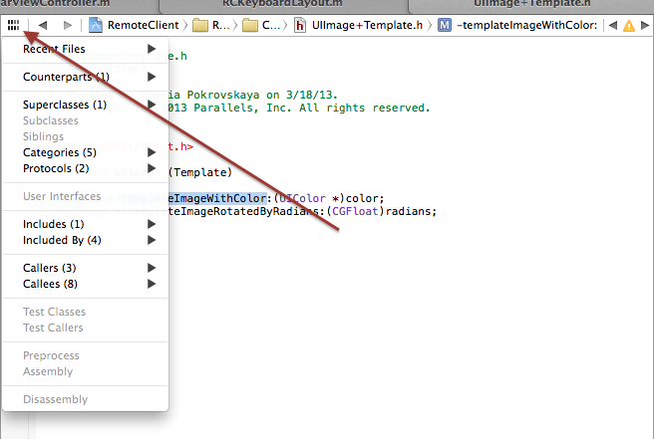
Hidden iOS 7 Developing Gem: Xcode

Slide 11
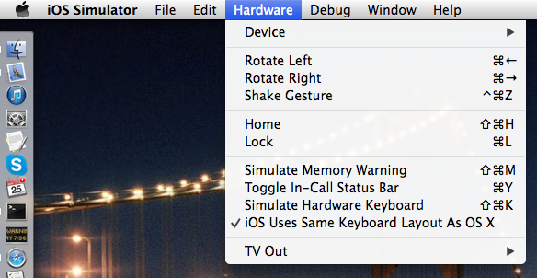
Hidden iOS 7 Developing Gem: iOS Simulator

Slide 12
Hidden iOS 7 Developing Gem: Frameworks
NSURLComponents to build URL from pieces
NSByteCountFormatter
- testing localizations

Slide 13
App Store Distribution and Marketing
Languages to localize:
English, French, Italian, German, Spanish
Japan, Korean, Both Chinese
Brazil, Russian, Turkish, Arabic
New section in Dev Center – Marketing Resorces
Alternative Price Tiers
App Store price changes from New Zealand to USA

Slide 14
App Store Distribution and Marketing
SKU – should be unique and meaningful
good: app_name_creation_date
bad: 1, 2, 123, a
Application version number – use standard versioning
good: 1.0, 2.0, 4.3.1
bad: 2342342384, beta1, ii333

