Slide 1
LION: Latent Point Diffusion Models for 3D Shape Generation
A hierarchical generative approach for 3D shapes

Slide 2
Content:
Introduction to 3D shape generation
Background on generative models
LION’s approach: Hierarchical Latent Point Diffusion Models
Results and applications
Concluding thoughts

Slide 3
Importance of 3D Shape Generation
Foundational for AR/VR, gaming, CAD, robotics, and 3D printing.
Challenges:
Generated shapes need to be realistic and of high-quality without artifacts.
The model should enable flexible and interactive use and refinement
The model should output smooth meshes

Slide 4
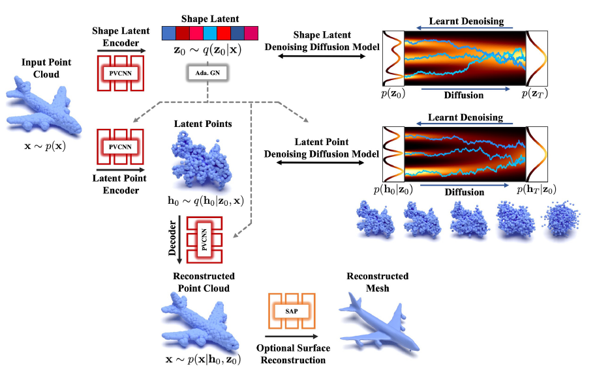
Introducing LION: Latent point diffusion model

Slide 5
Two Content Layout with Table
Class | Group A | Group B
Class 1 | 82 | 85
Class 2 | 76 | 88
Class 3 | 84 | 90
First bullet point here
Second bullet point here
Third bullet point here

Slide 6
Two Content Layout with SmartArt
First bullet point here
Second bullet point here
Third bullet point here
Group A
Task 1
Task 2
Group B
Task 1
Task 2

