Slide 1

Activating Workplace Giving
Unlocking employer dollars to feed more neighbors
Prepared for Food Bank of the Rockies
Daniels College of Business, University of Denver · June 2026
Alex Claunch · Nadia Marciniak · Fletcher Roberts · Maria DelMonte · Lucia Marquez

Slide 2
In January 2027,
298,000 Coloradans may lose their food
assistance.
$200B
cut from SNAP nationally
2 / 16
Notes:
Alex
In January 2027, 298,000 Coloradans may lose their food assistance,

Slide 3

Agenda
01 — The Situation
02 — The Problem
03 — The Opportunity
04 — The Case for Workplace Giving
05 — Our Recommendation
06 — Summary & Q&A
3 / 16

Slide 4
298,000
THE
SITUATION
Coloradans at risk of losing SNAP by January 2027
Federal SNAP cuts, July 2025
$200B cut from SNAP
3,400+ local workers on SNAP
May 2026
Sources: Colorado Newsline, May 1, 2026 · 9News Colorado · Food Bank of the Rockies FY2025 Annual Report
4 / 16
Notes:
Alex
These cuts come from the federal One Big Beautiful Bill Act which is trimming an estimated 200B nationally; the 3,400 local figure is 2,300 Amazon plus 1,100 King Soopers Colorado workers on SNAP

Slide 5
The Challenge
$31M
$1.5M
Zero
Total Philanthropic
Budget
Workplace Giving
Revenue
Dedicated Staff
or Strategy
Coming in through other channels
< 5% of total budget
Food Bank of the Rockies Speaker Session, May 13, 2026
Food Bank of the Rockies already receives through Benevity, YourCause, Bonterra & more — the gap is activation, not enrollment.
Source: Food Bank of the Rockies Guest Speaker Session, May 13, 2026
5 / 16
Notes:
Nadia
As you know, Food Bank of the Rockies raises about $31 million philanthropically.
Only $1.5 million — under 5% — comes from workplace giving, and there is zero dedicated staff or strategy behind it.
Food Bank of the Rockies has experience with donations through Benevity, YourCause, Bonterra, and Deed, as well as through ColoradoGives platform.
Across all these channels, $1.5M arrives passively — with no one driving it. The gap is activation, not enrollment.

Slide 6
The Opportunity: Employer Money
24,000
$20/hr
Volunteers every year
Employer-funded grants
140,000 hours already logged
Arrow’s published rate — volunteers pay $0
$0
2×
Asked of your volunteers
Match on existing donors
Employers fund the grants, not them
Employers double gifts already made
~140,000 volunteer hours (68 FTE) per Food Bank of the Rockies FY2025 · Illustrative — Arrow pays $20/hr · pilot to confirm.
6 / 16
Notes:
Lucia
First of all, we do NOT ask volunteers for their own money.
Food Bank of the Rockies has 24,000 volunteers a year — about 140,000 hours, the equivalent of 68 full-time staff. They're already in the building.
The lever is volunteer grants, or "Dollars for Doers": employers donate a set amount per hour their employee volunteers — commonly $8–15/hour. The volunteer pays nothing; the employer pays because they showed up.
Conservatively, even 1 in 4 of those hours at $10/hour is $350,000+ a year in employer money — about 1 million meals — for time your volunteers already give.
So why is workplace giving the right lever? Four reasons.

Slide 7
As You Already Know
• Workplace giving is low-hanging fruit
• Already receiving through these platforms
• The gap is activation, not awareness
So we built the missing piece — a play, and an owner.
7 / 16
Notes:
Lucia
Reference quote from Charlene if you want "We think that workplace giving is low-hanging fruit. We think it's the money that we could get fairly easily if we just tried. And it's not for lack of awareness.” - Charlene, May 13th 2026
So we built the missing piece: a clear play and an owner.
Transition: "Here is how it actually works."

Slide 8
How It Works
Volunteer grants
Employers pay for staff volunteer hours
Donor matching
Employers double gifts staff already give
Arrow & Prologis
Denver employers already volunteering here
8 / 16
Notes:
Maria
This slide explains the two ways employer money flows in.
Volunteer grants: when an employee volunteers, their company donates based on the hours logged — Arrow's published rate is about $20 an hour — and the volunteer pays nothing.
Donor matching: when an employee makes a gift, their employer doubles it.
Arrow and Prologis are our first targets because they're large Denver-area employers who already volunteer with the Food Bank and already run these programs — so we're activating existing relationships, not cold outreach.
Worked example: an Arrow employee volunteers 10 hours, Arrow sends the Food Bank $200, and it costs the employee nothing. That's employer money the Food Bank isn't currently collecting.

Slide 9
The Recommendation
THE PLAY
THE ASK
• Win Arrow & Prologis campaigns
• Reawaken donors with a match-finder
• Pilot volunteer grants with Arrow
• Name a workplace-giving lead by July
• Run it before fall enrollment
• Free tools first, paid tool later
9 / 16
Notes:
Maria
The play, left to right: win the corporate campaigns first — Arrow and Prologis have real match, grant, and payroll programs and already volunteer here, so one yes is worth thousands of forms.
Then reawaken existing donors with a match-finder on the donate page — in Charlene's own words, matches are not automatic, a separate request often goes uncompleted, and she wants to close the loop on match-eligible gifts made outside these platforms.
The ask, on the right: hire or name a workplace-giving lead by end of July, run this before fall open enrollment closes, and treat the free profiles plus Millie as plumbing — 360MatchPro only after the free play proves out.
Land it: this is what has been missing for three years — an owner and a play, not another tool.

Slide 10
Who Runs It
The role
A part-time lead who owns workplace giving end to end
What they do
Lead generation — find and sign employers with match and grant programs
Start, then grow
Anchor with Arrow & Prologis; grow into smaller companies without giving platforms
The hire
Experienced in corporate giving — not a green intern
It’s a pipeline: every new employer feeds more neighbors.
10 / 16
Notes:
Fletcher
Who runs it: Today no one does — which is exactly why Charlene said it's sat undone for three years.
We're recommending a part-time workplace-giving lead whose main job is lead generation: finding and signing employers that have match and grant programs.
Start by anchoring with Arrow and Prologis to prove the model fast, then grow into the smaller and mid-size companies
You said (say to Charlene) you wanted to reach the ones that don't have giving platforms. This should be someone experienced in corporate giving, not a green intern, because it's relationship and pipeline work. it's a pipeline — every new employer signed feeds more neighbors, and it compounds year after year.

Slide 11
An Investment, Not a Cost
30–50¢
~4¢
Events — cost per $1 raised
A giving owner — per $1, at scale
the Food Bank’s own figure
~$80K salary vs $2–3M raised
Even a conservative lift returns ~4× the salary — and unlike events, it renews every year.
Sources: Food Bank of the Rockies guest session (events 30–50¢/$1; $1.5M of $31M); Denver nonprofit salary, ZipRecruiter / Salary.com 2026.
11 / 16
Notes:
Fletcher
"At first glance, hiring a workplace-giving lead sounds like an added expense. But when we compare it to existing fundraising methods, it starts to look more like an investment."
"Food Bank events currently cost about 30 to 50 cents for every dollar raised. By comparison, a dedicated workplace-giving lead could potentially generate two to three million dollars in annual revenue at a cost of roughly eighty thousand dollars per year."
"Even under conservative assumptions, that's about a four-times return on the salary alone. And unlike a one-time fundraising event, workplace giving creates recurring revenue through employer matches, volunteer grants, and long-term corporate partnerships."
"The key point is that we're not recommending a new program that has to be rebuilt every year. We're recommending an owner who can activate systems and relationships that already exist and continue generating value over time."

Slide 12
The First 90 Days
1. Capture
Add employer at check-in
2. Remind
Auto-email the grant claim
3. Match
Match-finder on donate page
4. Finish
Complete the platform profiles
Most cost nothing; start now.
12 / 16
Notes:
Alex
At the volunteer check in, you add a screening question "where do you work?", so the system can flag who's eligible for a grant.
Second, we remind them: an automatic email after each shift with a link to claim it.
Third, we add a match-finder box like Double the Donation to the donation page so anyone giving online can pull up their employer's match form on the spot.
If not already done, fill in the Employer Identification Number, logo, photos, and bank details so Food Bank of the Rockies shows up when employees search and the money actually lands.
Three of these four cost nothing, and the first one can be live this week.

Slide 13
Summary
The Situation:
298,000 lose SNAP by 2027
The Problem:
$1.5M of $31M, no strategy
The Plan:
Name a lead, run the play
The Goal:
Prove with Arrow, then scale
13 / 16
Notes:
Nadia –
Situation: up to 298,000 Coloradans may lose SNAP. Problem: $1.5M of $31M, Food Bank of the Rockies name an owner and run the corporate and donor activation play this fall — free tools are just the plumbing. Goal: prove it this fall with one employer like Arrow, then scale employer by employer, past today’s passive $1.5M.
"The facility is ready. The relationships exist. The only thing missing is activation."

Slide 14
FOOD BANK OF THE ROCKIES · INTERNAL STRATEGY SESSION
Thank You.
Assign. Activate. Authorize.
Daniels College of Business · University of Denver
Sources: Colorado Newsline (May 1, 2026) · Food Bank of the Rockies FY2025 Annual Report · Food Bank of the Rockies Guest Speaker Session (May 13, 2026) · ColoradoGives Foundation · 9News Colorado · Double the Donation / 360MatchPro · Millie (millie.com)
14 / 16
Notes:
Nadia

Slide 15
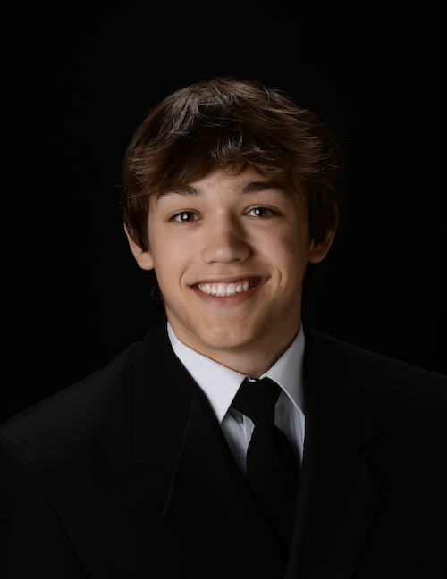
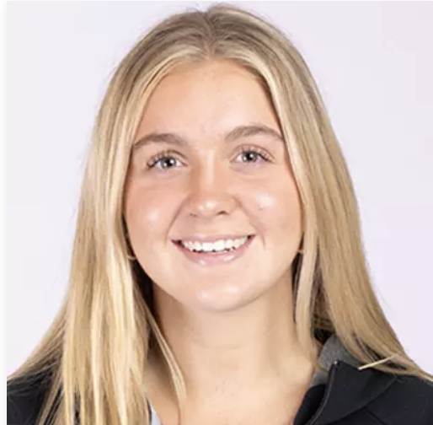
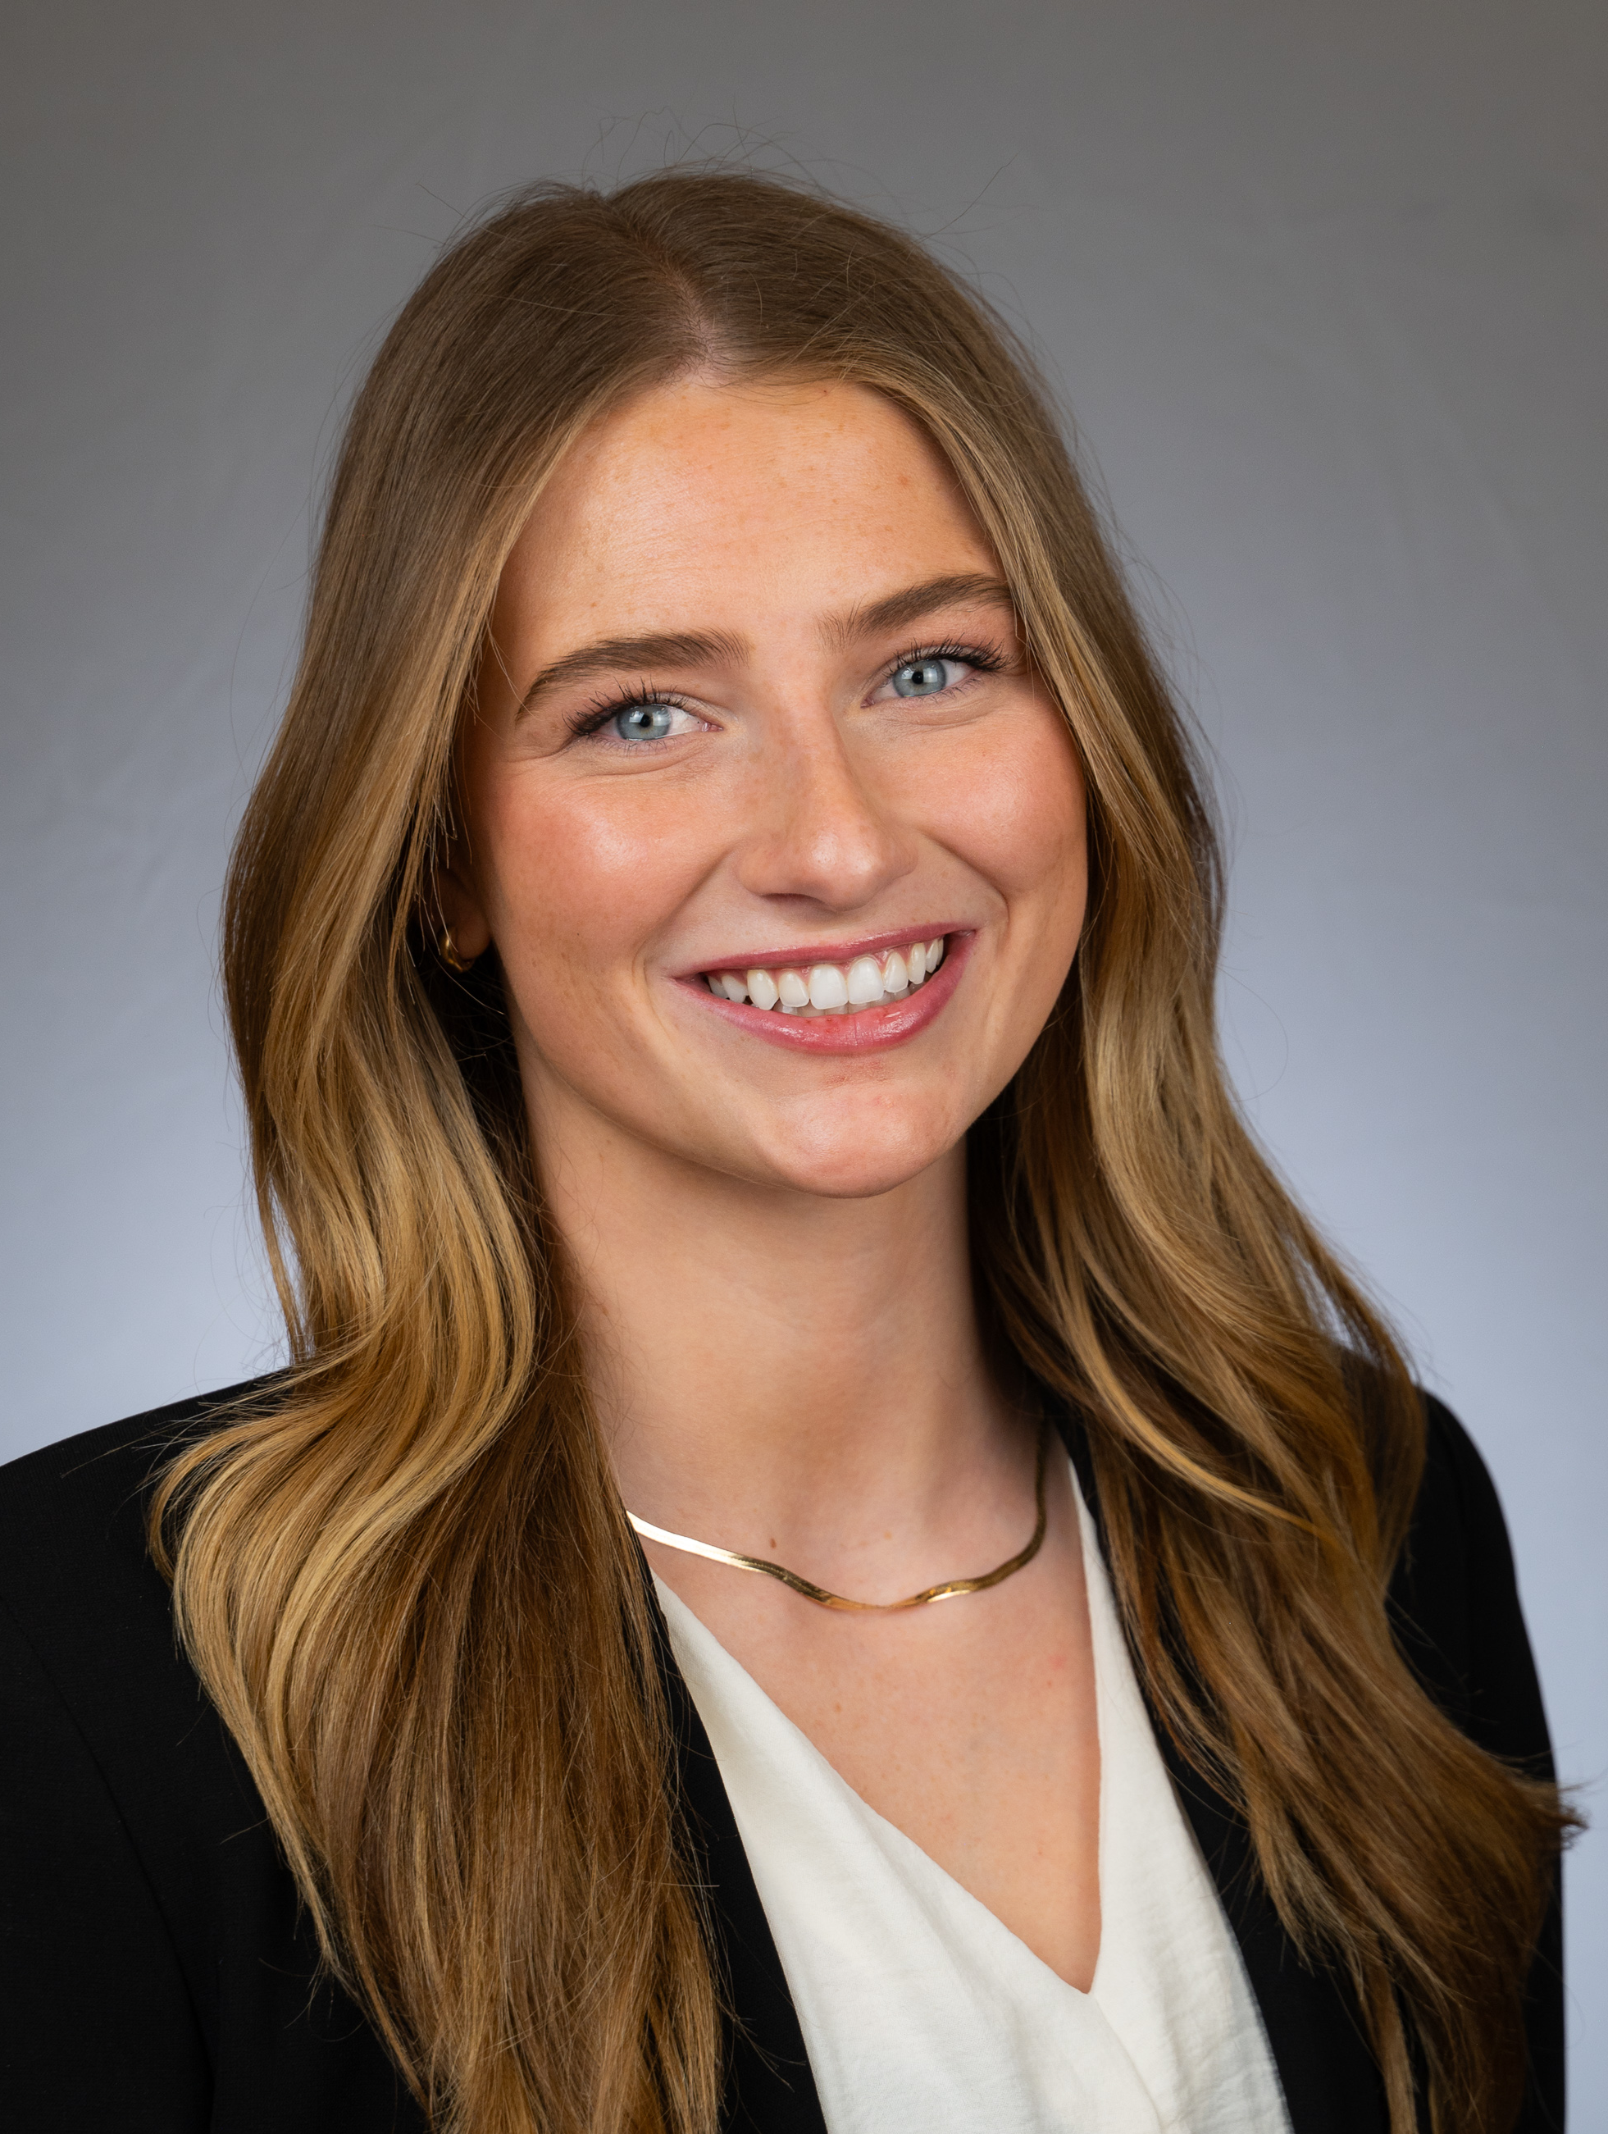
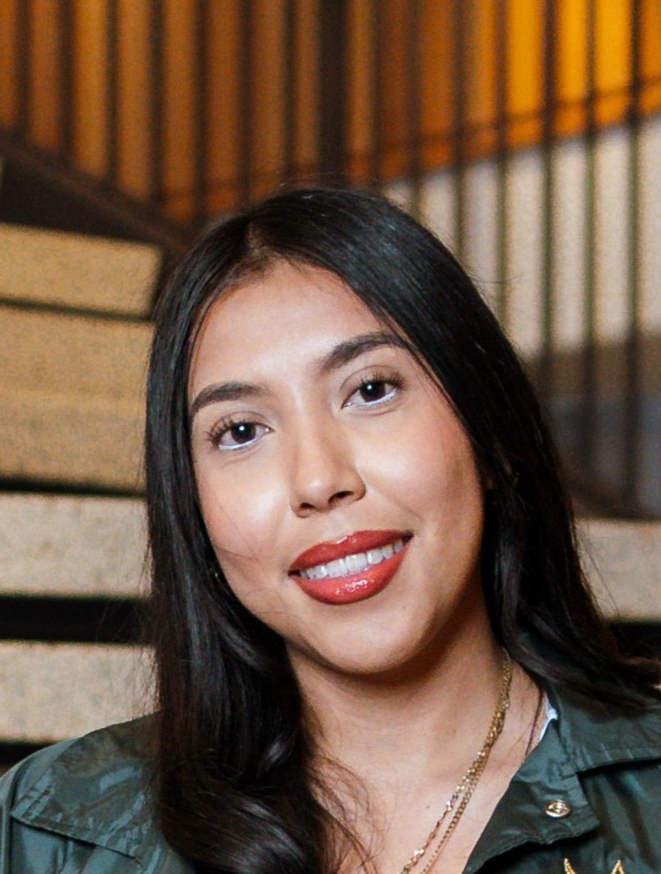
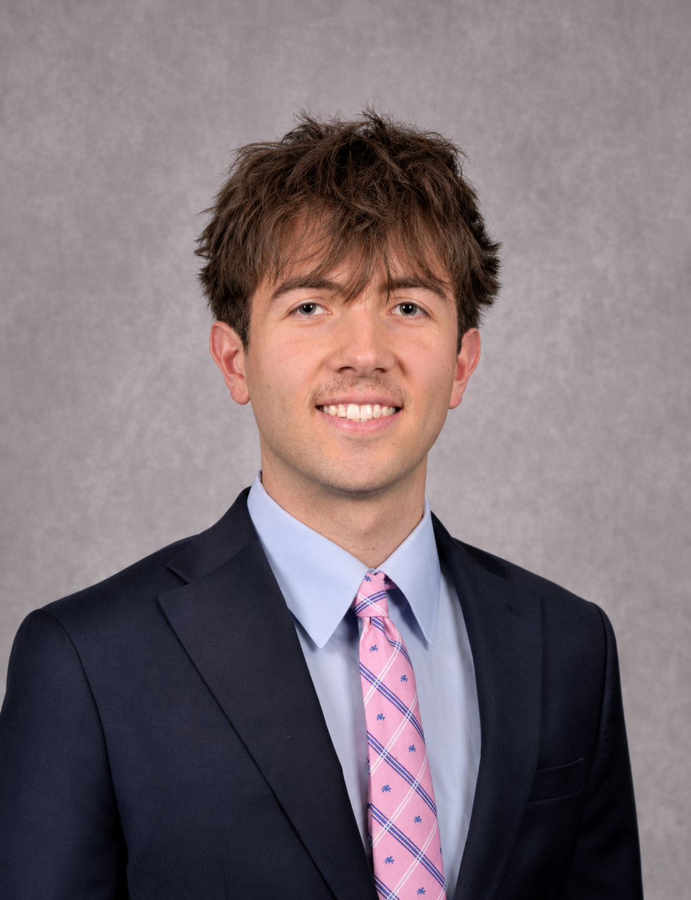
The Team
[ Photo ]
[ Photo ]
[ Photo ]
[ Photo ]
[ Photo ]
Alex Claunch
Maria DelMonte
Nadia Marciniak
Lucia Marquez
Fletcher Roberts
BSBA Hospitality Management
Figure Skating Club
LEAD Mentorship Program
Fritz Ambassadors
BSBA Business Information Analytics,
Minor in Finance
Alpine Club
Finance Club
BSBA Marketing, Minoring in BIA
Executive Leadership in Sigma Chi
Chess Club
Outdoor Enthusiast
Real Estate and Built Environment,
Minoring in Management
D1 Athlete- Swim and Dive team
BS in Accounting
Minoring in Business Analytics
Treasurer in Pi Lambda Chi
ALPHA Member
15 / 16

Slide 16
Q&A
Questions?
5 minutes — we welcome your pushback.
alex.claunch@du.edu
16 / 16

