Slide 1
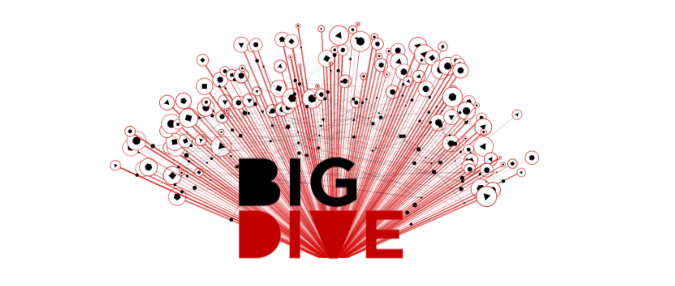
#Dev #Viz #DataScience Project by Alex, Giuseppe & Erika
June 25, 2013

Slide 2
Dataset
Twitter 11 Feb 2011
Mubarack Falls
#Egypt: the most used HashTag in 2011
-> Idea:
Where & When people talked about #Egypt?
-> Goals:
Why #Egypt was so important?
June 25, 2013

Slide 3
Some Numbers
HashTag most used on Feb 11:
#Ff: 116564
#Egypt: 44368
#jan25: 27801
….
Tweet processed:
-> 8.758.431
June 25, 2013

