Slide 1
Using Datalakes for Security Storage
Alexander Cote

Slide 2

About me
Lead Security architect at Abbott Laboratories
Volunteer red teamer at various collegiate events
Ucf alumni
UCF NCCDC 2021
Discovered FluentBit CVE 2024-23722

Slide 3


Questions?
https://app.sli.do/event/uUryNE3F8jL42Gr5Qy8RX2

Slide 4
What's the problem?
High Costs of Traditional Storage
  The old way of storing security events is extremely expensive.
  Most vendors charge based on the amount of data stored.
  Disk-based storage is one of the most expensive classes of storage on the cloud.
Inefficiency in Data Management
  Accessing archived data is labor-intensive.
  There are security-relevant logs that we do not store or ingest due to high costs.
Need for Cost-Effective Solutions
  We have significantly cheaper ways to store data that is infrequently accessed.

Slide 5
Pricing example (Elastic Cloud)
Storage Node Costs
  Hourly Rate: $20.90 per hour
  Annual Cost: 20.90 USD/hour×24 hours×365 days=183,084
Ingest Nodes and Search Head Costs
  Hourly Rate: $1.10 per hour
  Annual Cost: 1.10 USD/hour×24 hours×365 days=9,636
Total Cost for the Year
  183,084+9,636=192,720 USD183,084 + 9,636 = 192,720 USD

Slide 6
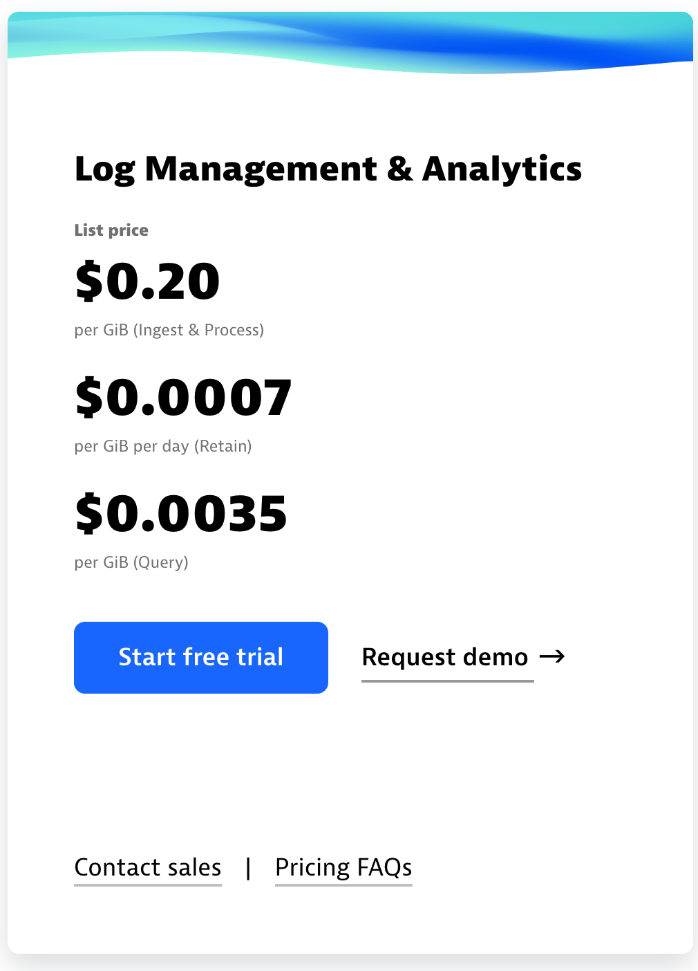
Pricing examples (Dynatrace)
Ingest pricing: 1TB per day for 365 days
Total GiB per year = 365 × 1,024 = 373,760 GiB.
Cost per GiB for ingest and process = $0.20.
Total Ingest & Process Cost = 373,760 GiB × $0.20 = $74,752.
Retention Cost: 1TB per day retained for a year.
  Total GiB per year for retention = 373,760 GiB.
  Cost per GiB per day for retention = $0.0007.
  Total Retention Cost per year = 373,760 GiB × $0.0007 × 365 = $95,028.80.
Query Cost:
  Assuming you query the full 1TB per day over the year:
  Total Query Cost per year = 373,760 GiB × $0.0035 = $1,308.16.
Total Cost per Year
Adding up these costs:
Ingest & Process: $74,752
Retention: $95,028.80
Query: $1,308.16
Total: $171,088.96

Slide 7
Pricing example (datalake/aws athena)
Ingest Costs:
  Total GiB per year: 365 × 1,024 = 373,760 GiB. Cost per GiB for ingest and processing: $0.02.
  373,760 GiB × $0.02 = $7,475.20.
Retention Costs:
  Retention of 1TB per day for a year using Glacier Instant Retrieval. Cost per GiB per month for Glacier Instant Retrieval: $0.004.
  373,760 GiB × $0.004 × 12 months = $17,940.48.
Query Costs:
  Athena query cost: $5 per TB of data scanned (or $0.005 per GB).
  373,760 GiB × $0.005 = $1,868.80.
Total Yearly Cost:
  $7,475.20 + $17,940.48 + $1,868.80 = $27,284.48
Notes:
‹#›

Slide 8
Traditional mindset
Let's create a clustered document store database, each host owns some documents or a replica of a document.
We need the compute needed to query the data correctly
When we get a query lets send it to every host that could have the data on their disk
  We have that provisioned at all times
  We use disks as our basis of storage
  Tiering of data is handled through different type of hosts
    Hot tier typically has high CPU and ssds, assuming that we will query data a lot when its new

Slide 9
What does Datalake mean?
  Borrowed from the data analytics landscape where large amounts of data are stored to answer questions across the entire enterprise.
  Example questions:
    How many registrations did we have month over month?
    What’s the average transaction per active user?
  Storing data in low-cost repositories that can be queried when needed.
  Like security questions, just with less frequent query execution.
  Most datalake solutions charge mainly for query time, making them more cost-effective for storing large volumes of infrequently accessed security data.

Slide 10
Datalake mindset
Let other people handle storing the data they are better at it
  S3/backblaze/ceph/minio/GCP/azure ETC ETC
  Storing it in object storage will almost always be cheaper or can rely on other enterprise resources
We can do all the searching from a dedicated place, we can autoscale that if we are doing lots of big searches
  Or use CSP managed searching infrastructure
We can tier data in object storage making it cheaper to store and more expensive to retrieve instead of primarily effecting query speed

Slide 11
AWS Athena
Data Storage:
  Store security event data in Amazon S3, a cost-effective and scalable storage solution.
  Amazon s3 is meant for generic object storage and is priced to work for archiving data
Billing Model:
  Billing is based on the amount of data scanned during queries, not just the storage used.
  Amazon S3 charges are for storage and requests, while AWS Athena charges are based on the amount of data scanned per query.
Data Partitioning:
  Optimize queries and reduce costs by partitioning data in Amazon S3. Partitioning can be done using fields such as date, log type, or region.
  Partitioning helps to minimize the amount of data scanned during a query, reducing both costs and query time.
SQL-like Queries:
  Use AWS Athena to run SQL-like queries directly on data stored in Amazon S3. Queries are straightforward for users familiar with SQL.

Slide 12
Azure Synapse Analytics with Azure Data Lake
Data Storage:
  Store security event data in Azure Data Lake Storage (ADLS) which ultimately stores the data in Azure blob storage.
Billing Model:
  Billing is based on the amount of data processed, not just stored.
  Azure Data Lake Storage charges are based on the volume of data stored and transactions, while Azure Synapse Analytics charges for the compute resources used during queries.
Data Partitioning:
    Partitioning works similarly to with Athena
SQL-like Queries:
    Similar to Athena you query logs using SQL like queries.

Slide 13
Trino
Distributed SQL Query Engine:
  Trino is an open-source, distributed SQL query engine designed for running interactive analytics on large datasets.
  It supports querying data from multiple sources, including cloud storage, relational databases, and non-relational systems, all within a single query.
Comparison to Athena and Azure Synapse Analytics:
  Flexibility: Unlike Athena (tied to AWS) or Azure Synapse Analytics (tied to Azure), Trino is platform-agnostic, meaning it can run on any cloud provider or on-premises.
  Unified Querying: Trino allows you to query data across different storage systems and databases simultaneously, offering a more unified approach to data analysis.
  Aws Athena under the hood is Trino .
Key Features:
  Scalability: Trino is built for large-scale data processing, capable of handling queries across petabytes of data.
  Low Latency: It provides low-latency performance, making it suitable for interactive queries.
  Advanced SQL Support: Trino supports complex SQL queries, including joins, aggregations, and window functions, making it versatile for various analytical needs.

Slide 14
Fluent Bit
Log Router:
  Think of Fluent Bit as a log router that allows you to easily ingest, transform, filter, and output logs to virtually any destination. That means you can use multiple services from various vendors to store your logs vs the solution from AWS/azure which is more limited
Log Destination Transparency:
  We started using Fluent Bit to make the log destination transparent to the application itself. This means we can send different logs to different places behind the scenes without the application needing to know.
Flexible Log Routing:
  Customized Routing: Fluent Bit enables us to route logs based on their type or content. For example, logs that require easy searching and alerting might be sent to Elasticsearch or splunk or any service you can think of.
Security Integration:
  In line alerting : We can potentially detect suspicious behavior within Fluent Bit and route alerts to a case management system.
Log Transformation:
  Format Transformation: Fluent Bit allows us to transform logs into a format that is easier to parse, enhancing downstream processing and analysis.

Slide 15
AWS firehose
Log Transformation and Delivery:
  AWS Firehose allows you to transform logs and deliver them to multiple destinations, functioning similarly to Fluent Bit.
Comparison to Fluent Bit:
  Similar Functionality: Essentially, AWS Firehose provides the same core functionality as Fluent Bit but is managed by AWS.
  No Persistent Storage Needed: Unlike Fluent Bit, which would need persistent storage to store records for batch uploading, AWS Firehose handles this natively, reducing the need for additional infrastructure.
Data Partitioning:
  AWS Firehose automatically partitions data by various fields within the S3 folder structure. This makes the data easier to search and more efficiently organized for downstream processing.
  FluentBit can also do partitioning if needed

Slide 16
Azure Event Hub
Log Ingestion and Transformation:
  Azure Event Hubs allows you to ingest large volumes of logs from various sources and deliver them to multiple destinations.
  Azure Stream Analytics can be used to transform logs in real-time, applying filtering, aggregation, and other transformations before delivery.
Comparison to AWS Firehose:
  Similar Functionality: Together, Azure Event Hubs and Stream Analytics offer similar capabilities to AWS Firehose, enabling real-time data ingestion, transformation, and delivery.
  Managed Service: Like AWS Firehose, Azure’s solution is fully managed, reducing the need for persistent storage and additional infrastructure for batch processing.
Data Partitioning:
  Event Hubs can partition data by various keys, ensuring efficient ingestion and processing.
  Stream Analytics can output the transformed data to Azure Data Lake or other azure services

Slide 17
Partitioning
Cost Efficiency in Data Queries:
  When querying large datasets, many systems bill based on the amount of data scanned.
  If your query does not use a partition key, it may need to scan the entire dataset, which can be expensive and time-consuming.
Example:
  A query like SELECT * FROM logs WHERE account_id="ssssss" could require scanning all records in the dataset, potentially spanning terabytes of data.
  However, a more specific query that includes partition keys, such as SELECT * FROM logs WHERE account_id="ssssss" AND day=24 AND month=6 AND year=2024 AND logtype="sms message sent" AND envrname="-preprod-jp", can significantly reduce the amount of data scanned.
Partitioning Strategy:
  By organizing data into partitions (e.g., by date, log type, cluster name), the system can quickly narrow down the search to only the relevant subset of data.
  For instance, the above query would only need to scan a small, specific portion of the data, potentially reducing the amount scanned from terabytes to mere megabytes.

Slide 18

Demo
https://github.com/alexcote1/datalake-security-storage-demo
Notes:
SELECT * FROM "fluentbit_logs_db"."fluentbit_logs" ;
SELECT * FROM "fluentbit_logs_db"."fluentbit_logs" WHERE year = 2024 AND month = 10 AND day = 16 LIMIT 10; SELECT * FROM "fluentbit_logs_db"."fluentbit_logs" WHERE year = 2024 AND month = 10 AND service LIKE 'host.drkonqi-coredump-processor%’ ;
SELECT * FROM "fluentbit_logs_db"."fluentbit_logs" WHERE year = 2024 AND month = 10 AND syslog_identifier = 'drkonqi-coredump-processor’;
18

Slide 19
Data management
Field Consistency Requirement:
  In many data lakes, tables need to have consistent fields across all records. If you need a field like email for some logs but not others, you face two challenges:
    Include all fields in every log: Even if they’re empty, leading to inefficiency.
    Create separate tables for each log type: Resulting in complexity and table proliferation.
Regional Table Fragmentation:
  Data is often partitioned across regional tables, making it cumbersome to query across all regions without performing complex unions or joins.
Managing Variable Fields with Views:
  JSON Fields Object: By storing variable fields within a JSON object in each record, you can maintain a single table structure. However, querying these fields directly can be complex.
  Using Views: A view can be created to extract Every field from the JSON object, transforming them into named columns. This simplifies querying by making these fields directly accessible as if they were regular table columns.
    Example: A view can automatically extract fields like email, transaction_id, and status from the JSON object, making them easily query able without manually parsing JSON in every query.
    You can Also use views to combine entries from multiple regions

Slide 20
When to use data Lakes?
Infrequently Accessed Data:
  Data lakes are perfect for storing data that you might not access frequently but still want to retain for future use or analysis.
Examples of Data to Store:
  Network Flows: Detailed records of network traffic that might only be analyzed during specific incidents or audits.
  End User Actions: Logs of user activities that are essential for security but aren’t typically accessed unless investigating a particular event.
  Extended Storage for Security Events: Keeping historical security events that don’t need to be in a high-cost, high-performance storage tier.
  DNS Logs: Logs of domain name system queries, which can be useful for tracing network issues or investigating malicious activity.
  Any Data You Initially Discarded: Data that you considered storing but decided against due to cost or storage constraints can now be stored in a cost-effective manner.

Slide 21
When to use existing setups
Low Data Quantity:
  If the data volume is low, the cost savings from switching to a data lake might be minimal.
  Savings Impact: A 50% savings might seem significant, but if your total bill is already low, the actual dollar amount saved might not justify the transition.
Frequent Querying Needs:
  If you plan on querying the same data often, sticking with your existing setup might be more efficient.
  Dashboard Dependency: For data that will be used to create dashboards that are constantly viewed and updated, traditional setups often offer better performance and lower overall costs in the long term.
  Break-Even Point: Depending on where the data is stored, the break-even point for the cost of querying can be as low as querying a record 10 times.

Slide 22
Questions!

