Slide 1
Compression for Distributed Acoustic Sensing Data
Date: 5/14/2021
Name: Alex Popescu

Slide 2
Progress
Compression Libraries
Lossless
FastPFor
Byte-oriented single-instruction-multiple-data (SIMD) compression method
ZSTD
Fast entropy coding compression method developed by Facebook
Lossy
ZFP
D-dimensional array compression method that encodes data by mapping small blocks of 4^{d} values to a user-specified number of bits per block
SZ
Curve-fitting compression method that linearizes multi-dimensional data and replaces predictable sequences with curve-fitting model code and encodes unpredictable data via lossy binary representation analysis

Slide 3
Progress
Compression Libraries
Unable to be implemented
IDEALEM
Compression method that encodes exchangeable blocks of data with a similar representation using KS score to compare blocks
Main issue: Unable to capture 1D pattern in 2D data
Promising compression method once multi-dimensional encoding feature is released
Curvelab (Curvelet)
Supports curvelet transform and inverse transform
Main issue: No library focused on compression → solely computes transform

Slide 4
Progress
Compression Libraries
In progress
MGARD
Technique for multilevel lossy compression of scientific data based on the theory of multigrid methods
Unable to implement GPU version due to account issues with snowbear
Very promising method
Tilib (Wavelet)
Lossy image compression library that is an extension of fast Fourier transform and compression
Main issue: Works only on image input, so code implementation requires a workaround to represent DAS data as an image → unknown effects

Slide 5
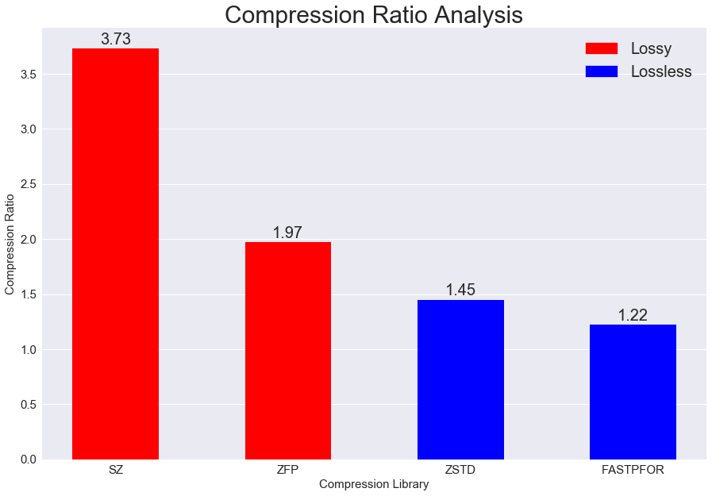
Compression Results

Slide 6
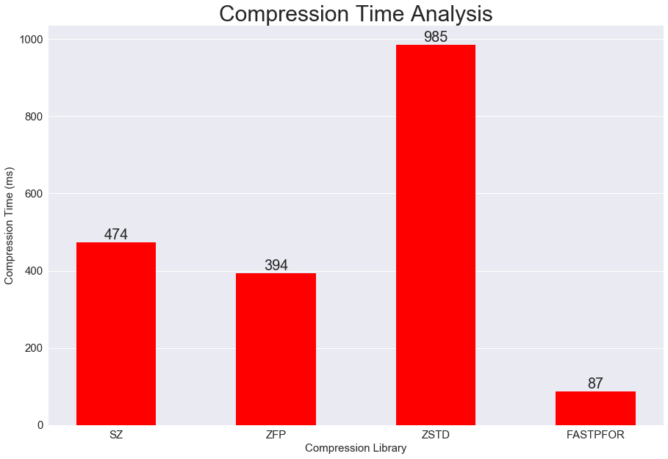
Compression Results

Slide 7
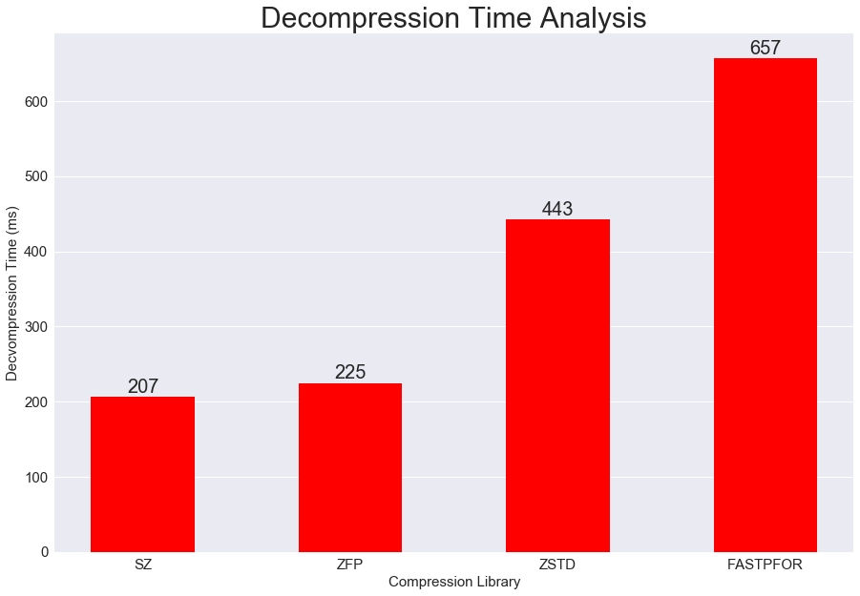
Compression Results

Slide 8
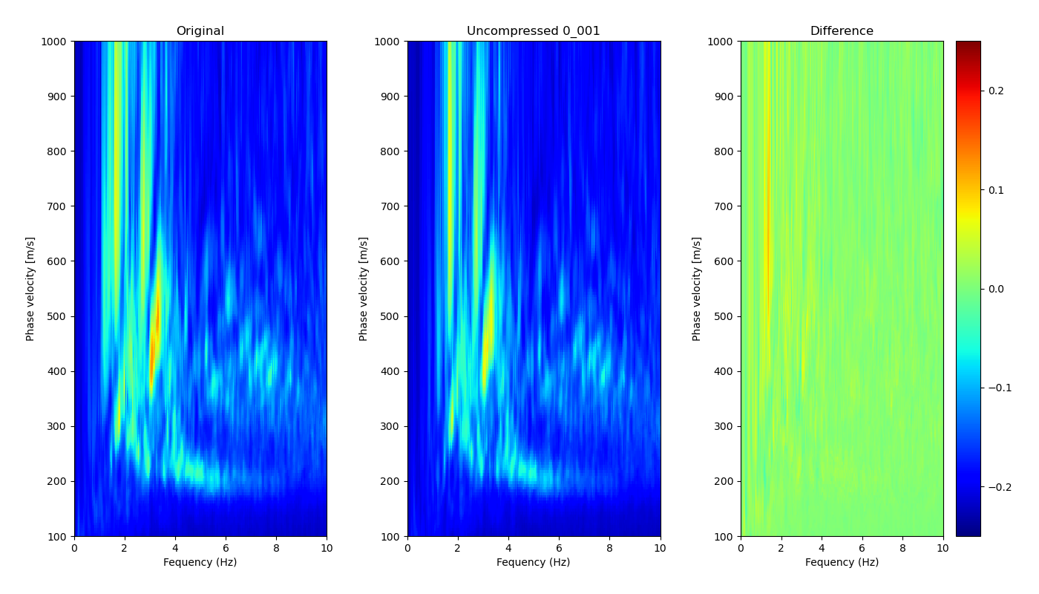
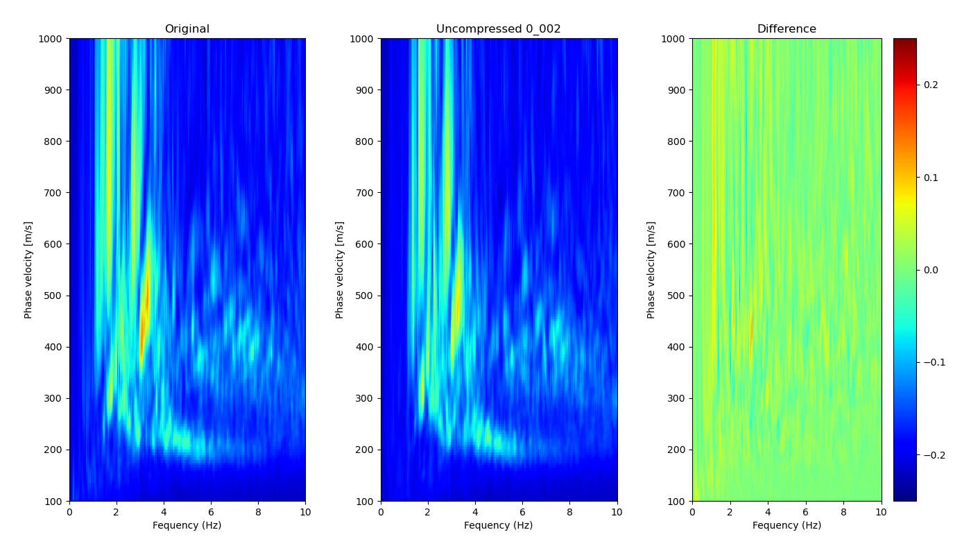
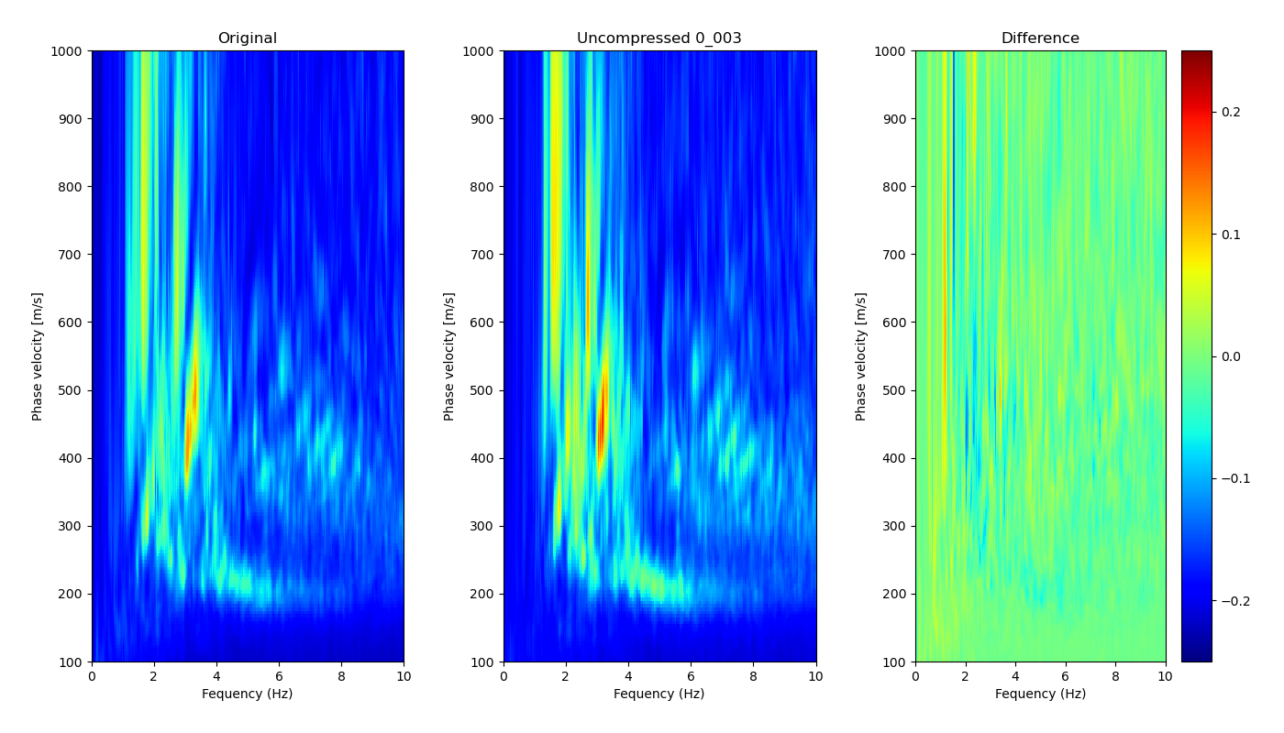
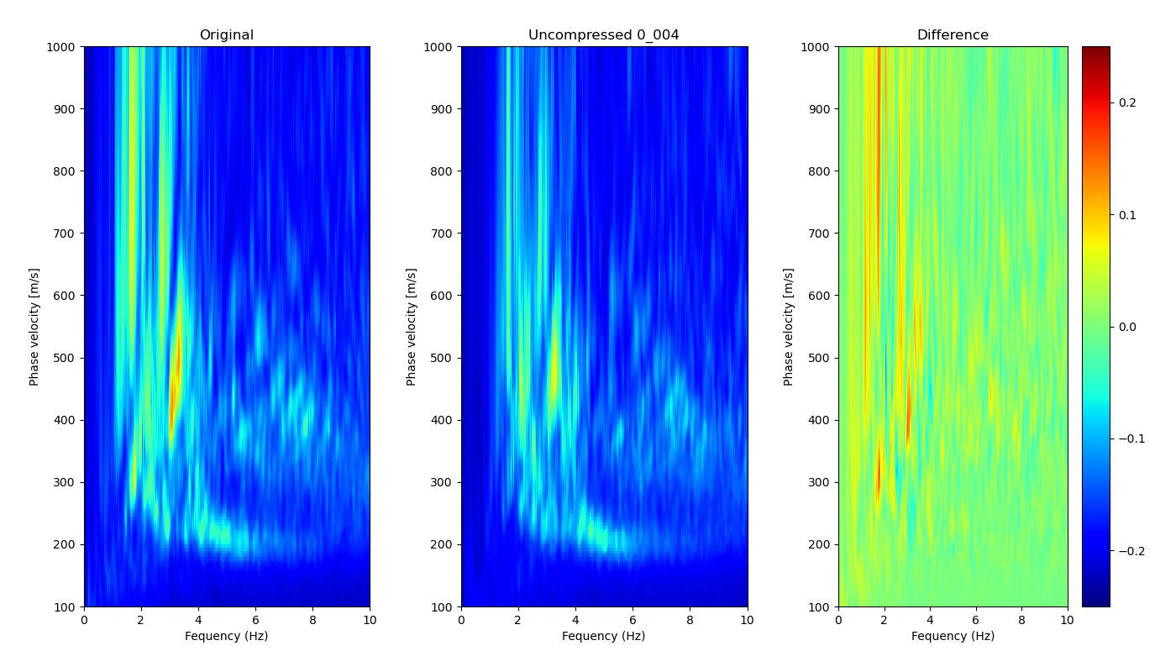
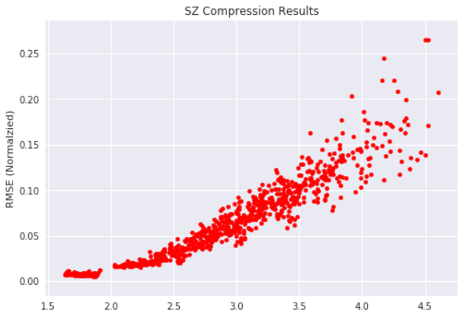
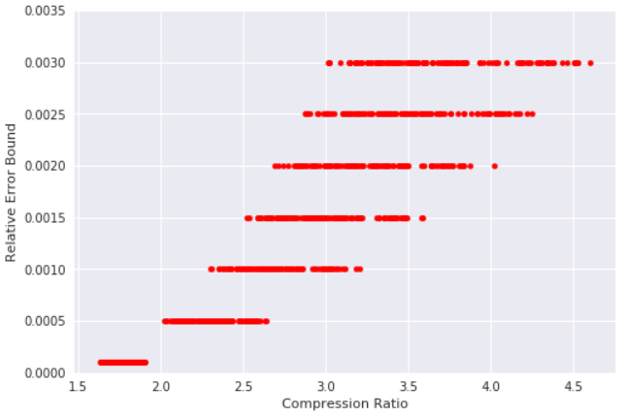
SZ Lossy Compression
Notes:
Curve-fitting compression method that linearizes multi-dimensional data and replaces predictable sequences with curve-fitting model code and encodes unpredictable data via lossy binary representation analysis

Slide 9
Preparing for the Future
Consolidated all compression code and related files on Cori
Created GitHub repo with an associated README
github.com/alexcpopescu/DAS_Compression.git
Document each compression method with file name and instructions on how to run the code
Link to dependencies and how to build each one
Clean up and comment code for maximum readability

