Slide 1
Topics:
RoboWars Virtual Elements and Testing
Augmented Reality
Server Model
Testing Plan
Presented By: Alex Dinardo

Slide 2
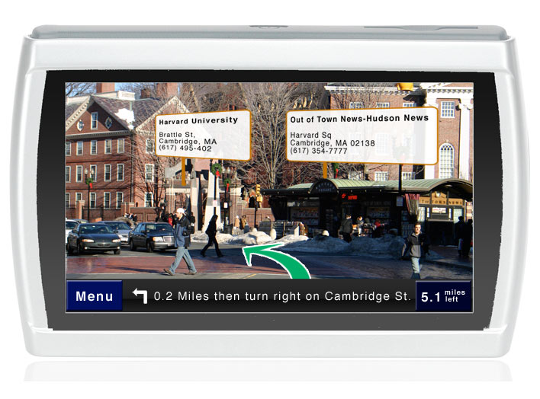
Augmented Reality
A fast growing area of research and development with never before thought of everyday applications.
D1
Applications made possible largely thanks to easily searchable data in the internet, combined with wireless technology.

Slide 3
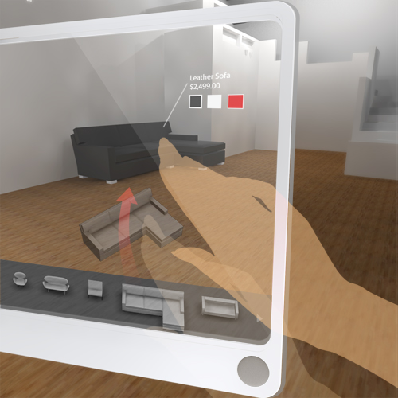
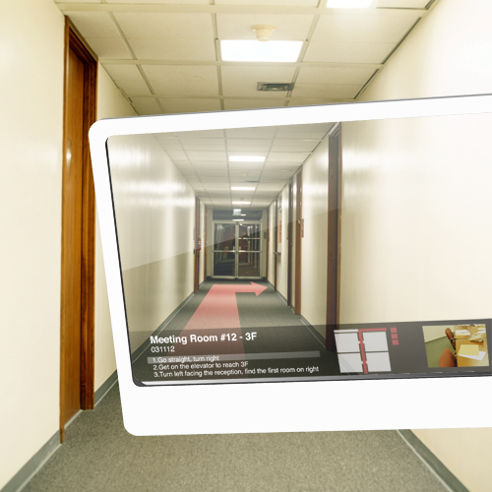
Augmented Reality
Today’s mobile platforms and devices are very powerful.
Access to internet and advanced visual interfaces allow for new ideas to be realised easier than before.
D2

Slide 4
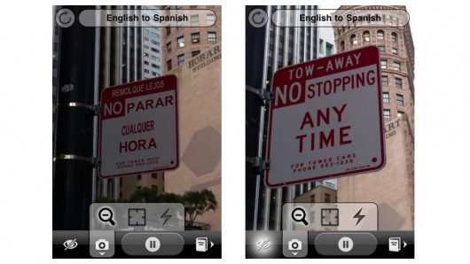
Augmented Reality
Actual example in today’s technology: WordLens, a real time translation app for IPhone.
D3

Slide 5
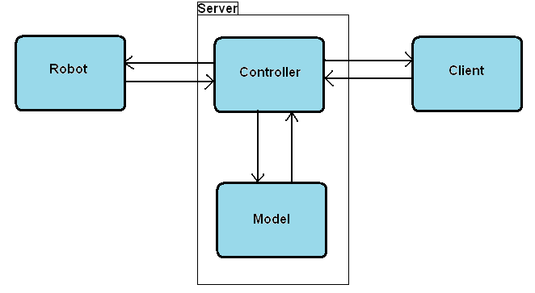
Structure of System – How It Works

Slide 6
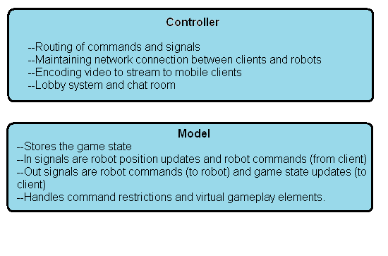
Responsibilities of the Server

Slide 7
Structure of System
Discrete modules with rigidly defined responsibilities.
Easy to test with unit testing (internal functionality only).
For functionality that depend on signals passed in from other modules, stubbing is required for ease of testing.
No unrelated functionality of stub is needed, only meant for injecting all possible signals for given module to process.

Slide 8
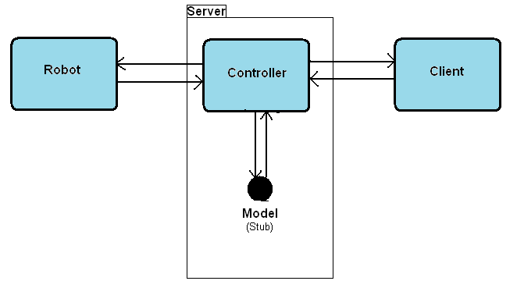
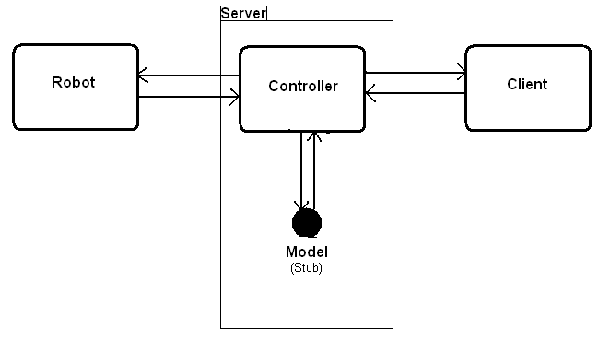
Stubbing of System Modules

Slide 9
Stubbing of System Modules
The Model stub
A subclass of GameModel class, a game type with no virtual entities and no command restrictions.
The Robot Stub
Fully functioning software representation of robot. Lejos navigator classes hooked up to simulated motors.
The Client Stub
A simple client simulator controlled at console command line.

Slide 10
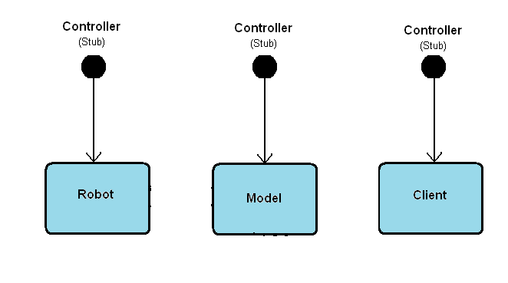
Stubbing of System Modules

Slide 11
Stubbing of System Modules
The Controller Stubs
Simulating controller for each module require different implementations.
Each stub has different in/out signals to generate.
Controller stub for robot completed.
Controller stubs for model and client are in progress.

Slide 12
Non-Functional Testing
Other things to consider when testing system wide:
Network Latency
Network Bandwidth
Performance Issues

Slide 13
References
D1 - http://www.raizlabs.com/blog/262/augmented-reality-gps
D2 - http://petitinvention.wordpress.com/2008/08/20/future-of-mobile-search-virtual-shopping-1/
D3 - http://questvisual.com/

