Slide 1
RoboWars SYSC 4907 Engineering Project
Presented: Monday January 17th, 2011
Development Team:
Alexander Craig Alexander Dinardo
Steve Legere Michael Wright

Slide 2
Topics:
RoboWars Overview
Project Objectives
Proposed Solution
System Architecture
Potential Applications
Presented By: Alexander Craig

Slide 3
Project Objectives
To develop a robotics control system which is both intuitive to use and is implemented on a mobile platform that is widely available and used by the public.
To experiment with the combination of live video and virtually generated, overlaid imagery to enhance the ease of use and feature set of a robotics control system. This technology is commonly referred to as augmented reality.

Slide 4
Solution
The project aims to create a system which allows remotely controlled robots to share and interact with a simple virtual world, which will be rendered overtop of a live video feed and displayed to the remote operators.
Notes:
Remote users from any internet capable location
Connect to our server and use our robotics kits
Interact with a simple virtual world

Slide 5
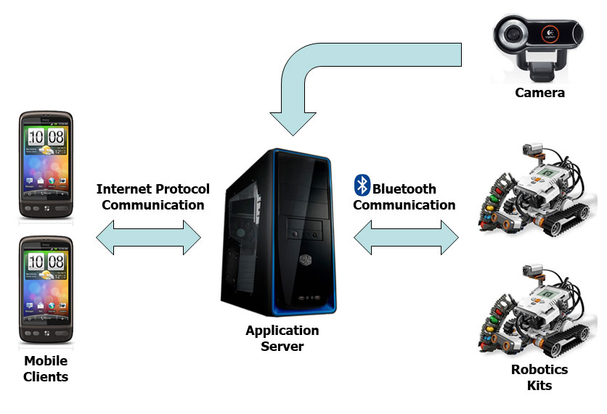
Solution - System Architecture
Notes:
- Try to avoid talking about robot arena

Slide 6
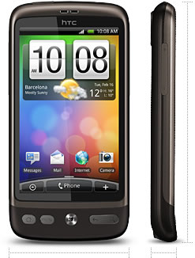
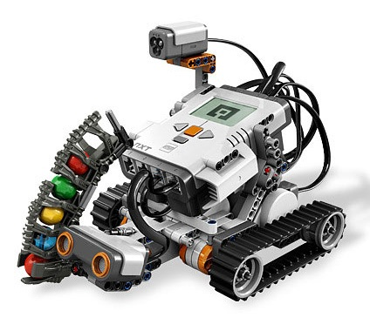
Solution - Hardware
Mobile Client
Robotics
Smart phones running Android version 2.2 [1]
LEGO Mindstorms NXT 2.0 Robotics Kits [2]

Slide 7
Solution – How it Works
Robots are placed into a designated arena, and register wirelessly with the application server.
Mobile users connect to the application server, and are paired to one of the registered robots.
User input is used to generate and send commands to the user’s paired robot.

Slide 8
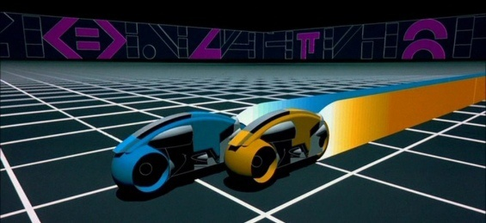
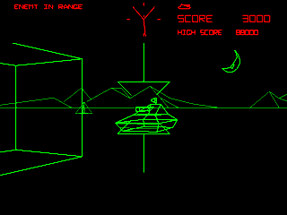
Solution – How it Works
The application server simulates a real-time virtual environment which the robots interact with based on user input and their current position within the arena.
For our prototype, simple video games will be used as the virtual environments. For example:
[3] Light Cycles
[4] Tank Simulation

Slide 9
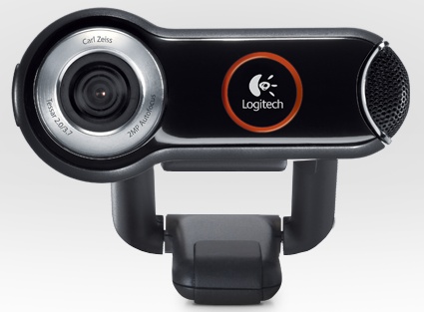
Solution – How it Works
A camera connected to the application server overlooks the robot arena.
The application server streams the video feed and the state of the simulated virtual world to remotely connected clients.
[5] Logitech Quickcam 9000 Pro

Slide 10
Solution – How it Works
The mobile client uses OpenGL to render 3D imagery corresponding to the virtual world state on top of the received live video feed.
The end user uses either an on-screen button display or the tilt sensors in their smartphone to send movement commands to their paired robot.

Slide 11
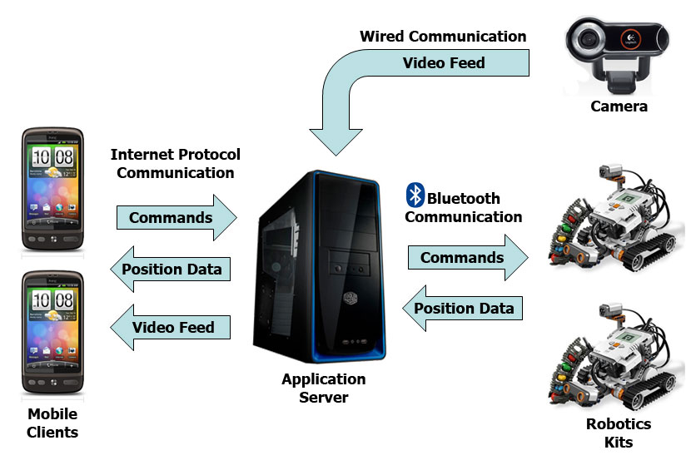
Solution - System Architecture
Notes:
- FIX

Slide 12
Potential Applications
Elderly / Disabled Assistance
Search and Rescue
Security and Surveillance

Slide 13
Potential Applications
Virtual world state could be entirely simulated as in the prototype case, or the virtual world could be used to collaborate sensor information from external sources.
In our implementation, robots remain idle when not paired and do not receive virtual world state. Robots could operate autonomously while making use of virtual world data when not actively paired to a human operator.

Slide 14
Potential Application Elderly / Disabled Assistance
A virtual world could be used to collaborate with other sensors and appliances in a home environment. For example, stored information might include grocery stocks, locations of various items… etc.
A remotely controlled robotic drone could be used by the elderly or disabled to perform simple tasks around the home such as fetching items or mapping potential hazards in the area.

Slide 15
Potential Application Search and Rescue
Robotic drones are a means of performing search and rescue operations in areas which may be hazardous or inaccessible to human personnel.
A virtual world could be used to collaborate sensor information as well as to coordinate the movements of the drones themselves.
A small number of personnel could potentially manage a large number of rescue drones.

Slide 16
Potential Application Security and Surveillance
Robotic drones could be used to augment an existing security system by using a virtual world to collaborate with existing alarm and camera systems.
A mobile client ensures that security personnel can operate the drones regardless of their current position when an alarm is triggered (greatly decreased the response time to an emergency).

Slide 17
Topics:
Android and Completed Work
Why Android?
Requirements and Components
Progress
Demonstration
Presented By: Steve Legere

Slide 18
Android – Why Android?
Android is Open Source; anyone with sufficient knowledge is able to download the source code and propose new content, modifications, updates or patches.
Market Share – Android rose from 4% (Q2 2009) to 27% (Q2 2010). Android held 34% market share in the US (last year), placing it above Apple and RIM. [6]

Slide 19
Android – Why Android? (cont'd)
Android Software Development Kit (SDK) is extremely well laid out and documented.

Slide 20
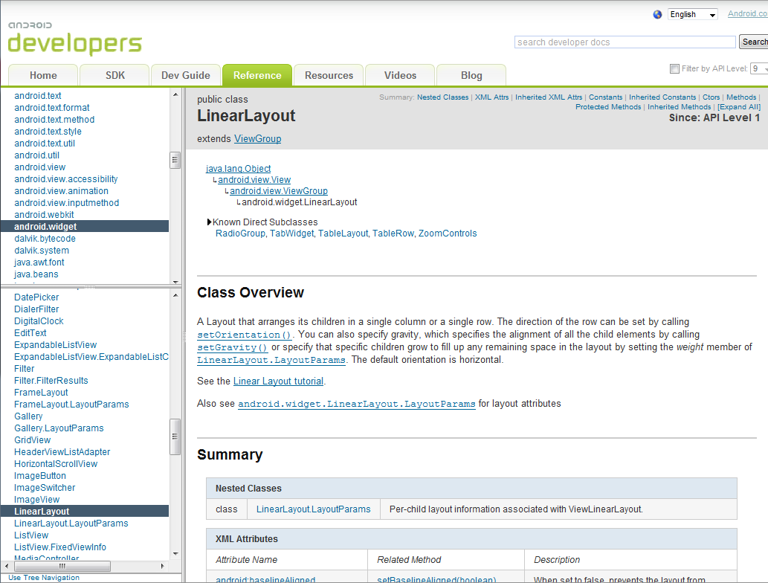
Android – Why Android? (cont'd)
[7] An example of the Android documentation

Slide 21
Android – Requirements and Components
Wireless Connectivity over LAN or WAN
Accelerometer to provide tilt based robotics control
Touchscreen capabilities for various user interactions and functionality
Media client to display and render video feed

Slide 22
Android – Progress
Currently, the mobile client is able to chat on the application server, initialize a game, and move its paired robot.
Future work includes streaming video to the mobile clients and rendering the augmented reality over the streaming video in real-time.

Slide 23
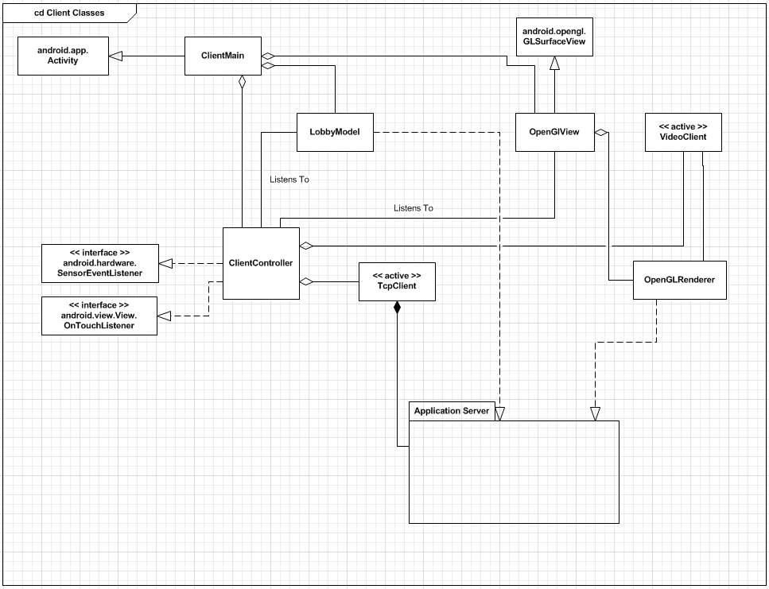
Android – Progress (cont’d)

Slide 24
Android
DEMONSTRATION

Slide 25
Topics:
RoboWars Virtual Elements and Testing
Augmented Reality
Server Model
Testing Plan
Presented By: Alex Dinardo

Slide 26
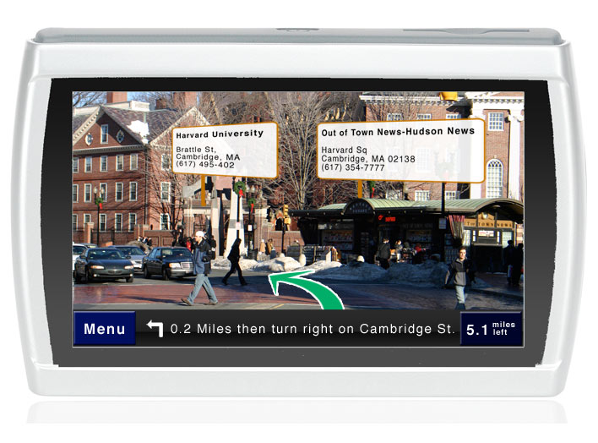
Augmented Reality
A fast growing area of research and development with never before thought of everyday applications.
[8]
Applications made possible largely thanks to easily searchable data in the internet, combined with wireless technology.

Slide 27
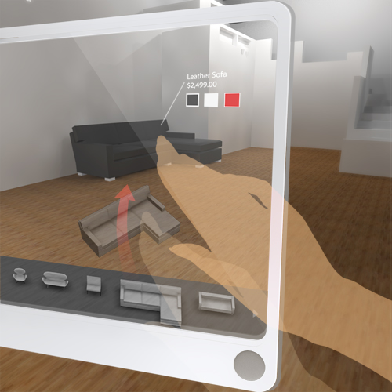
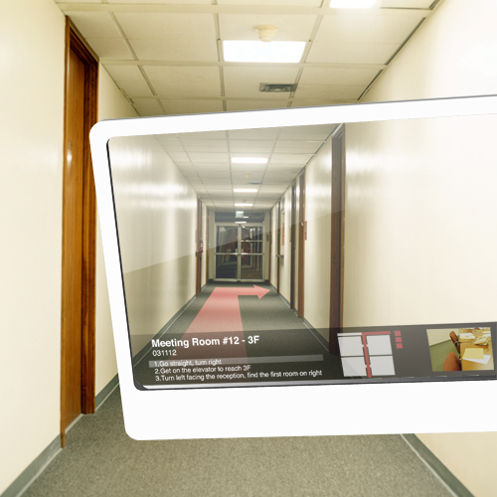
Augmented Reality
Today’s mobile platforms and devices are very powerful.
Access to internet and advanced visual interfaces allow for new ideas to be realised easier than before.
[9]

Slide 28
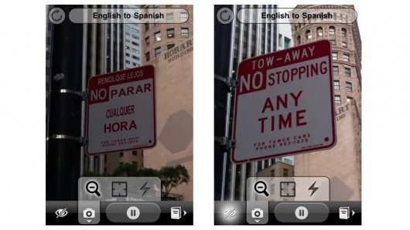
Augmented Reality
Actual example in today’s technology: WordLens, a real time translation app for IPhone.
[10]

Slide 29
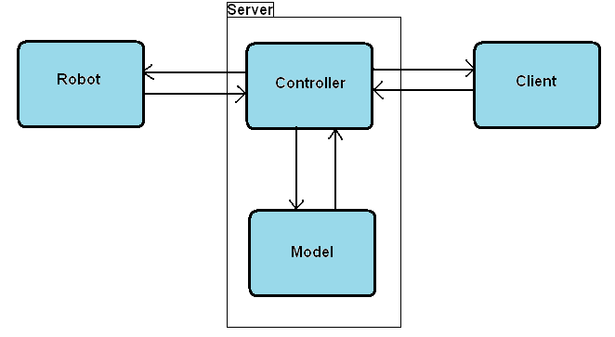
Structure of System – How It Works

Slide 30
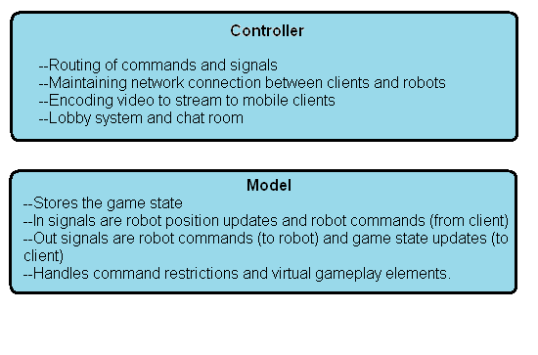
Responsibilities of the Server

Slide 31
Structure of System
Discrete modules with rigidly defined responsibilities.
Easy to test with unit testing (internal functionality only).
For functionality that depend on signals passed in from other modules, stubbing is required for ease of testing.
No unrelated functionality of stub is needed, only meant for injecting all possible signals for given module to process.

Slide 32
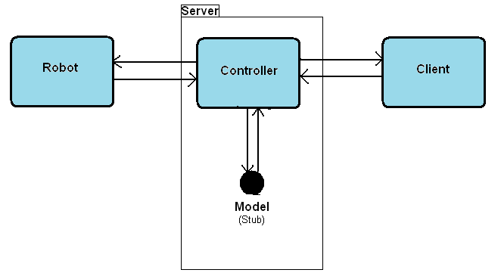
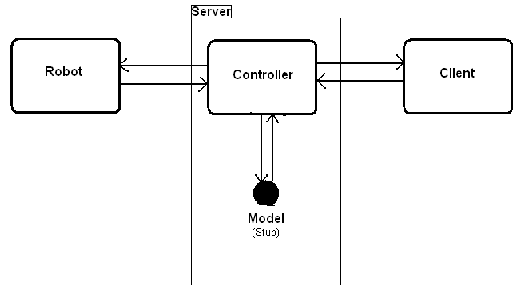
Stubbing of System Modules

Slide 33
Stubbing of System Modules
The Model stub
A subclass of GameModel class, a game type with no virtual entities and no command restrictions.
The Robot Stub
Fully functioning software representation of robot. Lejos navigator classes hooked up to simulated motors.
The Client Stub
A simple client simulator controlled at console command line.

Slide 34
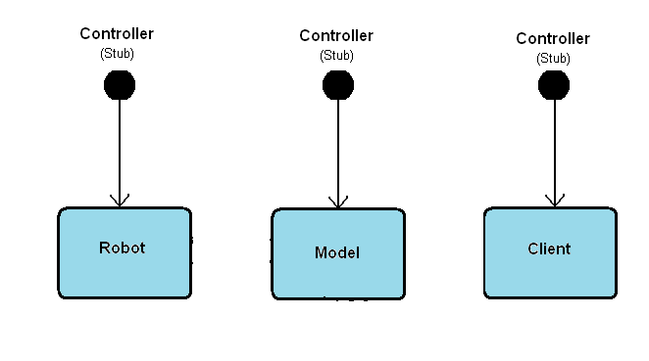
Stubbing of System Modules

Slide 35
Stubbing of System Modules
The Controller Stubs
Simulating controller for each module require different implementations.
Each stub has different in/out signals to generate.
Controller stub for robot completed.
Controller stubs for model and client are in progress.

Slide 36
Non-Functional Testing
Other things to consider when testing system wide:
Network Latency
Network Bandwidth
Performance Issues

Slide 37
Topics:
RoboWars
Robotics
Robotics Requirements
Lego NXT 2.0 Mindstorms
Lejos Firmware
Controls And Positioning
Error Corrections
Presented By: Michael Wright
Notes:
Robots goals
Introduce mindstorm
Mention the firmware
Controls and positioning
Error correction

Slide 38
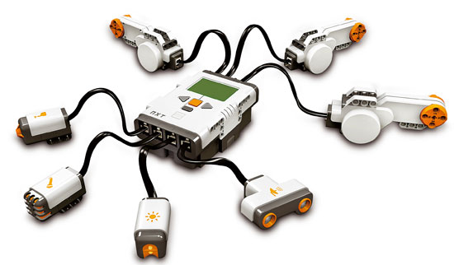
Robotics Requirements
Point Turning
Independent Wheel Control
Wireless communication
Local Position Tracking
Notes:
Need on the spot game turning
Independent wheel control:not building a gearbased turning
Wireless
Need local position tracking to ensure that even when packets are dropped the state remains consistant

Slide 39
Lego NXT 2.0 Mindstroms
Programmable robotics kit
Highly Modifiable
Large number of advanced sensors
Notes:
Lego allows easy to build
Well supported libraries
Infinite possibilities
Lots of external hardware (cameras, compasses’)

Slide 40
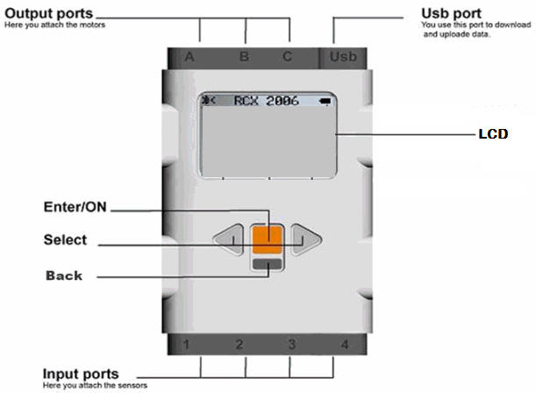
NXT Brick
3 Motor output Ports, 4 Sensor Input Ports
Supports USB 2.0 and Bluetooth 2.1
48MHz microprocessor [17]
Can support and playback 8Hz sound [11]
[16] The NXT 2.0 Intelligent Brick
Notes:
Up to 7 peripherals
Can communicate with other robots to ensure no collisions
48MHz processor
64KB SRAM
Has embedded microphone and speaker

Slide 41
NXT Sensors And Motors
2 Servo Motors capable of up to 180 rpm unloaded. [13]
1 Colour sensor capable of reading full 8Bit RGB [14]
2 Touch Sensors
Ultrasonic Sensor [15]
[12] peripherals packaged with the standard NXT 2.0 kit
Notes:
Ultra sonic sensor can see objects and estimate its proximity with in a centimetre
Touch sensors are NOT used
Colour sensor has radius of about a dime, and also contains a floodlight and infrared detection

Slide 42

Lejos Firmware
Open source microcontroller firmware
Provides a JVM for the NXT brick
Has large libraries for position control
Wide support for USB and Bluetooth communication
[17]
Notes:
Started in 1999, switched to NXT and RCX in 2001
Still many problems
Custom IO was had to be redone.
Adds local JVM using a section of the java library and their own libraries
Provides easy access to USB and Bluetooth
By having the jvm awe avoid having to do our own context switches while having the entire system be thread based

Slide 43
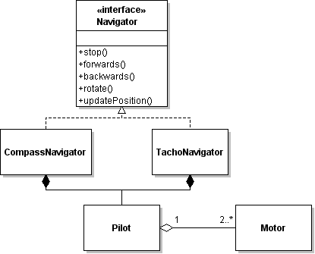
Lejos Navigation Library
Overall Control done by Navigator Interface
Through a pilot motion commands are given
The pilot will then issue the correct action to the individual motors
Notes:
Navigator provides the basic movement, and turning and position control
These are then implemented using concrete interfaces, the most common being Compass and Tachonavigator
These are named after their pilots
Tachonavigator uses deadreconing on the servo motor tachometers where compass uses extra hardware to get heading information
Pilots are used to directly interact with the motors

Slide 44
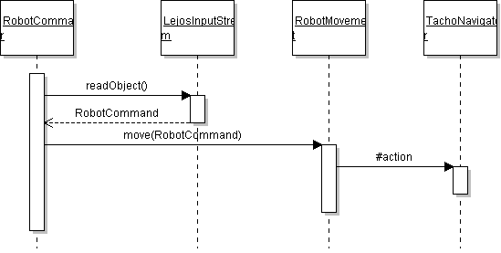
Controls and Positioning
Notes:
Receives a command
Uses the thread safe IO
Provides the command to the thread-safe robot movement
Which then interacts with the navigator
Positions are tracked using a custom data structure (Pose)

Slide 45

Error Correction And The Grid
Errors will be compounded thus must be corrected
Colour Sensor and the grid are used in tandem
Notes:
Travels over grid sampling the colours should the robot detect a dot it snaps its location to the nearest point
Samples 3/s
Grid is programmed and saved in the system, the representation is provided by the server.
Dots on grid are spaced 2cm apart
Heading error cannot be fixed without additional hardware.

Slide 46
Topics:
RoboWars
Future Works
OpenGL integration
Video streaming
Testing
Arena
Additional Robot Integration
Presented By: Michael Wright
Notes:
Need to start making the client side open GL (Me and steve)
Need to start getting video streaming onto the phone
Need to formalize (lots of testing modules no test plan)
Need to expand the grid
Need to make the server to integrate with 2 robots

Slide 47
RoboWars SYSC 4907 Engineering Project
https://github.com/alexcraig/RoboWars

Slide 48
References
[1] http://www.htc.com/www/product/desire/specification.html
[2] http://mindstorms.lego.com/en-us/products/default.aspx
[3] http://static.guim.co.uk/sys-images/Technology/Pix/pictures/2009/4/21/1240307015871/Tron-001.jpg
[4] http://1.bp.blogspot.com/_s0SSX3Y2JTw/S-Cv_6lfKVI/AAAAAAAAFE8/SUlrHiF5RUg/s1600/battlezone_1.gif
[5] http://www.logitech.com/en-us/webcam-communications/webcams/devices/6333
[6] http://www.canalys.com/pr/2010/r2010081.html
[7] http://developer.android.com/reference/android/widget/LinearLayout.html
[8] http://www.raizlabs.com/blog/262/augmented-reality-gps
[9] http://petitinvention.wordpress.com/2008/08/20/future-of-mobile-search-virtual-shopping-1/
[10] http://questvisual.com/

Slide 49
References
[11] http://shop.lego.com/Product/?p=9841
[12] http://engk12.ece.missouri.edu/LegoCamp/pictures/NXT%20Robots/LEGO%20NXT%20Brick.jpg
[13] http://www.philohome.com/nxtmotor/nxtmotor.htm
[14] http://www.hitechnic.com/cgi-bin/commerce.cgi?preadd=action&key=NCO1038
[15] http://shop.lego.com/ByTheme/Product.aspx?p=9846&cn=17
[16] http://pirate.shu.edu/~wachsmut/Teaching/CSAS3085/images/nxt-brick-labeled.jpg
[17] http://christhompson.ca/2009/08/at91sam7s256-aka-the-nxt-brain/

