Slide 1
RoboWars SYSC 4907 Engineering Project
Presented: Monday January 17th, 2011
Development Team:
Alexander Craig Alexander Dinardo
Steve Legere Michael Wright

Slide 2
Topics:
RoboWars Overview
Project Objectives
Proposed Solution
System Architecture
Potential Applications
Presented By: Alexander Craig

Slide 3
Project Objectives
To develop a robotics control system which is both intuitive to use and is implemented on a mobile platform that is widely available and used by the public.
To experiment with the combination of live video and virtually generated, overlaid imagery to enhance the ease of use and feature set of a robotics control system. This technology is commonly referred to as augmented reality.

Slide 4
Solution
The project aims to create a system which allows remotely controlled robots to share and interact with a simple virtual world, which will be rendered overtop of a live video feed and displayed to the remote operators.

Slide 5
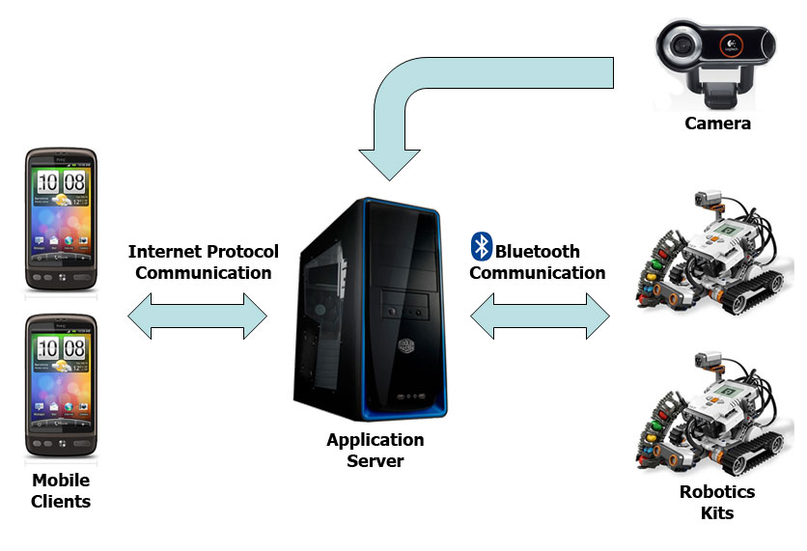
Solution - System Architecture

Slide 6
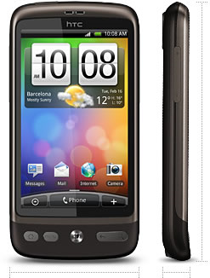
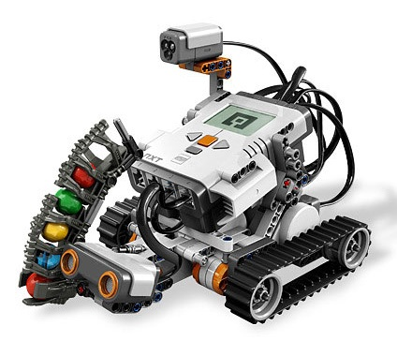
Solution - Hardware
Mobile Client
Robotics
Smart phones running Android version 2.2 [1]
LEGO Mindstorms NXT 2.0 Robotics Kits [2]

Slide 7
Solution – How it Works
Robots are placed into a designated arena, and register wirelessly with the application server.
Mobile users connect to the application server, and are paired to one of the registered robots.
User input is used to generate and send commands to the user’s paired robot.

Slide 8
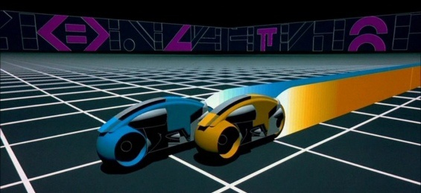
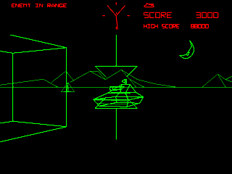
Solution – How it Works
The application server simulates a real-time virtual environment which the robots interact with based on user input and their current position within the arena.
For our prototype, simple video games will be used as the virtual environments. For example:
[3] Light Cycles
[4] Tank Simulation

Slide 9
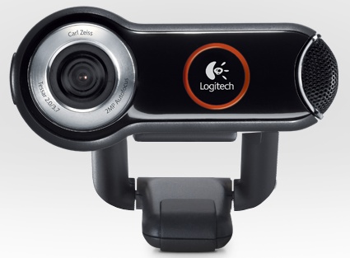
Solution – How it Works
A camera connected to the application server overlooks the robot arena.
The application server streams the video feed and the state of the simulated virtual world to remotely connected clients.
[5] Logitech Quickcam 9000 Pro

Slide 10
Solution – How it Works
The mobile client uses OpenGL to render 3D imagery corresponding to the virtual world state on top of the received live video feed.
The end user uses either an on-screen button display or the tilt sensors in their smartphone to send movement commands to their paired robot.

Slide 11
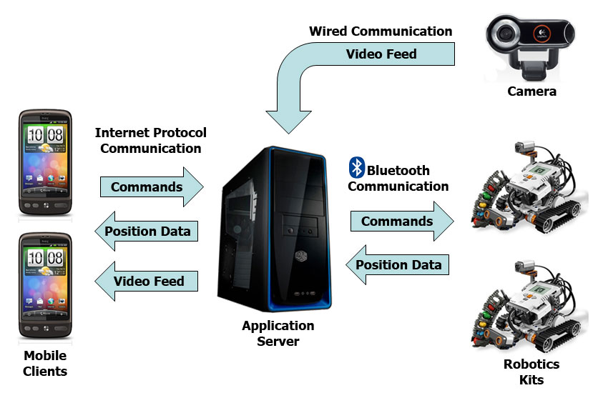
Solution - System Architecture

Slide 12
Potential Applications
Virtual world state could be entirely simulated as in the prototype case, or the virtual world could be used to collaborate sensor information from external sources.
In our implementation, robots remain idle when not paired and do not receive virtual world state. Robots could operate autonomously while making use of virtual world data when not actively paired to a human operator.

Slide 13
Potential Applications
Elderly / Disabled Assistance
Search and Rescue
Security and Surveillance

Slide 14
Potential Application Elderly / Disabled Assistance
A virtual world could be used to collaborate with other sensors and appliances in a home environment. For example, stored information might include appliance settings, thermostat settings, the status of lights in various rooms, grocery stocks… etc.
A remotely controlled robotic drone could be used by the elderly or disabled to perform simple tasks around the home such as fetching items or interacting with appliances.

Slide 15
Potential Application Search and Rescue
Robotic drones are a means of performing search and rescue operations in areas which may be hazardous or inaccessible to human personnel.
A virtual world could be used to collaborate sensor information as well as to coordinate the movements of the drones themselves.
A small number of personnel could potentially manage a large number of rescue drones.

Slide 16
Potential Application Security and Surveillance
Robotic drones could be used to augment an existing security system by using a virtual world to collaborate with existing alarm and camera systems.
A mobile client ensures that security personnel can operate the drones regardless of their current position when an alarm is triggered.

Slide 17
References
[1] http://www.htc.com/www/product/desire/specification.html
[2] http://mindstorms.lego.com/en-us/products/default.aspx
[3] http://static.guim.co.uk/sys-images/Technology/Pix/pictures/2009/4/21/1240307015871/Tron-001.jpg
[4] http://1.bp.blogspot.com/_s0SSX3Y2JTw/S-Cv_6lfKVI/AAAAAAAAFE8/SUlrHiF5RUg/s1600/battlezone_1.gif
[5] http://www.logitech.com/en-us/webcam-communications/webcams/devices/6333

