Slide 1
Topics:
Android and Completed Work
Why Android?
Requirements and Components
Progress
Demonstration
Presented By:
Steve Legere

Slide 2
Android – Why Android?
Android is Open Source; anyone with sufficient knowledge is able to download the source code and propose new content, modifications, updates or patches.
Market Share – Android rose from 4% (Q2 2009) to 27% (Q2 2010). Android held 34% market share in the US (last year), placing it above Apple and RIM. [s1]

Slide 3
Android – Why Android? (cont'd)
Android Software Development Kit (SDK) is extremely well laid out and documented.

Slide 4
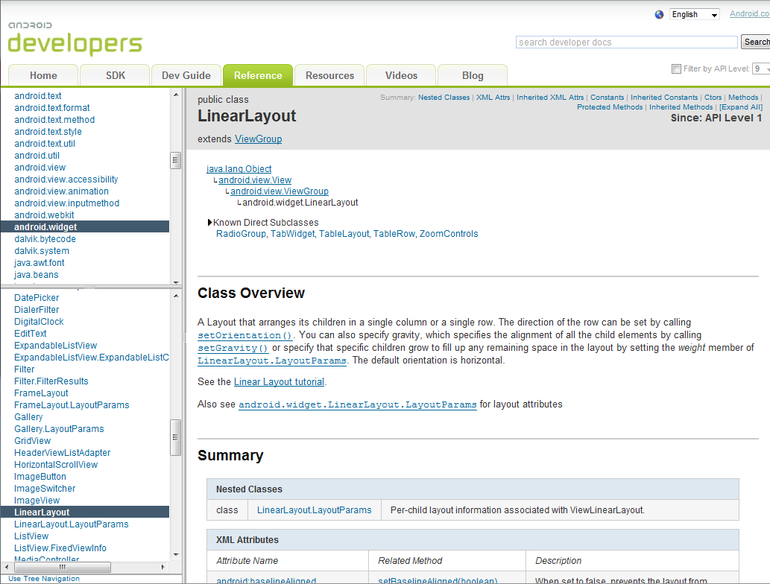
Android – Why Android? (cont'd)
[s2]

Slide 5
Android – Requirements and Components
Wireless Connectivity over LAN or WAN
Accelerometer to control a robot
Touchscreen capabilities for various user interactions and functionality
Media client to display and render video feed

Slide 6
Android – Progress
Currently, the mobile client is able to chat on the application server, initialize a game, and move its paired robot.
Future work includes streaming video to the mobile clients and rendering the augmented reality over the streaming video in real-time.

Slide 7
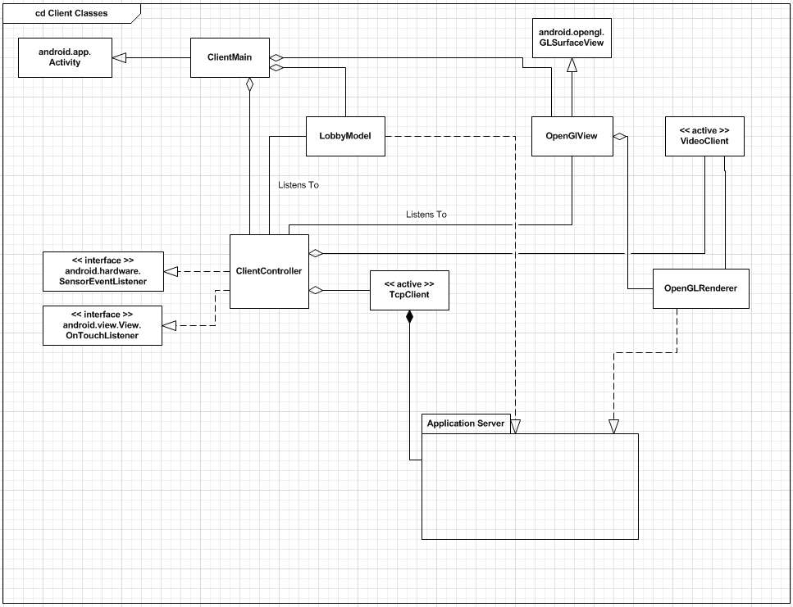
Android – Progress (cont’d)

Slide 8
Android
DEMONSTRATION

Slide 9
References
[s1] http://www.canalys.com/pr/2010/r2010081.html
[s2] http://developer.android.com/reference/android/widget/LinearLayout.html

