Slide 1
Topics:
RoboWars Virtual Elements and Testing
Augmented Reality
Server Model
Testing Plan
Presented By: Alex Dinardo

Slide 2
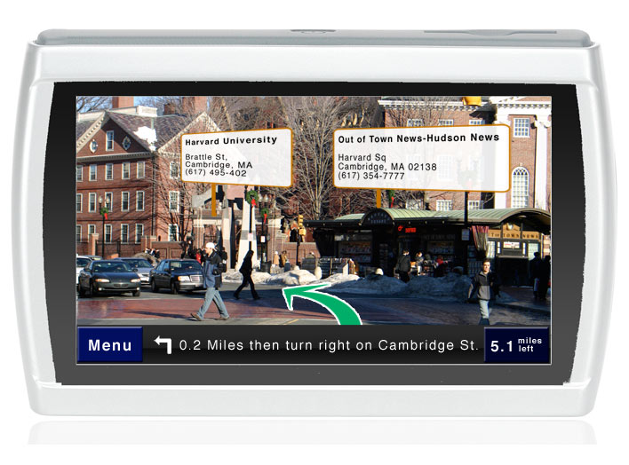
Augmented Reality
A fast growing area of research and development with never before thought of everyday applications.
Applications made possible largely thanks to easily searchable data in the internet, combined with wireless technology.

Slide 3
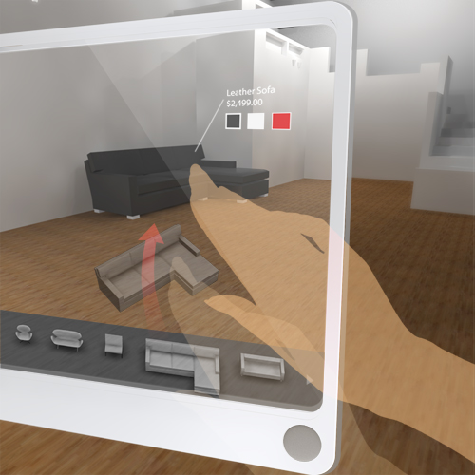
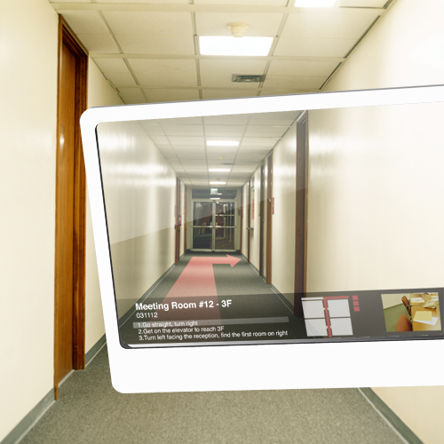
Augmented Reality
Today’s mobile platforms and devices are very powerful.
Access to internet and advanced visual interfaces allow for new ideas to be realised easier than before.

Slide 4
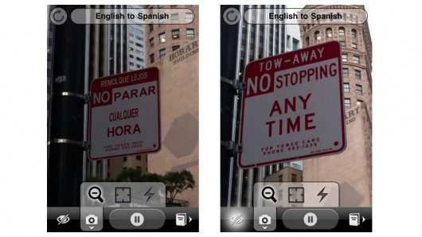
Augmented Reality
Actual example in today’s technology: WordLens, a real time translation app for IPhone.

Slide 5
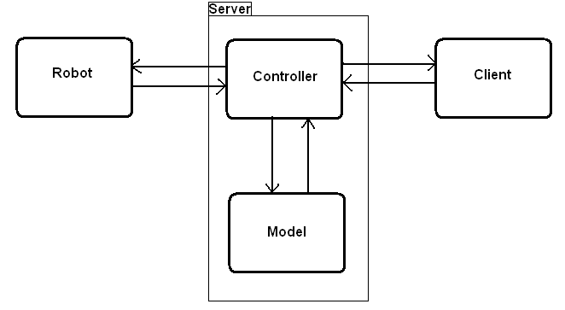
Structure of System – How It Works

Slide 6
The Server Controller
Responsibilities:
Routing of commands and signals
Maintaining network connection between clients and robots
Encoding video to stream to mobile clients
Lobby system and chat room

Slide 7
The Server Model
Stores the logical representation of the robots and their position and heading, and the game state.
Uses the representation of the robots to interact with the virtual elements of the game.
Accepts incoming position updates and robot commands from the controller.

Slide 8
The Server Model
Sends game state updates (bound for the client) and override commands (bound for the robot) all to the controller.
The entire game state is serialized and sent to the Android client, where the changes in the state (represented by 3D OpenGL graphics) are updated on the screen.

Slide 9
Structure of System
Discrete modules with rigidly defined responsibilities.
Easy to test with unit testing (internal functionality only).
For functionality that depend on signals passed in from other modules, stubbing is required for ease of testing.
No unrelated functionality of stub is needed, only meant for injecting all possible signals for given module to process.

Slide 10
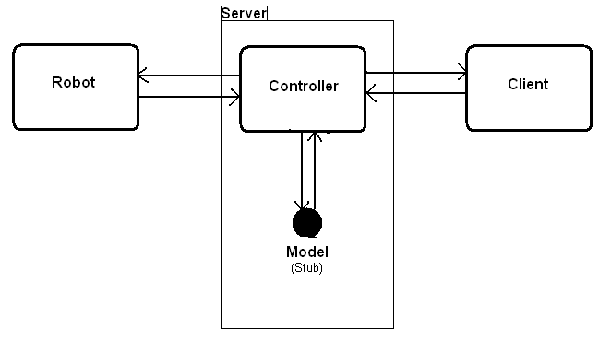
Stubbing of System Modules

Slide 11
Stubbing of System Modules
The model stub
Only one robot
No virtual entities
No command or control restrictions
Meant for easily testing the communication between the client and robot without worrying about broken game logic.

Slide 12
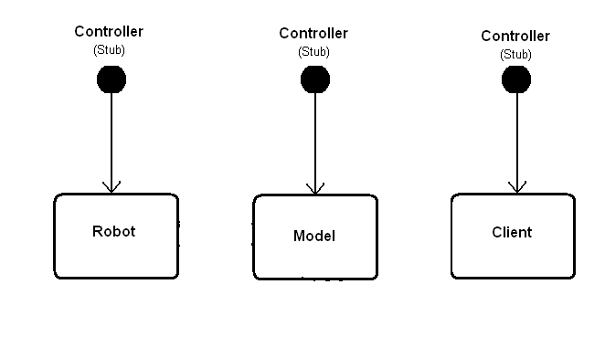
Stubbing of System Modules

Slide 13
Stubbing of System Modules
For testing the outlying modules, stubbing the controller simply involves injecting the set of signals that the given module expects (and some it doesn’t expect).
Unit testing should cover all methods that don’t rely on external signals.

Slide 14
Non-Functional Testing
Other things to consider when testing system wide:
Network Latency
Network Bandtwidth
Performance Issues

Slide 15
References
http://www.raizlabs.com/blog/262/augmented-reality-gps
http://questvisual.com/
http://petitinvention.wordpress.com/2008/08/20/future-of-mobile-search-virtual-shopping-1/

