Slide 1
Topics:
RoboWars
Robotics
Robotics Requirements
Lego NXT 2.0 Mindstorms
Lejos Firmware
Controls And Positioning
Error Corrections
Presented By:
Michael Wright
Notes:
Robots goals
Introduce mindstorm
Mention the firmware
Controls and positioning
Error correction

Slide 2
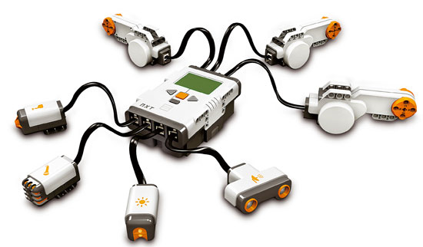
Robotics Requirements
Point Turning
Independent Wheel Control
Wireless communication
Local Position Tracking
Notes:
Need on the spot game turning
Independent wheel control:not building a gearbased turning
Wireless
Need local position tracking to ensure that even when packets are dropped the state remains consistant

Slide 3
Lego NXT 2.0 Mindstroms
Programmable robotics kit
Highly Modifiable
Large number of advanced sensors
Notes:
Lego allows easy to build
Well supported libraries
Infinite possibilities
Lots of external hardware (cameras, compasses’)

Slide 4
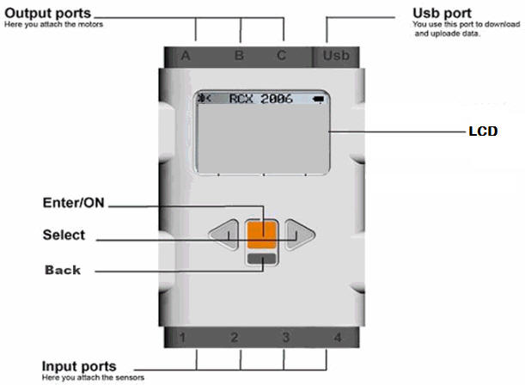
NXT Brick
3 Motor output Ports, 4 Sensor Input Ports
Supports USB 2.0 and Bluetooth 2.1
48MHz microprocessor[m7]
Can support and playback 8Hz sound [m1]
[m6]
Notes:
Up to 7 peripherals
Can communicate with other robots to ensure no collisions
48MHz processor
64KB SRAM
Has embedded microphone and speaker

Slide 5
NXT Sensors And Motors
2 Servo Motors capable of up to 180 rpm unloaded. [m3]
1 Colour sensor capable of reading full 8Bit RGB [m4]
2 Touch Sensors
Ultrasonic Sensor [m5]
[m2]
Notes:
Ultra sonic sensor can see objects and estimate its proximity with in a centimetre
Touch sensors are NOT used
Colour sensor has radius of about a dime, and also contains a floodlight and infrared detection

Slide 6

Lejos Firmware
Open source microcontroller firmware
Provides a JVM for the NXT brick
Has large libraries for position control
Widest support for USB and Bluetooth communication
[m7]
Notes:
Started in 1999, switched to NXT and RCX in 2001
Still many problems
Custom IO was had to be redone.
Adds local JVM using a section of the java library and their own libraries
Provides easy access to USB and Bluetooth
By having the jvm awe avoid having to do our own context switches while having the entire system be thread based

Slide 7
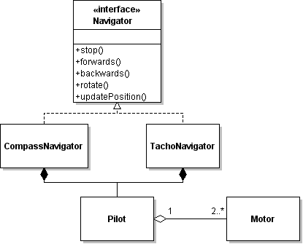
Lejos Navigation Library
Overall Control done by Navigator Interface
Through a pilot motion commands are given
The pilot will then issue the correct action to the individual motors
Notes:
Navigator provides the basic movement, and turning and position control
These are then implemented using concrete interfaces, the most common being Compass and Tachonavigator
These are named after their pilots
Tachonavigator uses deadreconing on the servo motor tachometers where compass uses extra hardware to get heading information
Pilots are used to directly interact with the motors

Slide 8
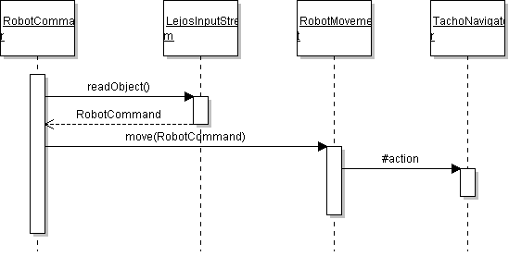
Controls and Positioning
Notes:
Receives a command
Uses the thread safe IO
Provides the command to the thread-safe robot movement
Which then interacts with the navigator
Positions are tracked using a custom data structure (Pose)

Slide 9

Error Correction And The Grid
Errors will be compounded thus must be corrected
Colour Sensor and the grid are used in tandem
Notes:
Travels over grid sampling the colours should the robot detect a dot it snaps its location to the nearest point
Samples 3/s
Grid is programmed and saved in the system, the representation is provided by the server.
Dots on grid are spaced 2cm apart
Heading error cannot be fixed without additional hardware.

Slide 10
Topics:
RoboWars
Future Works
OpenGL integration
Video streaming
Testing
Arena
Additional Robot Integration
Presented By:
Michael Wright
Notes:
Need to start making the client side open GL (Me and steve)
Need to start getting video streaming onto the phone
Need to formalize (lots of testing modules no test plan)
Need to expand the grid
Need to make the server to integrate with 2 robots

Slide 11
References
[1] http://www.htc.com/www/product/desire/specification.html
[2] http://mindstorms.lego.com/en-us/products/default.aspx
[3] http://static.guim.co.uk/sys-images/Technology/Pix/pictures/2009/4/21/1240307015871/Tron-001.jpg
[4] http://1.bp.blogspot.com/_s0SSX3Y2JTw/S-Cv_6lfKVI/AAAAAAAAFE8/SUlrHiF5RUg/s1600/battlezone_1.gif
[5] http://www.logitech.com/en-us/webcam-communications/webcams/devices/6333
[m1] http://shop.lego.com/Product/?p=9841
[m2] http://engk12.ece.missouri.edu/LegoCamp/pictures/NXT%20Robots/LEGO%20NXT%20Brick.jpg
[m3] http://www.philohome.com/nxtmotor/nxtmotor.htm
[m4] http://www.hitechnic.com/cgi-bin/commerce.cgi?preadd=action&key=NCO1038
[m5] http://shop.lego.com/ByTheme/Product.aspx?p=9846&cn=17

Slide 12
References
[m6] http://pirate.shu.edu/~wachsmut/Teaching/CSAS3085/images/nxt-brick-labeled.jpg
[m7] http://christhompson.ca/2009/08/at91sam7s256-aka-the-nxt-brain/

