Slide 1
RoboWars SYSC 4907 Engineering Project
Presented: Monday January 17th, 2011
Development Team:
Alexander Craig Alexander Dinardo
Steve Legere Michael Wright

Slide 2
Topics:
RoboWars Overview
Project Objectives
Proposed Solution
System Architecture
Potential Applications
Presented By: Alexander Craig

Slide 3
Project Objectives
The first project objective is to develop a robotics control system which is both intuitive to use and is implemented on a mobile platform that is widely available and used by the public.
The second project objective is to experiment with the combination of live video and virtually generated, overlaid imagery to enhance the ease of use and feature set of a robotics control system. This technology is commonly referred to as augmented reality.

Slide 4
Solution
To combine these objectives, the project aims to create a system which allows remotely controlled robots to share and interact with a simple virtual world which will be rendered on to a live video feed and displayed to the remote operators.

Slide 5
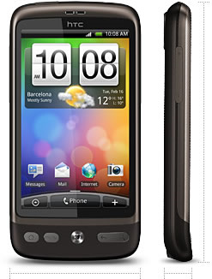
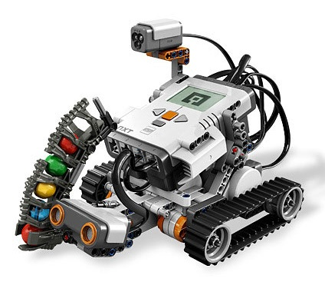
Solution - Hardware
Mobile Client
Robotics
Smart phones running Android version 2.2 [1]
LEGO Mindstorms NXT 2.0 Robotics Kits [2]

Slide 6
Solution – How it Works
Robots are placed into a designated arena, and register wirelessly with the application server.
Mobile users connect to the application server, and are paired to one of the registered robots.
User input is used to generate and send commands to the user’s paired robot.

Slide 7
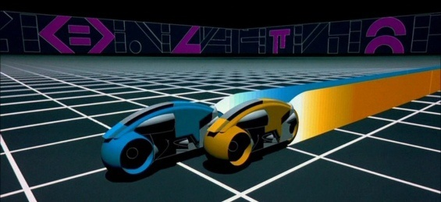
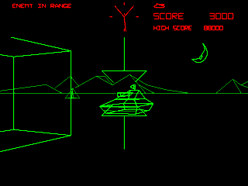
Solution – How it Works
The application server simulates a real-time virtual environment which the robots interact with based on user input and their current position within the arena.
For our prototype, simple video games will be used as the virtual environments. For example:
[3] Light Cycles
[4] Tank Simulation

Slide 8
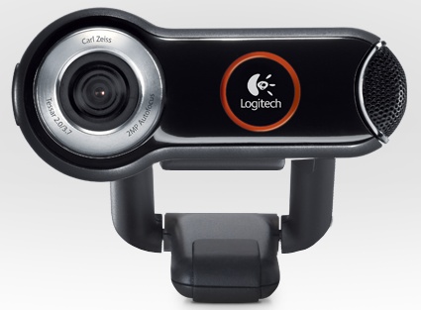
Solution – How it Works
A camera connected to the application server overlooks the robot arena.
The application server streams the video feed and the state of the simulated virtual world to remotely connected clients.
[5] Logitech Quickcam 9000 Pro

Slide 9
Solution – How it Works
The mobile client uses OpenGL to render 3D imagery corresponding to the virtual world state on top of the received live video feed.
The end user uses either an on-screen button display or the tilt sensors in their smartphone to send movement commands to their paired robot.

Slide 10
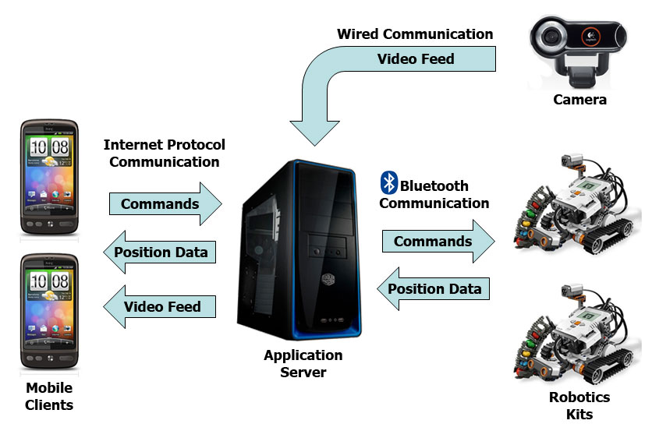
System Architecture

Slide 11
Potential Applications
Although video games are used as the virtual worlds in our prototype, this is not a hard limitation.
Virtual world state could be entirely simulated as in the prototype case, or the virtual world could be used to collaborate sensor information from external sources.

Slide 12
Potential Application Elderly / Disabled Assistance
A virtual world could be used to collaborate with other sensors and appliances in a home environment. For example, stored information might include appliance settings, thermostat settings, the status of lights in various rooms, grocery stocks… etc.
A remotely controlled robotic drone could be used by the elderly or disabled to perform simple tasks around the home such as fetching items or interacting with appliances.

Slide 13
Potential Application Search and Rescue
Robotic drones are a means of performing search and rescue operations in areas which may be hazardous or inaccessible to human personnel.
A virtual world could be used to collaborate sensor information (such as heartbeat sensors, thermal imaging, radar/sonar… etc.), as well as to coordinate the movements of the drones themselves.
A small number of personnel could potentially manage a large number of rescue drones.

Slide 14
Potential Application Security and Surveillance
Robotic drones could be used to augment an existing security system by using a virtual world to collaborate with existing alarm and camera systems.
For example, drones could automatically move toward the site of an alarm until a human operator assumes control.
A mobile client ensures that security personnel can operate the drones regardless of their current position when an alarm is triggered.

Slide 15
Topics:
RoboWars
Robotics
NXT Mindstorms
Lejos Firmware
Controls And Positioning
Error Corrections
Presented By: Michael Wright

Slide 16
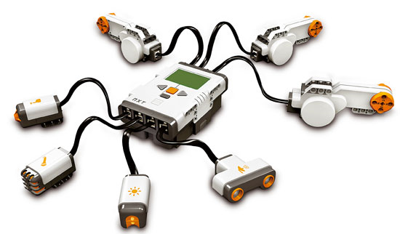
NXT Mindstroms
Programmable robotics kit
Highly Modifiable
Large number of advanced sensors

Slide 17
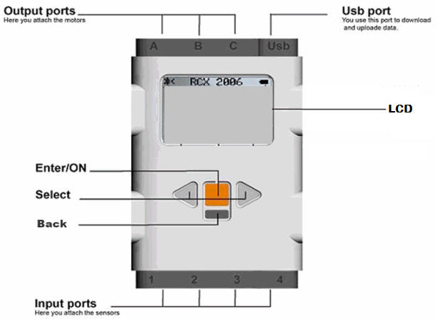
NXT Brick
3 Motor output Ports, 4 Sensor Input Ports
Supports USB 2.0 and Bluetooth 2.1
32Bit microprocessor
Can support and playback 8Hz sound [m1]
[m6]

Slide 18
NXT Sensors And Motors
2 Servo Motors capable of up to 180 rpm unloaded. [m3]
1 Colour sensor capable of reading full 8Bit RGB [m4]
2 Touch Sensors
Ultrasonic Sensor [m5]
[m2]
Notes:
Ultra sonic sensor can see objects and estimate its proximity with in a centimetre
Touch sensors are NOT used
Colour sensor has radius of about a dime, and also contains a floodlight and infrared detection

Slide 19

Lejos Firmware
Open source microprocessor firmware
Provides a JVM for the NXT brick
Has large libraries for position control
Widest support for USB and Bluetooth communication
[m7]
Notes:
Started in 1999, switched to NXT and RCX in 2001
Still many problems
Custom IO was had to be redone.

Slide 20
Controls and Positioning
Commands are received over Bluetooth
They are interpreted and the corresponding wheel movements are performed
Lejos Navigator provides positioning within ±2%
[m7]
Notes:
Started in 1999, switched to NXT and RCX in 2001
Still many problems
Custom IO was had to be redone.

Slide 21

Error Correction And The Grid
Errors will be compounded thus must be corrected
Colour Sensor and the grid are used in tandem
Provides position within ±3mm
Notes:
Travels over grid sampling the colours should the robot detect a dot it snaps its location to the nearest point
Samples 10/s
Grid is programmed and saved in the system, the representation is provided by the server.
Dots on grid are spaced 2cm apart
Heading error cannot be fixed without additional hardware.

Slide 22
References
[1] http://www.htc.com/www/product/desire/specification.html
[2] http://mindstorms.lego.com/en-us/products/default.aspx
[3] http://static.guim.co.uk/sys-images/Technology/Pix/pictures/2009/4/21/1240307015871/Tron-001.jpg
[4] http://1.bp.blogspot.com/_s0SSX3Y2JTw/S-Cv_6lfKVI/AAAAAAAAFE8/SUlrHiF5RUg/s1600/battlezone_1.gif
[5] http://www.logitech.com/en-us/webcam-communications/webcams/devices/6333
[m1] http://shop.lego.com/Product/?p=9841
[m2] http://engk12.ece.missouri.edu/LegoCamp/pictures/NXT%20Robots/LEGO%20NXT%20Brick.jpg
[m3] http://www.philohome.com/nxtmotor/nxtmotor.htm
[m4] http://www.hitechnic.com/cgi-bin/commerce.cgi?preadd=action&key=NCO1038
[m5] http://shop.lego.com/ByTheme/Product.aspx?p=9846&cn=17

Slide 23
References
[m6] http://pirate.shu.edu/~wachsmut/Teaching/CSAS3085/images/nxt-brick-labeled.jpg

