Slide 1
Challenges Facing Cloud Computing
Presented By: Michail Greshishchev
Thursday, March 24th

Slide 2
Security
Reliability
Performance
Interoperability
Challenges Facing Cloud Computing
Michail Greshishchev

Slide 3
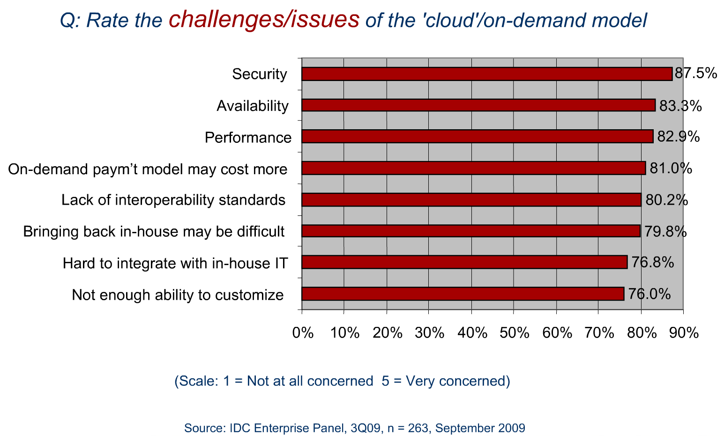
Notes:
Security is the top challenge associated with cloud computing.
Poll by IDC, provider of market intelligence, advisory services, and events for the information technology, telecommunications, and consumer technology markets.

Slide 4



Cloud Computing Security
The benefits of cloud computing often share equivalent security risks.
An employee losing his laptop no longer equates to data loss or a breach of security.
Data loss or breach of security is now a possibility regardless of the laptop’s status.
Notes:
Cloud Computing offering are a double edged sword.

Slide 5
Cloud Computing Security
“For many applications, stringent compliance requirements in areas such as privacy, financial controls, and health information will preclude use of public clouds, regardless of the actual security controls of the provider” (Foley, 2009e).
“It would be difficult to impossible to achieve Payment Card Industry (PCI) compliance in a cloud … given the requirements for understanding … and controlling access to the systems and the credit-card data.“ (Mackey, 2010)
Notes:
Other examples:
Public or private health care providers, government bodies.
Customers are ultimately responsible for the security and integrity of their own data, even when it is held by a service provider.
Privileged user access by cloud administrators implies your information is as secure as those who are entrusted to access it.

Slide 6
Cloud Computing Security
No cloud-specific security standards in place.
Outsourced services bypass the physical, logical and personnel control IT shops exert over in-house programs.
Notes:
Lack of standards don’t allow for quantitative analysis of security.

Slide 7

Cloud Computing Reliability
Reliability metrics
Downtime
Planned / Unplanned
Data retention
Data corruption prevention
Highly dependent on Cloud Computing service provided.
Notes:
Measured in 9’s
Planned = scheduled maintenance
Data redundancy, error correction

Slide 8
Cloud Computing Reliability
Downtime
“Recent large outages at Amazon and Google have shown that even the largest cloud vendors can still have glitches that take considerable time to repair. ” (Enki, 2010)
“Despite claims of reliability, few cloud vendors have tight service level agreements that promise controlled downtime or offer rebates for excess downtime. ” (Enki, 2010)
Notes:
SLAs invariably can’t cover actual business losses from downtime or outages “is a rationalization, not a reason” for not engaging the cloud computing model.

Slide 9
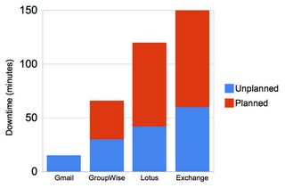
Cloud Computing Reliability
In general, cloud reliability issues arise from introduced system complexity relative to identical offerings on a local scale.
Although Reliability in cloud computing is a major concern, it is a strong selling point. (Sun, 2010)

Slide 10

Cloud Computing Performance
Performance metrics applicable to cloud computing:
Response Time in normal and abnormal stress conditions.
Network latency, Cloud processing delays, data loss
Computing Performance
There is no standard for cloud computing metrics. (Fogarty, 2010)
Notes:
Highly dependent on cloud computing service being provided

Slide 11
Cloud Computing Performance
Quality of Service in combination with qualitative analysis would be the ideal benchmark for Cloud Computing services.
QoS: The ability of a network (including applications, hosts, and infrastructure devices) to deliver traffic with minimum delay and maximum availability.
Notes:
Example: “Image rendering is 50% faster but scrolling provides image artifacts.”
^ QoS ^ Qualitative

Slide 12
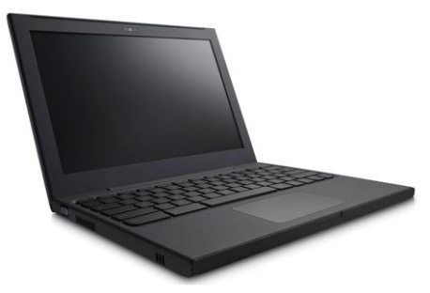

Cloud Computing Performance
Cloud computing is the future for low power, high efficiency, and low cost consumer electronics.
Google Chrome Notebook
OnLive video game console

Slide 13

Cloud Computing Interoperability
"There are different clouds from companies such as Microsoft, Amazon, … and Google, but a lack of interoperability between them.“ (Cerf, 2010)
Applications are not compatible between clouds.
No standards here, either…
few cloud standards organizations, such as the Open Cloud Consortium, are looking to drive some interoperability standards
Notes:
There are a number of ways to deal with the proliferation of cloud APIs. Cohen proposes a "unified cloud interface," or cloud broker, that implements industry standard definitions. Dave Powers, an IT pro with Eli Lilly, talks of a third-party "orchestration layer" as a way of managing multiple cloud services. Clouds within clouds?

Slide 14
References:
Mackey, Dick (2010). “Moving to the Cloud: An Introduction to Cloud Computing in Government” Retrieved Mar. 15, 2011 from http://www.etransform.org/gti/sites/etransform.org/files/Documents/2010-07%20IBM%20Business%20of%20Gov%20-%20Cloud%20Computing%20in%20Government.pdf
Foley, John (2009a). “How government’s driving cloud computing ahead.” InformationWeek, July 4, 2009. retrieved July 14, 2009, from informationweek.com/news/government/technology/showArticle.jhtml?articleiD=218400025.
IDC “Cloud Computing 2010. An IDC Update” Retrieved Mar. 16, 2011 from http://www.slideshare.net/JorFigOr/cloud-computing-2010-an-idc-update
Fogarty, Kevin (2010). “Cloud performance metrics: No standards, so mileage varies.” Retrieved March 21, 2011, from http://www.networksasia.net/content/cloud-performance-metrics-no-standards-so-mileage-varies
Sun, Raymond J (2010). “Cloud Computing: Looking for Security, Reliability and Resiliency” Retrieved March 21, 2011, from http://www.baselinemag.com/c/a/Utility-Computing/Cloud-Computing-Looking-for-Security-Reliability-Resiliency-466013/

