Slide 1
Grid Computing An Introduction and History
Presented: Thursday March 24th, 2011
Presented By: Michael Wright

Slide 2
What Is “Grid” Computing
Standardization
Early History
Stagnation
Growth
Modern Grid Systems
Grid Computing An Introduction And History
Michael Wright

Slide 3
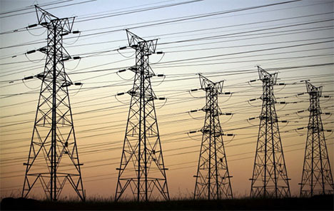
What Is “Grid” Computing
Grid computing is a series of independent computers working together through sharing resources to achieve more than could be achieved independently.
Can be likened to an Electrical Grid.

Slide 4
Requirements
There have been three requirements for a true grid computing system [1]:
Resource Allocation: Coordinates resources that are not under centralized control
Protocols and Middleware: Must use open, standardized general purpose protocols and interfaces
Deliver nominal quality of service: Must be able to provide quality greater than the sum of its parts

Slide 5

Standardization
The key to growth in Grid computing is the use of standardized middleware [2].
Managed by the Open Grid Forum
Current Standards are stated in the Open Grid Standard Architecture (OSGA)

Slide 6
Early History
First discussed in the 1960’s by Len Klienrock
“We will probably see the spread of ‘computer utilities’, which, like present electric and telephone utilities, will service individual homes and offices across the country”[1]
First grid computing system was implemented in 1969 by researchers at UCLA with 15 leading universities connected by the end of 1970 [3]
Was designed to “Pool the computer power, programs and specialized know how”

Slide 7
Stagnation
Due to Costs and technology available grids were unable to proliferate over the following 20 years
Through the 1980s technologies were created to provide growth in the 1990s [4]
Parallel processing was unable to compare the potential power of parallel computing, thus technologies were created to enable this
Parallel Virtual Machine
Message Passing Interface
High performance fortran
High performance Routing

Slide 8
Growth
The first modern grid computing network was I-YAM in 1995
Based out of Chicago it connected 17 research centers for two weeks
Was a development that ““knitted” the sites “into a single virtual system,” so users could “log on once, locate suitable computers, reserve time, load application codes, and then monitor their execution.””[5]
With a proof of concept mass funding was provided to develop similar systems.

Slide 9
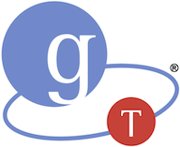
Growth
Globus Toolkit [5]
Developed in 1997
Software to enable this knitting
Served as the basis for grids provided by NASA, National Science Foundation, and Department of Energy
Serves as the standard middleware for most modern grid computing systems

Slide 10
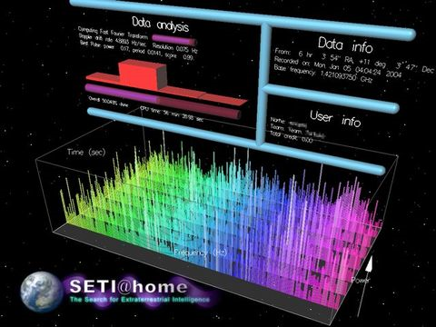
Modern Grid Computing Systems
SETI@home Project [6]
Started in 1999
Uses grid computing to power to scan radio waves to detect extraterrestrial intelligence.
Provides a combined power of 514.7 TeraFLOPS
Notes:
Currently has 1,168,821 active users
Joined by downloading the SETI@home screensaver

Slide 11
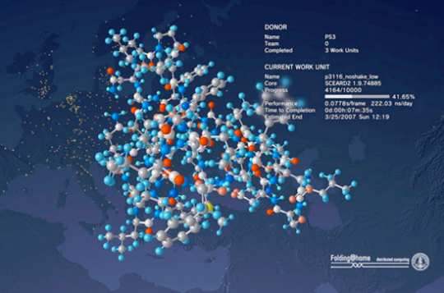
Modern Grid Computing Systems
Folding@home Project [7]
Started in 2000
Uses grid computing to power to do protien folding and other molecular dynamics.
Provides a combined power of 5.0 PetaFLOPS
Notes:
Currently has 6,046,720 active users
Joined by downloading and enabling the Folding@home toolbar (or the google compute toolbar)

Slide 12
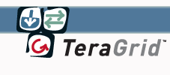
Modern Grid Computing Systems
TeraGrid [8]
Used by universities to provide high quality persistant research computing
Conisists of 11 universities with its head quarters at the university of Chicago
Provides 2.5PetaFlops of power with 50 PetaBytes of storage and reaserchers have access to 100 research specific databases.

Slide 13
Grids and Clouds: Similarities and Differences
Presented By: Alexander Craig
Thursday, March 24th

Slide 14
Grids and Clouds: Similarities and Differences
What is a Cloud system?
How are Cloud systems similar to Grid systems?
How do Cloud systems differ from Grid Systems?
Alexander Craig

Slide 15
What is a Cloud computing System?
A combination of two ideas [9]:
Grid Computing: A system to link networks of computers into a single, large processing infrastructure.
Utility Computing: Paying for processing power per usage, much like a public utility such as gas or electricity.
With the addition of:
On-Demand Resource Provisioning: Processing resources can be allocated to clients based on usage requirements in real-time.

Slide 16
What is a Cloud Computing System?
Characteristics [10]:
Scalability: Cloud systems are massively scalable.
Economies of Scale: Cloud systems are feasible because of reduced operating cost due to economies of scale.
Software as a Service: Cloud systems can be encapsulated as an abstract entity that offers services to outside customers (the internal hardware in abstracted away from a client perspective)
On-Demand Load Balancing: Cloud services can be dynamically configured and delivered on demand (usually through virtualization)

Slide 17
Similarities
Both paradigms share a similar vision: To reduce costs, increase flexibility and increase reliability by delivering computational power as a utility operated by a third party.
Both paradigms face many of the same implementation challenges.

Slide 18
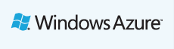
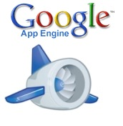

Differing Scales
Cloud systems operate at a greater scale than traditional grid systems.
Cloud computing is largely feasible because of significant financial investment in distributed data centers by industry leaders.
Examples of currently available Cloud solutions [11][12][13]

Slide 19
Business Model
Clouds: Customers pay for processing power on a consumption basis. Resources are dynamically provisioned, and customers pay only for what they use.
Grids: Distribution of resources is project oriented, and projects must submit proposals to obtain a fixed number of service units (ex. CPU hours).
TeraGrid is a scientific computing Grid with 11 partner sites in North America [14]
Notes:
TeraGrid is an open scientific discovery infrastructure combining leadership class resources at 11 partner sites to create an integrated, persistent computational resource.
Using high-performance network connections, TeraGrid integrates high-performance computers, data resources and tools, and high-end experimental facilities around the country. Currently, TeraGrid resources include more than 2.5 petaflops of computing capability and more than 50 petabytes of online and archival data storag

Slide 20
Scheduling Model
Clouds: All resources in the cloud are shared by all users at all times. Loads are dynamically balanced based on the real-time requirements of user applications.
Grids: Grids typically use a batch-scheduled model, where batch jobs are scheduled to have dedicated access to specific hardware for a specific amount of time or processing units.
Notes:
TeraGrid is an open scientific discovery infrastructure combining leadership class resources at 11 partner sites to create an integrated, persistent computational resource.
Using high-performance network connections, TeraGrid integrates high-performance computers, data resources and tools, and high-end experimental facilities around the country. Currently, TeraGrid resources include more than 2.5 petaflops of computing capability and more than 50 petabytes of online and archival data storag

Slide 21
Virtualization
Clouds need to run great numbers (up to thousands of millions) of user applications which must appear to run simultaneously.
This is accomplished through virtualization, or software which allows underlying hardware to be abstracted into a pool of shared resources.
Notes:
Grids make less use of virtualization, as hardware is heterogeneous and under separate control of multiple authorities.
While performance limited this technique in the past, hardware support for virtualization now makes this technique feasible.

Slide 22
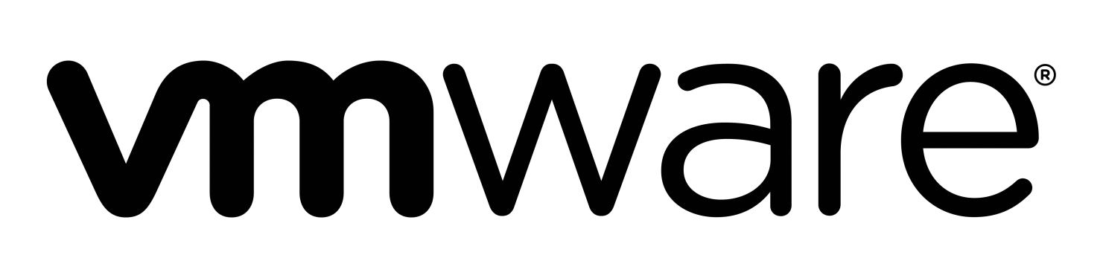
Virtualization
For example, a single server machine may use virtualization to run multiple virtual instances and appear to clients as multiple servers (much the same way that threads allow a single processor to appear as multiple parallel processors)
An example of currently available virtualization software [15]

Slide 23
Application Model
Although both paradigms can be used for a wide variety of applications, some general trends can be noted:
Clouds: Applications tend to be loosely coupled, transaction oriented (many small and relatively quick tasks), and interactive.
Grids: Grids support a wide range of applications, but jobs tend to be batch scheduled and non-interactive.
Notes:
TeraGrid is an open scientific discovery infrastructure combining leadership class resources at 11 partner sites to create an integrated, persistent computational resource.
Using high-performance network connections, TeraGrid integrates high-performance computers, data resources and tools, and high-end experimental facilities around the country. Currently, TeraGrid resources include more than 2.5 petaflops of computing capability and more than 50 petabytes of online and archival data storag

Slide 24
Interoperability
Clouds: Cloud are generally operated by a single provider with homogenous hardware. No standardized interfaces exist between the major cloud providers, leading to interoperability issues.
Grids: Interoperability and security are primary concerns. Grid sites are often run by separate administrative authorities with heterogeneous hardware, and therefore the use of standardized interfaces, protocols, toolsets, and middleware is essential.
Notes:
TeraGrid is an open scientific discovery infrastructure combining leadership class resources at 11 partner sites to create an integrated, persistent computational resource.
Using high-performance network connections, TeraGrid integrates high-performance computers, data resources and tools, and high-end experimental facilities around the country. Currently, TeraGrid resources include more than 2.5 petaflops of computing capability and more than 50 petabytes of online and archival data storag

Slide 25
Challenges Facing Cloud Computing
Presented By: Michail Greshishchev
Thursday, March 24th

Slide 26
Security
Reliability
Performance
Interoperability
Challenges Facing Cloud Computing
Michail Greshishchev

Slide 27
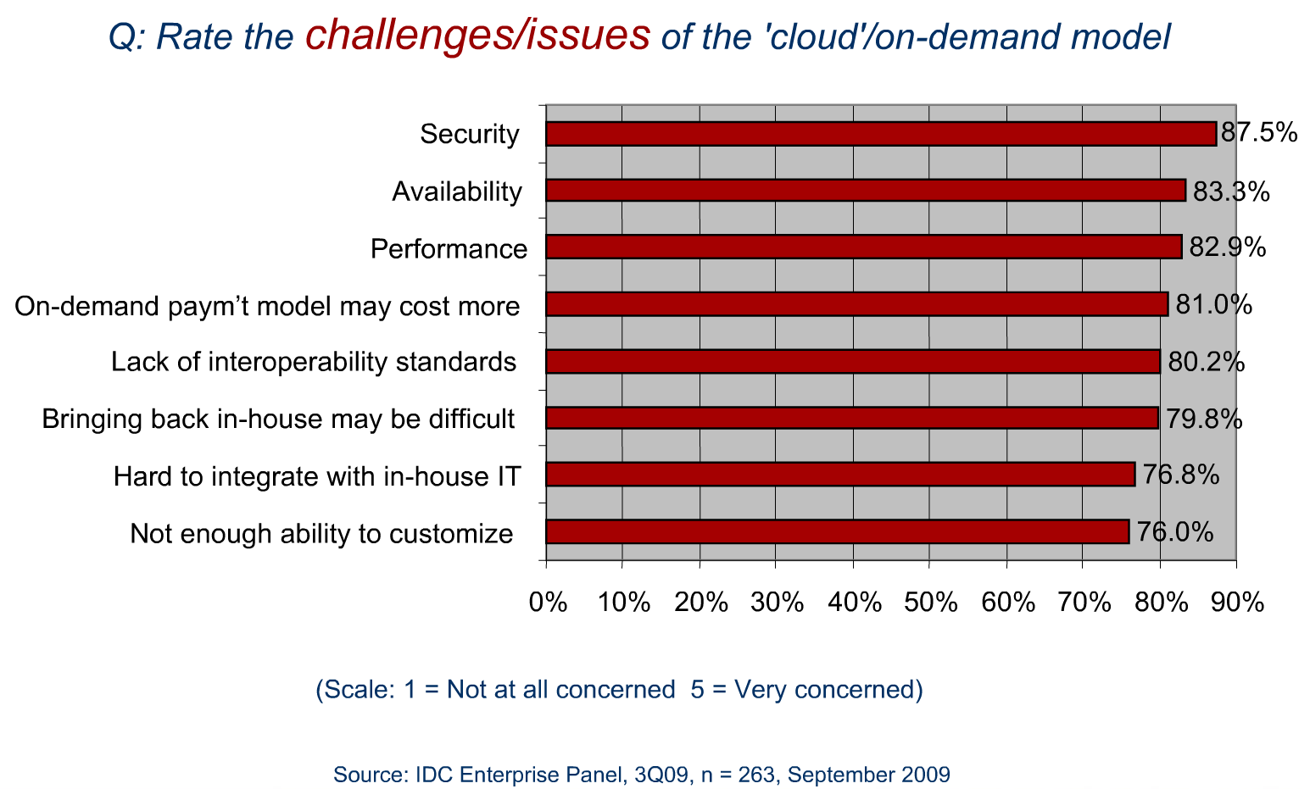
Notes:
Security is the top challenge associated with cloud computing.
Poll by IDC, provider of market intelligence, advisory services, and events for the information technology, telecommunications, and consumer technology markets.

Slide 28
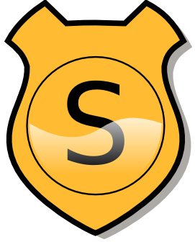


Cloud Computing Security
The benefits of cloud computing often share equivalent security risks.
An employee losing his laptop no longer equates to data loss or a breach of security.
Data loss or breach of security is now a possibility regardless of the laptop’s status.
Notes:
Cloud Computing offering are a double edged sword.

Slide 29
Cloud Computing Security
“For many applications, stringent compliance requirements in areas such as privacy, financial controls, and health information will preclude use of public clouds, regardless of the actual security controls of the provider” [16]
“It would be difficult to impossible to achieve Payment Card Industry (PCI) compliance in a cloud … given the requirements for understanding … and controlling access to the systems and the credit-card data.“ [17]
Notes:
Other examples:
Public or private health care providers, government bodies.
Customers are ultimately responsible for the security and integrity of their own data, even when it is held by a service provider.
Privileged user access by cloud administrators implies your information is as secure as those who are entrusted to access it.

Slide 30
Cloud Computing Security
No cloud-specific security standards in place.
Outsourced services bypass the physical, logical and personnel control IT shops exert over in-house programs.
Notes:
Lack of standards don’t allow for quantitative analysis of security.

Slide 31
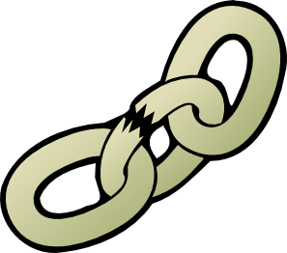
Cloud Computing Reliability
Reliability metrics
Downtime
Planned / Unplanned
Data retention
Data corruption prevention
Highly dependent on Cloud Computing service provided.
Notes:
Measured in 9’s
Planned = scheduled maintenance
Data redundancy, error correction

Slide 32
Cloud Computing Reliability
Downtime
“Recent large outages at Amazon and Google have shown that even the largest cloud vendors can still have glitches that take considerable time to repair. ” [18]
“Despite claims of reliability, few cloud vendors have tight service level agreements that promise controlled downtime or offer rebates for excess downtime. ” [18]
Notes:
SLAs invariably can’t cover actual business losses from downtime or outages “is a rationalization, not a reason” for not engaging the cloud computing model.

Slide 33
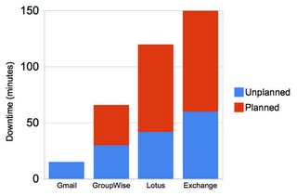
Cloud Computing Reliability
In general, cloud reliability issues arise from introduced system complexity relative to identical offerings on a local scale.
Although Reliability in cloud computing is a major concern, it is a strong selling point. [19]

Slide 34

Cloud Computing Performance
Performance metrics applicable to cloud computing:
Response Time in normal and abnormal stress conditions.
Network latency, Cloud processing delays, data loss
Computing Performance
There is no standard for cloud computing metrics. [20]
Notes:
Highly dependent on cloud computing service being provided

Slide 35
Cloud Computing Performance
Quality of Service in combination with qualitative analysis would be the ideal benchmark for Cloud Computing services.
QoS: The ability of a network (including applications, hosts, and infrastructure devices) to deliver traffic with minimum delay and maximum availability.
Notes:
Example: “Image rendering is 50% faster but scrolling provides image artifacts.”
^ QoS ^ Qualitative

Slide 36
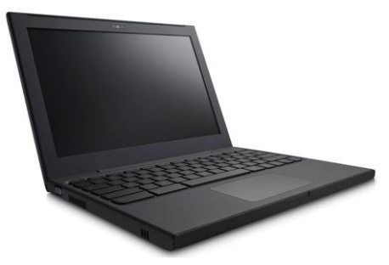
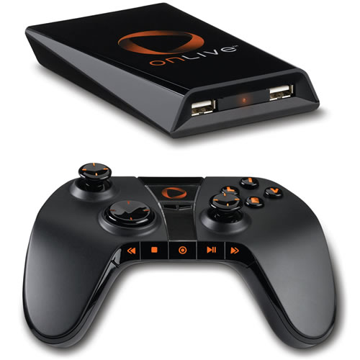
Cloud Computing Performance
Cloud computing is the future for low power, high efficiency, and low cost consumer electronics.
Google Chrome Notebook
OnLive video game console

Slide 37
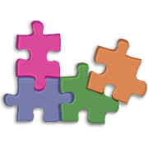
Cloud Computing Interoperability
"There are different clouds from companies such as Microsoft, Amazon, … and Google, but a lack of interoperability between them.“ [21]
Applications are not compatible between clouds.
No standards here, either…
few cloud standards organizations, such as the Open Cloud Consortium, are looking to drive some interoperability standards
Notes:
There are a number of ways to deal with the proliferation of cloud APIs. Cohen proposes a "unified cloud interface," or cloud broker, that implements industry standard definitions. Dave Powers, an IT pro with Eli Lilly, talks of a third-party "orchestration layer" as a way of managing multiple cloud services. Clouds within clouds?

Slide 38
Questions?

Slide 39
References:
[1] I, Foster. (2002)“What is The Grid? A Three Point Checklist”, Available: http://dlib.cs.odu.edu/WhatIsTheGrid.pdf, Accessed March 17, 2011
[2]”OGF Standards”, Available: http://www.gridforum.org/standards/, Accessed March 17,2011
[3] (1969), “UCLA Set To Be First Station In Nationwide Network” Available: http://www.lk.cs.ucla.edu/LK/Bib/REPORT/press.htm;. Accessed March 19, 2011
[4]F, Bernman, G. Cox. (2003). “Grid computing: making the global infrastructure a reality“. Available: http://books.google.ca/books?id=b4LWXLRBRLsC&lpg=PA12&ots=GSLfF7U8RW&dq=grid%20computing%201980s&pg=PP1#v=onepage&q=grid%20computing%201980s&f=false Accessed: March 19, 2011.
[5]A. Braverman, (2007). ”Father of the Grid” Available: http://magazine.uchicago.edu/0404/features/index.shtml, Accessed March 20, 2011.
[6] “Seti@Home”, Available: http://boincstats.com/stats/project_graph.php?pr=sah, Accessed: March 2011
[7] “Folding@home”, Available: http://folding.stanford.edu/, Accessed: March 20, 2011
[8] “TeraGrod”, Available: https://www.teragrid.org/, Accessed: March 20,2011

Slide 40
References:
[9] “Cloud computing versus grid computing,” http://www.ibm.com/developerworks/web/library/wa-cloudgrid/ Accessed Mar. 15, 2011.
[10] I. Foster, Y. Zhao, I. Raicu, S. Lu, ”Cloud Computing and Grid Computing 360 – Degree Compared,” in Proceedings of the Grid Computing Environments Workshop, 2008. GCE '08 , pp. 1 – 10, Austin, TX, Nov. 12 – 16, 2008.
[11] “Windows Azure | Microsoft Platform Hosting,” http://www.microsoft.com/windowsazure/windowsazure/ Accessed Mar. 15, 2011.
[12] “Amazon Elastic Compute Cloud (Amazon EC2),” http://aws.amazon.com/ec2/ Accessed Mar. 15, 2011.
[13] “Google App Engine,” http://code.google.com/appengine/ Accessed Mar. 15, 2011.
[14] “TeraGrid”, https://www.teragrid.org/ Accessed Mar. 15, 2011.
[15] “VMWare Virtualization Software”, http://www.vmware.com/ Accessed Mar. 15, 2011.

Slide 41
References:
[16] Foley, John (2009a). “How government’s driving cloud computing ahead.” InformationWeek, July 4, 2009. retrieved July 14, 2009, from informationweek.com/news/government/technology/showArticle.jhtml?articleiD=218400025.
[17] Mackey, Dick (2010). “Moving to the Cloud: An Introduction to Cloud Computing in Government” Retrieved Mar. 15, 2011 from http://www.etransform.org/gti/sites/etransform.org/files/Documents/2010-07%20IBM%20Business%20of%20Gov%20-%20Cloud%20Computing%20in%20Government.pdf
[19] Sun, Raymond J (2010). “Cloud Computing: Looking for Security, Reliability and Resiliency” Retrieved March 21, 2011, from http://www.baselinemag.com/c/a/Utility-Computing/Cloud-Computing-Looking-for-Security-Reliability-Resiliency-466013/
[18] Enki(2010). “RELIABILITY AND CLOUD COMPUTING” Retrieved March 21, 2011, from http://www.enki.co/blog/reliability-and-cloud-computing.html
[20] Fogarty, Kevin (2010). “Cloud performance metrics: No standards, so mileage varies.” Retrieved March 21, 2011, from http://www.networksasia.net/content/cloud-performance-metrics-no-standards-so-mileage-varies
[21] IDC “Cloud Computing 2010. An IDC Update” Retrieved Mar. 16, 2011 from http://www.slideshare.net/JorFigOr/cloud-computing-2010-an-idc-update

