Slide 1
Grids and Clouds: Similarities and Differences
Presented By: Alexander Craig
Thursday, March 24th

Slide 2
Grids and Clouds: Similarities and Differences
What is a Cloud system?
How are Cloud systems similar to Grid systems?
How do Cloud systems differ from Grid Systems?
Alexander Craig

Slide 3
What is a Cloud computing system?
A combination of two ideas [ac1]:
Grid Computing: A system to link networks of computers into a single, large processing infrastructure.
Utility Computing: Paying for processing power per usage, much like a public utility such as gas or electricity.
With the addition of:
On-Demand Resource Provisioning: Processing resources can be allocated to clients based on usage requirements in real-time.

Slide 4
What is a Cloud computing system?
“A large-scale distributed computing paradigm this is driven by economies of scale, in which a pool of abstracted, virtualized, dynamically scalable, managed computing power, storage, platforms, and services are delivered on demand to external customers over the internet.” [ac2]

Slide 5
Distinguishing Features of Cloud Computing Systems
Scalability: Cloud systems are massively scalable.
Economies of scale: Cloud systems are feasible because of reduced operating cost due to economies of scale.
Software as a Service: Cloud systems can be encapsulated as an abstract entity that offers services to outside customers (the internal hardware in abstracted away from a client perspective)
On-Demand Load Balancing: Cloud services can be dynamically configured and delivered on demand (usually through virtualization)

Slide 6
Clouds and Grids: Similarities
Both paradigms share a similar vision: To reduce costs, increase flexibility and increase reliability by delivering computational power as a utility operated by a third party.
Both paradigms face many of the same implementation challenges.

Slide 7
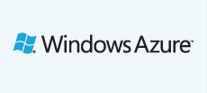
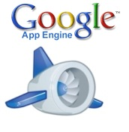

Clouds and Grids: Differing Scales
Cloud systems operate at a greater scale than traditional grid systems.
Cloud computing is largely feasible because of significant financial investment in distributed data centers by industry leaders.
Examples of currently available Cloud solutions [ac3][ac4][ac5]

Slide 8
Clouds and Grids: Scheduling Model
Clouds: All resources in the cloud are shared by all users at all times. Loads are dynamically balanced based on the real-time requirements of user applications.
Grids: Grids typically use a batch-scheduled model, where batch jobs are scheduled to have dedicated access to specific hardware for a specific amount of time or processing units.
Notes:
TeraGrid is an open scientific discovery infrastructure combining leadership class resources at 11 partner sites to create an integrated, persistent computational resource.
Using high-performance network connections, TeraGrid integrates high-performance computers, data resources and tools, and high-end experimental facilities around the country. Currently, TeraGrid resources include more than 2.5 petaflops of computing capability and more than 50 petabytes of online and archival data storag

Slide 9
Virtualization
Clouds need to run great numbers (up to thousands of millions) of user applications which must appear to run simultaneously.
This is accomplished through virtualization, or software which allows underlying hardware to be abstracted into a pool of shared resources.
While performance limited this technique in the past, hardware support for virtualization now makes this technique feasible.
Notes:
Grids make less use of virtualization, as hardware is heterogeneous and under separate control of multiple authorities.

Slide 10
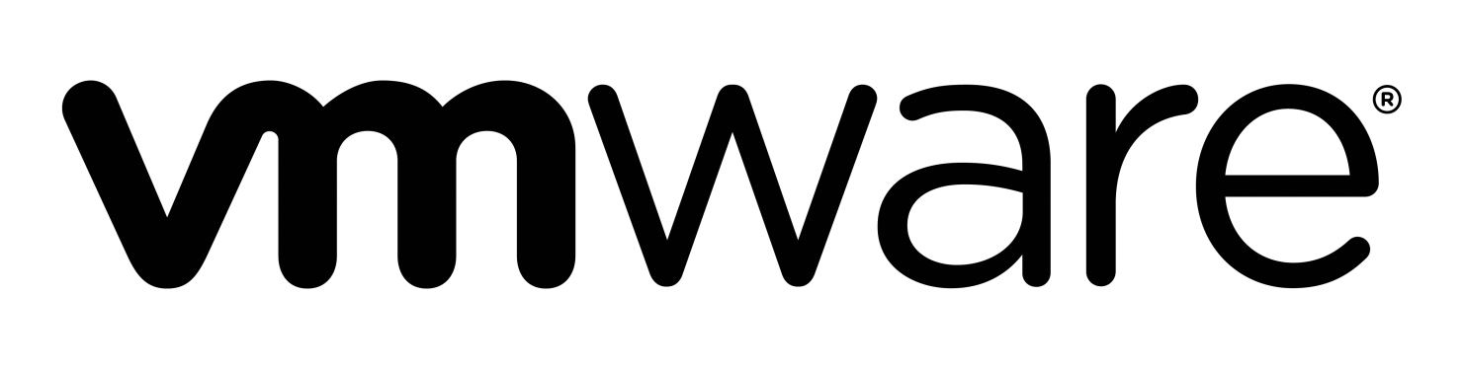
Virtualization
For example, a single server machine may use virtualization to run multiple virtual instances and appear to clients as multiple servers (much the same way that threads allow a single processor to appear as multiple parallel processors)
An example of currently available virtualization software [ac6]

Slide 11
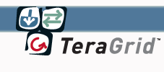
Clouds and Grids: Business Model
Clouds: Customers pay for processing power on a consumption basis. Resources are dynamically provisioned, and customers pay only for what they use.
Grids: Distribution of resources is project oriented, and projects must submit proposals to obtain a fixed number of service units (ex. CPU hours).
TeraGrid is a scientific computing Grid with 11 partner sites in North America [ac7]
Notes:
TeraGrid is an open scientific discovery infrastructure combining leadership class resources at 11 partner sites to create an integrated, persistent computational resource.
Using high-performance network connections, TeraGrid integrates high-performance computers, data resources and tools, and high-end experimental facilities around the country. Currently, TeraGrid resources include more than 2.5 petaflops of computing capability and more than 50 petabytes of online and archival data storag

Slide 12
Clouds and Grids: Application Model
Although both paradigms can be used for a wide variety of applications, some general trends can be noted:
Clouds: Applications tend to be loosely coupled, transaction oriented (many small and relatively quick tasks), and interactive.
Grids: Grids support a wide range of applications, but jobs tend to be batch scheduled and non-interactive.
Notes:
TeraGrid is an open scientific discovery infrastructure combining leadership class resources at 11 partner sites to create an integrated, persistent computational resource.
Using high-performance network connections, TeraGrid integrates high-performance computers, data resources and tools, and high-end experimental facilities around the country. Currently, TeraGrid resources include more than 2.5 petaflops of computing capability and more than 50 petabytes of online and archival data storag

Slide 13
Clouds and Grids: Interoperability
Clouds: Cloud are generally operated by a single provider with homogenous hardware. No standardized interfaces exist between the major cloud providers, leading to interoperability issues.
Grids: Interoperability and security are primary concerns. Grid sites are often run by separate administrative authorities with heterogeneous hardware, and therefore the use of standardized interfaces, protocols, toolsets, and middleware is essential.
Notes:
TeraGrid is an open scientific discovery infrastructure combining leadership class resources at 11 partner sites to create an integrated, persistent computational resource.
Using high-performance network connections, TeraGrid integrates high-performance computers, data resources and tools, and high-end experimental facilities around the country. Currently, TeraGrid resources include more than 2.5 petaflops of computing capability and more than 50 petabytes of online and archival data storag

Slide 14
References:
[ac1] “Cloud computing versus grid computing,” http://www.ibm.com/developerworks/web/library/wa-cloudgrid/ Accessed Mar. 15, 2011
[ac2] I. Foster, Y. Zhao, I. Raicu, S. Lu, ”Cloud Computing and Grid Computing 360 – Degree Compared,” in Proceedings of the Grid Computing Environments Workshop, 2008. GCE '08 , pp. 1 – 10, Austin, TX, Nov. 12 – 16, 2008.
[ac3] “Windows Azure | Microsoft Platform Hosting,” http://www.microsoft.com/windowsazure/windowsazure/ Accessed Mar. 15, 2011
[ac4] “Amazon Elastic Compute Cloud (Amazon EC2),” http://aws.amazon.com/ec2/ Accessed Mar. 15, 2011
[ac5] “Google App Engine,” http://code.google.com/appengine/ Accessed Mar. 15, 2011
[ac6] “VMWare Virtualization Software”, http://www.vmware.com/ Accessed Mar. 15, 2011
[ac7] “TeraGrid”, https://www.teragrid.org/ Accessed Mar. 15, 2011

