Slide 1
Grid Computing An Introduction and History
Presented: Thursday March 24th, 2011
Presented By: Michael Wright

Slide 2
What Is “Grid” Computing
Standardization
Early History
Stagnation
Growth
Modern Grid Systems
Grid Computing An Introduction And History
Michael Wright

Slide 3
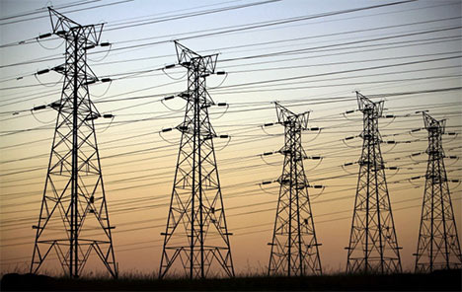
What Is “Grid” Computing
Grid computing is a series of independent computers working together through sharing resources to achieve more than could be achieved independently.
Can be likened to an Electrical Grid.

Slide 4
Requirements
There have been three requirements for a true grid computing system [mw1]:
Resource Allocation: Coordinates resources that are not under centralized control
Protocols and Middleware: Must use open, standardized general purpose protocols and interfaces
Deliver nominal quality of service: Must be able to provide quality greater than the sum of its parts

Slide 5

Standardization
The key to growth in Grid computing is the use of standardized middleware[mw2].
Managed by the Open Grid Forum
Current Standards are stated in the Open Grid Standard Architecture (OSGA)

Slide 6
Early History
First discussed in the 1960’s by Len Klienrock
“We will probably see the spread of ‘computer utilities’, which, like present electric and telephone utilities, will service individual homes and offices across the country”[mw1]
First grid computing system was implemented in 1969 by researchers at UCLA with 15 leading universities connected by the end of 1970 [mw3]
Was designed to “Pool the computer power, programs and specialized know how”

Slide 7
Stagnation
Due to Costs and technology available grids were unable to proliferate over the following 20 years
Through the 1980s technologies were created to provide growth in the 1990s [mw4]
Parallel processing was unable to compare the potential power of parallel computing, thus technologies were created to enable this
Parallel Virtual Machine
Message Passing Interface
High performance fortran
High performance Routing

Slide 8
Growth
The first modern grid computing network was I-YAM in 1995
Based out of Chicago it connected 17 research centers for two weeks
Was a development that ““knitted” the sites “into a single virtual system,” so users could “log on once, locate suitable computers, reserve time, load application codes, and then monitor their execution.””[mw5]
With a proof of concept mass funding was provided to develop similar systems.

Slide 9

Growth
Globus Toolkit [mw5]
Developed in 1997
Software to enable this knitting
Served as the basis for grids provided by NASA, National Science Foundation, and Department of Energy
Serves as the standard middleware for most modern grid computing systems

Slide 10
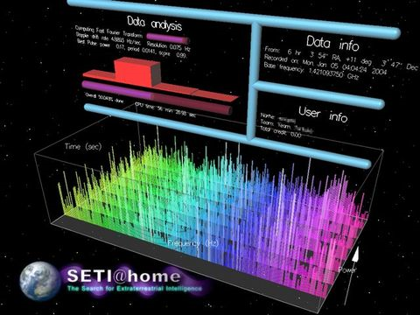
Modern Grid Computing Systems
SETI@home Project [mw6]
Started in 1999
Uses grid computing to power to scan radio waves to detect extraterrestrial intelligence.
Provides a combined power of 514.7 TeraFLOPS
Notes:
Currently has 1,168,821 active users
Joined by downloading the SETI@home screensaver

Slide 11
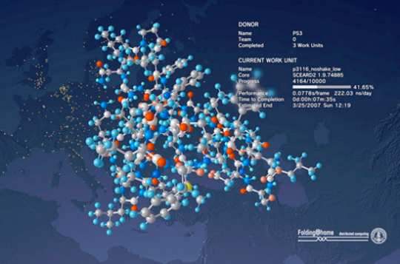
Modern Grid Computing Systems
Folding@home Project [mw7]
Started in 2000
Uses grid computing to power to do protien folding and other molecular dynamics.
Provides a combined power of 5.0 PetaFLOPS
Notes:
Currently has 6,046,720 active users
Joined by downloading and enabling the Folding@home toolbar (or the google compute toolbar)

Slide 12

Modern Grid Computing Systems
TeraGrid [mw8]
Used by universities to provide high quality persistant research computing
Conisists of 11 universities with its head quarters at the university of Chicago
Provides 2.5PetaFlops of power with 50 PetaBytes of storage and reaserchers have access to 100 research specific databases.

Slide 13
References
[mw1] http://dlib.cs.odu.edu/WhatIsTheGrid.pdf
[mw2] http://www.gridforum.org/standards/
[mw3] http://www.lk.cs.ucla.edu/LK/Bib/REPORT/press.html
[mw4] http://books.google.ca/books?id=b4LWXLRBRLsC&lpg=PA12&ots=GSLfF7U8RW&dq=grid%20computing%201980s&pg=PP1#v=onepage&q=grid%20computing%201980s&f=false
[mw5] http://magazine.uchicago.edu/0404/features/index.shtml
[mw6] http://boincstats.com/stats/project_graph.php?pr=sah
[mw7] http://folding.stanford.edu/
[mw8] https://www.teragrid.org/

