Slide 1


Text Mining and Analysis of Political Discourse Using the LIAR Dataset
Alexandre crivellari
Andrea muscio

Slide 2
Table of contents
Introduction
Dataset Structure and preprocessing
Text Classification
Topic Modeling
Results and Discussions
Conclusions

Slide 3
Introduction

Slide 4
Introduction
Background
The spread of information in the digital age, especially political discourse, has led to the urgent need for automated fact-checking systems and analysis.
Objective
Develop and evaluate machine learning models for classifying political statements and applying topic modeling to distinguish between true and false statements.

Slide 5
Dataset structure and preprocessing

Slide 6
Dataset structure and preprocessing
Dataset: LIAR dataset with 12,836 statements labeled by veracity.
Features: Statements are categorized with metadata including speaker, political affiliation, and context.
Preprocessing: Text cleaning, tokenization, stop-word removal, lemmatization, and handling missing values.
Class Imbalance: Addressed by binarizing labels and using SMOTE for Random Forest and class weighting for RoBERTa.

Slide 7
Dataset structure and preprocessing
id: A unique identifier for each statement.
label: The veracity label assigned to the statement (pants-fire, false, barely-true, half-true, mostly-true, true).
statement: The text of the statement being fact-checked.
subject: The topic or subject area of the statement.
speaker: The name of the person who made the statement.
job_title: The job title or position of the speaker.
state_info: The state or location relevant to the statement.
party_affiliation: The political party affiliation of the speaker.
barely_true_counts, false_counts, half_true_counts, mostly_true_counts, pants_on_fire_counts: Historical count of the speaker's statements in each veracity category.
context: Additional contextual information about where or when the statement was made.

Slide 8
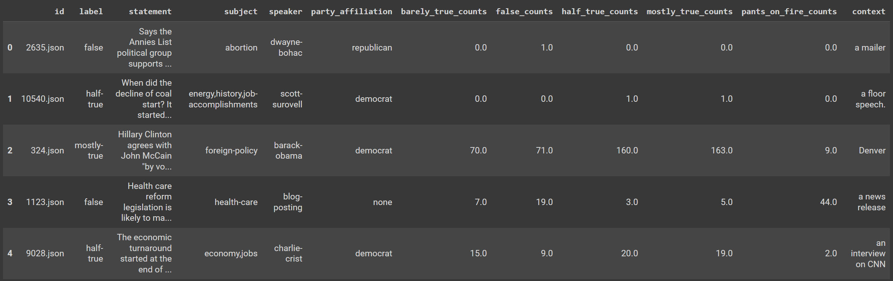
Dataset structure and preprocessing

Slide 9
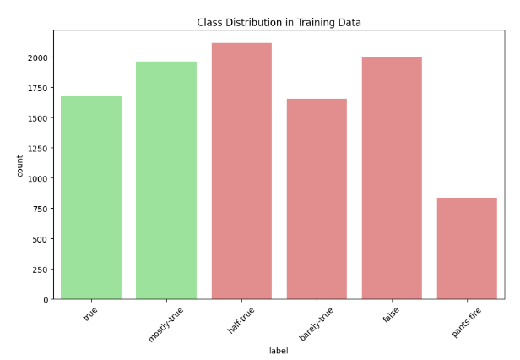
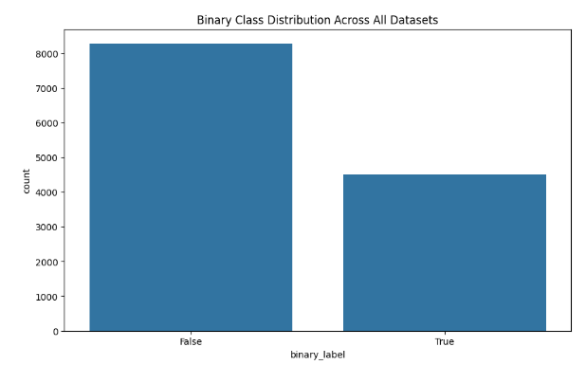
Dataset structure and preprocessing
As shown in the figure above, our initial dataset exhibited considerable class imbalance across the six veracity labels.
To prevent potentially skew of our model's and simplify our classification task, we decided to binarize our labels. We grouped 'true' and 'mostly-true' into a single 'True' category, while 'half-true', 'barely-true', 'false', and 'pants-fire' were consolidated into a 'False' category.

Slide 10
Dataset structure and preprocessing
Feature engineering
Statement Length:
A new feature was created to represent the length of each statement, which could help identify differences in verbosity between true and false statements.
Aggregated Counts:
Individual count features were combined into a single 'total_statements' feature to reflect a speaker's overall activity and history.Text
Vectorization:
The TF-IDF method was used for text vectorization in the random forest classifier, with a cap of 5000 features to balance detail and computational efficiency.
Numerical Feature Scaling:
Standardscaler was applied to normalize numerical features, ensuring consistency in scale and preventing any feature from disproportionately influencing the model.

Slide 11
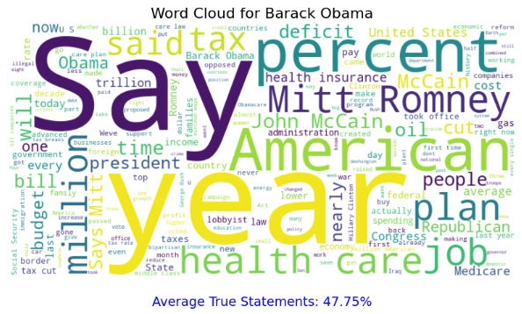
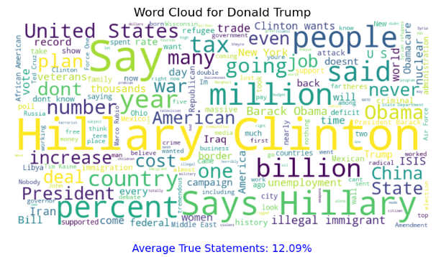
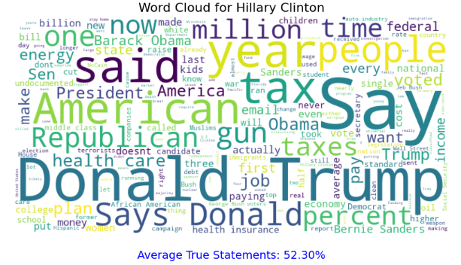
Dataset structure and preprocessing

Slide 12
Text classification

Slide 13
Text classification
Random Forest Classifier:
Traditional machine learning model, robust in handling high-dimensional data. Utilizes feature engineering and data balancing techniques.
RoBERTa Model:
Advanced deep learning model based on a pre-trained BERT variant. Optimized for language understanding tasks with tokenization and sequence classification.
Both models are evaluated using accuracy, precision, recall, F1-score, and AUC-ROC.

Slide 14

Text classification
Random Forest Classifier
Approach:
Feature Combination: Merged TF-IDF vectors with numerical features.
Class Imbalance Handling: Applied SMOTE to balance the dataset.
Model Training: Utilized 100 trees in a Random Forest, trained on resampled data.
Hyperparameter Tuning: Performed cross-validation to optimize the model.
Strengths:
Handles high-dimensional data effectively.
Benefits from feature engineering and ensemble learning.

Slide 15

Text classification
Roberta model
Approach:
Tokenization: Encoded statements with RobertaTokenizer, limiting to 128 tokens.
Model Architecture: Utilized RoBERTa with an added classification head for sequence classification.
Training Process: Trained for 3 epochs with AdamW optimizer, leveraging class weighting.
GPU Acceleration: Employed CUDA-enabled GPU for faster training.
Strengths:
Leverages advanced deep learning techniques.
Excels in understanding language context and semantics.

Slide 16
Topic modeling

Slide 17

Topic modeling
Latent Dirichlet Allocation (LDA)
For our topic modeling analysis, we employed Latent Dirichlet Allocation (LDA), a probabilistic model that discovers latent topics in a collection of documents.
Corpus Preparation:
Separate corpora for all, true, and false statements.
Dictionary Creation:
Generated dictionaries for each corpus, filtering out rare/common words.
Document-Term Matrix:
Converted text to bag-of-words representation.
Model Training:
Trained three LDA models (general, true, false statements) with 5 topics, 10 passes, Alpha: 'auto', Random state: 42.
Topic Interpretation:
Extracted top 10 words per topic for thematic analysis.
VISUALIZATION:
Used pyLDAvis for interactive exploration of topics.

Slide 18
Topic modeling
EVALUATIOn
Perplexity:
A statistical measure of how well a probability model predicts a sample. Lower perplexity indicates better generalization performance.
Coherence Score:
Measures semantic similarity between top words in each topic.
TOPIC INTERPRETABILITY:
Assessed by examining the relevance of top words to political discourse.

Slide 19
Results and
discussion

Slide 20
Results and discussion
Text classification results
Random Forest Classifier:
Accuracy: 72.69% Precision: 65.28% Recall: 48.99% F1-Score: 55.98% AUC-ROC: 0.7691
RoBERTa Model:
Accuracy: 61.17 %
Precision: 45.87 %
Recall: 53.23 %
F1-Score: 49.28 %
AUC-ROC: 0.5938

Slide 21
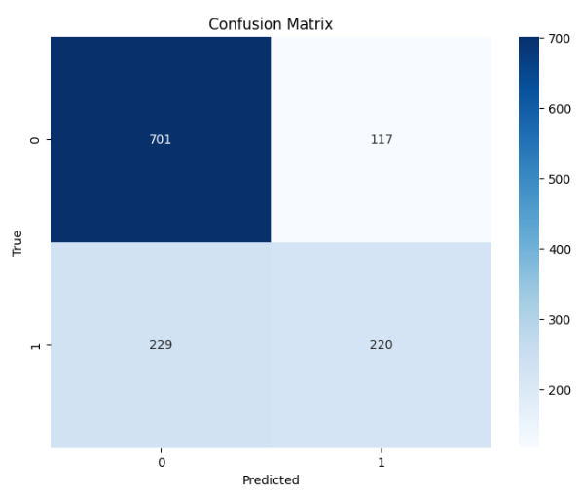
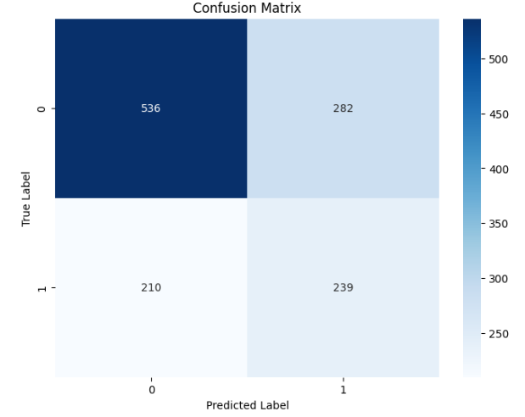
Results and discussion
Text classification results

Slide 22
Results and discussion
Text classification results interpretation
Random Forest's Superior Performance: Achieved 72.69% accuracy and a 0.769 AUC-ROC, outperforming RoBERTa, which had 61.17% accuracy and a 0.5938 AUC-ROC. This suggests that traditional machine learning with engineered features can sometimes surpass deep learning models in specialized tasks like political fact-checking.
Feature Importance in Random Forest: Utilized TF-IDF vectors and metadata effectively, capturing crucial domain-specific knowledge.
Challenges for RoBERTa: While strong in language understanding, RoBERTa struggled with fact-checking tasks that require external knowledge and context.
Precision vs. Recall: Random Forest prioritized precision, making it more conservative in true classifications, which is beneficial in minimizing false positives.

Slide 23
Results and discussion
Topic modeling performance overview
Topic 1:
Economic and Fiscal Policy (say, percent, tax, million, people, would, billion, bill, cut, texas)
Topic 2:
Healthcare Policy and Presidential Politics (Obama, health, president, care, time, Barack, voted, insurance, dollar, party)
Topic 5:
Education and State Governance (since, school, Florida, budget, plan, want, public, security, number, governor)
Topic 3:
State-Level Politics and Employment state (job, new, wisconsin, united, rate, clinton, gov, america, cost)
Topic 4:
Political Spending and Partisan Issues (year, one, get, last, democrat, money, spending, like, illegal, administration)

Slide 24
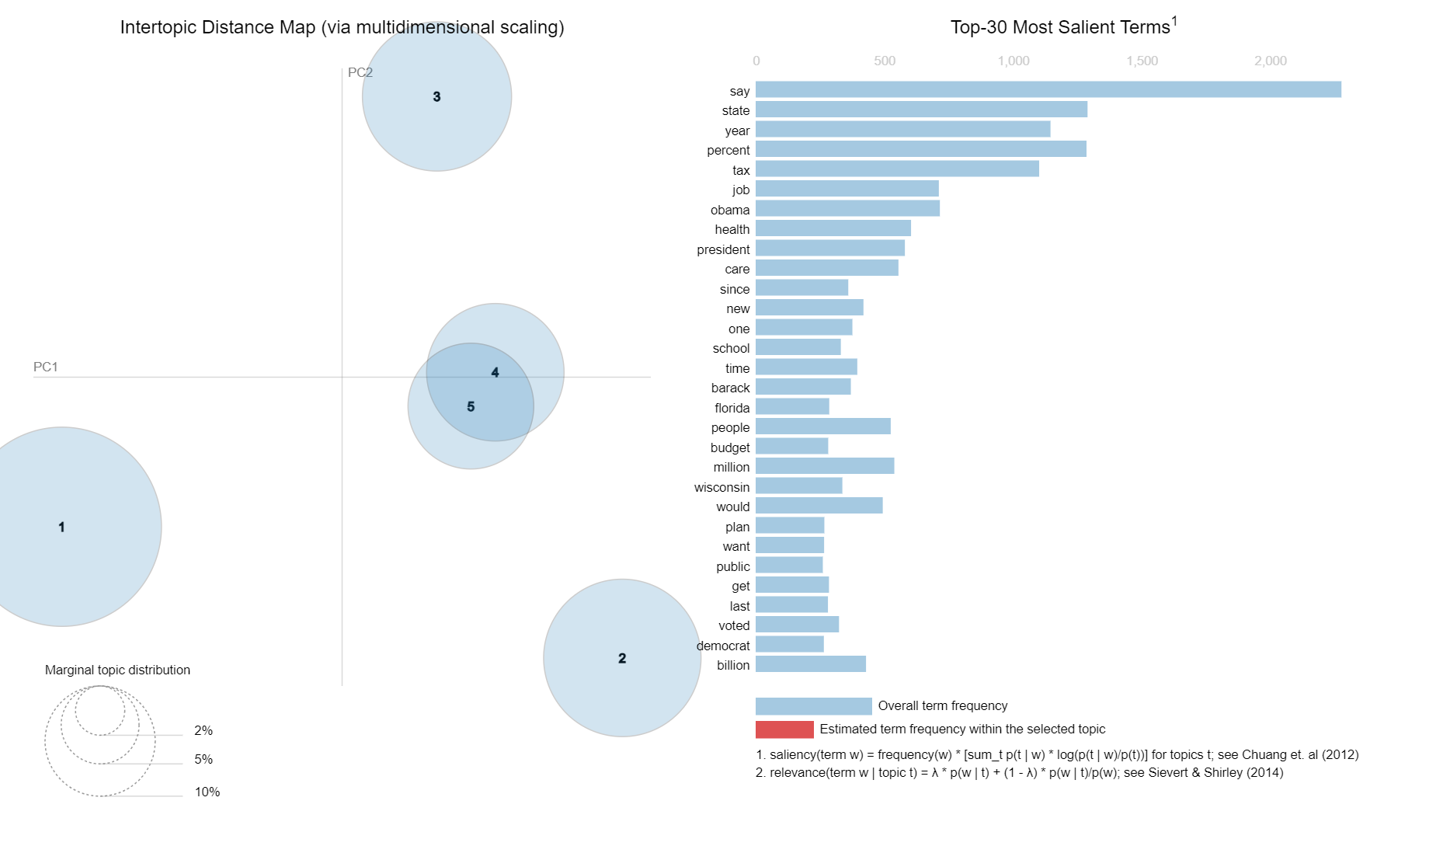
Results and discussion
Overall statements
Topic 1:
Economic and Fiscal Policy say, percent, tax, million, people, would, billion, bill, cut, texas)
Topic 2:
Political Spending and Partisan Issues (year, one, get, last, democrat, money, spending, like, illegal, administration)
Topic 5:
Healthcare Policy and Presidential Politics obama, health, president, care, time, barack, voted, insurance, dollar, party)
Topic 3:
State-Level Politics and Employment state, job, new, wisconsin, united, rate, clinton, gov, america, cost)
Topic 4:
Education and State Governance (since, school, florida, budget, plan, want, public, security, number, governor)

Slide 25
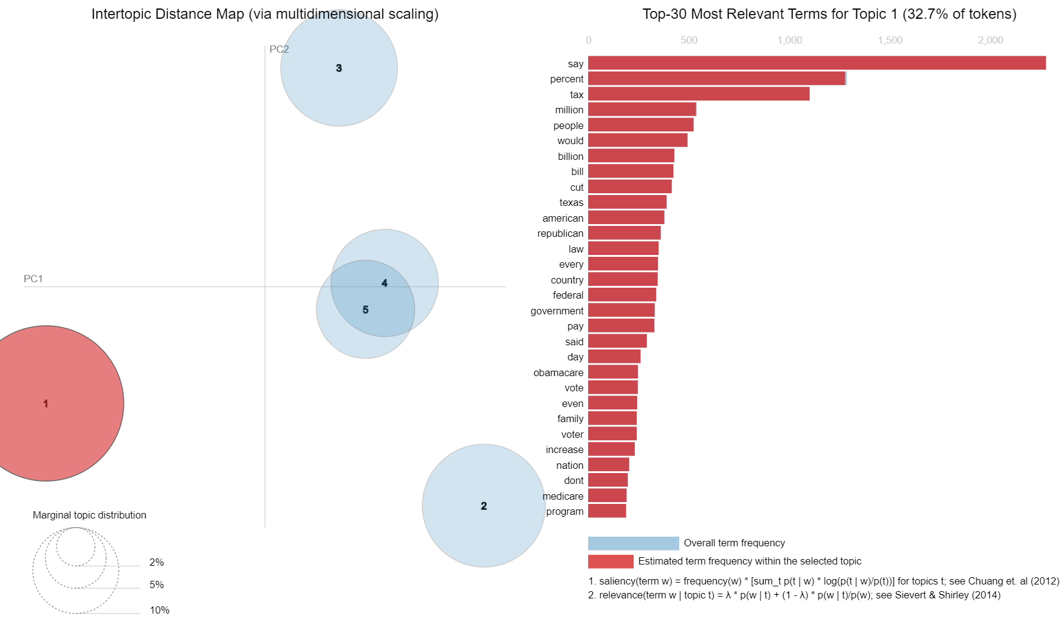
Results and discussion
Overall statements- Topic 1
Topic 1:
Economic and Fiscal Policy say, percent, tax, million, people, would, billion, bill, cut, texas)
Topic 2:
Political Spending and Partisan Issues (year, one, get, last, democrat, money, spending, like, illegal, administration)
Topic 5:
Healthcare Policy and Presidential Politics obama, health, president, care, time, barack, voted, insurance, dollar, party)
Topic 3:
State-Level Politics and Employment state, job, new, wisconsin, united, rate, clinton, gov, america, cost)
Topic 4:
Education and State Governance (since, school, florida, budget, plan, want, public, security, number, governor)

Slide 26
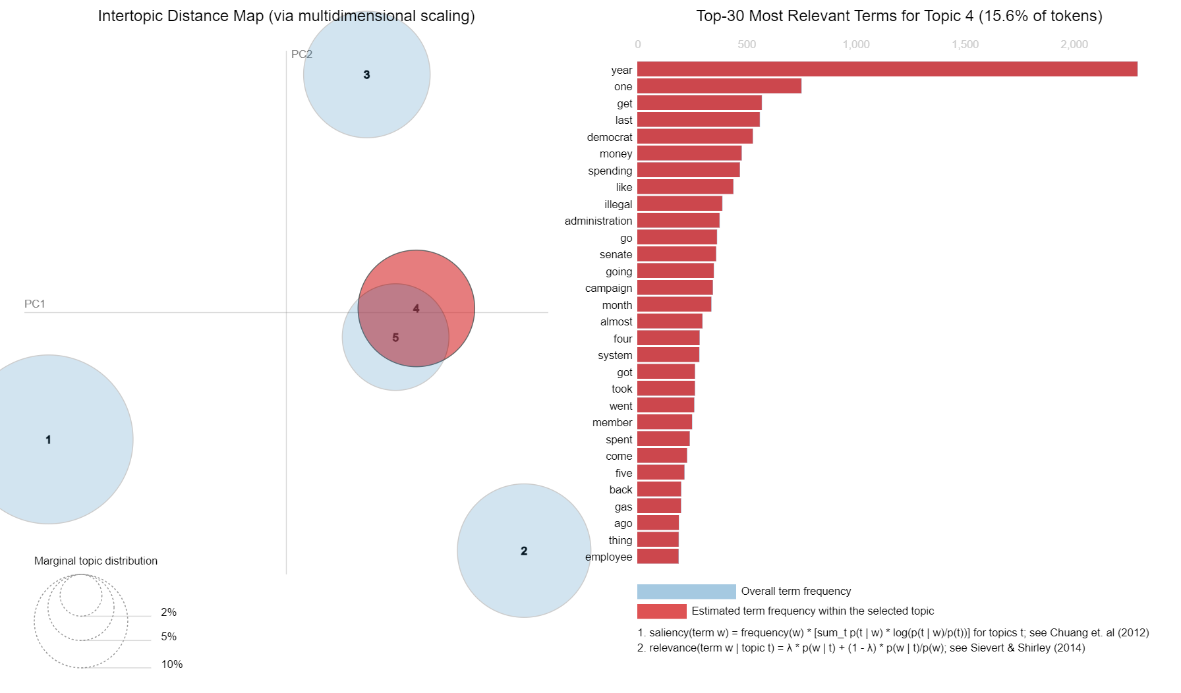
Results and discussion
Overall statements
Topic 1:
Economic and Fiscal Policy say, percent, tax, million, people, would, billion, bill, cut, texas)
Topic 2:
Political Spending and Partisan Issues (year, one, get, last, democrat, money, spending, like, illegal, administration)
Topic 5:
Healthcare Policy and Presidential Politics obama, health, president, care, time, barack, voted, insurance, dollar, party)
Topic 3:
State-Level Politics and Employment state, job, new, wisconsin, united, rate, clinton, gov, america, cost)
Topic 4:
Education and State Governance (since, school, florida, budget, plan, want, public, security, number, governor)

Slide 27
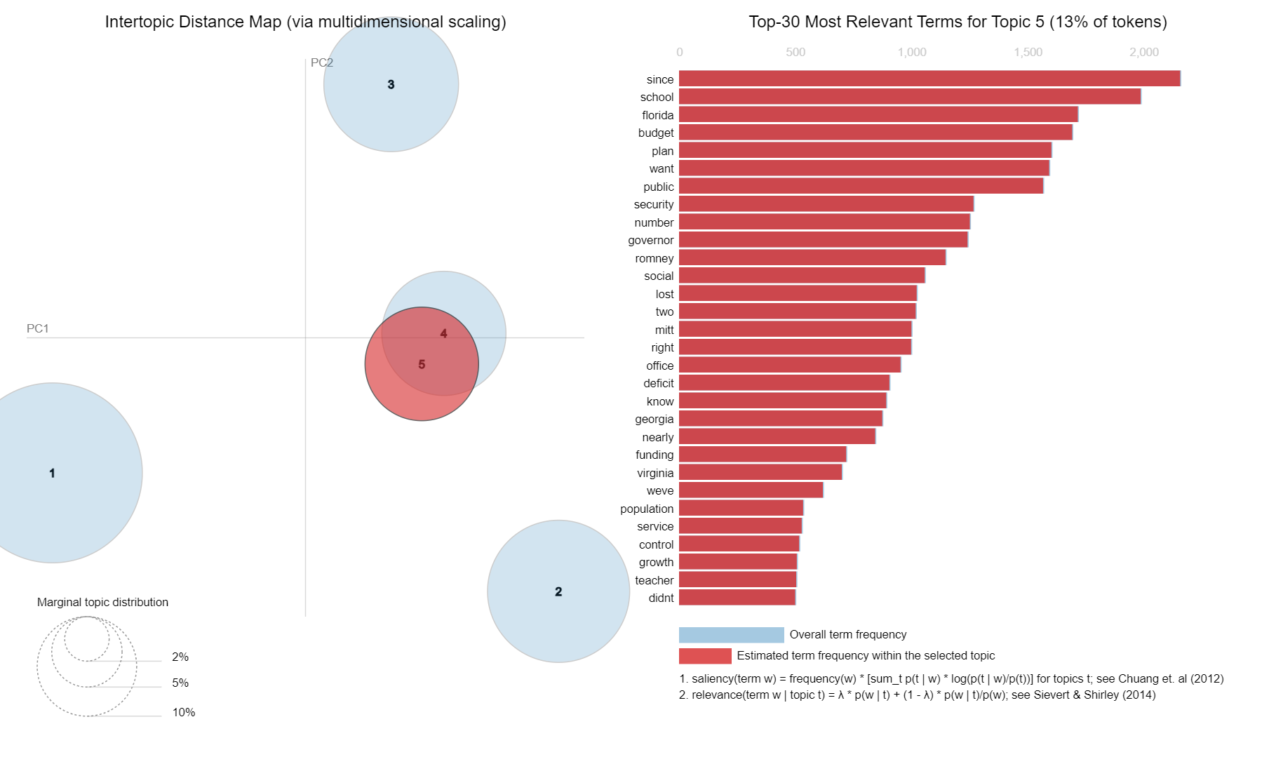
Results and discussion
Overall statements
Topic 1:
Economic and Fiscal Policy say, percent, tax, million, people, would, billion, bill, cut, texas)
Topic 2:
Political Spending and Partisan Issues (year, one, get, last, democrat, money, spending, like, illegal, administration)
Topic 5:
Healthcare Policy and Presidential Politics obama, health, president, care, time, barack, voted, insurance, dollar, party)
Topic 3:
State-Level Politics and Employment state, job, new, wisconsin, united, rate, clinton, gov, america, cost)
Topic 4:
Education and State Governance (since, school, florida, budget, plan, want, public, security, number, governor)

Slide 28
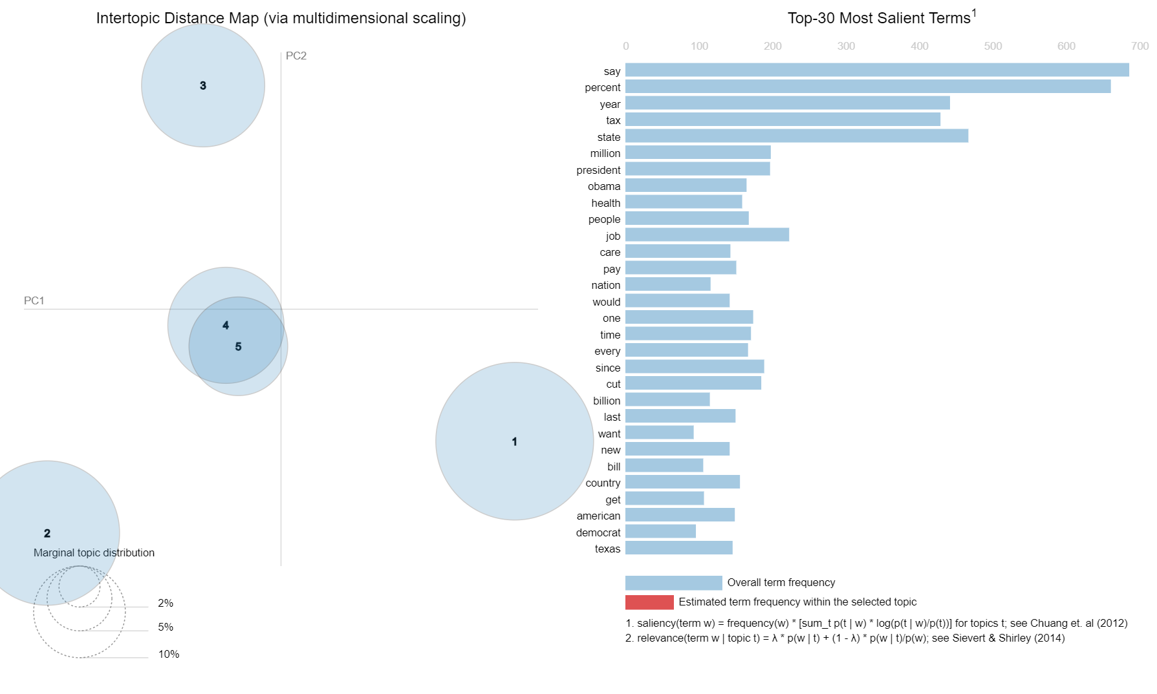
Results and discussion
true statements
Topic 1:
Economic and Fiscal Policy say, percent, tax, million, people, would, billion, bill, cut, texas)
Topic 2:
Political Spending and Partisan Issues (year, one, get, last, democrat, money, spending, like, illegal, administration)
Topic 5:
Healthcare Policy and Presidential Politics obama, health, president, care, time, barack, voted, insurance, dollar, party)
Topic 3:
State-Level Politics and Employment state, job, new, wisconsin, united, rate, clinton, gov, america, cost)
Topic 4:
Education and State Governance (since, school, florida, budget, plan, want, public, security, number, governor)

Slide 29
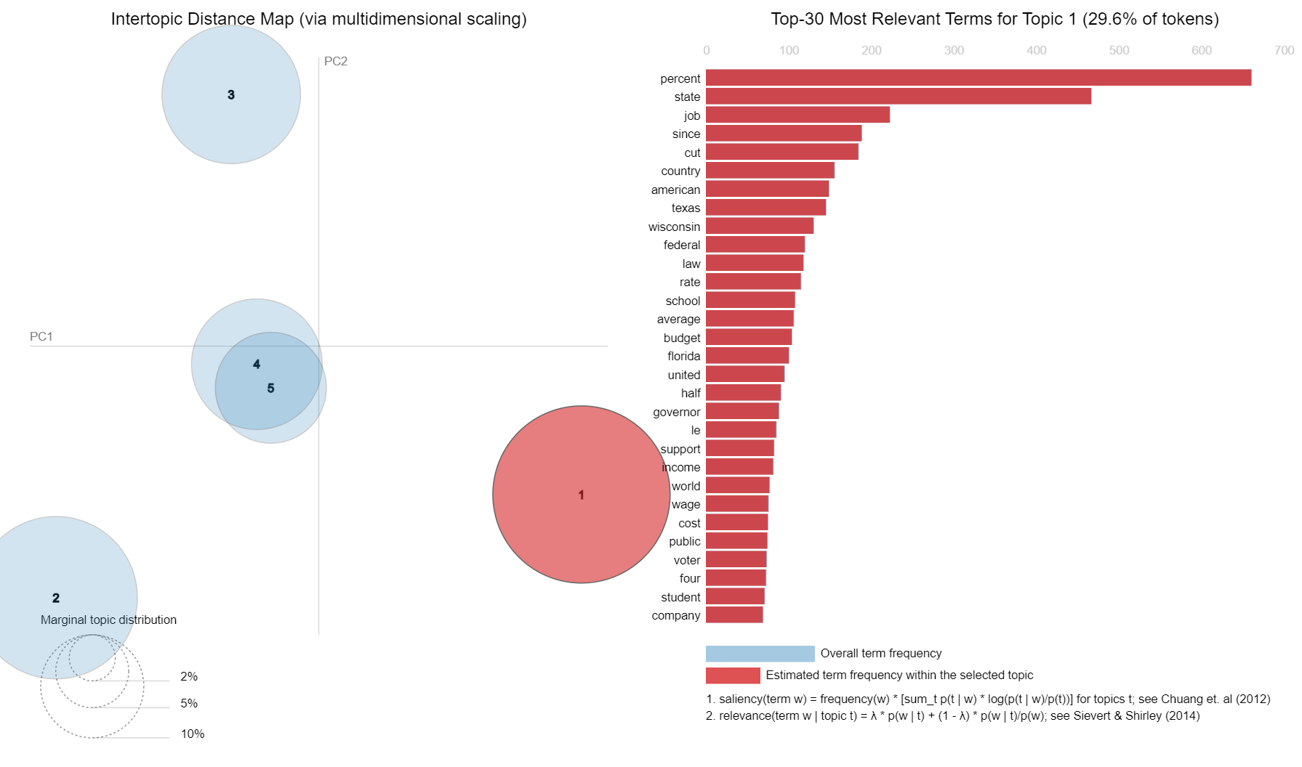
Results and discussion
true statements
Topic 1:
Economic and Fiscal Policy say, percent, tax, million, people, would, billion, bill, cut, texas)
Topic 2:
Political Spending and Partisan Issues (year, one, get, last, democrat, money, spending, like, illegal, administration)
Topic 5:
Healthcare Policy and Presidential Politics obama, health, president, care, time, barack, voted, insurance, dollar, party)
Topic 3:
State-Level Politics and Employment state, job, new, wisconsin, united, rate, clinton, gov, america, cost)
Topic 4:
Education and State Governance (since, school, florida, budget, plan, want, public, security, number, governor)

Slide 30
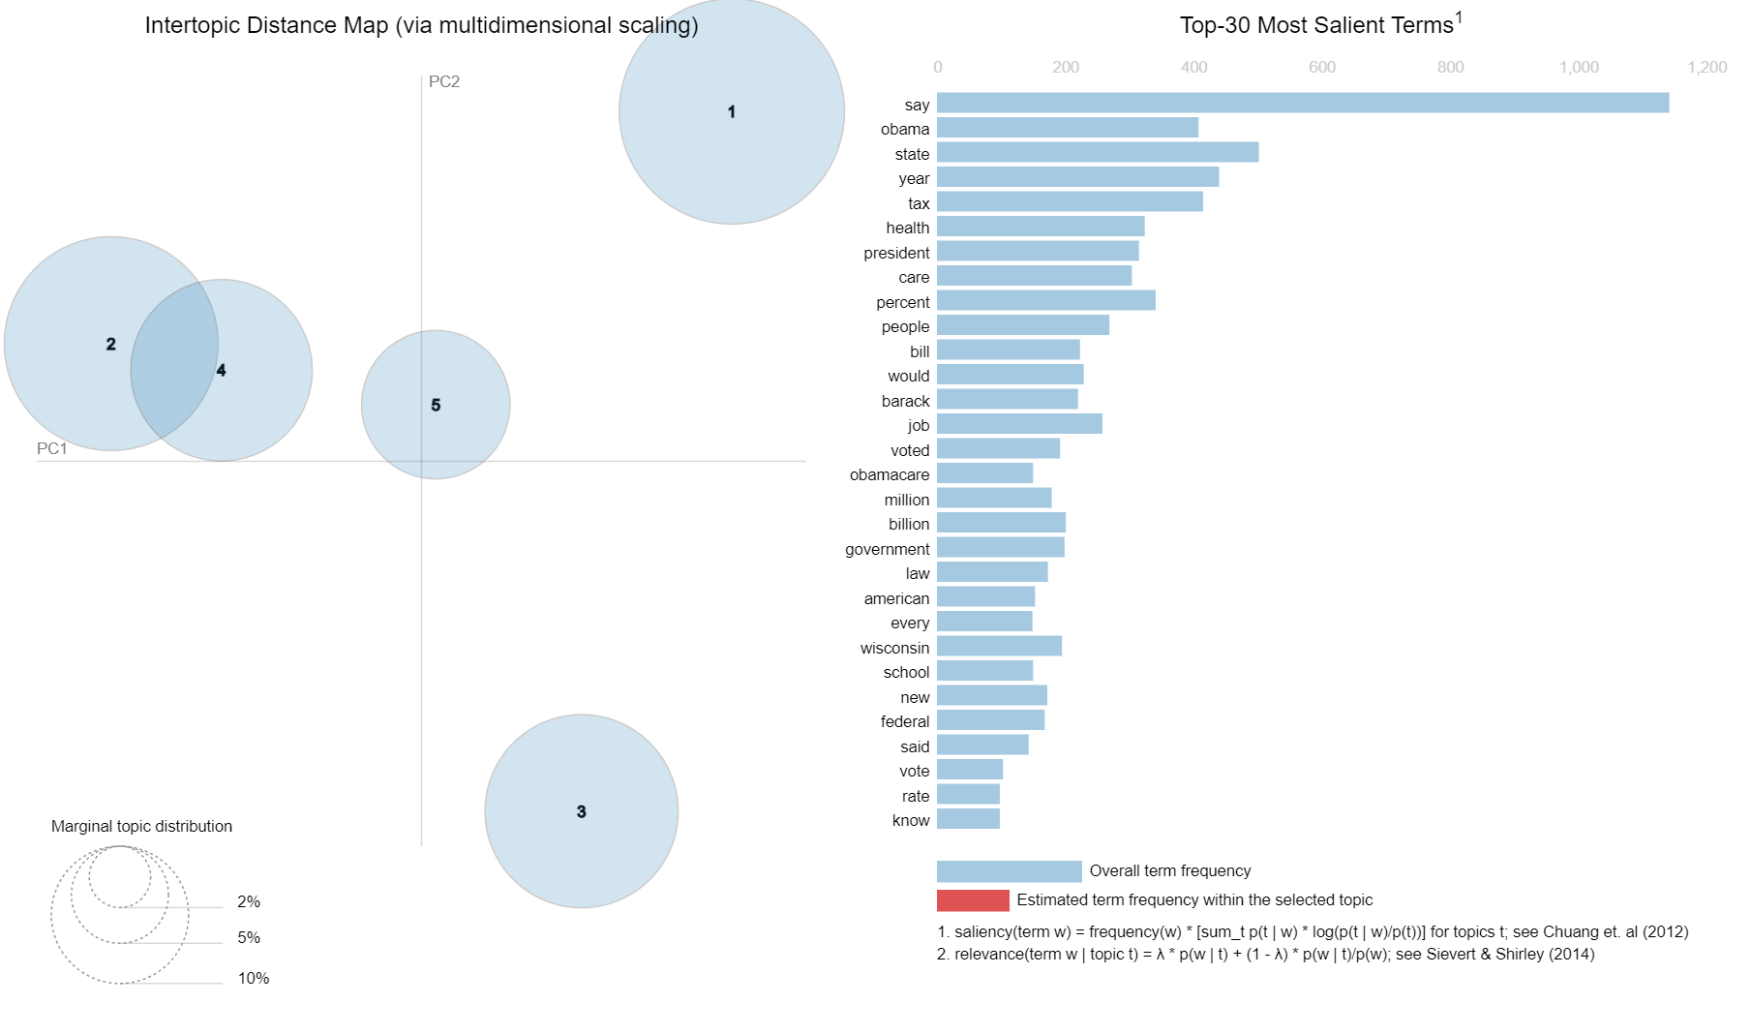
Results and discussion
false statements
Topic 1:
Economic and Fiscal Policy say, percent, tax, million, people, would, billion, bill, cut, texas)
Topic 2:
Political Spending and Partisan Issues (year, one, get, last, democrat, money, spending, like, illegal, administration)
Topic 5:
Healthcare Policy and Presidential Politics obama, health, president, care, time, barack, voted, insurance, dollar, party)
Topic 3:
State-Level Politics and Employment state, job, new, wisconsin, united, rate, clinton, gov, america, cost)
Topic 4:
Education and State Governance (since, school, florida, budget, plan, want, public, security, number, governor)

Slide 31
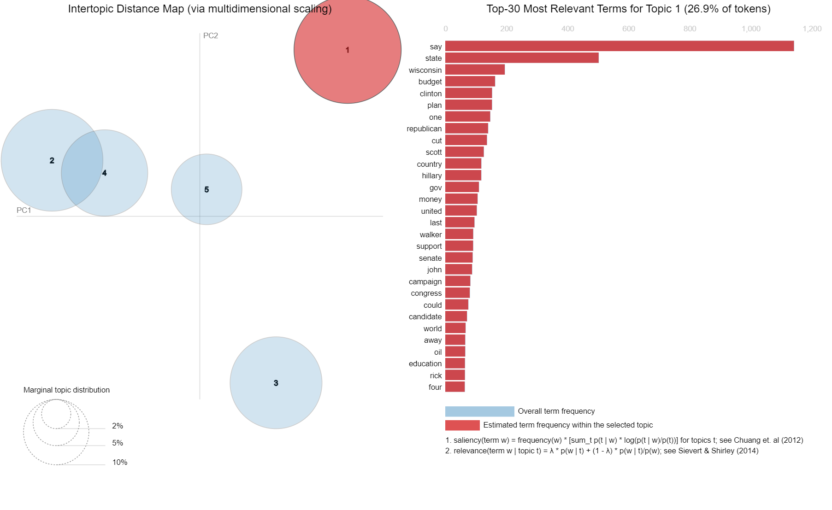
Results and discussion
false statements
Topic 1:
Economic and Fiscal Policy say, percent, tax, million, people, would, billion, bill, cut, texas)
Topic 2:
Political Spending and Partisan Issues (year, one, get, last, democrat, money, spending, like, illegal, administration)
Topic 5:
Healthcare Policy and Presidential Politics obama, health, president, care, time, barack, voted, insurance, dollar, party)
Topic 3:
State-Level Politics and Employment state, job, new, wisconsin, united, rate, clinton, gov, america, cost)
Topic 4:
Education and State Governance (since, school, florida, budget, plan, want, public, security, number, governor)

Slide 32
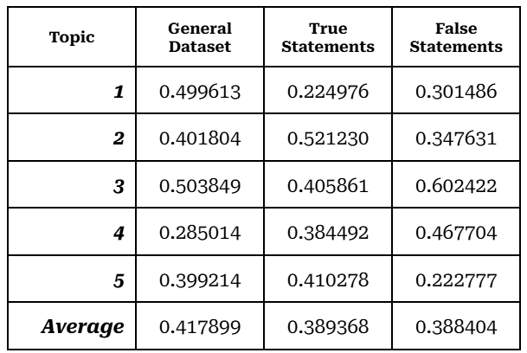
Results and discussion
Topic modeling results
Perplexity:
General dataset: 697.02
True Statements: 341.32
False Statements: 406.38
Coherence Score:

Slide 33
Results and discussion
Topic modeling results interpretation
Distinct Themes in True vs. False Statements:
True Statements: Focus on national politics, economic policy, and specific, concrete claims (e.g., "tax," "job").
False Statements: Emphasize controversial topics, political figures (e.g., "Obama"), and social policy, with a focus on contentious issues.
Perplexity Scores: True statements had the lowest perplexity (341.32), indicating more consistent linguistic patterns, while false statements were more diverse but still exhibited internal consistency.
Coherence Scores: False statements, particularly around state politics, showed high coherence, suggesting certain themes are well-defined even in misinformation.
Implications for Political Discourse Analysis:
Hybrid Approaches: Combining traditional machine learning with deep learning could improve automated fact-checking systems.
Contextual Challenges: Fact-checking requires broad and up-to-date knowledge bases to handle the complexity of political statements, especially those that conflate different policy areas or focus on international issues.
Thematic Focus as Veracity Indicator: Attention to specific topics and the presence of high-profile political figures in statements could help in assessing their truthfulness.

Slide 34
conclusions

Slide 35
conclusions
Random Forest vs. RoBERTa: The Random Forest model outperformed RoBERTa in classifying political statements, highlighting the importance of engineered features and domain-specific knowledge in automated fact-checking.
Thematic Differences: True statements focused on specific policy areas and precise claims, while false statements emphasized political figures, controversies, and broad, less specific claims.
Challenges in Political Fact-Checking: Political statements often require external knowledge and nuanced interpretation, which can be challenging for deep learning models like RoBERTa.
Implications: The study underscores the complexity of political language and suggests that combining machine learning with topic modeling offers a more comprehensive approach to understanding political discourse and enhancing fact-checking systems.

