Slide 1

Sarcasm Detection on Reddit
Comparing Pre-trained Models for Sarcasm Recognition and Sentiment Analysis
Alexandre crivellari
Matteo Pasotti
Andrea muscio

Slide 2
Table of contents
Introduction and Domain of Interest
Dataset Structure and Exploration
Sarcasm Detection
Sentiment Evaluation
Results and Discussions
Conclusions

Slide 3
Introduction and DOmain of Interest
The Challenge of Sarcasm in NLP
Sarcasm is a form of verbal irony where the intended meaning contrasts with the literal one.
Detecting sarcasm is difficult for NLP systems due to its context-dependent nature and reliance on shared cultural knowledge.
The Importance of Sarcasm Detection
Misinterpreting sarcasm can lead to substantial errors in sentiment analysis and intent recognition.
Accurate sarcasm detection allows for understanding the true sentiment behind online comments.

Slide 4
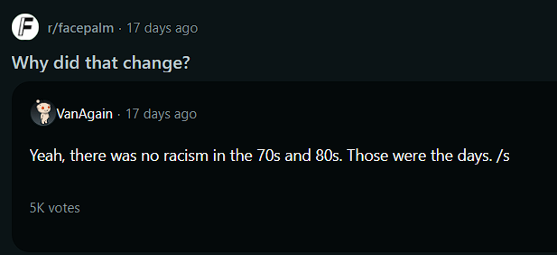
Introduction and domain of interest
Focus on Reddit
Vast collection of forums (subreddits) with diverse content
Rich data for studying sarcasm
Subreddit’s specific culture
Study Objectives
Develop a model capable for detecting sarcasm in Reddit posts
Compare the performance of different pre-trained models in sarcasm detection and sentiment analysis
Conduct a sentiment analysis and explore the impact of sarcasm on sentiment perception

Slide 5
Dataset structure, exploration and Cleaning

Slide 6
Dataset structure, exploration and cleaning
label: This is an integer value (0 or 1) indicating whether the comment is sarcastic (1) or not (0)
comment: A textual field containing the actual comment made by the user
author: The username of the person who made the comment
subreddit: The specific subreddit or community where the comment was posted
score: An integer representing the score of the comment, which is a net vote count (upvotes minus downvotes)
ups: The number of upvotes the comment received
downs: The number of downvotes the comment received
date: The date (in YYYY-MM format) when the comment was posted
created_utc: The exact timestamp (in UTC format) of when the comment was created
parent_comment: The text of the parent comment to which the current comment is a reply

Slide 7
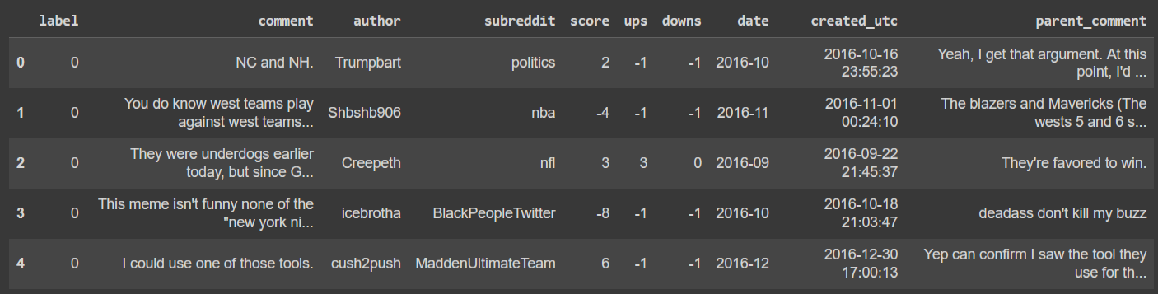
Dataset structure, exploration and cleaning

Slide 8
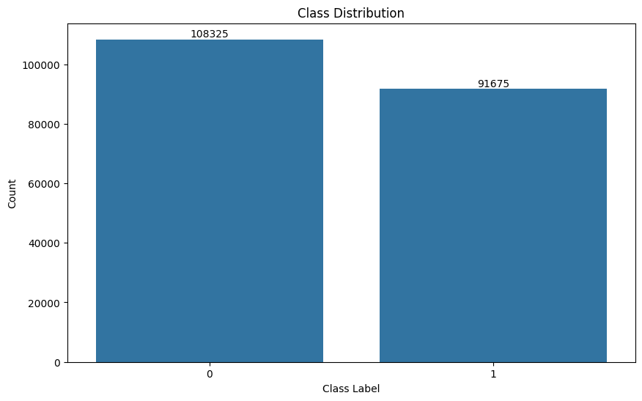
Dataset structure, exploration and cleaning
Training Dataset: 1.3 million comments
Preprocessing:
Remove URLs, Numerics, Puncts, extra spaces
Lowercase
Emojis
Only comments with 3+ words and 10+ characters

Slide 9
sarcasm detection
Task 1

Slide 10
Sarcasm Detection: methodology
Focus on Transformer-based Models
Four pre-trained models were fine-tuned: BERT, RoBERTa, DistilBERT, and ALBERT.
Each model represents a different architecture or variation of transformer-based models.
Balanced Dataset
The dataset used consists of Reddit comments, balanced between sarcastic and non-sarcastic labels.
This balance eliminates the need for advanced techniques to address class imbalance.
Model Fine-Tuning Process
The models were fine-tuned on the sarcasm detection task using the preprocessed Reddit comments dataset.
Fine-tuning involved adjusting model parameters to optimize performance on sarcasm detection.

Slide 11
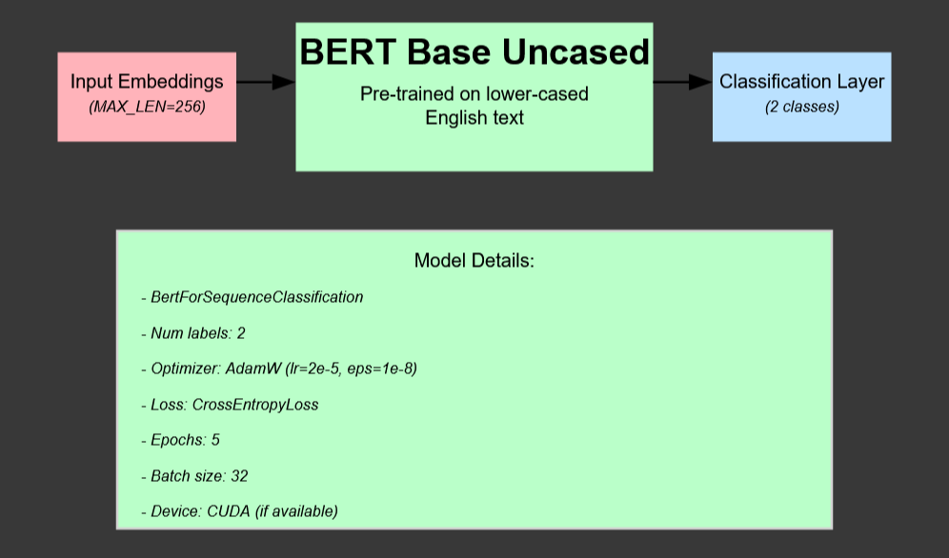
sarcasm detection: bert
BERT (Bidirectional Encoder Representations from Transformers)
Bidirectional Training: Considers both left and right context in all layers.
Attention Mechanism: Uses self-attention to focus on relevant parts of the input sequence.
Pre-trained on Large Corpus: Trained on a large corpus, including BooksCorpus and English Wikipedia.
Fine-tuning Capable: Can be fine-tuned for specific tasks like sarcasm detection with minimal task-specific architecture changes.

Slide 12
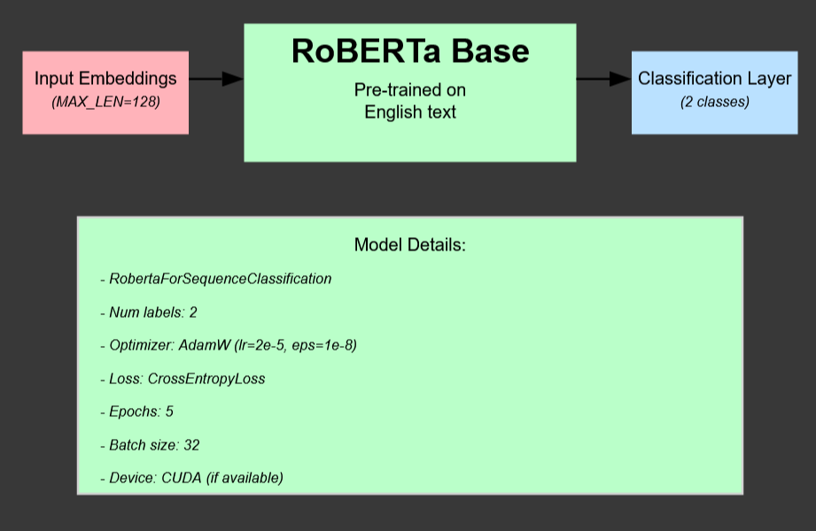
sarcasm detection: RoBERTA
RoBERTa (Robustly Optimized BERT Pretraining Approach)
Improved Training Techniques: Longer training with more data and larger mini-batches than BERT.
Dynamic Masking: Masking patterns change during pre-training, improving robustness.
Byte-Pair Encoding (BPE) Tokenizer: Allows more flexible vocabulary, handling diverse text inputs.
Higher Capacity: Enhanced by larger training data and longer sequences, leading to better performance on complex tasks.

Slide 13
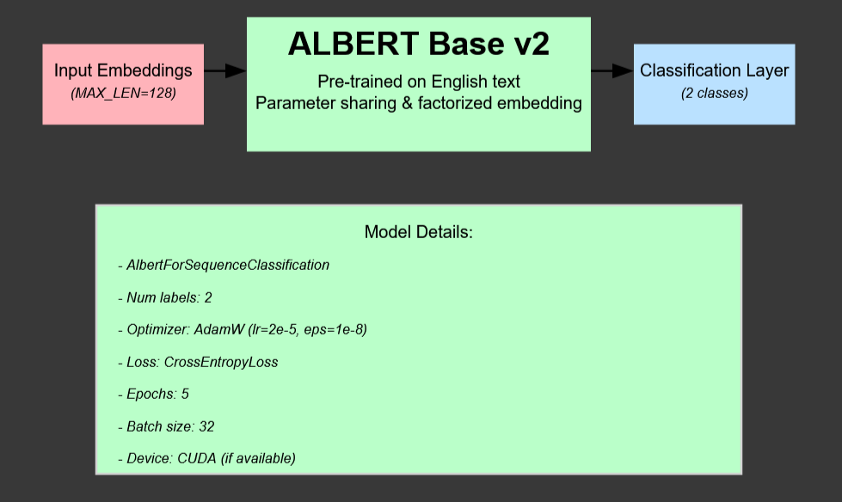
sarcasm detection: ALBERT
ALBERT (A Lite BERT)
Factorized Embedding Parameterization: Reduces the number of parameters in the model, making it more efficient.
Cross-layer Parameter Sharing: Parameters are shared across layers, further reducing memory footprint.
Sentence Order Prediction: Uses sentence order prediction as an additional pre-training task, enhancing understanding of sentence relationships.
Smaller Model Size: Achieves similar performance to BERT with fewer parameters, optimizing speed and efficiency.

Slide 14
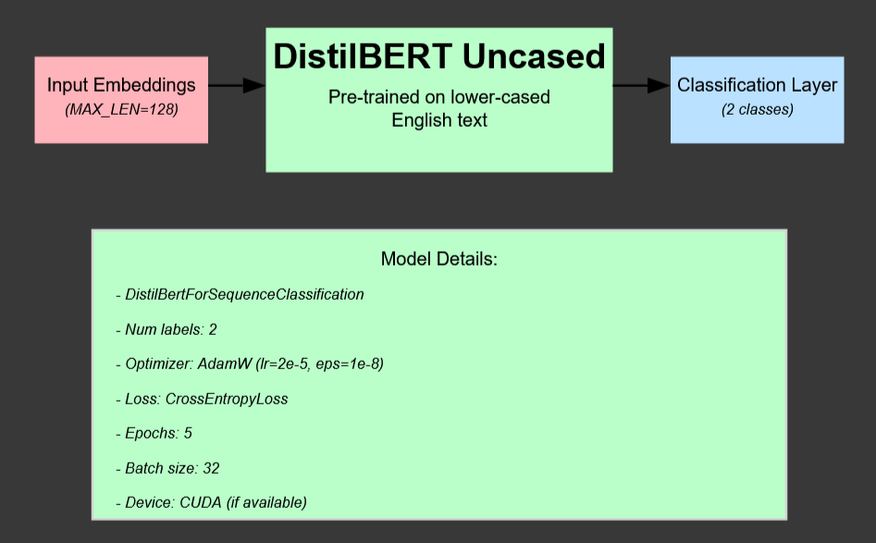
sarcasm detection: DISTILBERT
DistilBERT
Knowledge Distillation: Trained by distilling the knowledge of a larger BERT model, retaining 97% of BERT's performance.
Fewer Parameters: 40% smaller and 60% faster than BERT, making it highly efficient.
Retains Attention Layers: Maintains the attention mechanism from BERT, ensuring good language understanding.
Speed and Efficiency: Designed to offer a balance between performance and computational resource use, ideal for resource-constrained environments.

Slide 15
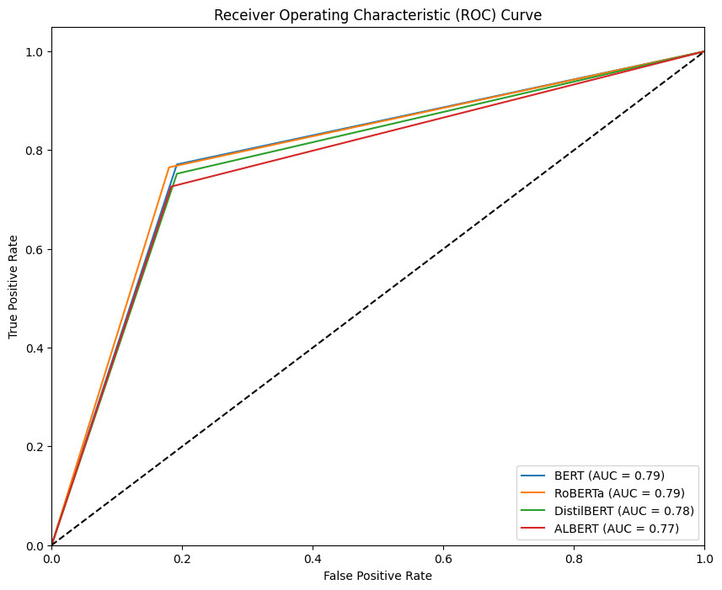
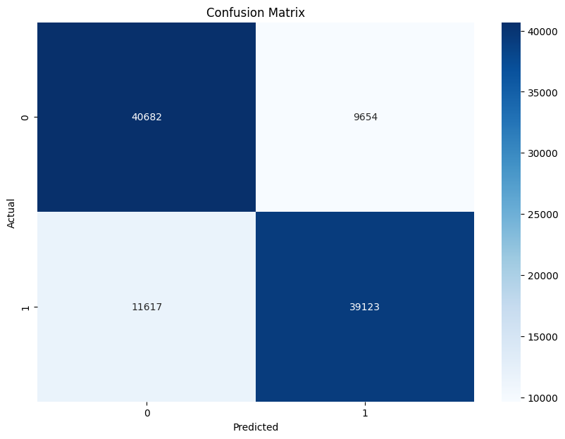
sarcasm detection:models comparison
Pre-trained Model | Accuracy | Precision | Recall | F1 Score
BERT | 0.79 | 0.80 | 0.77 | 0.79
RoBERTa | 0.77 | 0.79 | 0.73 | 0.76
DistilBERT | 0.78 | 0.80 | 0.75 | 0.77
ALBERT | 0.77 | 0.80 | 0.73 | 0.76
(e.g.: RoBERTa Results)
Text: I absolutely love waiting in long lines at the DMV.
Prediction: Sarcastic
Probability: 0.99
Text: The weather is beautiful today.
Prediction: Not sarcastic
Probability: 0.77
Text: Wow, getting a root canal is my favorite way to spend an afternoon!
Prediction: Sarcastic
Probability: 0.91
Text: I'm excited about the new movie coming out next week.
Prediction: Sarcastic
Probability: 0.98

Slide 16
sentiment evaluation
Task 2

Slide 17
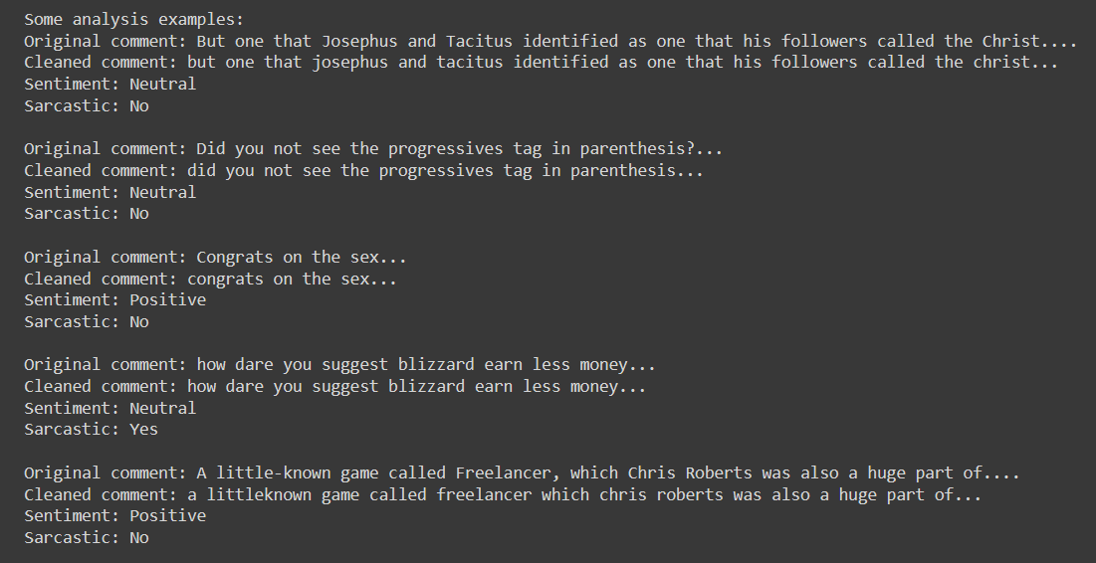
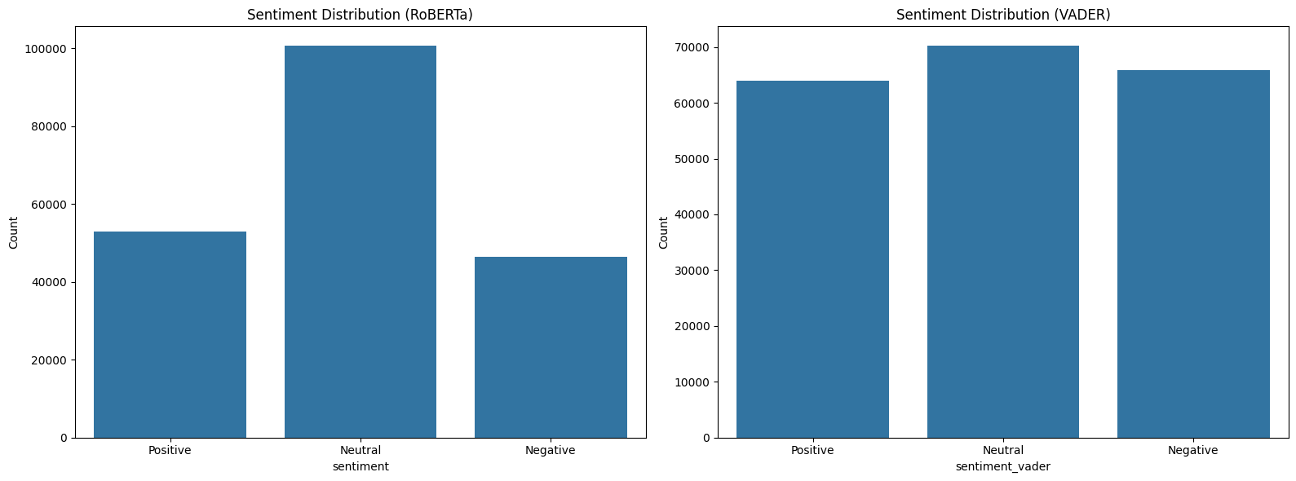
sentiment evaluation: roberta and vader
RoBERTa Sentiment Analyzer
VADER Sentiment Analyzer

Slide 18
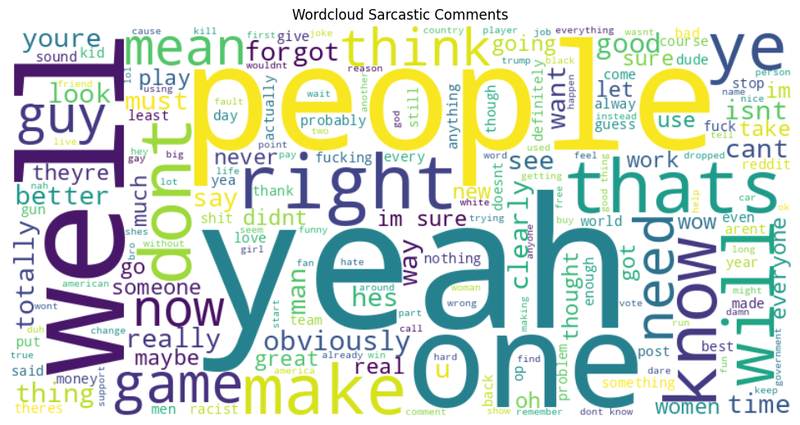
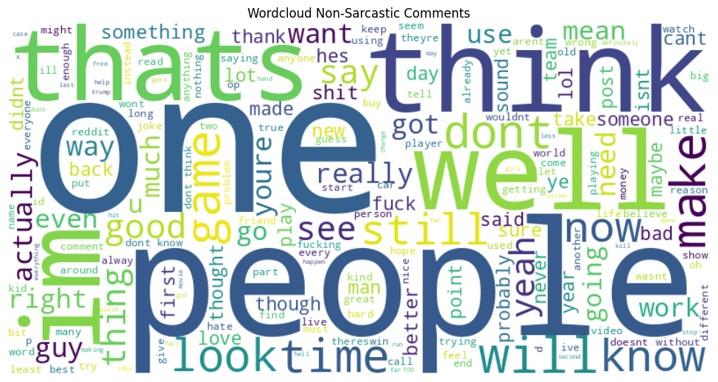
wordclouds: sarcastic vs non-sarcastic

Slide 19
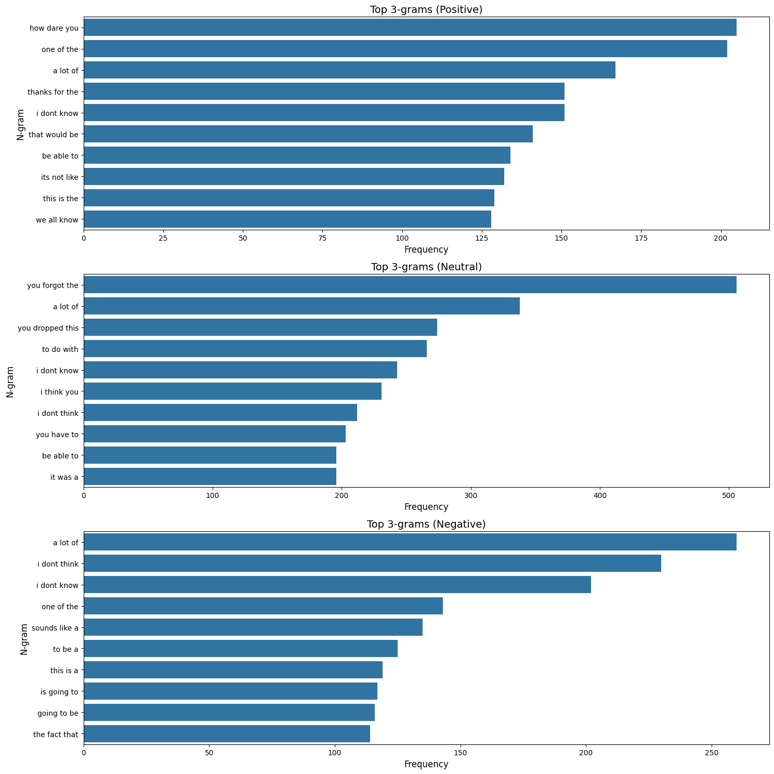
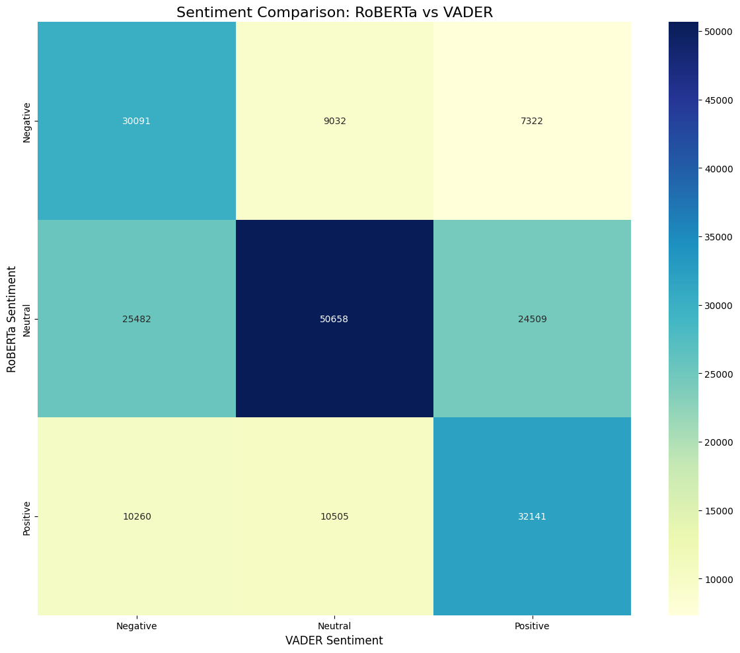
wordclouds: sarcastic vs non-sarcastic

Slide 20
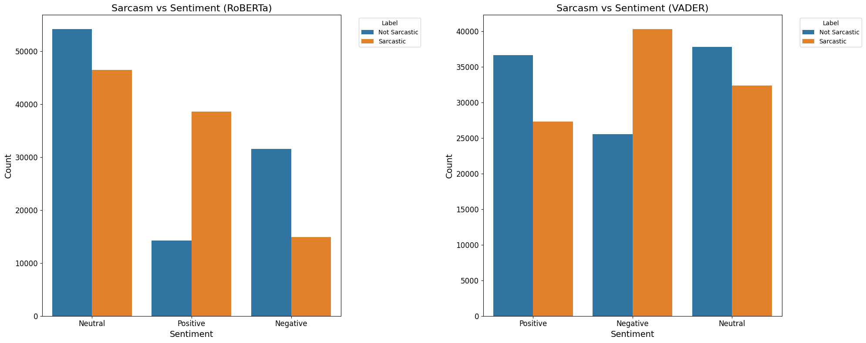
wordclouds: sarcastic vs non-sarcastic

