Slide 1
MGMT 59990 · GROUP 18
Turning Amazon electronics reviews
into early risk signals
An implemented AWS data lake, Classification ML model, and QuickSight dashboard
Final project presentation · August 2026
Notes:
Hello, and thank you for watching. I’m presenting on behalf of Group 18. Our project asks a practical question: can a cloud analytics pipeline turn a large stream of product reviews into an early-warning system for quality and customer-experience risk? We built the complete workflow in AWS, from raw reviews and product metadata through transformation, SQL analytics, machine learning, and a published business dashboard. The result is not an automated decision system. It is a prioritization tool that helps analysts and product teams focus attention where low-rating risk is highest.
[Sources]
- Project repository and implementation evidence in this workspace.
- Course presentation requirements in FINAL_PROJECT_SUBMISSION_REQUIREMENTS.md.

Slide 2
MGMT 59990 · GROUP 18
Manual research on reviews is information that is too late
Thousands of reviews contain quality signals, but teams cannot read and prioritize them consistently at scale.
Product teams
Customer experience
Analytics leaders
Which products show a concentrated pattern of low ratings?
Which reviews should be examined first for recurring issues?
Can the evidence be reproduced, governed, and delivered affordably?
Our target: predict likely 1–2 star reviews and surface product-level risk for human follow-up.
02
Notes:
The business problem is not simply sentiment classification. The deeper problem is prioritization. Product and customer-experience teams receive more feedback than they can manually review, while isolated complaints can be noisy. We therefore defined low-rating risk as one- or two-star feedback and designed the system to answer three questions: where is low-rating volume concentrated, which new reviews are most likely to be low-rated, and can those findings be delivered through a governed, repeatable cloud workflow? The intended users are product managers, quality analysts, and support leaders. They remain responsible for interpreting the evidence and deciding what action, if any, is appropriate.
[Sources]
- Project scope and target definition in README.md and sql/athena/03_analysis.sql.

Slide 3
MGMT 59990 · GROUP 18
A distributed sample avoids processing all 22.6 GB
A seeded, distributed byte-range sample from Amazon Reviews 2023 Electronics was joined to matched product metadata.
66,004
39,476
27,359
unique review records
matched products · 100% join
distinct reviewers
2000–2023 review years
32 seeded source-file segments
92.94% verified purchases
03
Notes:
The source is the McAuley Lab Amazon Reviews 2023 dataset. Instead of processing the entire 22.6-gigabyte Electronics review file, we used 32 seeded byte ranges distributed across the file. After removing incomplete and duplicate records, the saved sample contains 66,004 unique reviews from 27,359 users and 39,476 products. We then filtered the official Electronics metadata to exactly those product identifiers. Every review joined successfully to metadata, so product titles and attributes are available downstream. The sample spans review years 2000 through 2023, and 92.94 percent of records are verified purchases. The key sampling limitation is that byte-range sampling is reproducible and broad, but not perfectly uniform by row because JSON records have different lengths.
[Sources]
- data/bronze/reviews/category=Electronics/electronics_random_sample.manifest.json
- data/bronze/metadata/category=Electronics/electronics_metadata_sample.manifest.json
- Amazon Reviews 2023 introduction: https://amazon-reviews-2023.github.io/main.html
- Hou et al. (2024), Bridging Language and Items for Retrieval and Recommendation: https://arxiv.org/abs/2403.03952

Slide 4
MGMT 59990 · GROUP 18
AWS turns raw reviews into decision-ready data
Implemented end to end in us-east-2
S3 Bronze
→
AWS Glue
→
S3 Silver
→
Athena
→
S3 Gold
Immutable JSONL
+ metadata
Clean, dedupe,
join products
Partitioned
Snappy Parquet
Validate + build
Gold tables
Aggregates +
model features
↓
QuickSight
←
SageMaker
Gold trends +
model risk in SPICE
Train + score
low-rating risk
SageMaker writes predictions back to cataloged Gold tables; QuickSight consumes both descriptive and predicted risk.
04
Notes:
The architecture follows a medallion pattern. Bronze keeps the original reviews and metadata immutable, together with source manifests. Glue transforms that data into two Silver Parquet tables: a review fact and a product dimension. The Glue Data Catalog gives Athena and QuickSight consistent schemas. Athena then performs quality checks and creates Gold products for monthly ratings, product-level analysis, and model training. SageMaker trains the binary classifier and writes predictions back to S3, where Athena catalogs them. QuickSight imports three SPICE datasets: monthly ratings, product-month aggregates, and held-out model risk. This separation lets us preserve raw evidence, optimize trusted data for query cost, and keep analytics and machine-learning consumers decoupled.
[Sources]
- Implemented resources and paths documented in README.md, aws/glue_etl.py, and sql/athena/*.sql.
- Published QuickSight resource evidence in artifacts/evidence/quicksight_evidence.json.

Slide 5
MGMT 59990 · GROUP 18
Quality gates make each layer auditable
01
02
03
04
Land
Transform
Reconcile
Isolate
Verify S3 keys, byte sizes, checksums, and expected account/Region.
Reject malformed rows, enforce rating bounds, deduplicate, and join metadata.
Athena checks 66,004 fact rows, 39,476 products, partitions, and nulls.
Hash users into train, validation, and test so one user never crosses splits.
Promotion rule: a failed check stops the workflow; no downstream claim is made without matching evidence.
05
Notes:
Each layer has an explicit promotion gate. At ingestion, we verified exact S3 paths, object sizes, checksums, account, and Region. Glue validated required fields, rating bounds, timestamps, duplicate review identifiers, and metadata joins before writing Silver. Athena reconciled the fact and dimension counts, confirmed partition discovery, and validated Gold outputs against the original 66,004 reviews. For machine learning, users—not individual rows—were hashed into train, validation, and test partitions. That prevents the same reviewer’s language patterns from leaking across evaluation boundaries. The important governance principle is simple: if a check fails, the wizard stops, and the project does not claim the downstream layer as implemented.
[Sources]
- Quality contracts in aws/glue_etl.py, sql/athena/02_quality_checks.sql, and sql/athena/05_gold_quality_checks.sql.
- Wizard validation controls in scripts/aws_glue_silver_wizard.sh, scripts/aws_athena_wizard.sh, and scripts/aws_gold_wizard.sh.

Slide 6
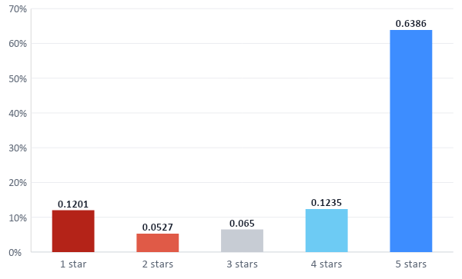
MGMT 59990 · GROUP 18
Positive reviews dominate, so low-rating recall matters
17.28%
of sampled reviews are 1–2 stars
11,408 low-rating reviews
42,153 five-star reviews
A majority-class guess already achieves 82.19% accuracy—so accuracy alone would be misleading.
06
Notes:
The descriptive distribution is highly imbalanced. Nearly 64 percent of the sample is five-star feedback, while one- and two-star reviews together represent 17.28 percent, or 11,408 records. That imbalance changes how we evaluate the model. A trivial classifier that predicts the majority class can achieve about 82.2 percent accuracy without identifying any low-rating review. Therefore, our primary business metric is recall on the low-rating class, supported by precision, F1, and ROC AUC. Descriptively, the dashboard also applies minimum-review thresholds before ranking products, which reduces the chance that a single negative review makes a low-volume product look like the highest priority.
[Sources]
- Counts computed from data/bronze/reviews/category=Electronics/electronics_random_sample.jsonl and reconciled to 66,004 rows.
- Baseline accuracy and held-out metrics in artifacts/evidence/sagemaker_metrics.json.

Slide 7
MGMT 59990 · GROUP 18
The model learns language linked to low ratings
Its job is to estimate whether a review is likely to receive one or two stars—then prioritize it for human review.
01
02
03
04
Define the outcome
Learn language patterns
Handle class imbalance
Test it fairly
→
→
→
Reviews rated 1–2 stars are labeled low rating.
The model predicts that label using only the written review text.
Each review becomes weighted words and two-word phrases.
The model learns which patterns are more common in low-rated reviews. Like ‘broken, excellent, refund’ etc.
Low ratings are only 17.28% of the sample.
Training gives the minority class more weight so it is not ignored.
Every reviewer stays in one data split to prevent leakage.
The final model is evaluated once on 6,436 unseen reviews.
MODEL OUTPUT
Review text → probability of a 1–2 star rating → prioritized human follow-up
07
Notes:
The machine-learning goal is straightforward: read the written review and estimate the probability that its rating is one or two stars. First, those low ratings become the positive label. Next, TF-IDF converts each review into weighted individual words and two-word phrases, allowing the model to learn which language patterns are associated with low ratings. Logistic regression then combines those signals into a probability. Because low ratings represent only 17.28 percent of the sample, class balancing prevents the model from simply favoring the majority class. For fair evaluation, every reviewer belongs to only one split. Validation chooses the 0.62 decision threshold, and the final model is evaluated once on 6,436 previously unseen reviews. The output prioritizes human follow-up rather than making an automatic product decision.
[Sources]
- Split construction in sql/athena/04_gold_tables.sql.
- Training implementation in aws/sagemaker/train.py.
- Training job request in aws/sagemaker/build_training_job.py.
- Runtime evidence in artifacts/evidence/sagemaker_cost_evidence.json.

Slide 8
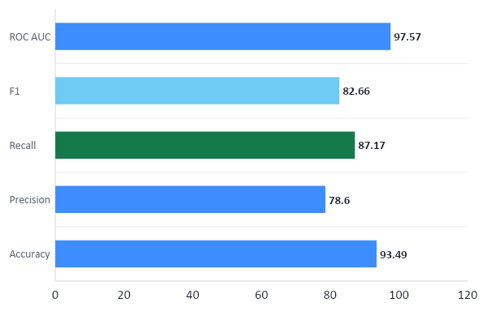
MGMT 59990 · GROUP 18
The model catches 87% of actual low ratings
Model
TF-IDF + balanced
logistic regression
Validation-selected threshold
0.62
6,436 held-out reviews
999 true positives · 147 false negatives
08
Notes:
The final SageMaker model uses TF-IDF text features with class-balanced logistic regression. Users were isolated across train, validation, and test partitions. We selected a probability threshold of 0.62 using validation F1, then evaluated once on 6,436 held-out reviews. The model achieved 93.49 percent accuracy, 78.60 percent precision, 87.17 percent recall, an F1 score of 82.66 percent, and a ROC AUC of 97.57 percent. Most importantly, it identified 999 true low-rating reviews while missing 147. Compared with the 82.19 percent majority baseline, this is a meaningful improvement, but the false positives and false negatives reinforce that the model should prioritize human review rather than trigger automatic customer or product actions.
[Sources]
- Final SageMaker metrics in artifacts/evidence/sagemaker_metrics.json.
- Confusion reconciliation in artifacts/evidence/sagemaker_athena_validation.json.
- Training implementation in aws/sagemaker/train.py.

Slide 9
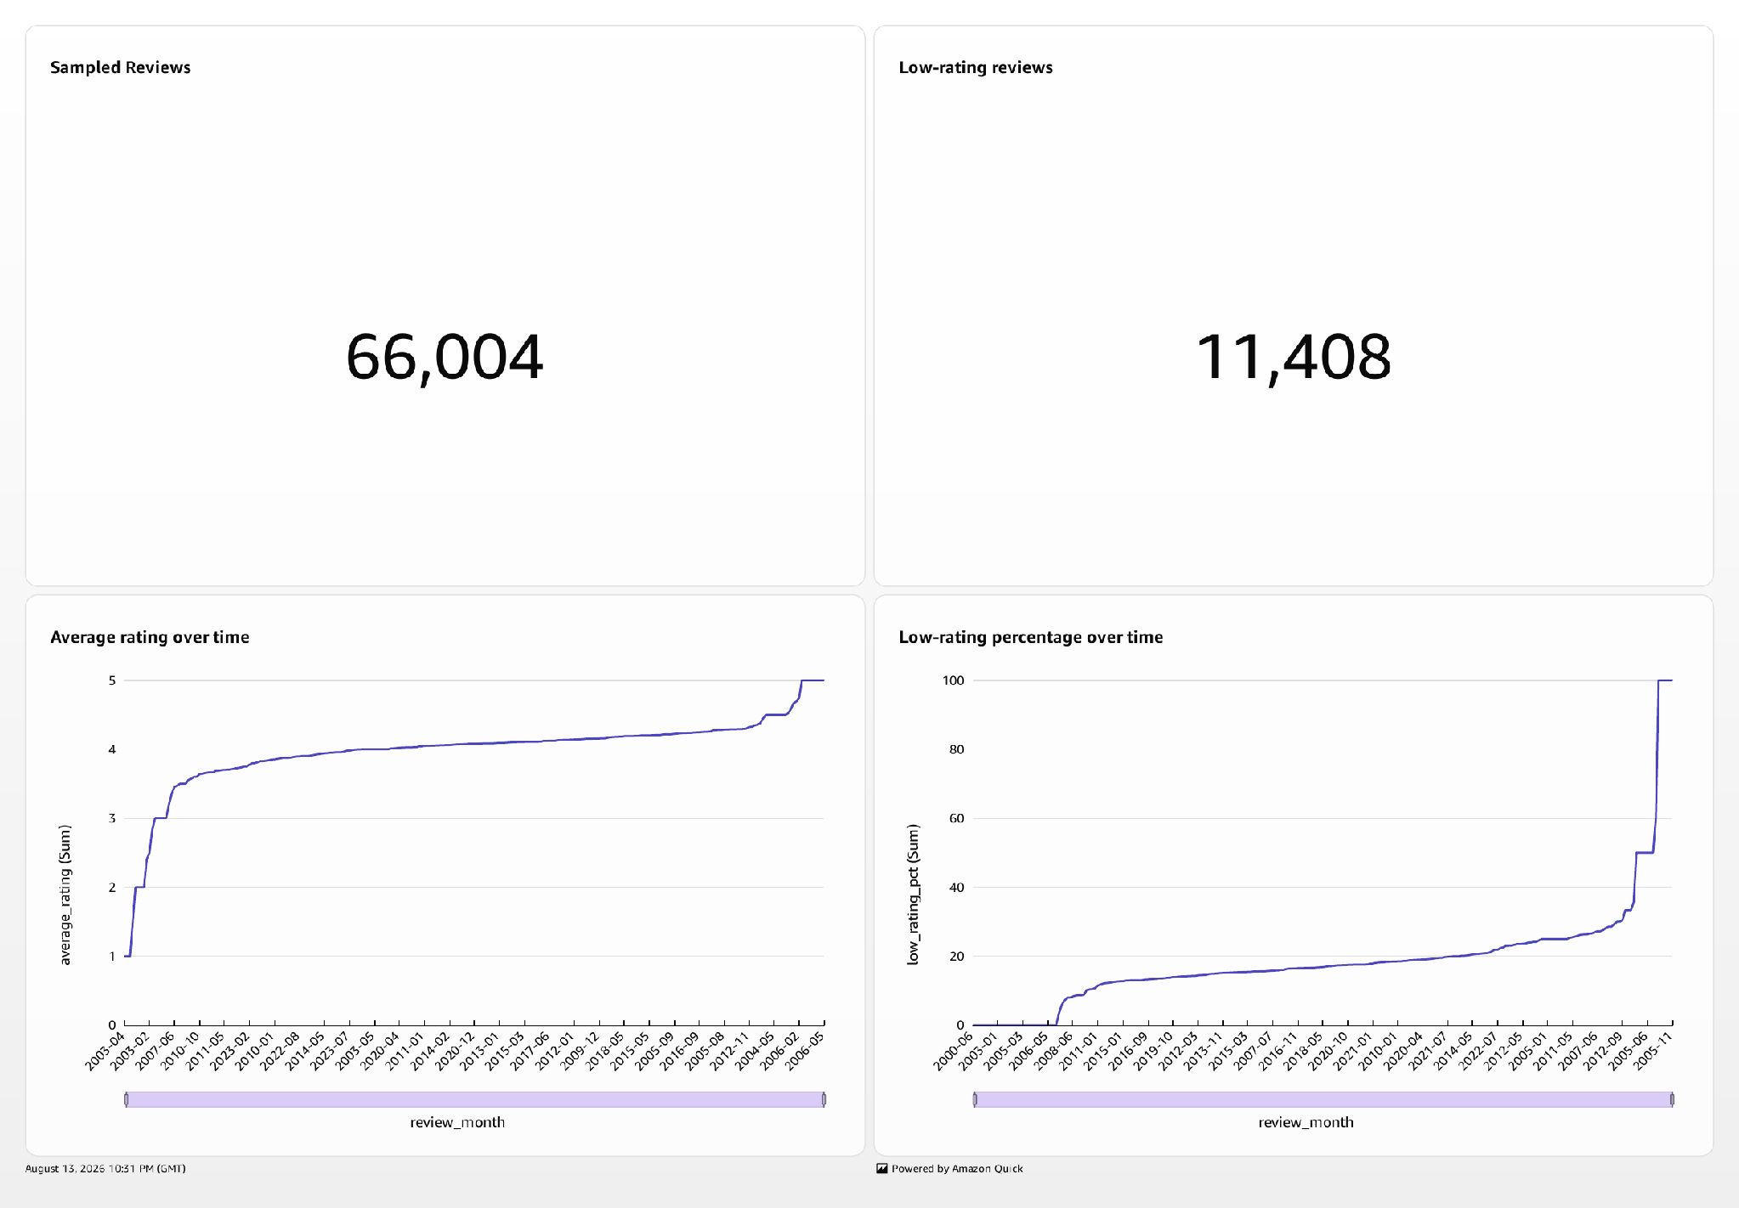
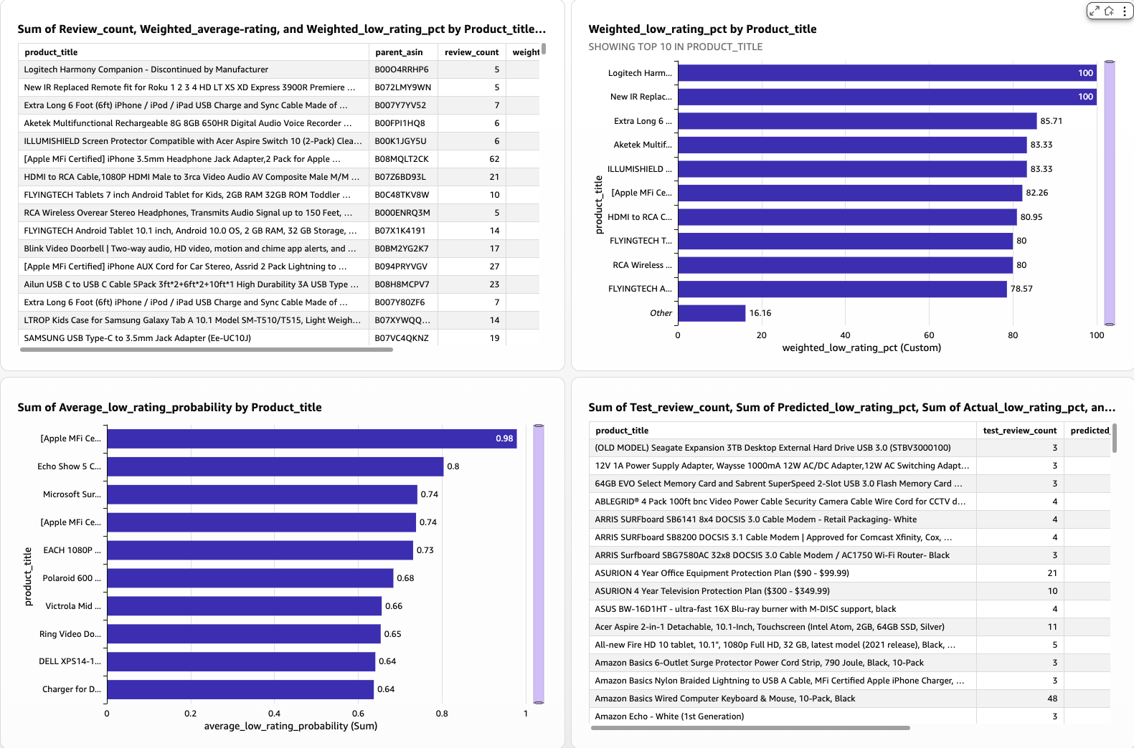
MGMT 59990 · GROUP 18
QuickSight connects trends to product risk
Portfolio overview
Product risk
66,004 reviews · 11,408 low-rated
Descriptive + predicted risk
3 SPICE datasets
09
Notes:
The final output is a published QuickSight dashboard rather than a static model report. The Portfolio Overview sheet summarizes all 66,004 reviews and the 11,408 low-rating records, with controls that support time-based exploration. The Product Risk sheet combines two perspectives: descriptive risk from observed ratings and predicted risk from the held-out model output. Three SPICE datasets make the dashboard responsive while reducing repeated Athena scans. This design lets a business user start with portfolio-level context, move to product rankings, and then inspect the model’s probability-based prioritization. The dashboard and its PDF export also provide implementation evidence that the analytics layer is connected to the actual Gold and prediction tables.
[Sources]
- Published dashboard evidence in artifacts/evidence/quicksight_evidence.json.
- Dashboard PDF in artifacts/evidence/quicksight_dashboard.pdf.
- Product Risk screenshot in artifacts/evidence/quicksight_product_risk.png.

Slide 10
MGMT 59990 · GROUP 18
AWS connected the lake, ML, and dashboard
ATHENA CONTROL
SAGEMAKER JOB
IDLE COMPUTE
256 MiB
89 sec
0 endpoints
256 MiB/query in group18-gold-build.
Checkpoint queries force results to project S3.
Parquet + Snappy reduce bytes before the cutoff.
One ml.m5.xlarge instance and 20 GB volume.
MaxRuntimeInSeconds = 1,800 automatically stops the job at 30 minutes.
Predictions and model.tar.gz were written to S3.
Three QuickSight SPICE datasets avoid repeated dashboard scans.
Why AWS fit this build
One evidence plane
One control plane
One delivery path
S3 holds Bronze, Silver, Gold, model artifacts, and predictions without moving data between platforms.
Glue Catalog schemas, IAM roles, and Athena workgroups govern the same tables used throughout the pipeline.
SageMaker returns results to S3; Athena catalogs them; QuickSight imports them into responsive SPICE datasets.
10
Notes:
AWS fit this build because storage, governance, machine learning, and business intelligence all operate around the same S3 data lake. The dedicated group18-gold-build Athena workgroup limits each query to 256 mebibytes scanned. Parquet, Snappy compression, and partitions reduce the bytes read before that ceiling is reached, while the checkpoint workgroup enforces the project results location. The SageMaker job used one ml.m5.xlarge instance with a 20-gigabyte volume and completed in 89 billable seconds. Its 1,800-second MaxRuntimeInSeconds setting would stop a stalled job after 30 minutes, and we created no persistent endpoint. SageMaker returned artifacts and predictions to S3, Athena cataloged those outputs, and QuickSight imported three SPICE datasets. That shared path reduces duplicate storage and integration work. The remaining recurring-cost risk is the QuickSight subscription after its trial.
[Sources]
- Athena Gold workgroup cutoff in scripts/aws_gold_wizard.sh.
- Training duration and endpoint evidence in artifacts/evidence/sagemaker_cost_evidence.json.
- Training resource request in aws/sagemaker/build_training_job.py.
- QuickSight integration evidence in artifacts/evidence/quicksight_evidence.json.
- AWS Glue pricing: https://aws.amazon.com/glue/pricing/
- Amazon Athena pricing reference: https://aws.amazon.com/athena/pricing/
- Amazon SageMaker AI pricing: https://aws.amazon.com/sagemaker/ai/pricing/
- Amazon QuickSight pricing: https://aws.amazon.com/quick/quicksight/pricing/

Slide 11
MGMT 59990 · GROUP 18
Production readiness requires governed scale
01
Expand data
Move from the sample to incremental full-category ingestion; partition by date and category, compact files, and apply S3 lifecycle policies.
02
Automate pipelines
Orchestrate Glue, Athena checks, retraining, model approval, and batch scoring with recoverable workflow steps and versioned releases.
03
Monitor behavior
Track data quality, drift, calibration, latency, and cost; use temporal holdouts and alarms before promoting a new model.
04
Operate safely
Start with scheduled batch scoring; add a real-time endpoint only when latency justifies it, while preserving human review and rollback.
Scale rule
Scale automation and controls before scaling the decisions the model influences.
11
Notes:
Making this production ready means scaling the controls before scaling the model’s influence. First, replace the fixed sample with incremental ingestion for the full Electronics category and eventually additional categories. Partition by date and category, compact small files, and manage retention. Second, automate Glue transformations, Athena quality gates, retraining, approval, and batch scoring through recoverable workflows and versioned model releases. Third, monitor data quality, feature drift, calibration, latency, and cost, using temporal evaluation before promotion. Finally, keep batch scoring as the default because it matches the current business workflow. Create a real-time endpoint only if an operational latency requirement justifies its recurring cost. Human review, feedback capture, and rollback remain required throughout.
[Sources]
- Current implemented baseline in README.md and aws/sagemaker/train.py.
- AWS Glue workflows: https://docs.aws.amazon.com/glue/latest/dg/workflows_overview.html
- Amazon SageMaker Pipelines: https://docs.aws.amazon.com/sagemaker/latest/dg/build-and-manage-steps.html
- Amazon SageMaker Model Monitor: https://docs.aws.amazon.com/sagemaker/latest/dg/model-monitor.html

