Slide 1

lain Privacy #19

Slide 2
PlainPrivacy is a Chrome Extension that automatically summarizes and highlights keywords in the privacy policies of the websites you visit.

Slide 3
Impact:
"Most Americans have no idea what they are signing up for because... terms of service are beyond comprehension."
- Senator Lindsey Graham in The New York Times

Slide 4
The Need:
“Every Internet user, were they to read every privacy policy on every website they visit would spend 25 days out of the year just reading privacy policies.” – The Atlantic

Slide 5
Features
Any website you visit
Simple UI for the everyday user (or lawmaker)
Provides what it collects and why it collects it
No need to sift through complex legal jargon

Slide 6
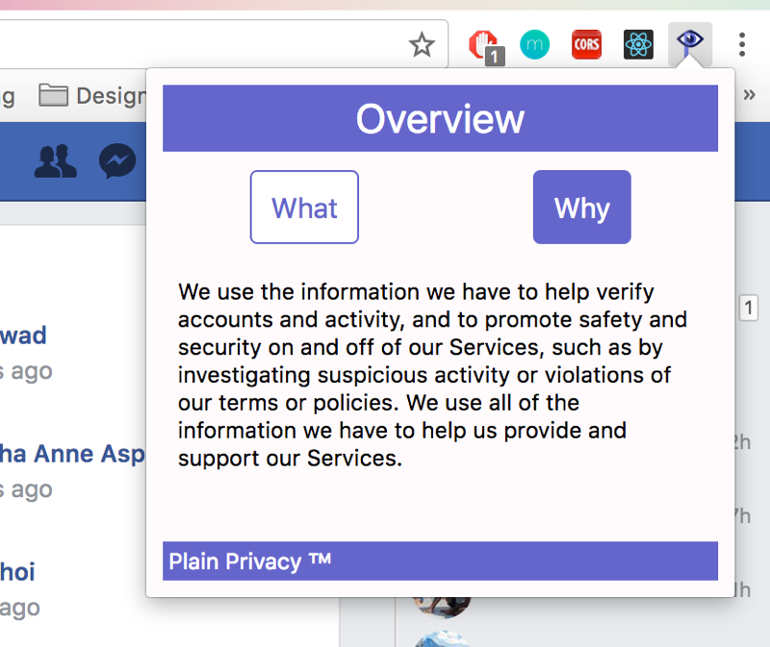

Slide 7
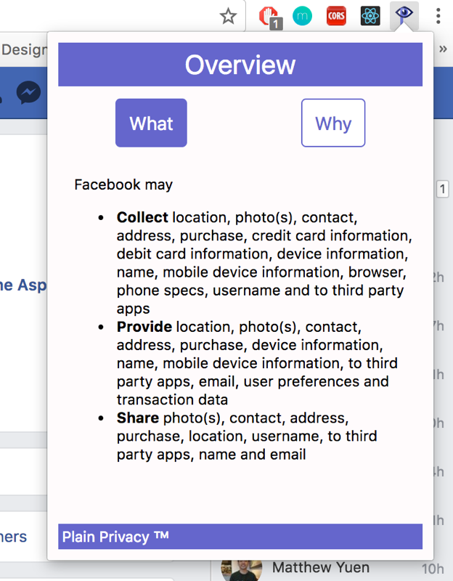

Slide 8
Technical Depth
Created asynchronous Chrome Extension reflecting data from backend server
Wrote NLP algorithm to parse out key terms and phrases
Front-end edge cases

Slide 9
Next Steps: How To Improve
Improving NLP algorithm to be smarter, and more cognizant of context
Improving Privacy Policy search algorithm to be able to find links on more websites
Applying similar techniques to other legal documents such as Terms & Services

Slide 10







Team

Slide 11
lain Privacy

