Slide 1
AlphaZero for Multiplayer Control:
Using a Sledgehammer to Crack a Nut
Notes:
Conversely to all of your project, I’m not looking for a solution to a problem. I have a solution that needs a problem

Slide 2
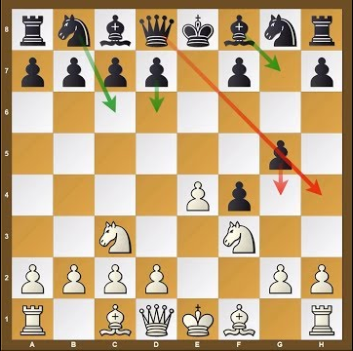
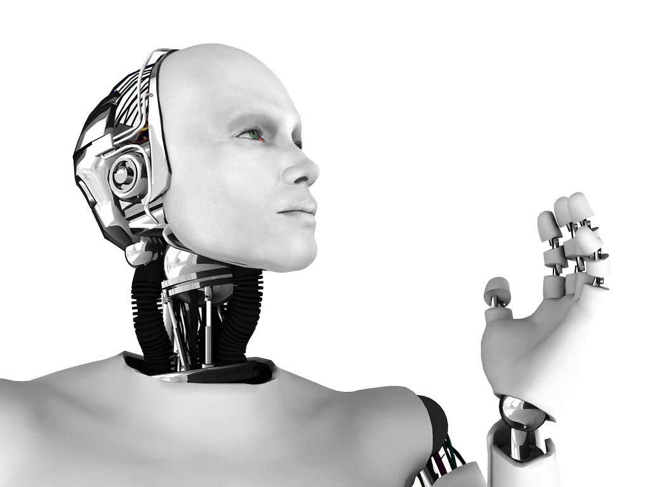
What is AlphaZero and How Does it Learn?
Turn-based self-play
Policy/Neural-Net Iteration
> 60% games won
Policy = p(a|s)
Notes:
AlphaZero is the best general board game AI in the world winning 100–0 against the previously published, champion-defeating AlphaGo.
Learns a policy - i.e. a probability over all actions when given a board state
It plays against itself - picking the moves that it thinks will do best, whilst inconveniencing the opponent the most (which is itself)
Randomness in the moves picked gives the variability within games & allows it to actually win
Uses two key algorithms: A convNN and MCTS
Requires no initial information! Only the system dynamics i.e. it needs deterministic simulation
It improves the nnet by creating two nnets and playing current vs previous policy. If the frac games won > 0.6 then accept the new policy
Bit abstract but will explain next. Simply, policy=nnet and predicts the actions you should take given the state

Slide 3
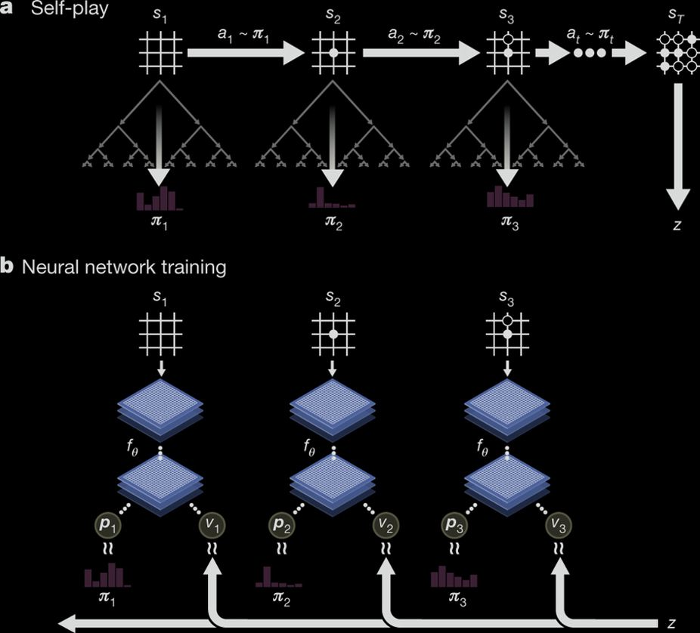
Self-Play & Training
Each state has a MCTS
z = {-1, 1} is the winner from the perspective of the player at the end state, s_T
MCTS (π, v-avg)
Neural Net (p, v). Note, nn = policy
Notes:
Players take turns in making a move
At each state MCTS is performed
Improves the vector of probabilities over each possible action compared to simply using the policy/nnet.
Each state is given a value wrt the player playing. This estimates the probability of the current player winning v = [-1, 1]
An action is sampled from pi & continue switching players until the episode ends
Network is trained so v-avg is closer to z and p is closer to pi

Slide 4
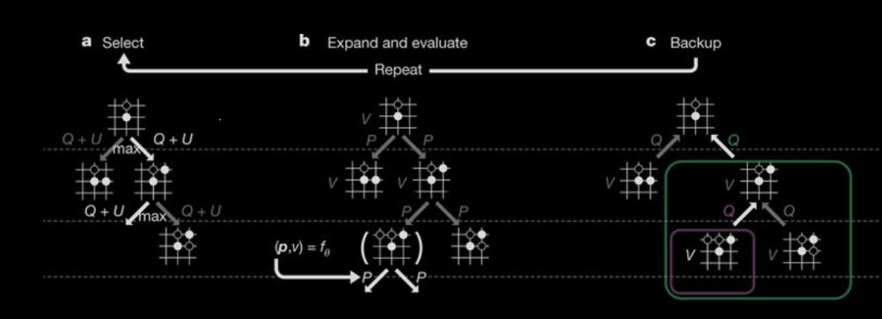
Monte Carlo Tree Search
Notes:
First it moves down the part of the tree already made, selecting moves by maximising the current action value + upperbound (not important).
Until it reaches a leaf node, at which it evaluates the current nnet to get (p, v) for that state - but doesnt take an action
It then backs up Q and N values by taking averages.
Q values are estimates of the state value and N is the times visited that state
Then repeat, or if finished Pi is then returned as \propto N(s0, a)
These values are saved for the next step

Slide 5
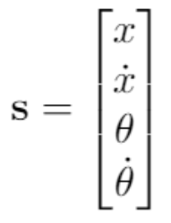
Problem: The Inverted Pendulum
Opponent Pushing Cart
Notes:
So how do we solve control problems with the alpha zero algorithm?
Start with the simplest problem: cartpole
Need to solve 3 problems:
We a 4D state space with continuous values, AlphaZero has a 2D state space with discrete values, how do we convert to this?
We can’t use whether we won or lost for the state-value: Ideally we stay up indefinitely, and how would we categorize how well we did?
Our opponent can’t be an equal adversary, we are already fighting against gravity.
Do we alternate steps and only give them 0.5F for each push?
Could do once every 3 steps
Could push somewhere else - top of the pole, or add some adversarial torque

Slide 6
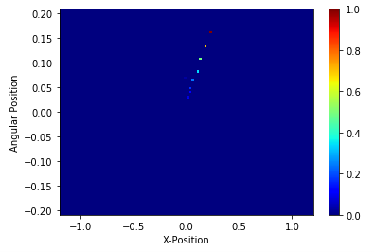
2D State?
State Value?
Expected Average Error from being upright
v = - θ - c x
Q = sub-tree avg(discounted v’s)
Possibly tanh(Q) ?
2
2
Notes:
We can represent our 4D state space by using a technique called discounting
We take the previous state and discount it (multiply by 0.7) and add the new position
This gives what looks like a position trajectory through space & encodes angular velocity and position
Crucially, looks like an image! So we can put this through our conv nnet!!
What discounting factor do we use? 0.7, 0.5? Don't know, 0.5 good because if we go back to the previous position it is unambiguous as to how we got there (⅝ = ½ + ⅛) only. How many bins do we discretise to? Have 100x100 here. Go is 64x64
A possible analogue to z=winner is to minimise the expected average squared error, I.e.
Each state is given an error, v
The value is then the average of future errors + the error in that state, where the future errors are discounted: So nearer states have more weight
Still need to implement this
An adversary would then try to maximise this error, but have a more limited means of doing so

Slide 7
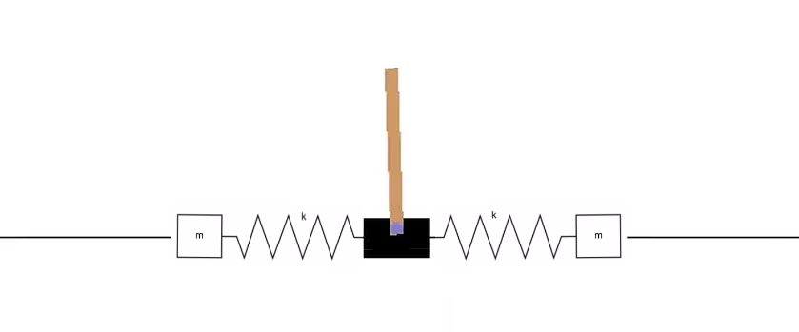
Future Considerations
Notes:
To start with, increasing the complexity of the system, e.g. by adding some phase lag to the system (or requiring phase lead by the controller)
Increase the state space dimensionality
Eventually we want a robust algorithm that, once you define how the three changed components (Opponent, state value and discretisation/converting to 2D), we can apply to a whole range of control problems
i.e. show that AlphaZero can be used as a robust general purpose control algorithm

Slide 8
Questions?

