Slide 1
Task 1.1 Exploring Vocabulary Learning Apps
Submitted By – Minal Bombatkar

Slide 2



The apps I will be looking at are
Vocabu words
Vocabulary Builder English Words offline
Duolingo
Learn Languages Free
Quizlet
flashcards & study tools

Slide 3
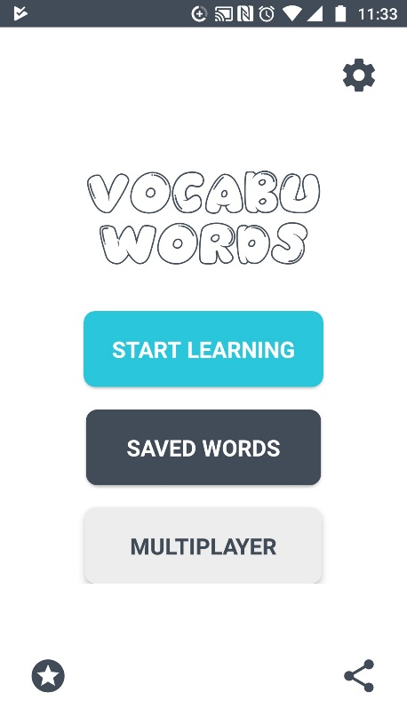
Vocabu words Vocabulary Builder English Words offline
Vocabu words app that lets to learn new English words using its interactive Flashcard Quiz format and help to improve English Vocabulary. This app has WORD OF THE DAY feature provides user with an English Word every day so that learn a new English word every single day, user are reminded to learn new Vocabulary words by playing this Vocabulary Builder app every day with motivational quotes, so you don't lag behind.

Slide 4
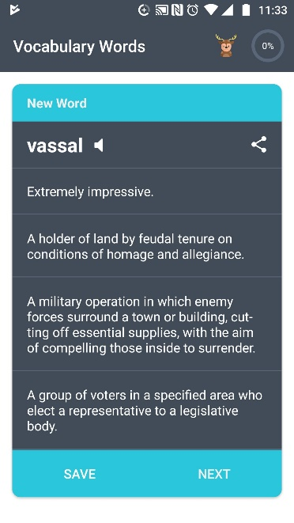
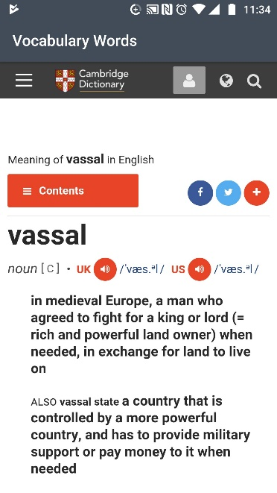
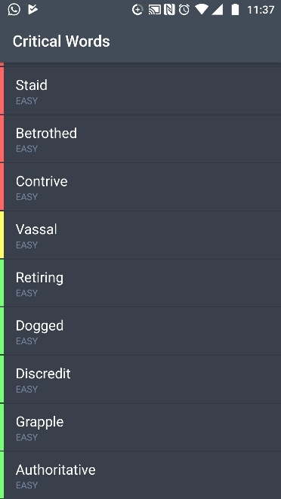
Vocabu words Vocabulary Builder English Words offline
Positive:
Offline mode: It perfectly works offline, just to take updates it requires internet
Start with your level: a very good way to start your learning journey, as the app gives you a possibility to start from Entry level to Expert level options
Easy to navigate: It is easy to make your way through the app
and find what you need
4. Pronunciation feature: New words in lessons come with a
Audio which gives a human touch to the the learning process
Fluency % wheel: a great indicator to see learning process, which also helps to set goals
Daily remainder: The best feature to keep user engaging is daily remainder alarm, It comes with auto pop up on users mobile
Advertise free: This app is totally advertise free, It is good quality to keep away from distraction while learning

Slide 5
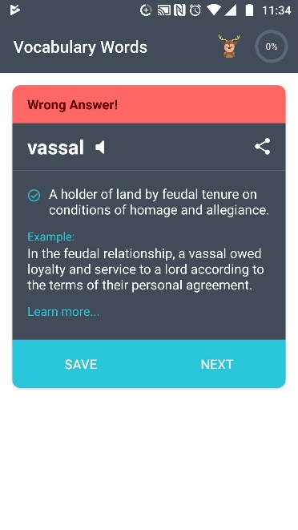
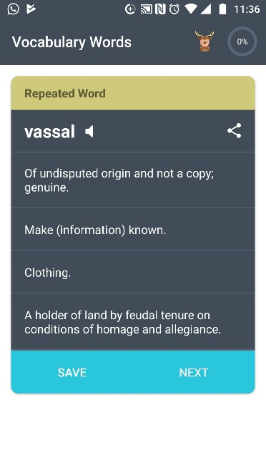
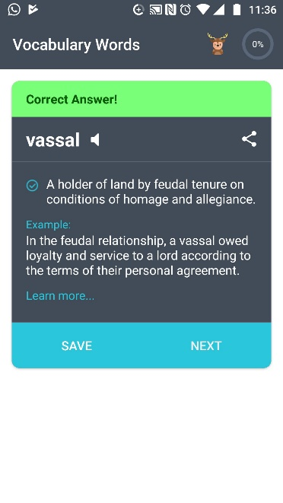
Vocabu words Vocabulary Builder English Words offline
Negative:
Unlaunched Multiplayers option : Multiplayers option is not available to play game with friends
Basic Design: Design is not bad, but not great, The design is grey based and it lacks of animation factor.
Lack of learning methods: The app fails to provide learning options such as picking the right word, matching pairs, fill in the blank etc.
Missing interaction: Missing of interactive interaction, it helps to keep the user active and relax
This app successful because it work offline as well as it has feature such as Flashcard quiz format ,See Your Progress, Word repetition, Words categorised based on difficulty, Save favourite words, Definitions and Examples for every word also it’s daily remainder to keep user engaging with learning. Even through it is fail to provide varieties of learning methods and interaction design. Which is must in today world.
Summary

Slide 6
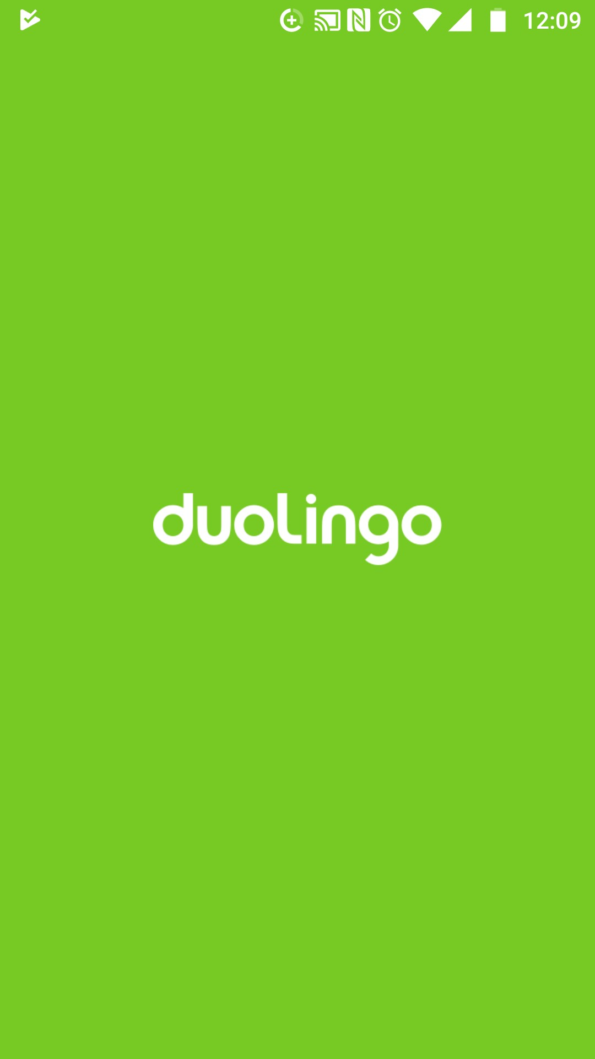
Duolingo Learn Languages Free
It help in practice speaking, reading, listening and writing skills while playing a game! User will improve vocabulary and grammar skills by answering questions and completing lessons. Start with basic verbs, phrases, and sentences, and learn new words daily. It is a free platform that includes a language-learning app, as well as a digital language proficiency assessment exam. As of it offer 85 different language courses in 24 languages. The app has about 300 million registered users across the world.

Slide 7
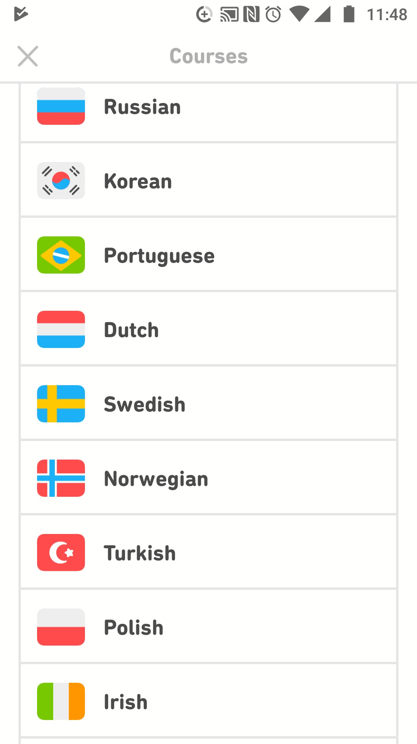
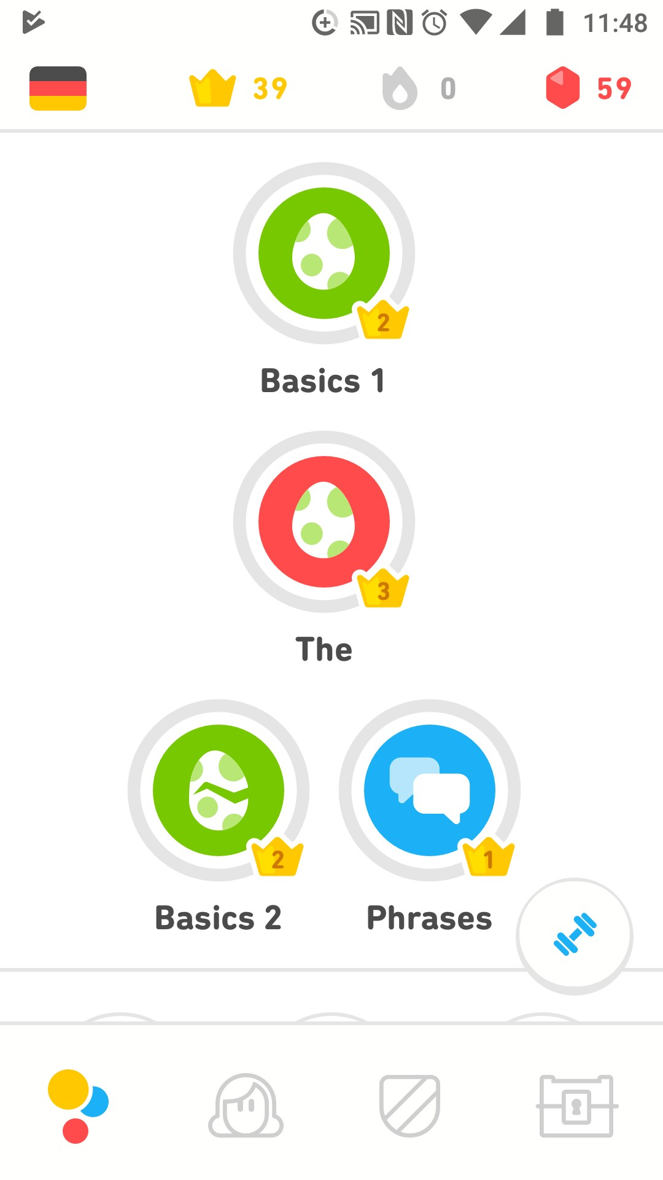
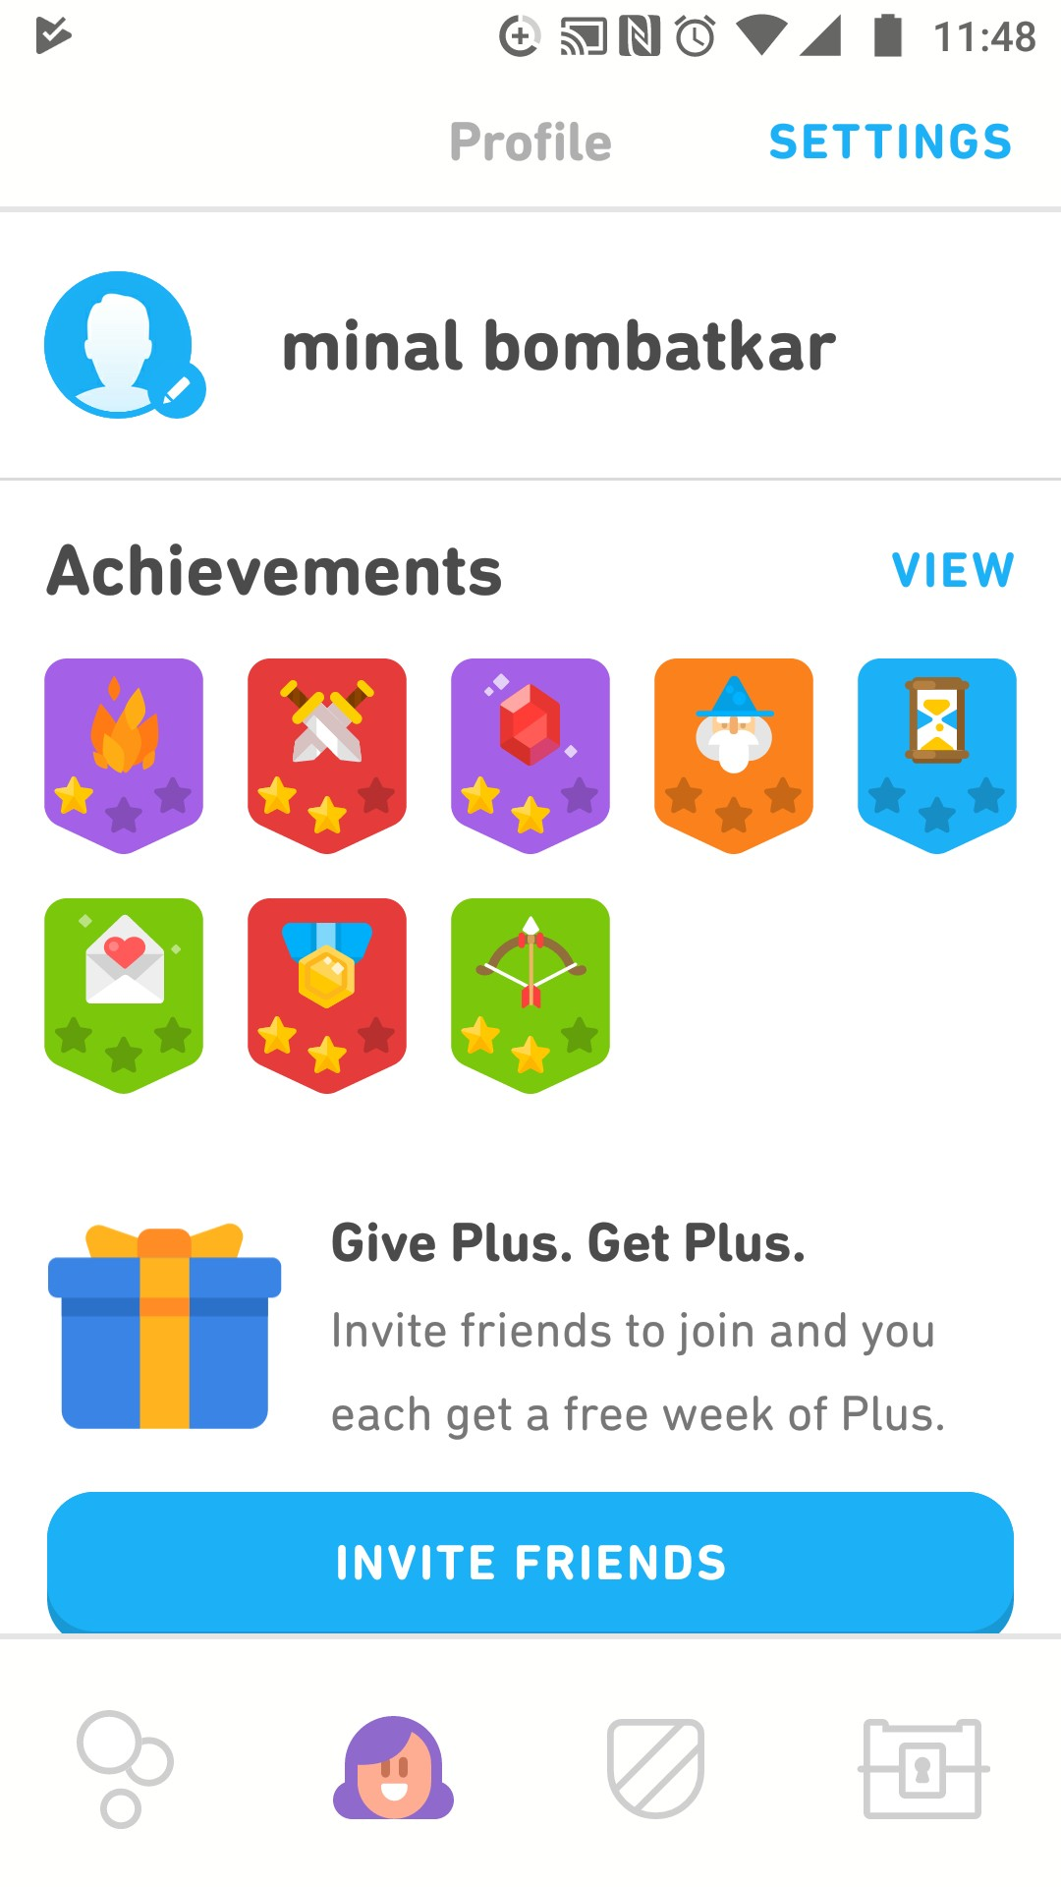
Duolingo Learn Languages Free
Positive:
User-friendly design: The mobile app is very with neutral
design and without extra fuzz, simplicity is the key
2. Interface: Duolingo’s design is clean, intuitive, and highly engaging, with a straightforward interface and built-in gamification elements
3. Smooth onboarding: Especially important for first-timers, Duolingo goes out of its way to make language learning fun
Variety of learning methods: The lessons offer a variety of
learning options such as picking the right word, matching
pairs, pronouncing the word
4. Motivational elements: the user can achieve higher level
crowns, power-ups, earn lingot – this should definitely keep
the user engaged
5. Resources: In addition to interactive lessons, Duolingo offers practice quizzes, explanations, a grammar guide. Which encourage learners to follow and translate real-world dialogue.

Slide 8
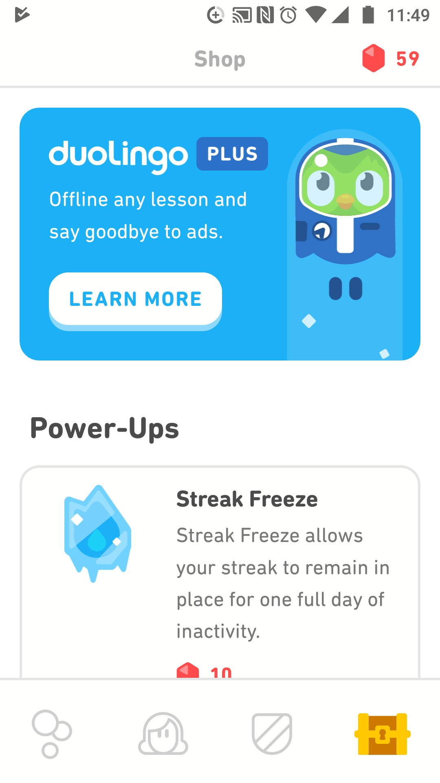
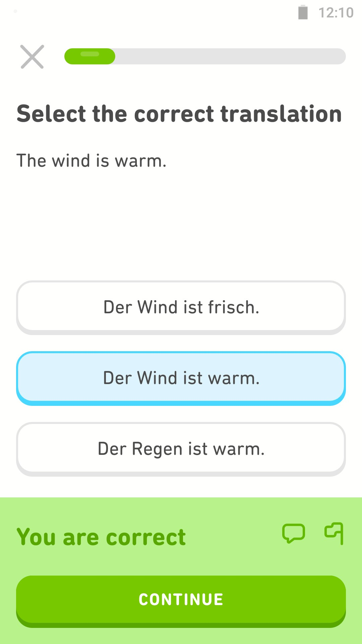
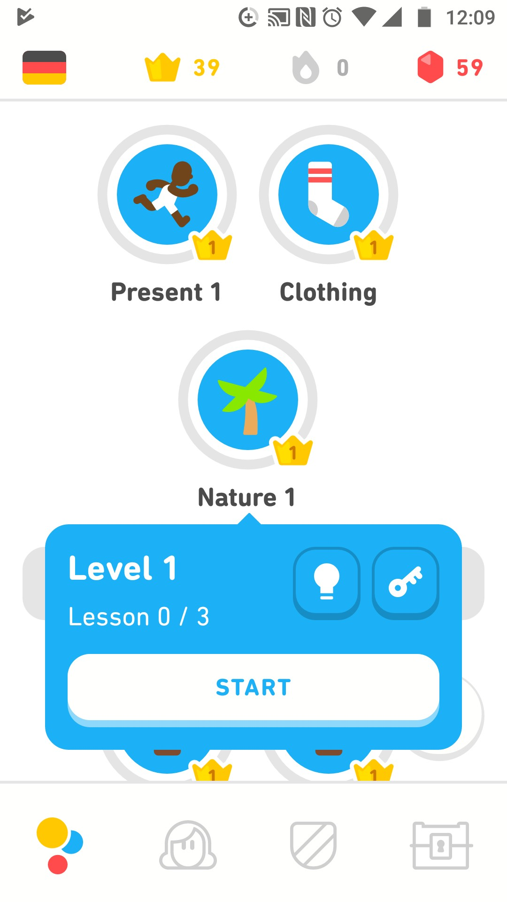
Duolingo Learn Languages Free
Negative:
It create occasionally awkward sentence constructions, i.e., sentences that had probably never use in the real world
The voices are lower than the "ding!“ that is pronunciation of the word should be louder than submitting sound.
Level up is revision: level up does not open new content and
learning material, but will just give access to the same lesson
in different order and format.
This app successful because it provides speaking, reading, listening and writing skills while playing a game! Motivational elements that user can achieve higher level crowns, power-ups, earn coins, it make
the user engaged. It’s User-friendly design make it best to paly with it. Even through it is fails by create occasionally awkward sentence constructions with may not be use in real life.
Summary

Slide 9
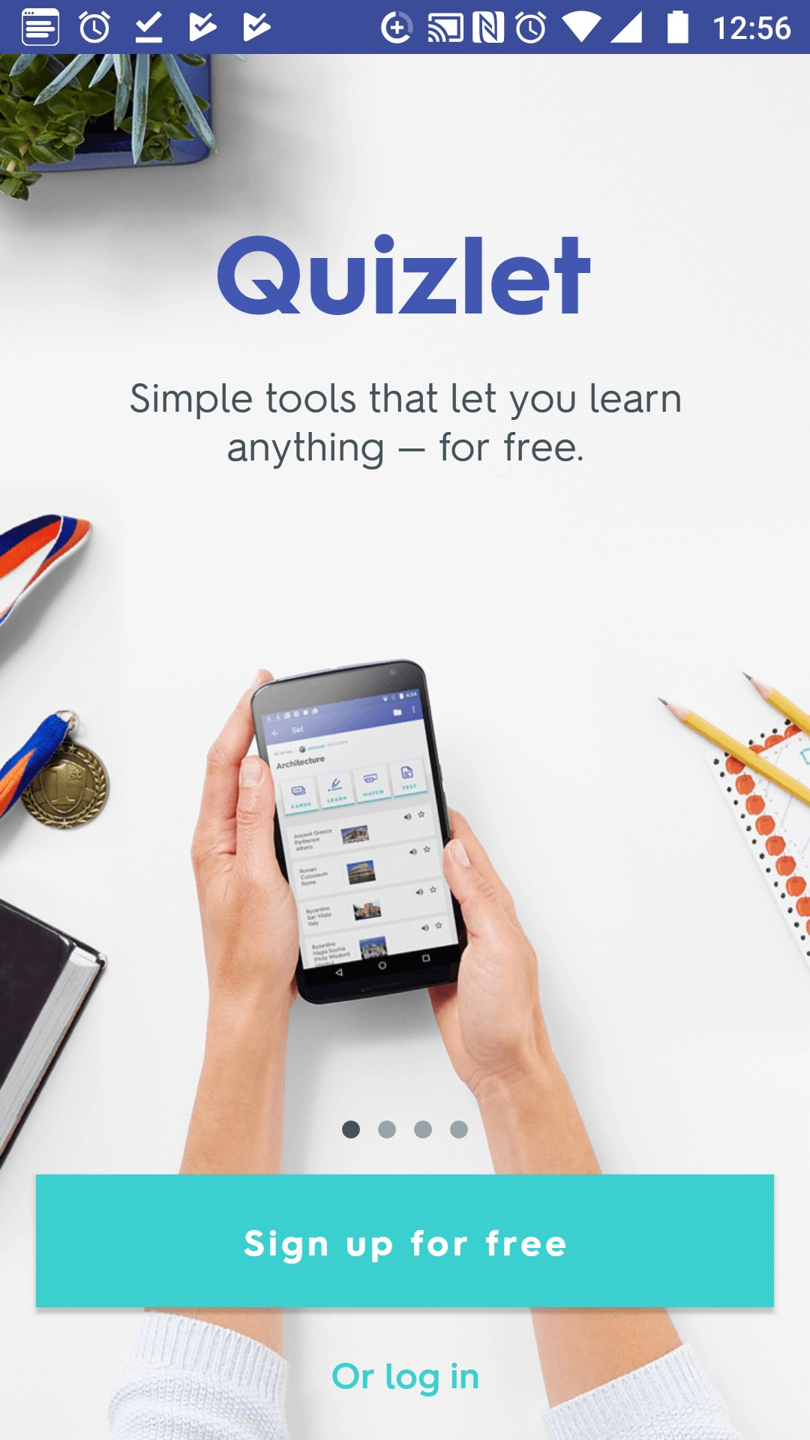
Quizlet flashcards & study tools
Quizlet is the easiest way to practice and master you’re learning. Create your own flashcards and study sets or choose from millions created by other students. More than 30 million students study with Quizlet each month because it’s the leading education and flashcard app that makes studying languages, history, vocab and science simple and effective.

Slide 10
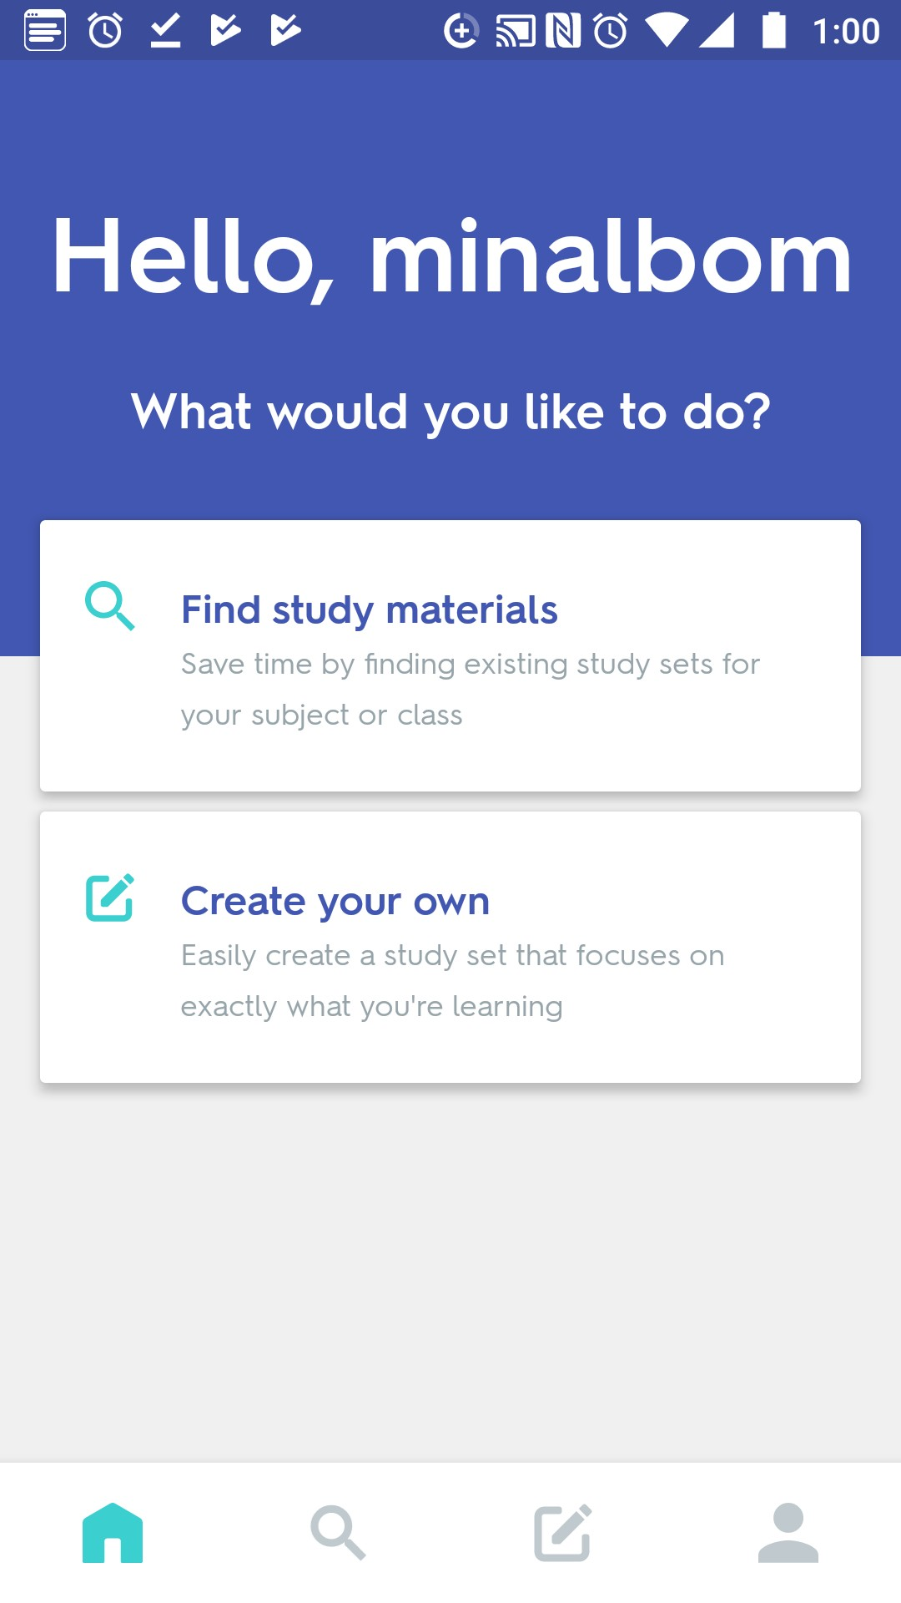
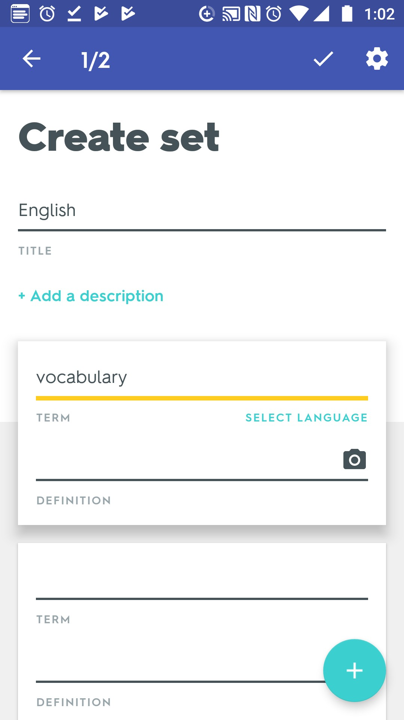
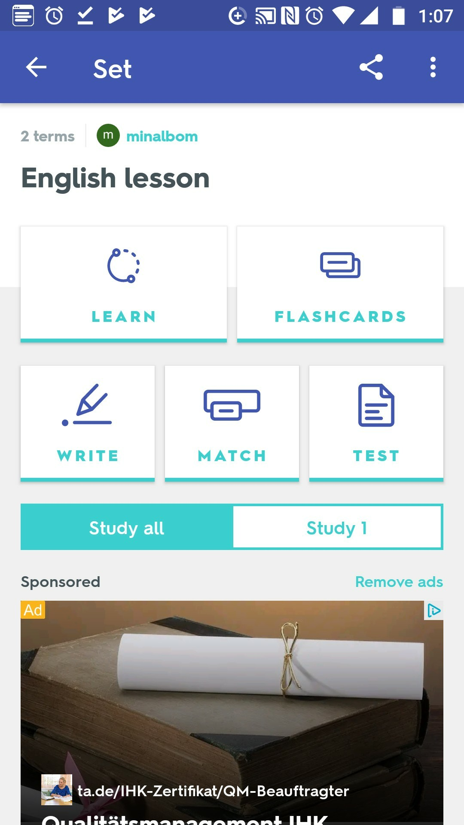
Quizlet flashcards & study tools
Positive:
On boarding: It’s easy to set up account and get started
Navigation: Simple, concise home screen makes navigation easy
Interface: Interactive and intuitive interface and built-in gamification elements
4. Variety of learning methods: Multiple study tools such as flash cards, matching, quizzes, tests, etc. It helps to keep learning
5. Learn from mistakes: Gives reasoning behind learning methods
and sets goals to achieve. Displays correct answers so user can
Learn from mistakes
6. Create your own flashcards: It provides feature in which user can create own Flash card and study sets or choose from millions created by other students

Slide 11
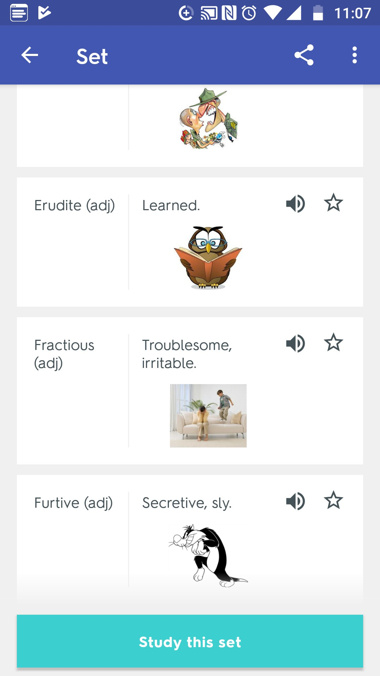
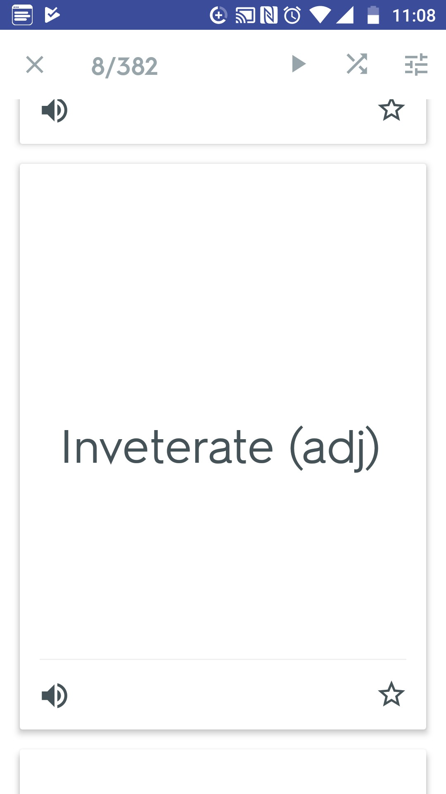
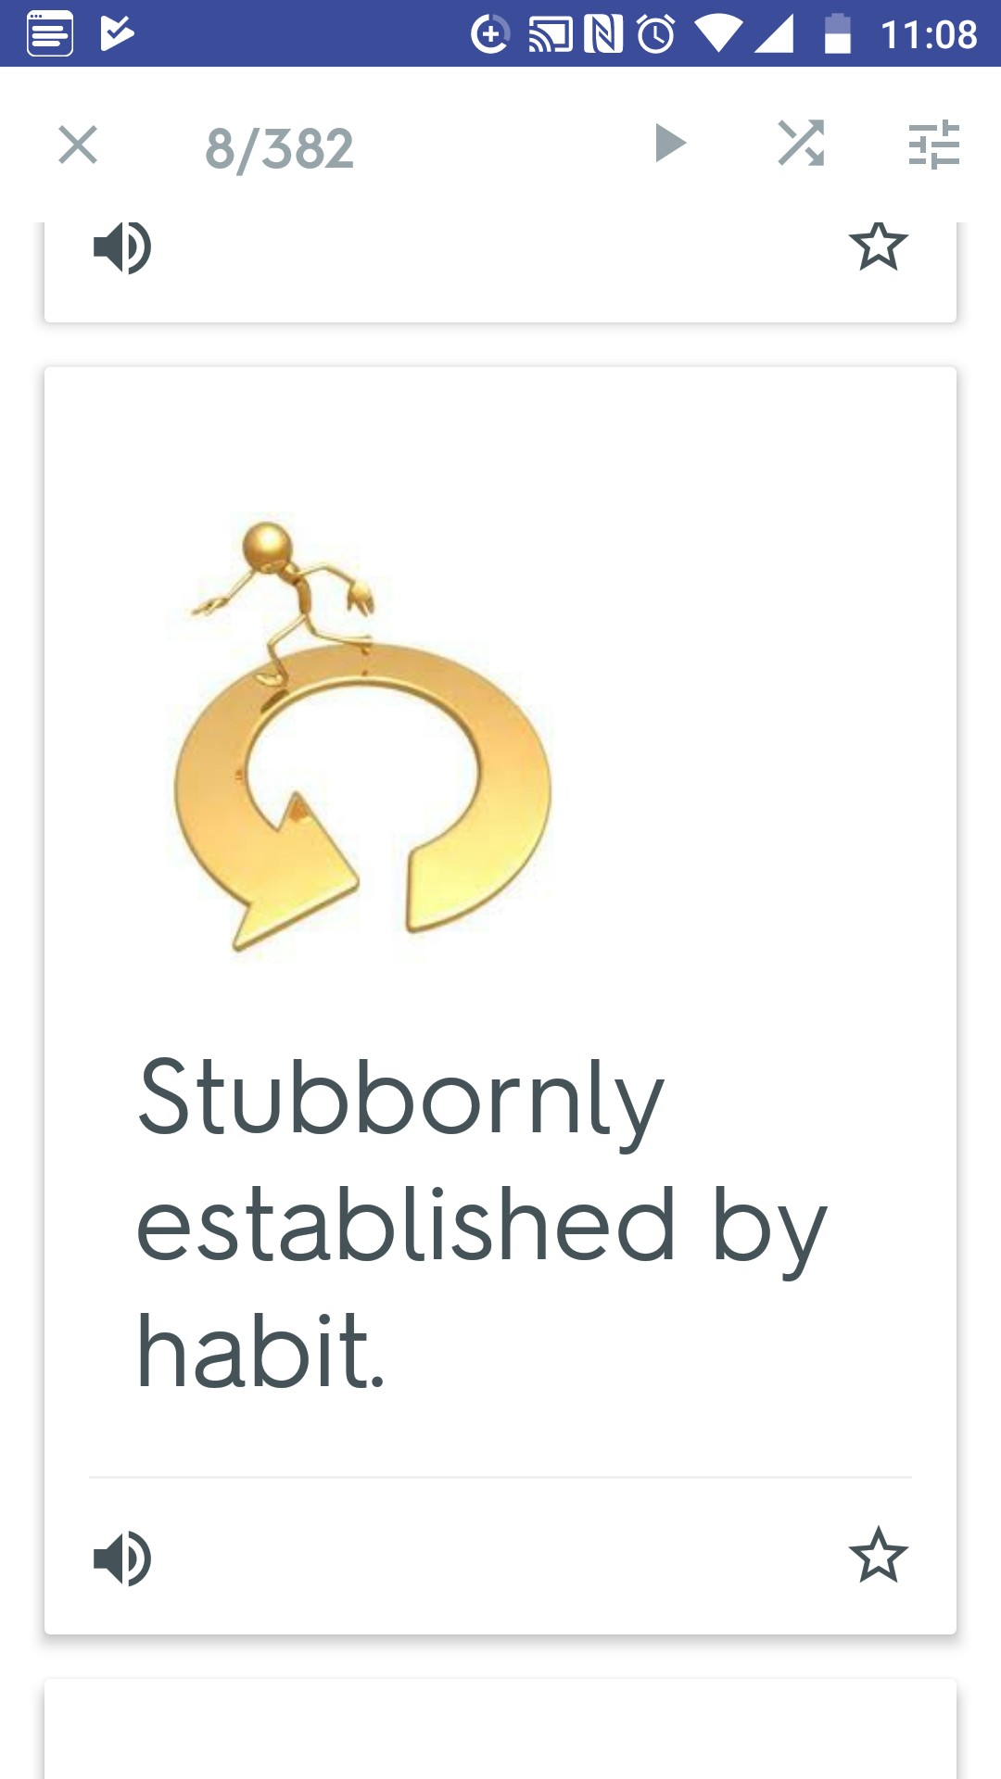
Quizlet flashcards & study tools
Negative:
Not all features are available to free users. Such as ad-free studying, Night Theme and offline access or get Quizlet Plus for all that AND image uploading, an unlimited number of classes and even more.
Ads appear on screen while studying, can be distracting to user.
Lack of motivational things to keep user engaging.
Summary
This app successful because it provides Multiple study tools such as flash cards, matching, quizzes, tests, etc. It does Not provide all features to free users and monthly fees is costly that is point this app fails.

