Slide 1
BEX.AI
Artificial Intelligence (AI)
Machine Learning (ML)
Deep Learning (DL)
Epoch 0: Intro
Speaker
Alexandru Constantin
Notes:
F pe scurt despre mine, pt cine nu stie
Azi va fi o sesiune f light, introductiva – imi pare rau sa ii dezamagesc pe cei entuziasmati sa scrie cod

Slide 2
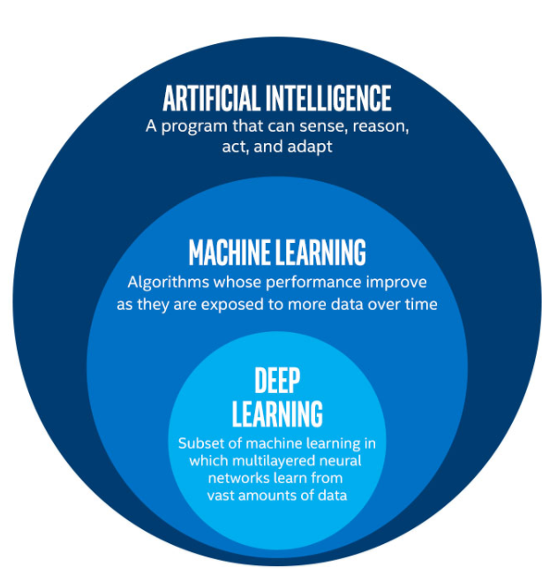
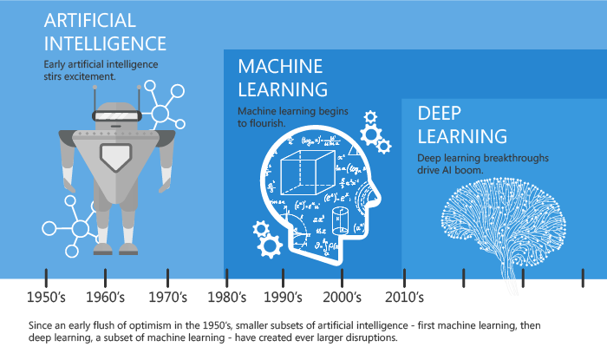
AI vs ML vs DL
Notes:
Unii prin ML inteleg doar shallow/traditional ML – terminologia e neimportanta

Slide 3
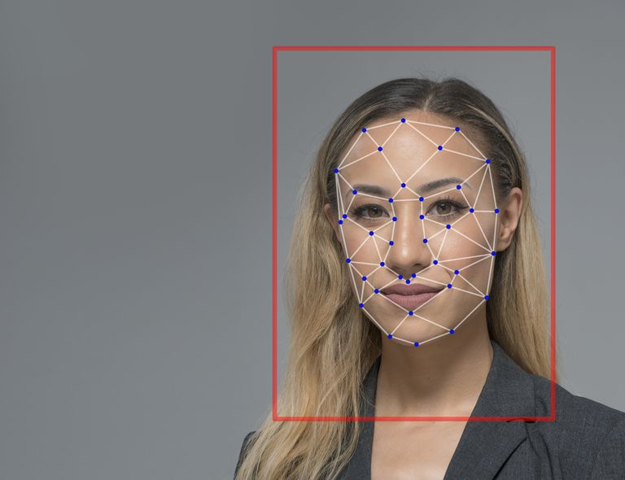
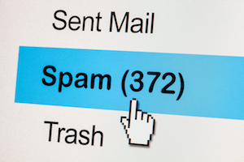

What kinds of business problems can ML handle?
Is the business process complex enough to qualify for ML?
Do you have new, clean data?
Is your data _correctly_ labeled, if at all?
Can (small) errors be tolerated?
Notes:
De ce ML? viteza, eficienta, scalare, reducere de costuri (exemplul cu spell checker)
De ce ML? pt mine - poti rezolva probleme care altfel nu ar avea rezolvare (face detection, understanding speech)
De ce ML? schimba modul de a gandi despre o problema (din determinist in experimental)
Ar putea fi structurata problema intr-o serie de expresii if-else?

Slide 4
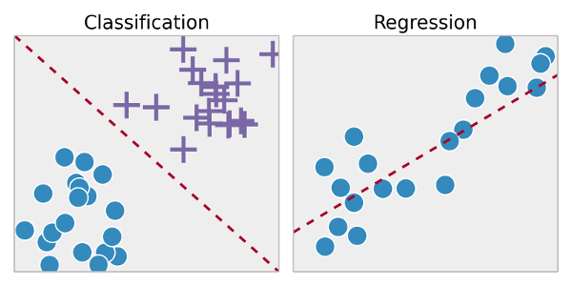
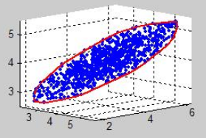
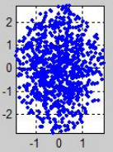
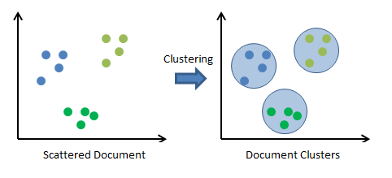
Machine learning overview
A computer program
is said to learn from experience _E_
with respect to some task _T_
if its performance measured by _P_ improves with experience _E_
Supervised learning
Classification
Regression
Unsupervised learning
Clustering
Dimensionality reduction
Notes:
E = mutarile unui joc de sah, T = a juca sah, P = ELO rating
Supervised – predictia unui output bazat pe un input (discret sau continuu) – avem exemple de input si output
Unsupervised – interpretarea datelor fara label
La baza, orice problema de ML supervised se reduce la o functie care mapeaza din input in output – cu cat e mai complexa cu atat poate prezice ceva mai complex

Slide 5
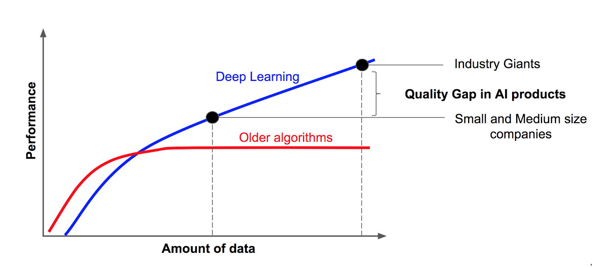
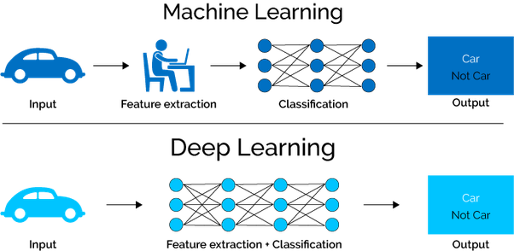
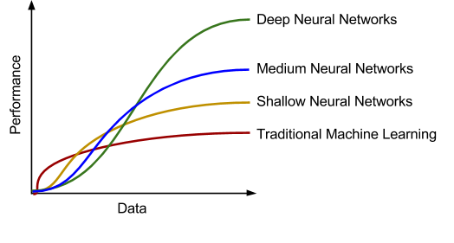
ML vs DL
Notes:
Spre deosebire de slide-ul initial, aici ML face referire la “traditional/shallow” ML
Imaginea de la classification de la ML e misleading, de fapt, acolo se poate aplica orice algoritm de ML (logistic regression, random forests, boosting, SVM etc.)
De ce are rezultate mai bune ML traditional pe putine date?

Slide 6



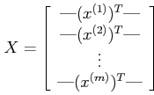

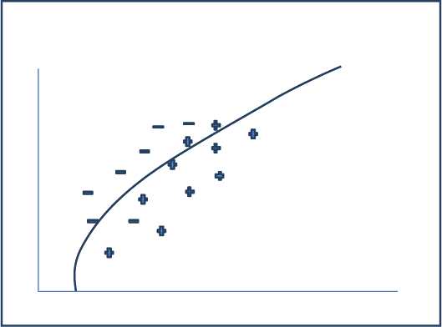
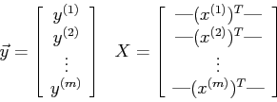
Traditional ML example: CV Pre-filtering
pdf2str
str2structured
predict
structured2features
train
Notes:
80% din efort a intrat in partea non-ML

Slide 7
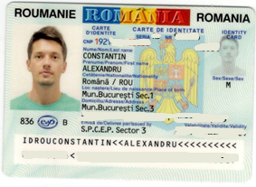
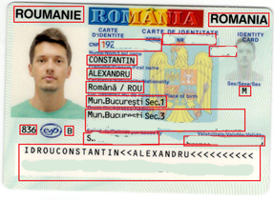
Hybrid DL example: Parsing MRZs from IDs
1. Identify MRZ(s)
2. Apply OCR on MRZ(s)
{
"first_name": "ALEXANDRU",
"last_name": "CONSTANTIN",
"number": “BD624585",
"birthday": "05/10/1992",
…
}
3. Process on a country basis
IDROUCONSTANTIN<<ALEXANDRU<<<<<<<<<<
BD624585<1ROU654146454666M42121
192xxxxxxxxxxxx
ALEXANDRU
CONSTANTIN
BD 624585
Mun. Bucuresti Sec. 1
…
Notes:
Step 1 involves deep ML (train a neural net to detect these boxes)
Step 2 involves ML (usually deep ML - LSTMs), but we can find good enough open source implementations, like Tesseract
Step 3 may actually not require ML (just a bunch of regexes and if statements), but it must be implemented and tested for each and every type of ID

Slide 8
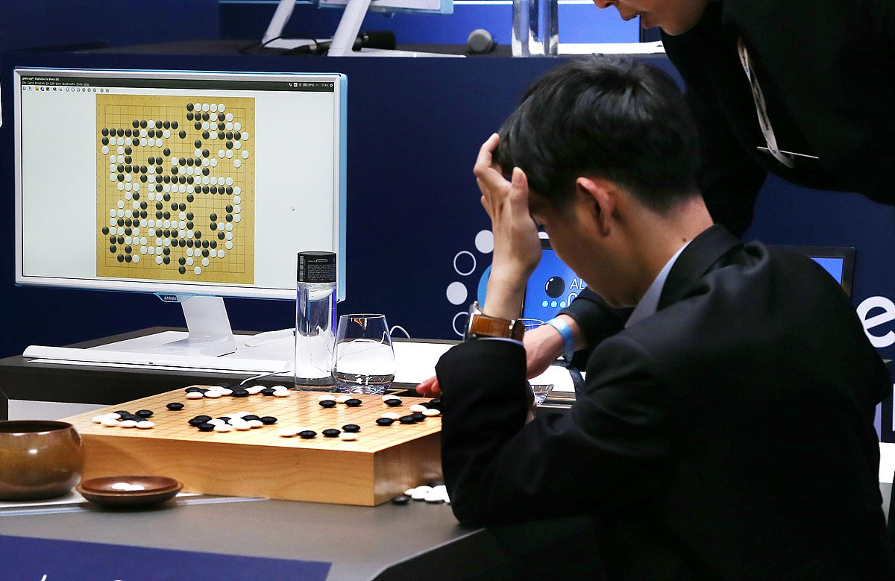
Well-known DL example: AlphaGo
October 2015: defeated Lee Sedol (9-dan)
10¹⁷⁰ board configurations (10⁸⁰ atoms in the universe)
Notes:
Sahul a putut fi rezolvat cu algoritmi buni, euristici, brute force si putere computationala (aproximativ 10^45 configuratii)
AlphaGo nu se putea, era nevoie de ceva care sa invete
Intre timp au fost mai multe iteratii care i-au ridicat ELO-ul de la ~3700 cat avea cand a castigat cu Lee Sedol la 5200+

Slide 9
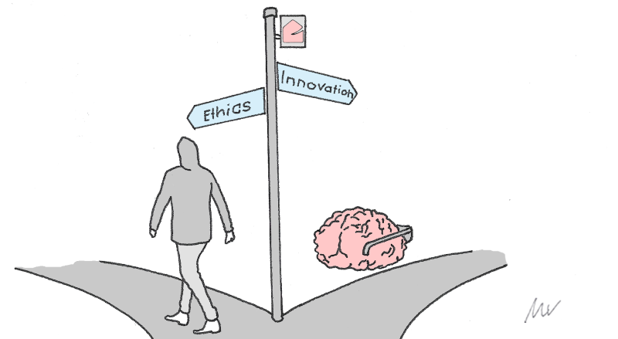
Ethics of AI
Bayes error
Human level error
AI doctor problem
Trolley problem for autonomous vehicles
Job automation problem
The singularity

Slide 10




BEX.AI course
Traditional ML
Supervised
Linear regression
Logistic regression
Regularization
Support vector machines
Optimization, best practices
Unsupervised
Clustering
Dimensionality reduction
Anomaly detection
Recommender systems
Deep ML
Neural networks, backpropagation
Tuning, regularization, optimization
Deep ML workflow
Convolutional neural networks (CNNs)
Sequence models (RNNs)
(G)ANs, autoencoders*
Reinforcement learning*
Notes:
Asta e tot ce am putea acoperi - este f mult, in functie de interes si vointa vom vedea cat de mult intram in detalii

Slide 11
Thank you alexandru.constantin@db.com
goo.gl/4CRjP5
Coursera machine learning course (Andrew Ng) FREE
Coursera deeplearning.ai specialization (Andrew Ng) $50/month
Fast.AI deep learning courses (Jeremy Howard) FREE
Kaggle competitions
Read well known scientific papers
Read new / state of the art scientific papers
Notes:
Va reamintesc ca daca vreti sa primiti invitatii pentru sesiuni viitoare trebuie sa dati Attend/Tentative pe event-ul de pe myDB

