Slide 1


Slide 2
Hate Speech Detection: A Solved PROBLEM?

Slide 3
Hate Speech Detection: A Solved PROBLEM?

Slide 4
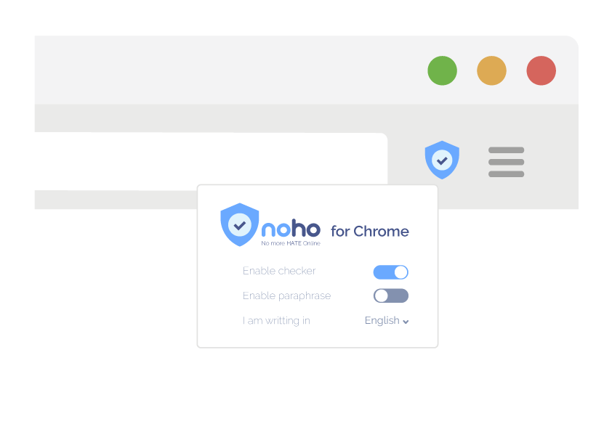
Chrome extension

Slide 5
Technical difficulty
FUN

Slide 6
Dataset and Experimental Settings

Slide 7
Results and Analysis

Slide 8
Innovation ??

Slide 9
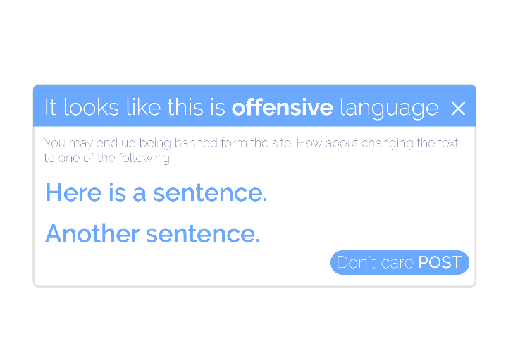
Business
aprouch

Slide 10
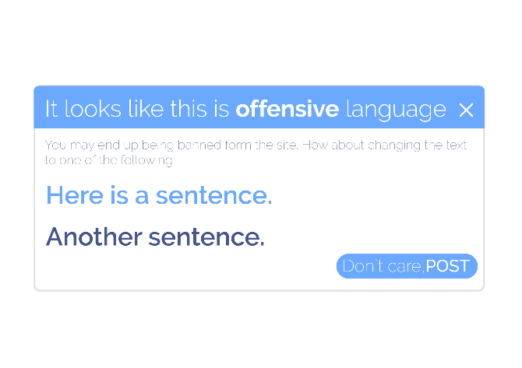

Slide 11
Growth PERSPECTIVES

Slide 12
Growth PERSPECTIVES

Slide 13
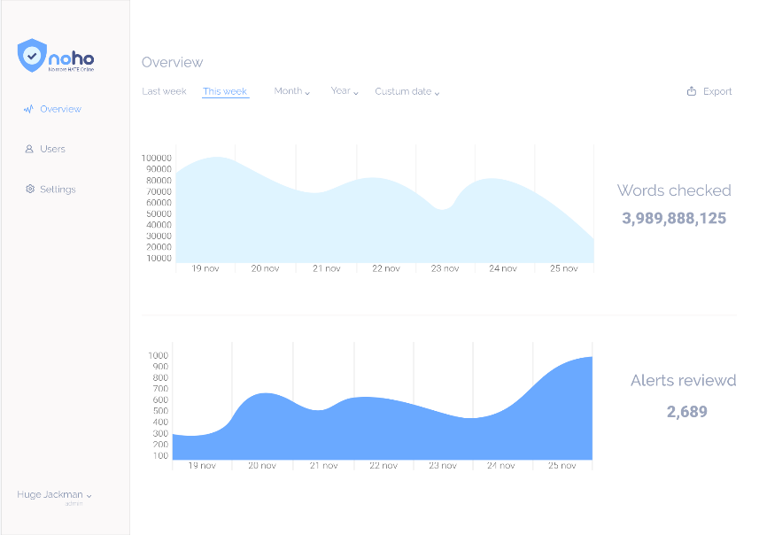

Slide 14
You can ensure that emails, documents, and even casual interactions will be clear, and peaceful. No hates alloweded !

Slide 15
Growth PERSPECTIVES

Slide 18
No more slides It`s time for DEMO

Slide 19
TEAM

Slide 20
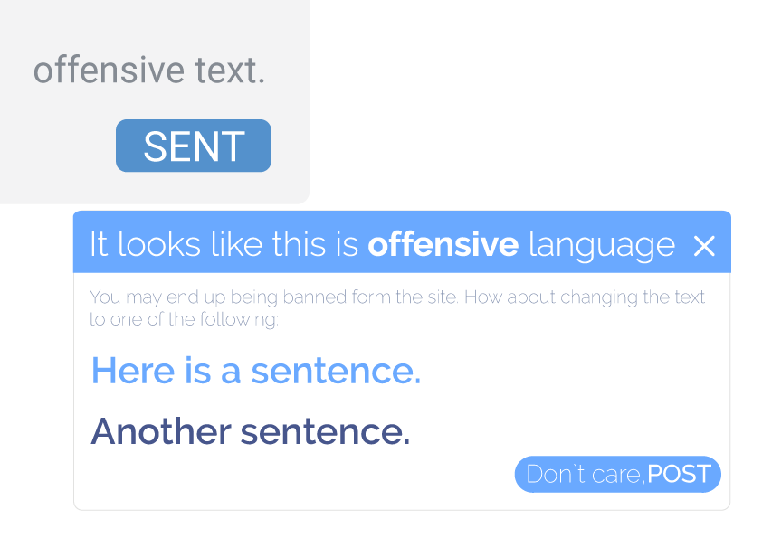

Slide 21
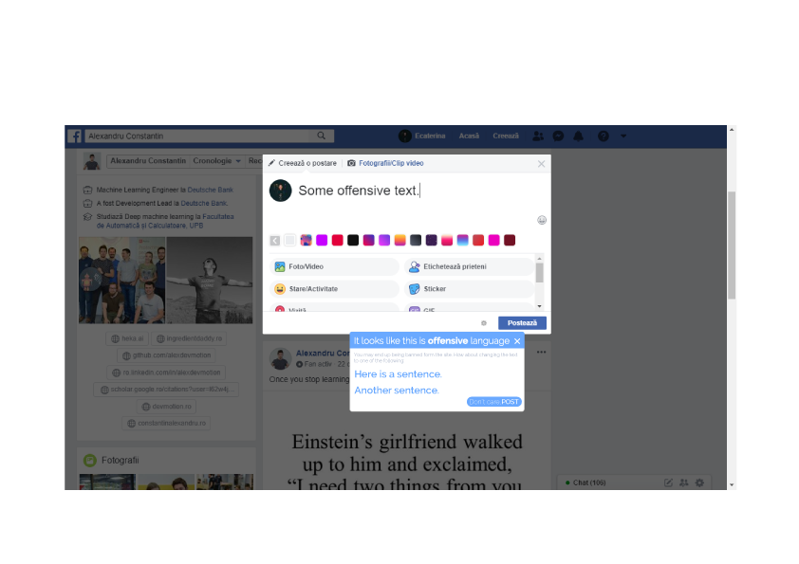

Slide 22







Tech stack

