Slide 1

Notes:
Noi suntem no-ho si misiunea nostra este sa eliminam hate speech ul din mediul online

Slide 2
Hate Speech Detection: A Solved PROBLEM?
Notes:
Cresterea exponentiala a popularitatii social media a revolutionat modul in care comunicam, dar a accelerat raspandirea hate-based activities.
Datorita: anonimitatii si mobilitatii

Slide 3
Solutions
Manual / automated tagging?
Regulation?
Reporting?

Slide 4
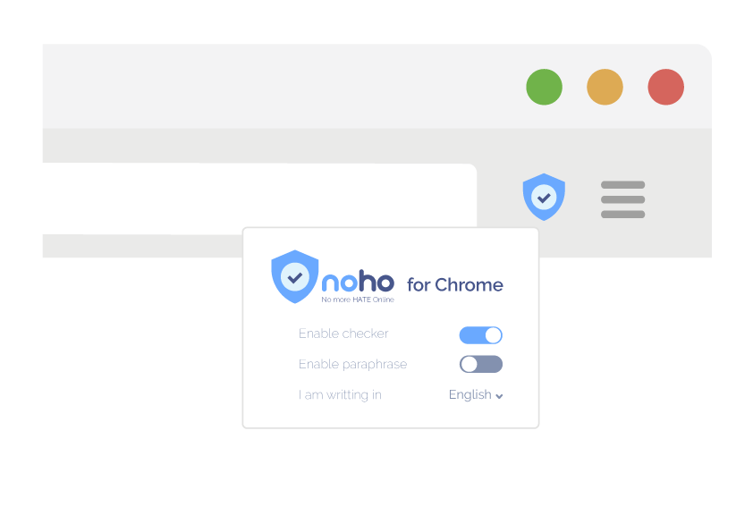
Chrome extension offensive language paraphraser
Notes:
Ca prim pas, idea noastra este sa dezvoltam o extensie pentru Chrome
Open source, pentru a demonstra tehnologia, construit aici
Scopul este este de a creste awareness-ul legat de hate speech, nu de a cenzura

Slide 5
Technical difficulty
FUN

Slide 6
Train pipeline

Slide 7
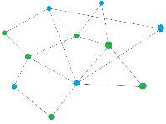
This is an extremely {offensive_word} sentence!
This is an extremely {less_offensive_word} sentence!
Identify offensive tokens
via
IBM Watson
Natural Language Understanding
Filter offensive tokens by POS
Replace offensive tokens one by one in the original sentence
Query Twitter GloVe embeddings for similar tokens
Store offensive to non-offensive mapping in a graph cache
Check if the replacement was successful

Slide 8
Paraphrase pipeline

Slide 9
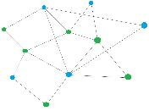
This is an extremely {offensive_word} sentence!
Lookup the offensive token in the graph cache
Not found
Trigger ad hoc training
Are there offensive tokens left?
via
IBM Watson
Natural Language Understanding
Replace offensive tokens one by one
Found
This is an extremely {totally_un_offensive_word} sentence!

Slide 10
Data
Pre-trained Twitter GloVe embeddings
Scraped Twitter for offensive tweets

Slide 11
Known & solved issues
Facebook security hurdles
IBM Watson poor swear-word detection
Finding less offensive but similar meaning tokens
Notes:
Content security policy (https, .com)
CORS
Rezolvat cu websockets

Slide 12
Tech Stack

Slide 13







Slide 14
Growth PERSPECTIVE

Slide 15
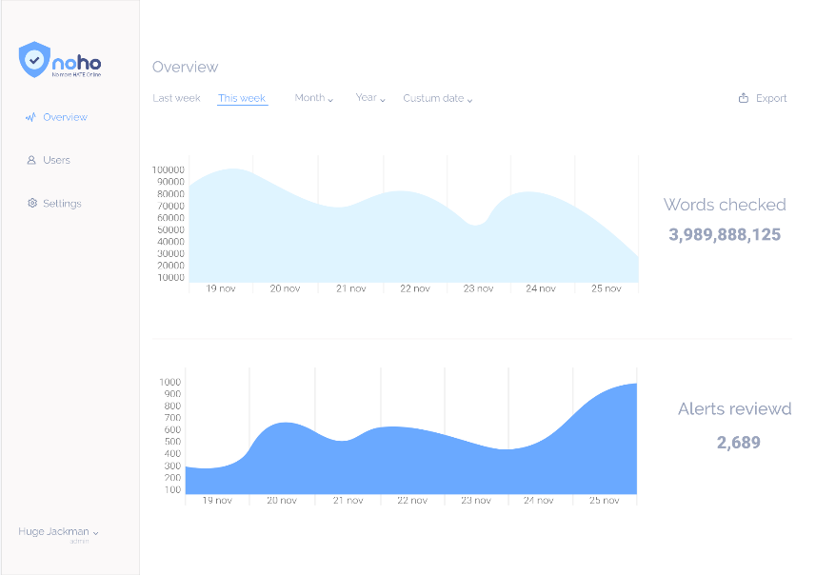
Business approach
Notes:
Ne-am gandit si la partea de viitor: idee de a vinde un produs catre companii
Poate deveni un requirement pe partea de regulation

Slide 16
No more slides It`s time for...

Slide 17
THE DEMO

Slide 18

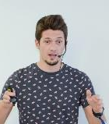
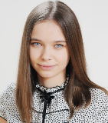
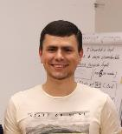
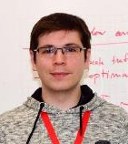
team
Alexandru Constantin
Ecaterina Donciu
Eugeniu Cernei
Alex Florin
ML engineer
graphic designer/
marketing
ML engineer
Full-stack web dev

Slide 19
