Slide 1
My Slides

Slide 2
Getting a description of the data
The data was obtained from the kaggle website
the data was called car’s dataset and it entailed the prices of second hand cars
The variables included in the data set include but not limited to
Price
Mileage
type
Make

Slide 3
Getting the working directory and importing the data
## [1] "C:/Users/ISAAC IRUNGU/Documents"
## Make Market Model Type Size ## Audi :10668 Luxury:34551 Fiesta : 6556 Hatch:24509 Large : 9402 ## BMW :10781 Mass :39854 Golf : 4863 Sedan:26604 Medium:17086 ## Ford :17959 Focus : 4588 Sport: 5197 Small :47917 ## MercBenz:13102 C Class: 3747 SUV :15978 ## Toyota : 6738 Polo : 3287 Truck: 279 ## VW :15157 A Class: 2561 Van : 1838 ## (Other):48803 ## Type_Size Year Year_Alpha Price ## Hatch-Small :23698 Min. :1996 Y2019 :20384 Min. : 495 ## Sedan-Small :12272 1st Qu.:2016 Y2017 :15891 1st Qu.: 10999 ## SUV-Small : 8809 Median :2017 Y2016 :11792 Median : 16407 ## Sedan-Medium: 8592 Mean :2017 Y2018 : 9715 Mean : 18458 ## Sedan-Large : 5740 3rd Qu.:2019 Y2015 : 5957 3rd Qu.: 22980 ## SUV-Medium : 5273 Max. :2020 Y2020 : 3600 Max. :159999 ## (Other) :10021 (Other): 7066 ## Price_Log10 Age mileage RoadTax ## Min. :2.695 Min. : 0.000 Min. : 1 Min. : 0.0 ## 1st Qu.:4.041 1st Qu.: 1.000 1st Qu.: 7093 1st Qu.:125.0 ## Median :4.215 Median : 3.000 Median : 17500 Median :145.0 ## Mean :4.206 Mean : 2.922 Mean : 23314 Mean :118.9 ## 3rd Qu.:4.361 3rd Qu.: 4.000 3rd Qu.: 32909 3rd Qu.:145.0 ## Max. :5.204 Max. :24.000 Max. :323000 Max. :580.0 ## ## MPG EngineSize Transmission FuelType ## Min. : 0.3 Min. :0.000 Automatic:17083 Diesel :34416 ## 1st Qu.: 47.1 1st Qu.:1.300 Manual :37093 Electric: 5 ## Median : 55.4 Median :1.800 Other : 3 Hybrid : 2709 ## Mean : 55.8 Mean :1.741 Semi-Auto:20226 Other : 236 ## 3rd Qu.: 64.2 3rd Qu.:2.000 Petrol :37039 ## Max. :470.8 Max. :6.600 ## ## MPG_inv ## Min. :0.002124 ## 1st Qu.:0.015576 ## Median :0.018051 ## Mean :0.019225 ## 3rd Qu.:0.021231 ## Max. :3.333333 ##

Slide 4
Creating Data Visualizations for the data
Creating a scatter plot for the price and Mileage variable
Loading the required libraries
## -- Attaching packages --------------------------------------- tidyverse 1.3.1 --
## v ggplot2 3.3.5 v purrr 0.3.4 ## v tibble 3.1.6 v dplyr 1.0.8 ## v tidyr 1.2.0 v stringr 1.4.0 ## v readr 2.1.2 v forcats 0.5.1
## -- Conflicts ------------------------------------------ tidyverse_conflicts() -- ## x dplyr::filter() masks stats::filter() ## x dplyr::lag() masks stats::lag()
## `geom_smooth()` using formula 'y ~ x'

Slide 5
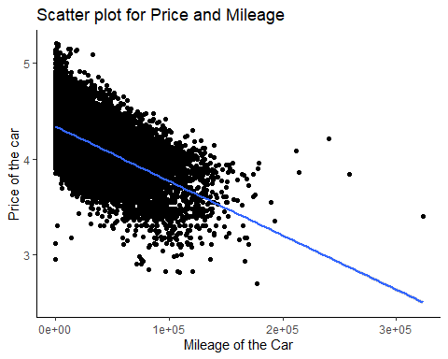

Slide 6
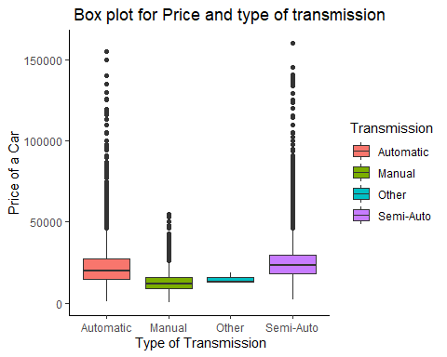
Creating a box plot for Price and type of transmission of a car

Slide 7
SAving the formatted data to an RData file

