Slide 1
Face Recognition with VGG19 and Transfer Learning
CS5567
Alexander Dowell

Slide 2
Project Description
Develop a face recognition system using the Georgia Tech dataset and VGG19 pre-trained CNN architecture. The model identifies 50 subjects using transfer learning and fine-tuning. Evaluate the performance using ROC curves, ROC AUC, and d-prime for verification tasks. Additionally, assess rank 1 and rank 5 identification rates and their accuracy after applying a matching threshold.

Slide 3
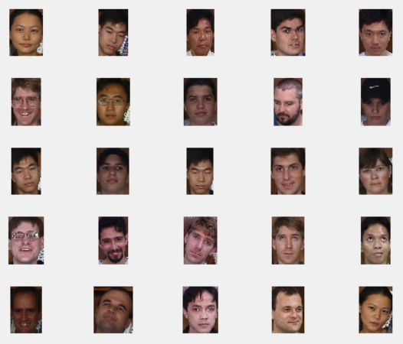
25 Random Samples from the Dataset

Slide 4
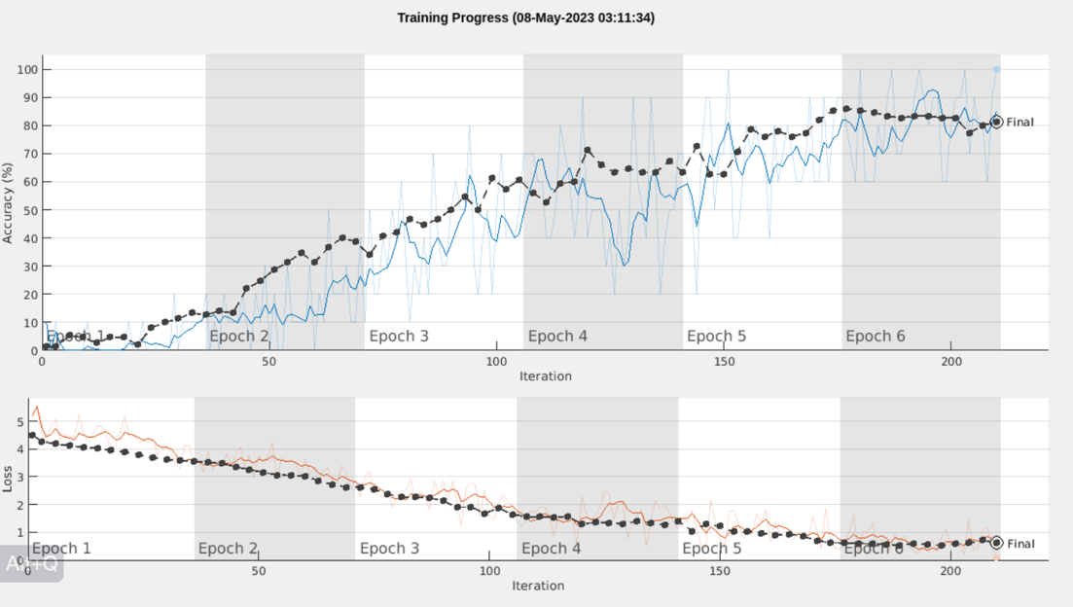
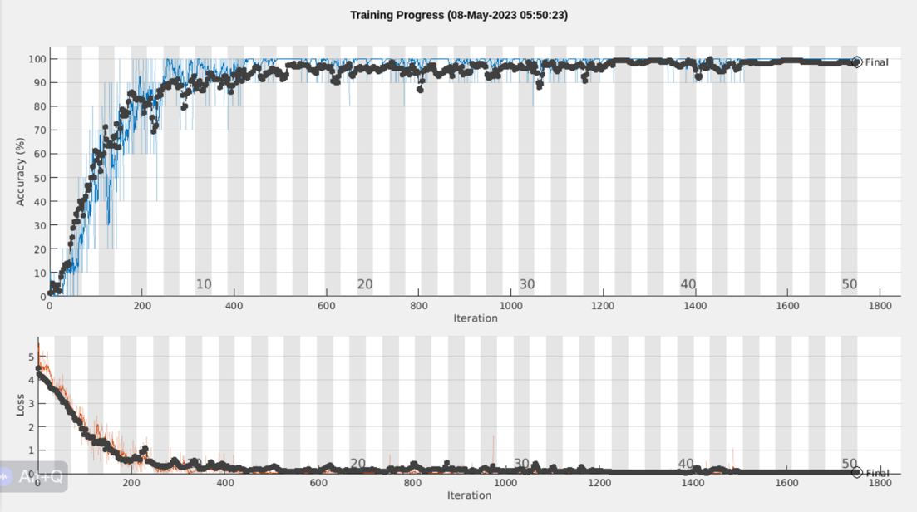
Methodology
Initial training for 6 epochs
Fine Tuned training for 50 epochs

Slide 5
Methodology
Network Training:
Two training cycles were conducted: initial 6 epochs and extended 50 epochs.
The network trained for 6 epochs achieved an accuracy of 81%.
The extended training cycle of 50 epochs achieved a final accuracy of 98.7%, and this refined network was used for the rest of the project.
Network Parameters:
Stochastic Gradient Descent with Momentum (sgdm) was used as the optimizer.
The mini-batch size was set to 10.
The initial learning rate was set to 1e-4.
The data was shuffled after every epoch.
Validation data was checked every 3 epochs.
Training progress was visually tracked using plots.
Data Augmentation:
A range of [-30, 30] pixels was set for random X and Y translation.
Random X reflection was enabled.
Augmentation was applied to the training images to create a more robust model.

Slide 6
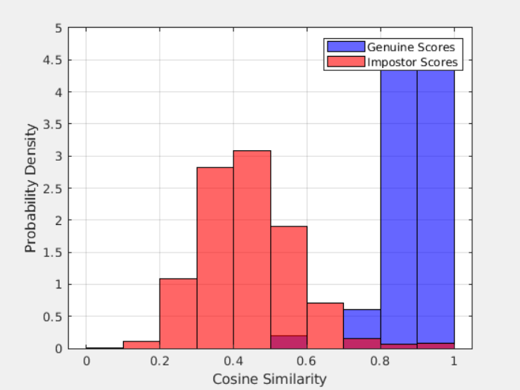
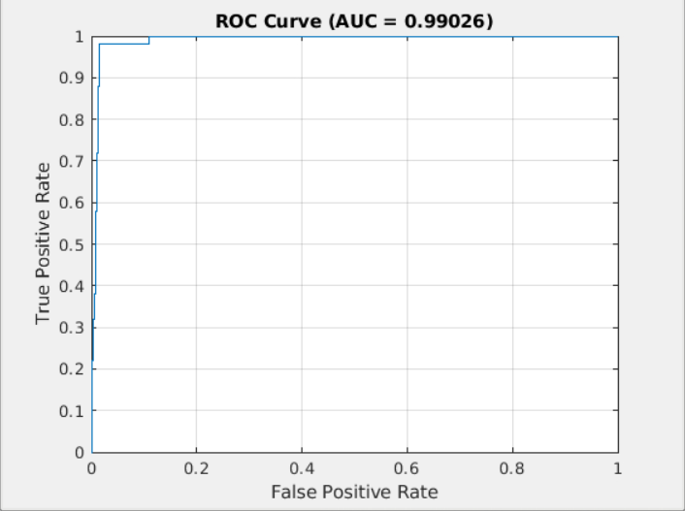
Verification

Slide 7
Verification
Probability Density vs. Cosine Similarity Histogram:
The Imposter scores mostly centered around a mean of 0.5, roughly following a Gaussian distribution.
A few Imposter scores overlapped the Genuine scores at 0.7, 0.8, and 0.9.
The Genuine scores primarily lay above 0.8, with few between 0.7 and 0.8, and a couple of outliers between 0.5 and 0.6.
Receiver Operating Characteristic (ROC) Curve:
The Area Under the Curve (AUC) for the ROC curve was 0.99926, suggesting near-perfect discriminative ability of the model.
D-prime (d'):
The d-prime value was calculated as 4.373305. This value is a measure of the separation between the means of the Genuine and Imposter score distributions, indicating a high level of separation in our model.
Key Insights:
The high AUC and d-prime values indicate that the network has excellent discriminative ability.
The overlap in the Genuine and Imposter scores suggests some room for improvement. Potential solutions could include more training data, further fine-tuning, or advanced data augmentation techniques.

Slide 8
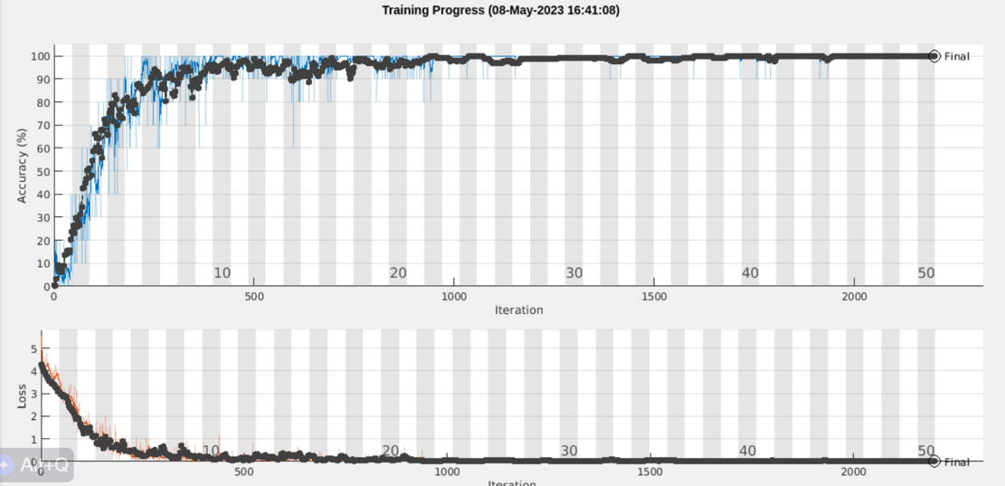
Subject-Independent Protocol Methodology
Training Process:
Similar to the previous protocol, the network underwent an extended training cycle of 50 epochs.
The same parameters were used, maintaining consistency across training processes.
Performance:
The Subject-Independent Protocol excelled with a perfect accuracy score of 100% after training.
Consistent Approach:
The use of Stochastic Gradient Descent with Momentum (sgdm) as the optimizer, a mini-batch size of 10, and an initial learning rate of 1e-4 were maintained.
Data shuffling and validation frequency remained the same, ensuring a stable training environment.
Data Augmentation:
The same data augmentation strategy was used, allowing for a fair comparison between the two protocols.
Key Takeaway:
The Subject-Independent Protocol, despite being trained on a more challenging task, achieved perfect accuracy, further demonstrating the robustness and effectiveness of our network and training methodology.

Slide 9
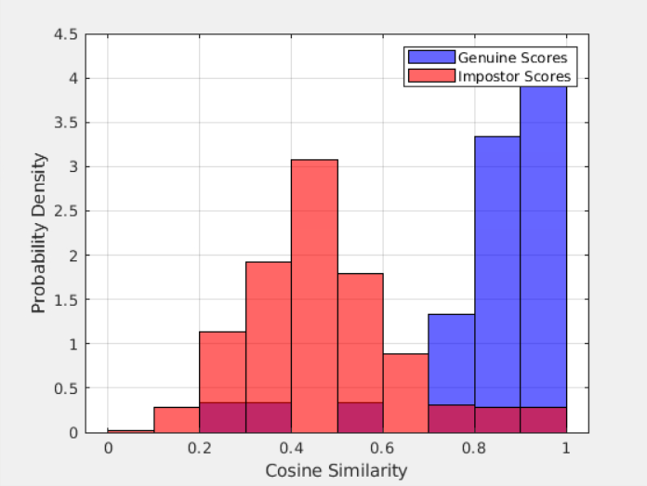
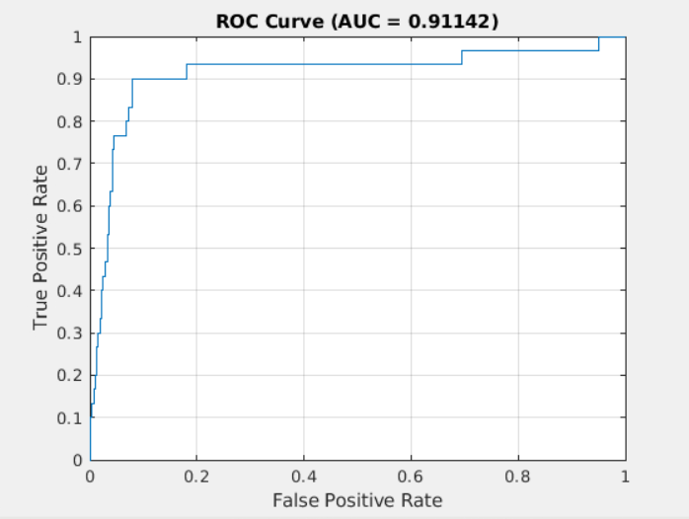
Subject-Independent Protocol Verification

Slide 10
Subject-Independent Protocol Verification
Probability Density vs. Cosine Similarity:
The Imposter scores mainly centered around a mean of 0.5, resembling a Gaussian distribution.
A portion of Imposter scores overlapped with Genuine scores between 0.7 and 0.9.
Genuine scores were predominantly above 0.8, with some outliers between 0.2 and 0.6.
Receiver Operating Characteristic (ROC) Curve:
The Area Under the Curve (AUC) for the ROC curve was 0.91142, demonstrating a strong model discriminative ability, albeit lower than the subject-dependent model (0.99926).
D-prime (d'):
The d-prime value was 2.192863, indicating a good separation between the means of the Genuine and Imposter score distributions, though not as high as the subject-dependent model (4.373305).
Comparative Insights:
Although the Subject-Independent Protocol performed well, it did not match the near-perfect performance of the Subject-Dependent Protocol.
The increased overlap in Genuine and Imposter scores and lower d-prime value indicate a slight decrease in discriminative ability.
This could potentially be mitigated through further fine-tuning, additional training data, or advanced data augmentation techniques.
Key Takeaway:
The Subject-Independent Protocol exhibits strong discriminative ability but falls short of the near-perfect performance observed in the Subject-Dependent Protocol. Further improvements are conceivable with additional fine-tuning and data augmentation

Slide 11
Rank 1 and Rank 5 Identification Rates
Probe and Gallery Sets:
Utilized to calculate the identification rates. The probe set comprised the first image from the subject-dependent testing subset of each identity, while the gallery consisted of the remaining images.
Application of Matching Threshold:
An optimal threshold derived from the Equal Error Rate (EER) was applied to further refine the identification process. The selected threshold was 0.744135.
Identification Rates:
Rank-1 identification rate was 98%, implying that the correct subject was the top match 98% of the time.
Rank-5 identification rate reached 100%, meaning the correct subject was within the top 5 matches every time.
Identification Rates Post Threshold Filtering:
After applying the matching threshold, the Rank-1 identification rate remained at 98%.
However, the Rank-5 identification rate slightly decreased to 98%, suggesting that the threshold filtering may exclude some correct matches in the top 5.
Key Takeaway:
The network performs excellently in both Rank-1 and Rank-5 identifications. The application of the matching threshold, however, slightly reduces the Rank-5 identification rate, suggesting a trade-off between precision and recall.

Slide 12
Project Conclusion
In summary, this project successfully developed a face recognition system using the Georgia Tech dataset and the VGG19 pre-trained CNN architecture. The model was capable of identifying 50 subjects with high accuracy. After two training cycles, the initial 6 epochs achieved 81% accuracy, while the extended training of 50 epochs resulted in a final accuracy of 98.7%. The latter model was used for the remaining steps of the project. Verification processes revealed excellent discriminative ability of the model, evidenced by an AUC of 0.99926 and a d-prime of 4.373305. However, some overlap in Genuine and Imposter scores indicated potential for further improvement.
The Subject-Independent Protocol also yielded remarkable results, achieving a perfect 100% accuracy after 50 epochs of training, thus demonstrating the robustness of the model. Nonetheless, its verification presented slightly lower discriminative ability than the Subject-Dependent Protocol, with an AUC of 0.91142 and a d-prime of 2.192863.
In terms of identification, the network performed exceptionally well, with Rank-1 and Rank-5 identification rates of 98% and 100%, respectively. However, after applying a matching threshold, there was a minor decrease in the Rank-5 identification rate to 98%, suggesting a trade-off between precision and recall.

Slide 13
Future Work
Looking ahead, future work will involve further fine-tuning of the model to improve discriminative ability and reduce overlap in Genuine and Imposter scores. There is also scope to explore advanced data augmentation techniques to enhance model robustness and performance, particularly for the Subject-Independent Protocol. Moreover, investigating different matching thresholds may better balance precision and recall in the identification rates. Finally, expanding the dataset or employing different pre-trained architectures could provide a path towards further enhancing the model's performance.

