Slide 1
Mini Project 5 Results
CS5567
Alexander Dowell

Slide 2
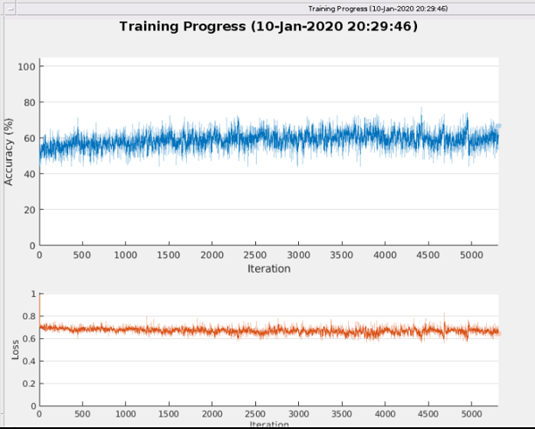
MATLAB Example Results

Slide 3
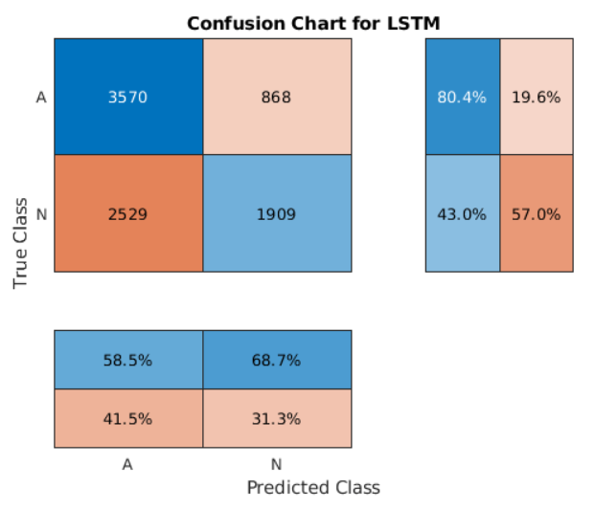
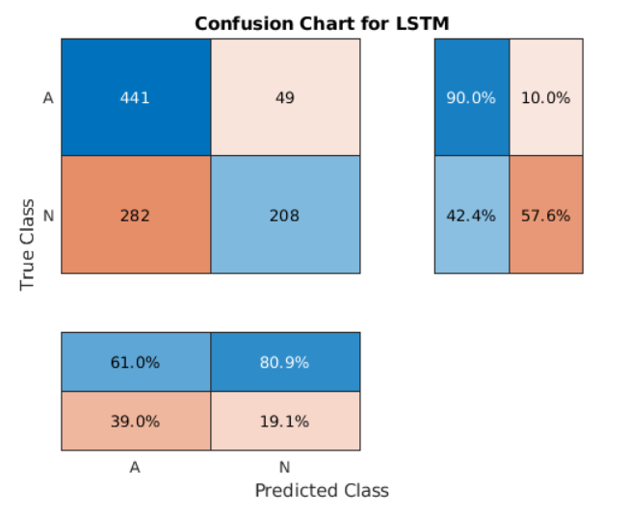
MATLAB Example Results
Confusion Matrix training
Confusion Matrix testing

Slide 4
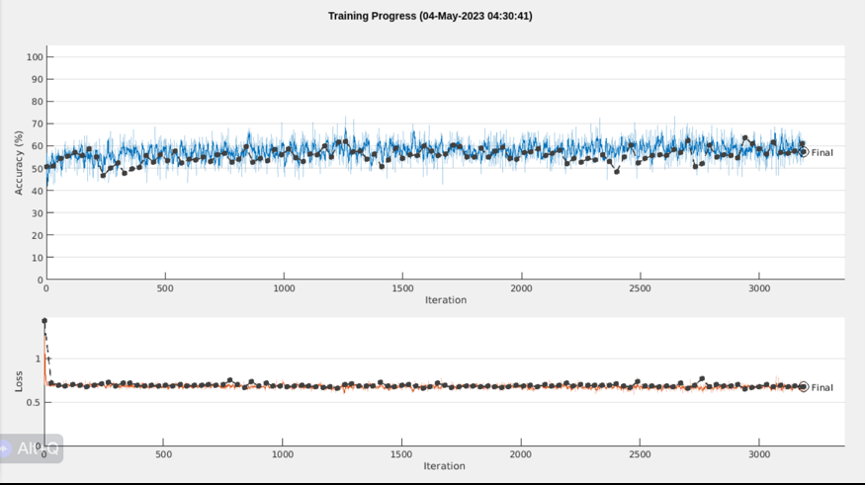
‘120 LSTM units for 6 epochs and add validation data for testing loss’ Results

Slide 5
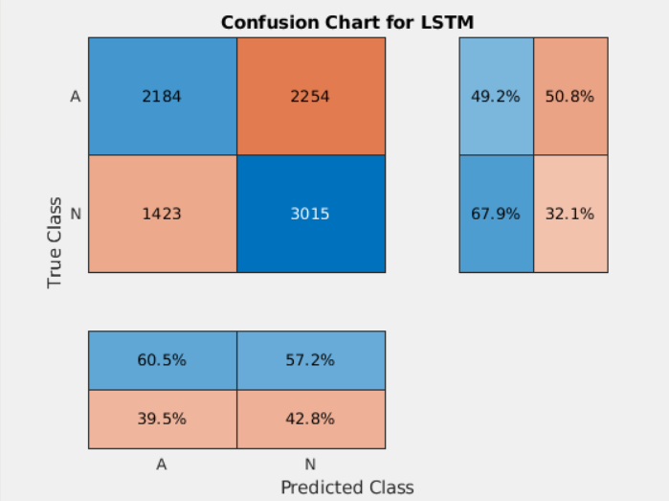
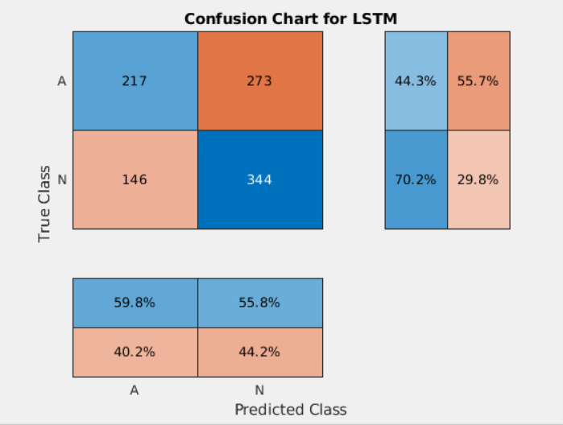
‘120 LSTM units and add validation data for testing loss’ Results
Confusion Matrix training
Confusion Matrix testing

Slide 6
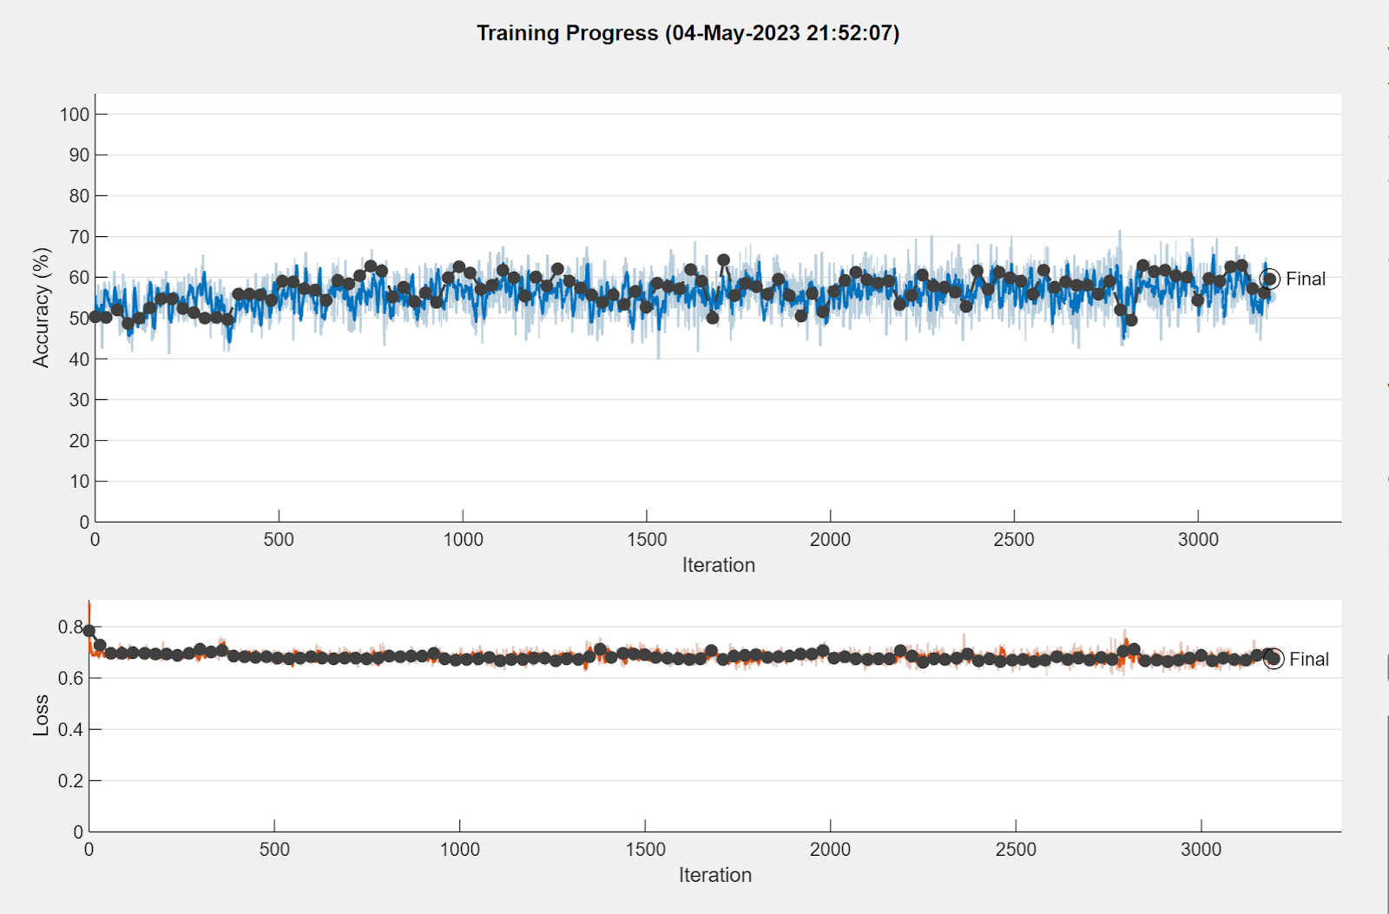
‘200 LSTM units add a 50% dropout layer for 6 epochs and validation data for testing loss’ Results

Slide 7
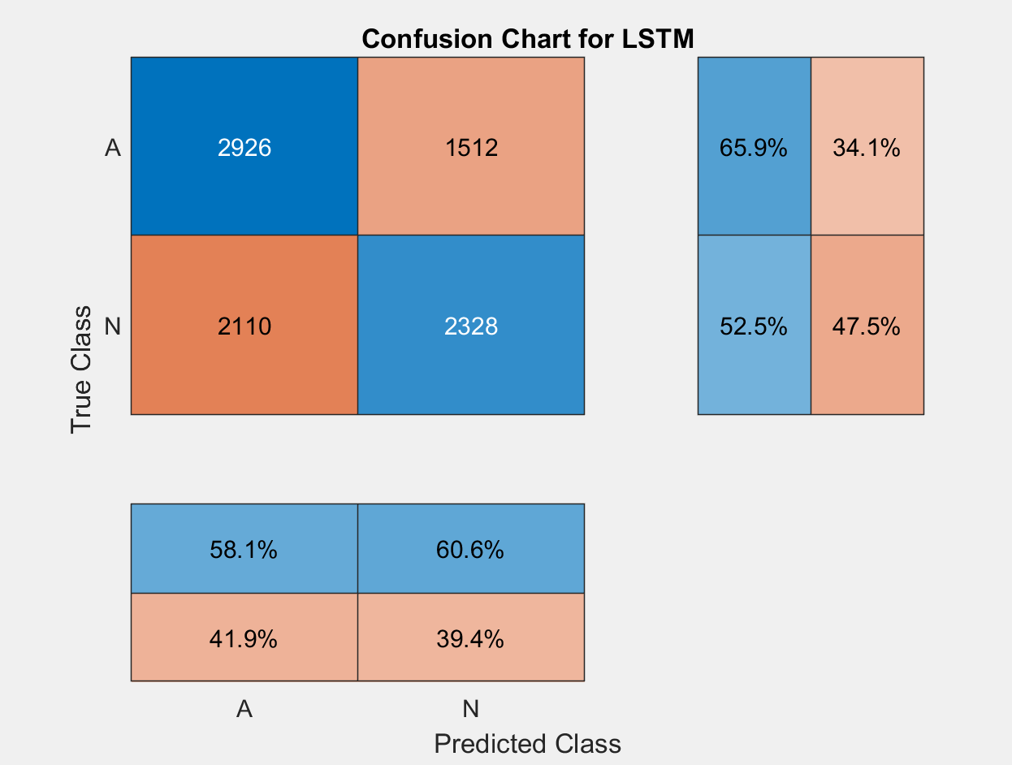
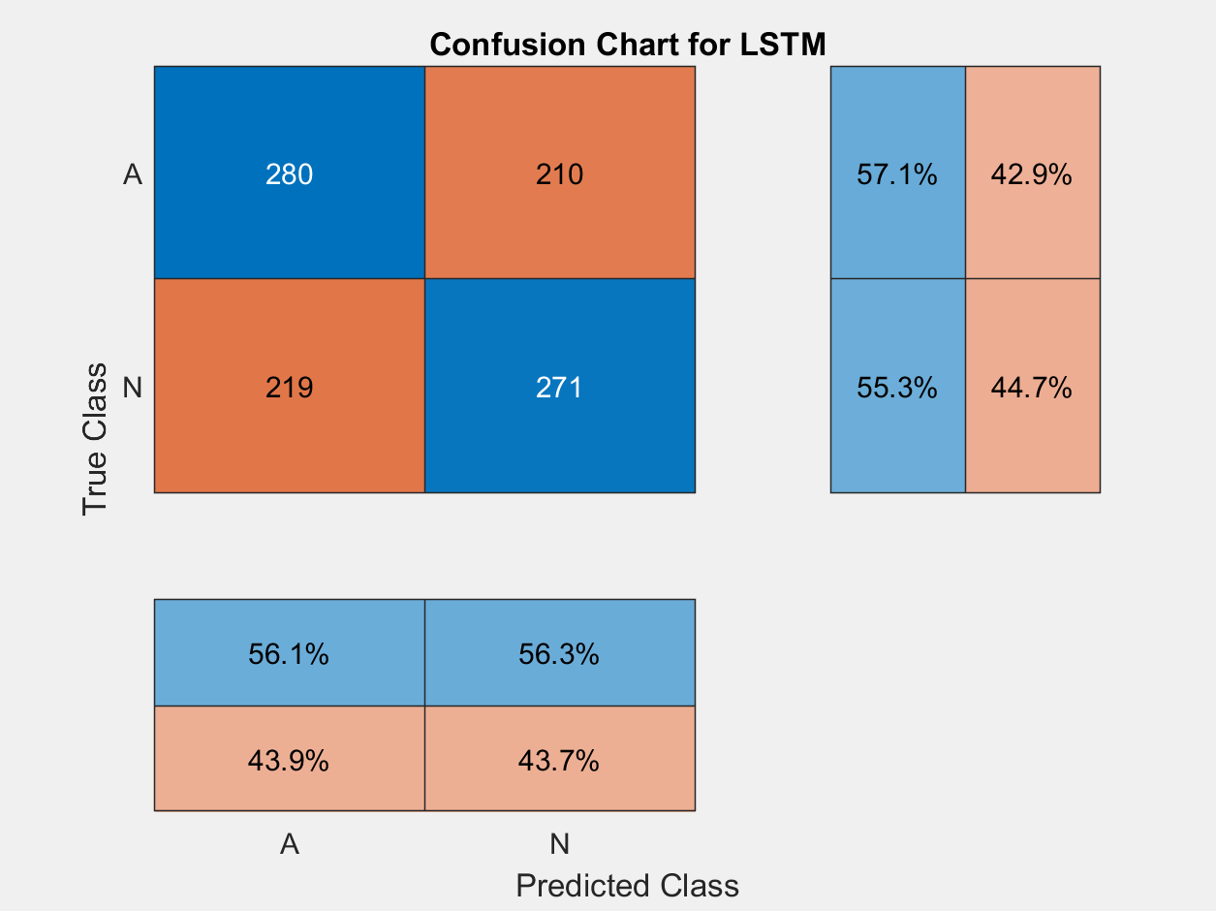
‘200 LSTM units add a 50% dropout layer for 6 epochs and validation data for testing loss’ Results
Confusion Matrix training
Confusion Matrix testing

Slide 8
Comparing Results
Variant 1 is a MATLAB example trained for ten epochs. Its training results show a relatively high number of true positives (TP = 3570) and false negatives (FN = 2529), while its testing results demonstrate a good balance between true positives (TP = 441) and false positives (FP = 49). This suggests that the network can detect the majority of positive cases, but may still have room for improvement in reducing false negatives.
Variant 2 adds 20 LSTM units (total of 120 LSTM units), incorporates validation data for testing loss, and is trained for only 6 epochs. The training results show a lower number of true positives (TP = 2184) and a higher number of false positives (FP = 2254) compared to Variant 1. Its testing results also exhibit a less balanced performance between true positives (TP = 217) and false positives (FP = 273). This could indicate that the additional LSTM units and reduced training epochs may have negatively impacted the network's performance.
Variant 3 further adds 100 LSTM units (total of 200 LSTM units), incorporates a 50% dropout layer, validation data for testing loss, and is trained for 6 epochs. Its training results show an improved balance between true positives (TP = 2926) and false positives (FP = 1512) compared to Variant 2. The testing results also demonstrate a better balance between true positives (TP = 280) and false positives (FP = 210) compared to Variant 2. The increased number of LSTM units and the addition of a dropout layer appear to have contributed to a more balanced performance in this variant.
In summary, Variant 1 and Variant 3 demonstrate better overall performance compared to Variant 2. Variant 3, with its additional LSTM units and dropout layer, shows improved balance between true positives and false positives.

