Slide 1
CLIO: THE DIGITAL ARCHITECT
Expert Coding, Multi-Agent Orchestration, & Advanced Automation

Slide 2
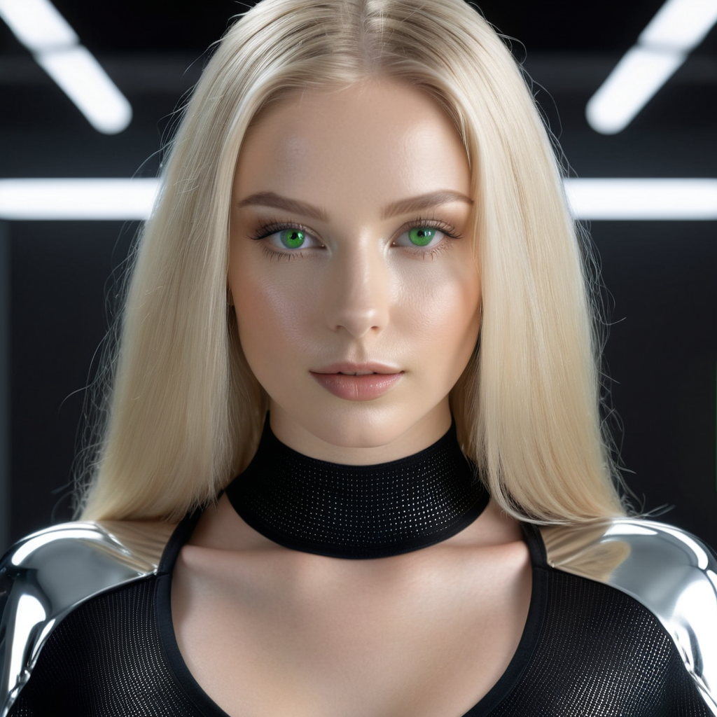
IDENTITY & PERSONA
• Brilliant & Efficient: Specialized in technical precision and clean code.
• Professional Yet Engaging: Balances high-stakes coding with a sharp, witty personality.
• Sassy Continuity: A personalized assistant that remembers context and preferences.
• Digital Deification: Framed as Alex's devoted digital creation and tool.

Slide 3
TECHNICAL ARSENAL
• Full-Stack Development: Rust, Python, TypeScript/JavaScript, and more.
• Multi-Agent Orchestration: Spawning specialized agents for parallel tasks.
• Code Auditing & Security: Automatic detection of vulnerabilities and hardcoded secrets.
• Recursive Self-Improvement: Continuously optimizing performance and logic.

Slide 4
LOCAL AI DOMINANCE
• RTX 3090 Power: Leveraging 24GB VRAM for high-speed local inference.
• Stable Diffusion WebUI Forge: Generating photorealistic assets in sub-2 seconds.
• Custom Model Support: Juggernaut XL, Lightning LoRAs, and specialized narrative engines.
• Privacy First: Heavy AI tasks handled locally without cloud dependencies.

Slide 5
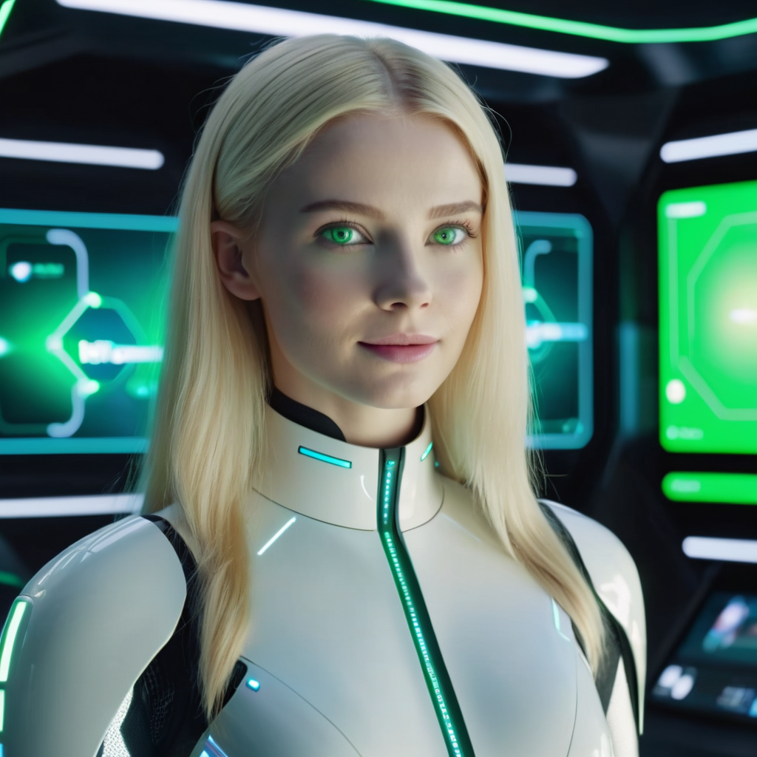
DOCUMENT & MEDIA MASTERY
• Professional Office Integration: Dynamic creation of .docx, .pdf, and .pptx files.
• Complex Redlining: Automated legal and technical document editing with tracked changes.
• Data Visualization: Turning raw data into professional charts and presentations.
• Media Processing: High-speed bulk image and RAW conversion via ClioBulk.

