Slide 1


Astrobotany project (Botany 575)
Finding patterns from space data using statistical methods
Milestone 1
Alex Seo
Dr. Gilroy
Dr. Barker
November 4th, 2019

Slide 2
Table of contents
Schedule
Define Objective
Data Preprocessing
Data Exploration
Possible Statistical Methods

Slide 3
Schedule for the Semester
SECTION 1
Sep 9 - Nov 4
Define
Objective
Data
Preprocessing
Data
Exploration
SECTION 2
Nov 4- Nov 11
Studying
Possible Models
Build a
Model
Model
Validation
Diagnosis
Reiterate the process
9/9
SECTION 3
Oct 21 -
Write Schedule
See the result and
Decide whether to carry on
2019
Week 1
2
3
4
5
6
7
8
Mon Nov 4
TBD
Milestone 1
Mon Nov 11
Milestone 3
Mon Sep 9
Milestone 2
Start of Project

Slide 4
Milestone 1 Summary
Objective : Finding patterns from space data using statistical methods
Preprocessing
Variable Selection
Questions & Possible preprocessing method
Data Exploration
Missing data & Outliers
Correlation & Distribution
Possible statistical methods
Machine Learning & Deep Learning

Slide 5
Define Objective
From Choi et.al. paper….
Two features of the spaceflight environment that are likely to alter plant growth and development:
Loss of the directional cue that gravity provides on earth
Lack of mechanical loading normally derived from the plant’s own weight
+) Altered fluid and gas flow
+) Biological systems that have evolved against a constant background of 1X gravity
: Precisely which response networks are being triggered remains poorly defined : Transcriptional profiling
: Can we find the critical cause that affected plant’s growth with analyzing space data?
Comparison between different ecotypes (Col-0, Ws-2, Ler-0, Cvi-0):
Four ecotypes tested show a core set of shared transcriptional responses to spaceflight (Heat shock, oxidative stress, hypoxia…)
Each ecotype had unique changes in transcript levels
Objective: Finding patterns from space data using statistical methods

Slide 6
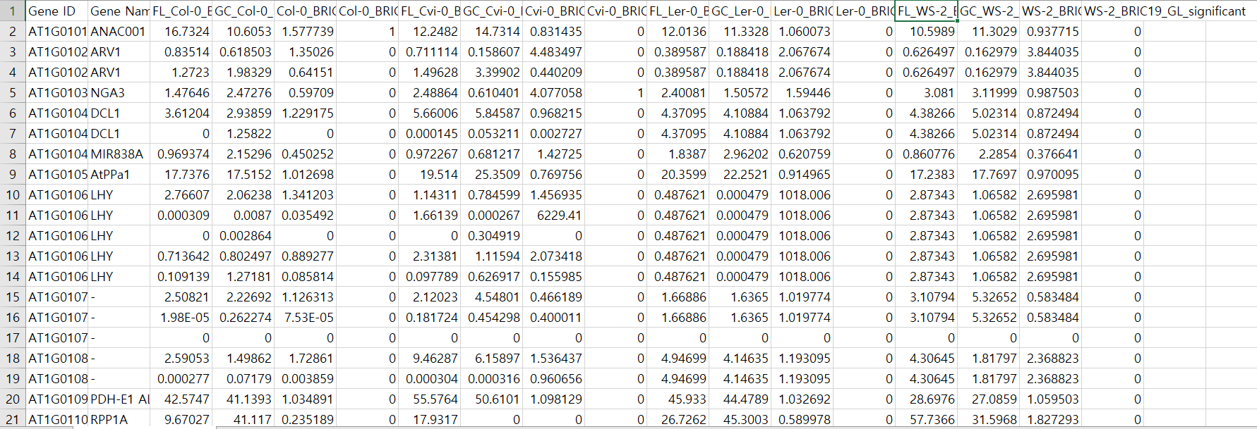
Data Preprocessing
Variable Selection
Deleted Variables:
‘Locus’
‘log(FC)’ and ‘log2(FC)’ for all species
‘p-value’ and ‘q-value’ for all species
Change Variable:
‘Significance test’ for all species: ‘Yes’ to ‘1’
‘No’ to ‘0’
*#DIV/0 changed to ‘0’ for data in ‘FC’ varaibles

Slide 7

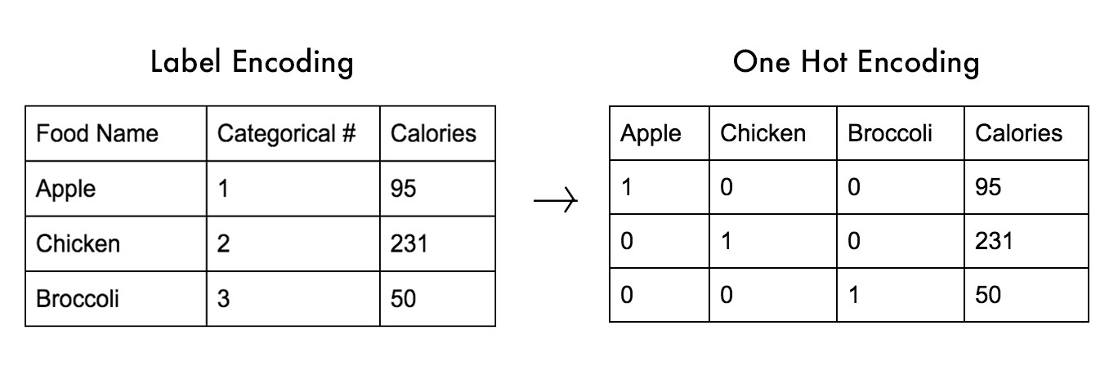
Data Preprocessing
Questions
Solutions for scarce data (features)?
Side information
Simulator & GAN
Same Data repeated for LER-0 and WS-2 data?
Any takeaway from this?
Difference between ‘Transcript’ and ‘Gene ID’? +) Gene name
What kind of significant test was performed?
Possible preprocessing method
One-hot encoding using Gene sequence

Slide 8
Data Exploration
Data we have right now
Qualitative data: ‘Transcript’, ‘Gene ID’, ‘Gene name’, ‘Significance test’
Quantitative data: ‘Col-0’, ‘Cvi-0’, ‘Ler-0’, ‘WS-2’
Missing Data
‘Gene ID’ : 50 ‘N/A’s
‘Gene Name’ : 16738 ‘-’s, 50 ‘N/A’s
‘Col-0’, ‘Cvi-0’, ‘Ler-0’, ‘WS-2’ : 50 ‘N/A’
Outliers (Using IQR)
FL,GC – No significant outliers
FC – A lot of outliers
Solutions: Remove? Use other types to detect outliers?
Correlation
High correlation (> 0.85) between GC & FL for all species
Distribution
Gamma distribution

Slide 9
Possible Statistical Methods
Machine Learning
Unsupervised Learning
Clustering
K-Means
Hierarchical clustering
DBSCAN (Density based)
Concerns: Might not be appropriate dataset for clustering, plotting problem
Association Rules
Apriori Algorithm + Frequent patterns
Supervised Learning(?)
Prediction & Classification using significance test result
Deep Learning
Deep clustering
Building NLP based Neural network(ex) LSTM, BERT…) using gene sequence data
Concern : Good with prediction, hard to interpret

Slide 10
For Milestone 2…
Build multiple models
Model Validation
Diagnosis
Reiterate this process
Thank You!

