Slide 1

Yelp Reviews
By Christopher Kardatzke, George Liu, Alex Seo, and Yichen Sun

Slide 2

Objectives
Find out what makes a review positive or negatives
Create a model to predict the ratings of reviews based on the text and related attributes

Slide 3
Final Model
Multiple Linear Regression
Rating(Star) =
Variable | Coefficient
Intercept | 1.29
Positive Overall | 0.479
Restaurant Average Rating | 0.593
Negative Words | -0.054
Positive/Length | 4.66

Slide 4
Contents
Feature Engineering
Model Selection
Interpretation
Application

Slide 5
Features
All Features
Final Features
Positive Overall
Rating Average
Number of Positive Word
Number of Negative Word
Positive words with Short Sentence
Negative words with Long Sentence
Average Characters
Number of Words
City Score
Number of Reviews
Positive Overall
Rating Average
Number of Negative Word
Positive words with Short Sentence

Slide 6
Feature Engineering
Formed a list of ‘positive’ and ‘negative’ words
Collect words intuitively
Calculate correlation between words and rating
Compare two methods to finalize list
Trends :
Positive Words : More adverbs, Authenticity, Dessert related, Alcohol
Negative Words : Past tense, Money related , Time related, Service related

Slide 7
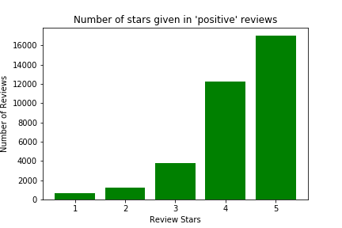
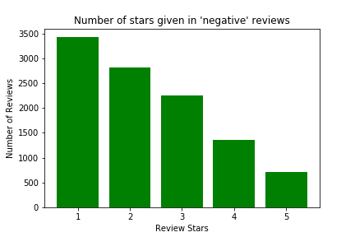
Feature Engineering
Average rating for ‘positive’ review: 4.25
Average rating for ‘negative’ review: 2.35

Slide 8
Feature Engineering
Generated Features using Positive/Negative List
Number of Positive words
Number of Negative words
Positive Overall Points
If review’s Number of positive words is higher than number of negative words : 1
If review’s number of positive words is same with number of negative words : 0
If review’s number of positive words is lower than number of negative words : -1.5
Why -1.5? : Tuned by cross-validation

Slide 9
Feature Engineering
Whether restaurant had lots of reviews or not many reviews
Ideas: People believes in the rating if there are many reviews
Classified reviews on whether they had more than 3 reviews in the training set
Average rating for ‘not many reviews’ review: 3.67
Average rating for ‘lots of reviews’ review: 3.74

Slide 10
Feature Engineering
Number of words in review
Ideas : Negative reviews will be longer since the customer is complaining about their experience
Generated Features using Number of words:
Positive words with short sentence
Number of positive words / nwords
Negative words with short sentence
Number of negative words * nwords
Average Characters
nchars / nwords

Slide 11
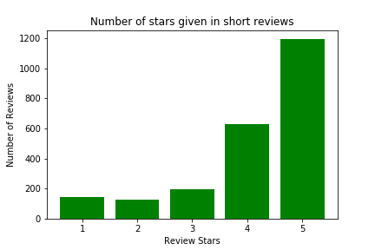
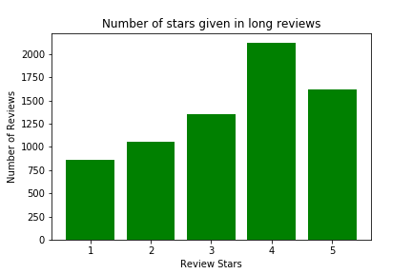
Feature Engineering
Average rating for long reviews: 3.37 (nwords > 200)
Average rating for short reviews: 4.13 (nwords < 20)

Slide 12
Feature Engineering
“All happy [meals] are alike; each unhappy [meal] is unhappy in its own way”
-Leo Tolstoy (paraphrased)

Slide 13
Feature Engineering
The average rating that a particular restaurant received
Ideas : Well-reviewed restaurant in the past would likely be well-reviewed in the future
Looked at average review for a restaurant in one half of the training set that had been highly reviewed in the other half of the training set

Slide 14
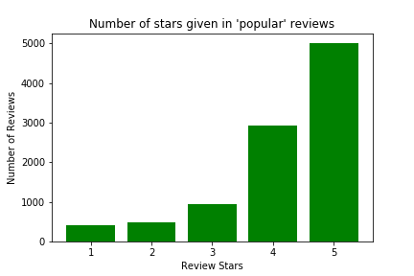
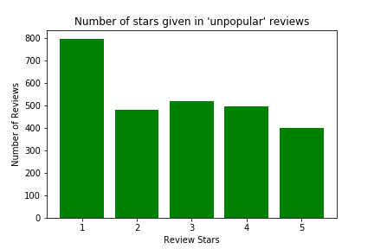
Feature Engineering
Average rating for loved restaurant: 4.20
Average rating for disliked restaurant: 2.70

Slide 15
Other Features..
City Score
- If average rating of the city is > 3.7
: City Score = 1
- Else
: City Score = 0
City Dummy Variables
Name Dummy Variables

Slide 16
Model Selection
Model | 3-fold Cross-Validation RMSE
Multiple Linear Regression | 0.929
Random Forest Classifier | 1.23
Random Forest Regressor | 1.03
K-Nearest Neighbors | 1.20
Gaussian Naïve Bayes | 1.22
Multi-Layer Perceptron | 1.10

Slide 17
Final Model : MLR
Adj. R^2 : 94.3% variance explained
RMSE : ~0.935 % variability in prediction
Coefficients
Variable | Coefficient | T-stat(p-value)
Intercept | 1.29 | -
Positive Overall | 0.479 | 84.083(<2*10^-16)
Restaurant Average Rating | 0.593 | 433.507(<2*10^-16)
Negative Words | -0.054 | -29.851(<2*10^-16)
Positive/Length | 4.66 | 45.809(<2*10^-16)

Slide 18
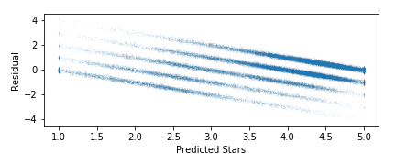
Residual Plot
Model does not violate assumptions of homoskedasticity

Slide 19
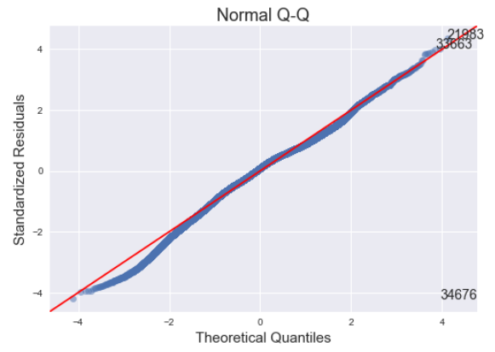
QQ-Plot
Model does not violate assumptions of Normality

Slide 20
Interpretation
Variable | Coefficient
Intercept | 1.29
Positive Overall | 0.479
Restaurant Average Rating | 0.593
Negative Words | -0.054
Positive/Length | 4.66

Slide 21
Example Review
Variable | Coefficient | Example Value
Intercept | 1.29 | -
Positive Overall | 0.479 | 1
Restaurant Average Rating | 0.593 | 4
Negative Words | -0.054 | 0
Positive/ Length | 4.66 | 0.2
” This is some of the best pizza I've ever had! Service is always quick and the pizza is consistently delicious.”
-Yelp Review for Ian’s on State
Predicted Rating: 5.0
True Rating: 5
Strength: Simple, easy to interpret

Slide 22
Example Review
“This location happens to be kitty corner to my work so I do go to lunch here occasionally. It's not great. Every time I order, I have to repeat it to them even though I tell them what I want clearly. Honestly, it is frustrating but no big deal. Overall location is not very clean and the staff don't seem very happy or helpful. Food is okay, not great.”
-Yelp Review for McDonald’s on Regent
Variable | Coefficient | Example Value
Intercept | 1.29 | -
Positive Overall | 0.479 | 1
Restaurant Average Rating | 0.593 | 2.5
Negative Words | -0.054 | 0
Positive/ Length | 4.66 | 0.058
Predicted Rating: 3.5
True Rating: 2
Weakness: Because our model only counts individual words, it doesn’t recognize that “not” often changes the meaning of the following word

Slide 23
Example Review
“Prof. Kang is incredibly knowledgeable about the material. Because of his past industry experience, he provides some really valuable insight into what employers are looking for. The class is not too difficult, and the projects that he assigns are super interesting and relevant. One of the best professors I've had at UW.”
-Rate My Professor Review
Variable | Coefficient | Example Value
Intercept | 1.29 | -
Positive Overall | 0.479 | 1
Restaurant Average Rating | 0.593 | 3.8 (Average professor rating at UW)
Negative Words | -0.054 | 0
Positive/ Length | 4.66 | 0.058
Predicted Rating: 4.3
True Rating: 5
Weakness: Our model is tailored to Yelp reviews in Wisconsin, and may do a poor job of predicting the sentiment of other reviews

Slide 24
Thank You!

