Slide 1
Homework #0
Deep Learning for Computer Vision
NTU, Fall 2021
110/9/28
110/10/8 (Fri.) 11:59 PM due

Slide 2
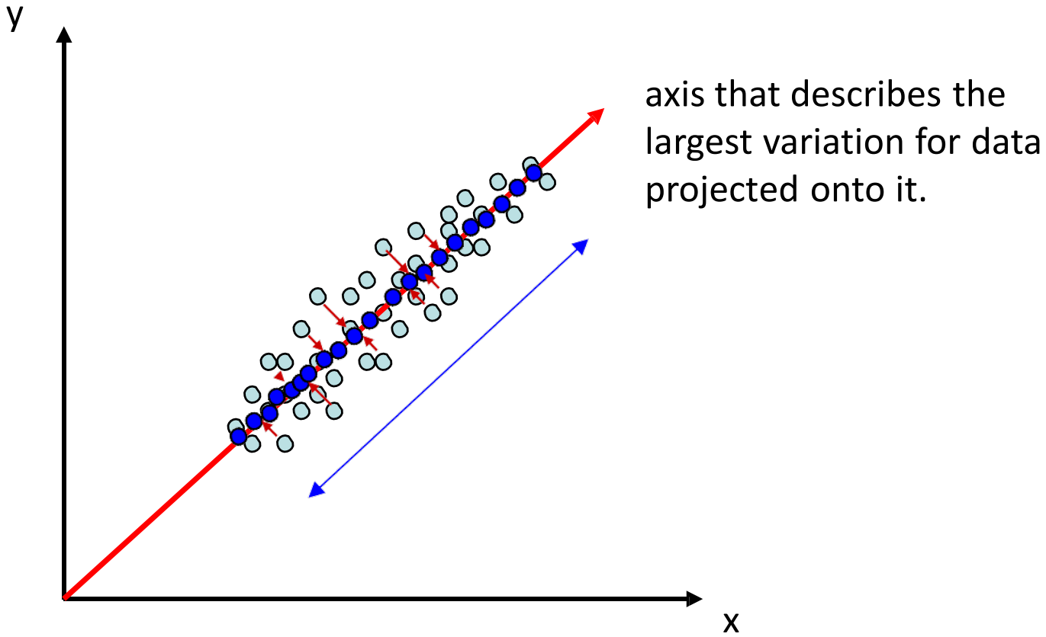
Problem 1: Principle Component Analysis
Perform PCA as taught in the lectures

Slide 3
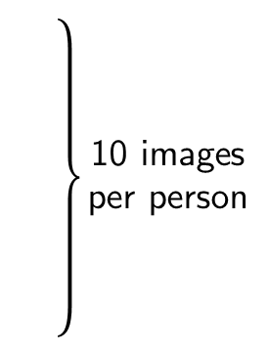









































Problem 1: Principle Component Analysis
Perform PCA as taught in the lectures
Dataset
person₃image₈
40 persons in total

Slide 4




Problem 1: Principle Component Analysis
Perform PCA as taught in the lectures
Dataset
Training Set
40 persons in total

Slide 5




































Problem 1: Principle Component Analysis
Perform PCA as taught in the lectures
Dataset
Testing Set
40 persons in total

Slide 6
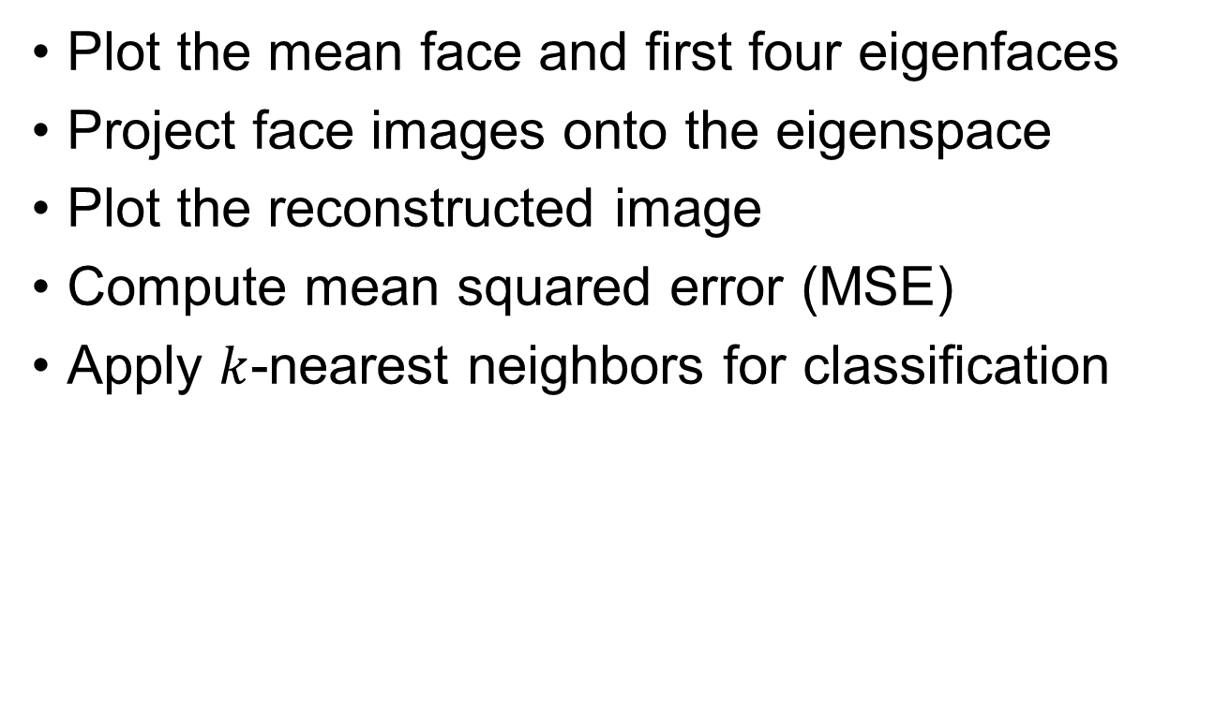
Problem 1: Principle Component Analysis

Slide 7
Remarks
You are allowed to use any programming language you desire, including all related packages/functions.
In your report, provide detailed explanations or discussions about your answer.
If unsure about your answer, write down how you obtained it as detailed as possible.
Convert your report into a pdf file and upload it to NTU COOL before the deadline.

