Slide 1


NATIONAL UNIVERSITY OF SCIENCE AND TECHNOLOGY POLITEHNICA BUCHAREST
Developing a System for Physiological Signal Acquisition and Analysis for Sleep Quality Assessment
DIPLOMA PROJECT
GRADUATE
SCIENTIFIC COORDINATOR
Duta Alexandru-Vlad
Ph.D. Ovidiu Grigore
Faculty of Electronics, Telecommunications and Information Technology · 2026

Slide 2
00
Presentation Structure
1
Introduction to Sleep
2
Motivation
Sleep stages, cycles, and why monitoring matters
PSG vs commercial wearables vs this project
3
System Architecture & Hardware
4
Data Acquisition & Dashboard
ESP32-C3, sensors, wearable integration
Firmware, server, SQLite storage, live monitoring
5
Signal Processing & Features
6
Sleep Stage Classification
Filtering, 21 features per 30-second window
K-Means clustering, physiological rules, KNN
7
Results & Validation
8
Conclusions & Future Work
10 sessions, hypnograms, quality scores
Achievements, limitations, next steps
Overview
02 / 17

Slide 3
01
Introduction to Sleep
Sleep occupies roughly one third of human life and is essential for physical recovery, memory consolidation, and emotional regulation. The AASM classifies sleep into four stages based on brain, muscle, and eye activity.
N1
5–10%
N2
45–55%
N3
20–25%
REM
20–25%
Light Transition
Light Sleep
Deep / SWS
Rapid Eye Movement
Theta waves replace alpha. Transition from wakefulness. Easy to wake.
Sleep spindles and K-complexes. Heart rate falls. Memory consolidation begins.
Delta waves dominate. Lowest heart rate. Peak growth hormone and immune activity.
Dreaming occurs. Muscle tone suppressed. Emotional and procedural memory processing.
→ System: Light Sleep
→ System: Light Sleep
→ System: Deep Sleep
→ System: REM Sleep
Not distinguished from N2 without EEG
Not distinguished from N2 without EEG
BPM≤P40 & motion≤P50, capped 25%
BPM≥P65 & std≥P55, capped 30%
This system outputs 4 classes — Wake/Movement, Light Sleep (N1+N2 combined), Deep Sleep, REM — since wrist sensors without EEG cannot separate N1 from N2.
A typical night contains 4–6 cycles of ~90 minutes each. N3 dominates early cycles; REM periods lengthen toward morning.
Introduction to Sleep
03 / 17

Slide 4
02
Motivation
€600 – 2 000
Clinical PSG
Gold standard but expensive, lab-bound, requires trained staff
per night
65 – 75%
Commercial Wearables
Affordable but black-box algorithms, no raw data access
accuracy
<€100
This Project
Full raw data access, 5 sensors + ML pipeline
OPEN-SOURCE
Goal: build an open, low-cost wearable sleep monitoring system with full raw data access
Motivation
04 / 17

Slide 5
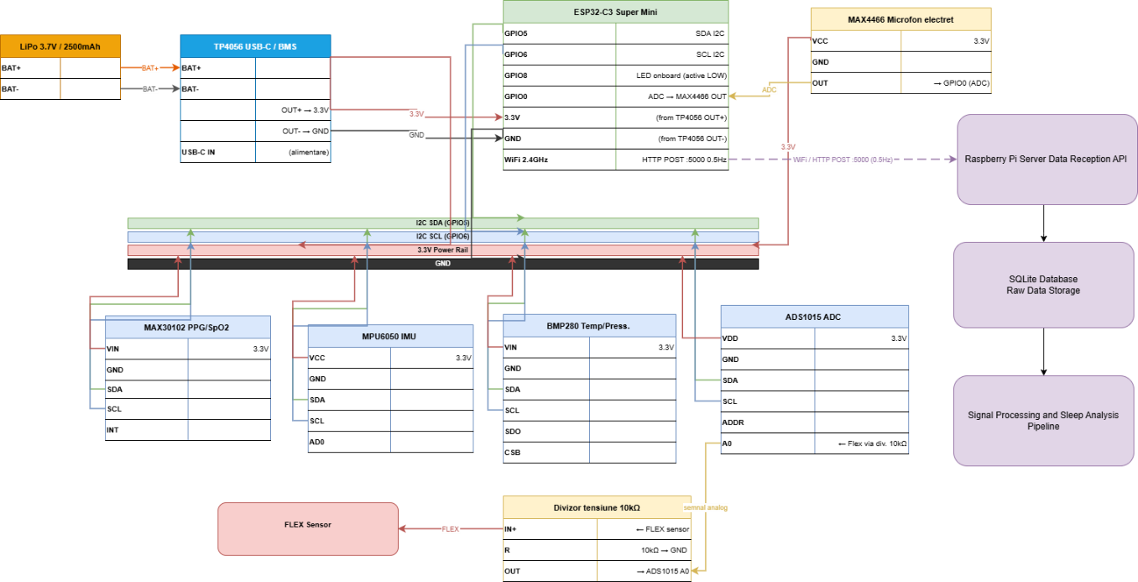
03
System Architecture
System Architecture & Hardware
05 / 17

Slide 6
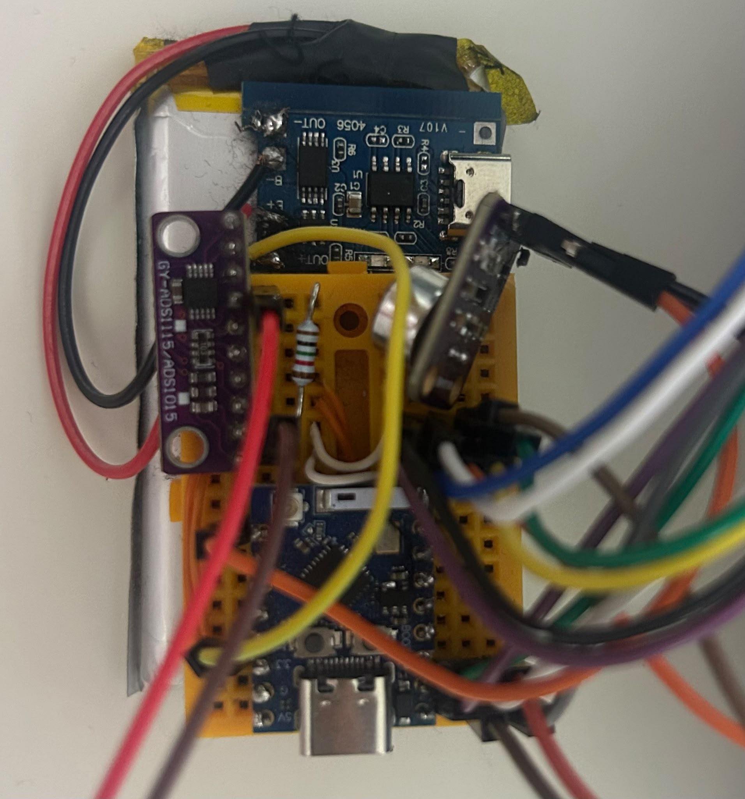
03
Hardware Design
ESP32-C3 Super Mini
MAX30102
MPU6050
RISC-V 160 MHz, WiFi, single-core
PPG + SpO₂ (red 660nm, IR 880nm)
6-axis IMU (accel + gyro)
MCU
Optical
Motion
BMP280
ADS1015 + Flex
MAX4466
Skin temperature (±0.5°C)
Respiration via chest band
Microphone for snoring detection
Temperature
Respiration
Acoustic
TP4056 + LiPo 2500 mAh · >17h runtime
System Architecture & Hardware
06 / 17

Slide 7
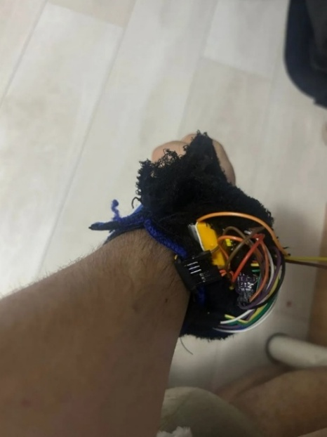
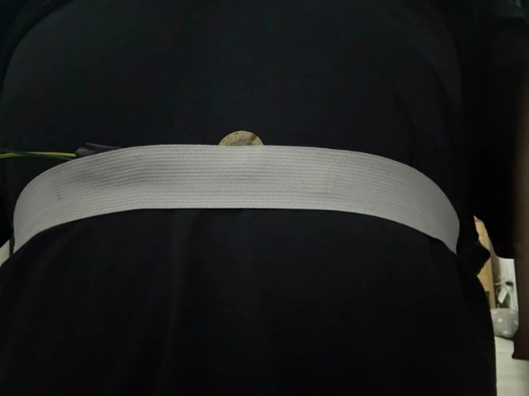
03
Wearable Integration
Wrist Unit
Elastic Chest Band
PPG, IMU, temperature, microphone sensors during recording
Flex sensor for respiration monitoring
System Architecture & Hardware
07 / 17

Slide 8
04
Data Acquisition
1
2
3
4
Sensor Reading
JSON Assembly
SQLite Storage
Analysis Pipeline
PPG (IR+Red)
12.5 Hz
Single combined HTTP POST every 2s (single-core constraint)
Raspberry Pi stores all raw data in structured tables
21 features/window. K-Means+KNN. Quality score.
IMU (Acc+Gyro)
10 Hz
raw_data
timestamp, JSON
{ "t":"23:35:01",
"ir":54231,
"red":48120,
"ax":0.01,
"ay":-0.99,"az":0.03,
"fr":612,"fd":-8,
"tmp":35.3,
"ppg_ir":"54231,...",
"mic_s":"1066,..." }
Step A
→
→
→
Signal filtering
(sensor-specific)
Flex (Resp.)
4 Hz
ppg_data
IR, Red, BPM
Step B
Temperature
1 Hz
flex_data
ADC, resp. rate
Feature extraction
(21 features)
Microphone
200 Hz
mic_data
RMS amplitude
Step C
K-Means clustering
(k=4)
Step D
KNN + smoothing
+ scoring
Key design decision: single combined POST per cycle avoids sample loss on single-core ESP32-C3
~227
samples/sec across
all sensors
2s
POST interval
single-core ESP32
6–10h
recording duration
per session
WiFi
HTTP POST :5000
to Raspberry Pi
Data Acquisition & Dashboard
08 / 17

Slide 9
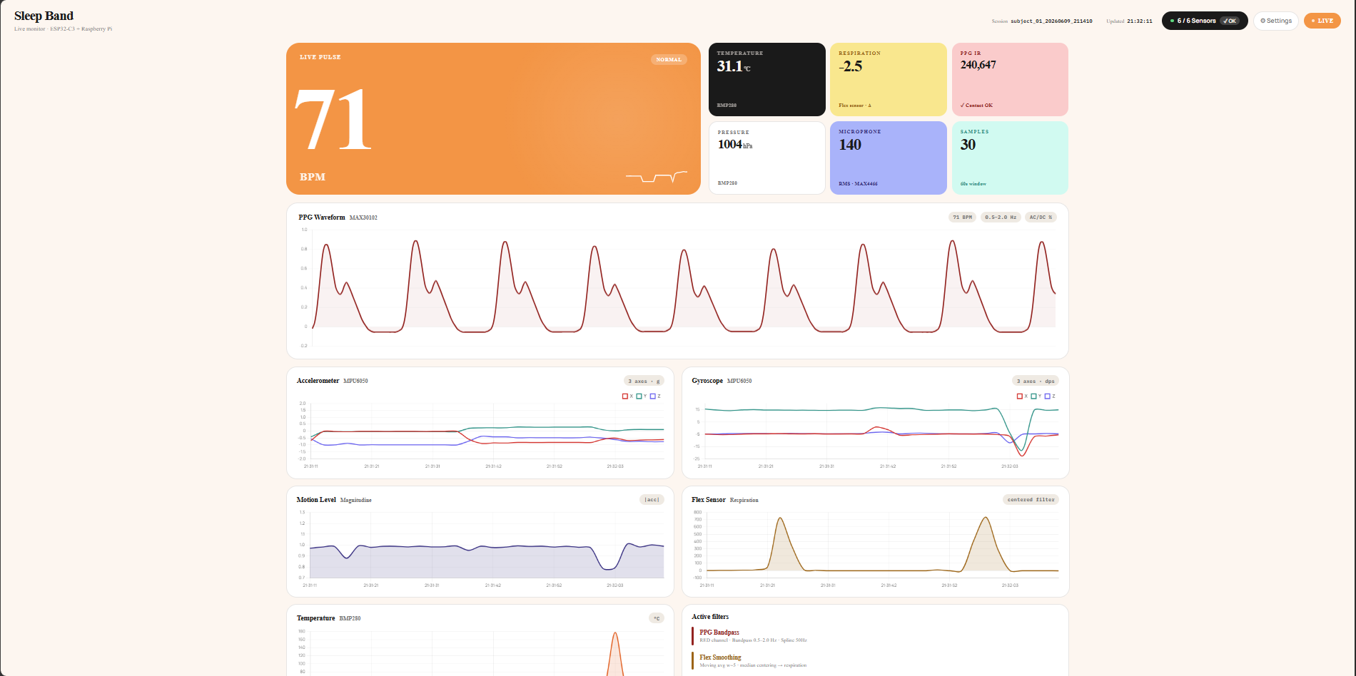
04
Live Dashboard
Real-time signal monitoring on port 8080 during active recording sessions
Data Acquisition & Dashboard
09 / 17

Slide 10
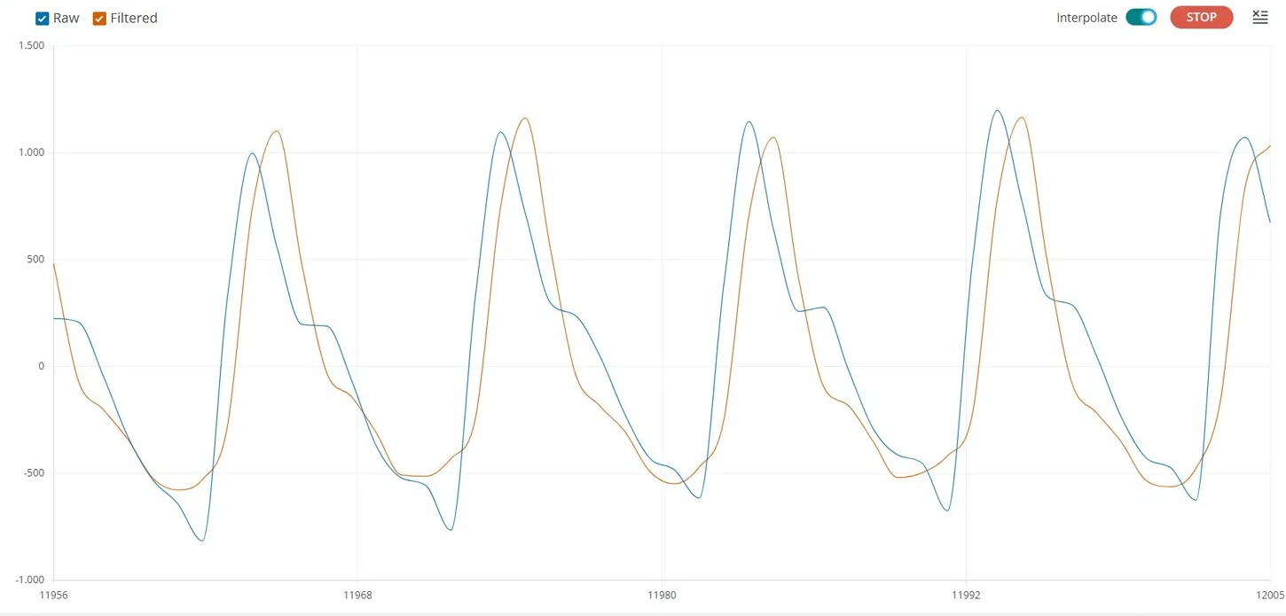
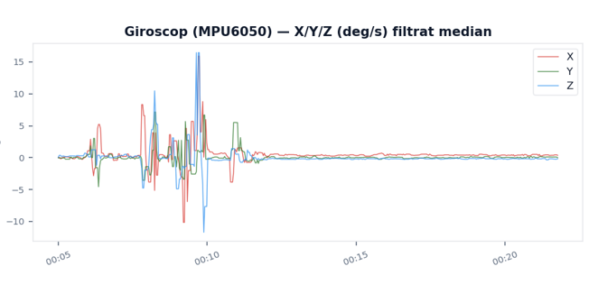
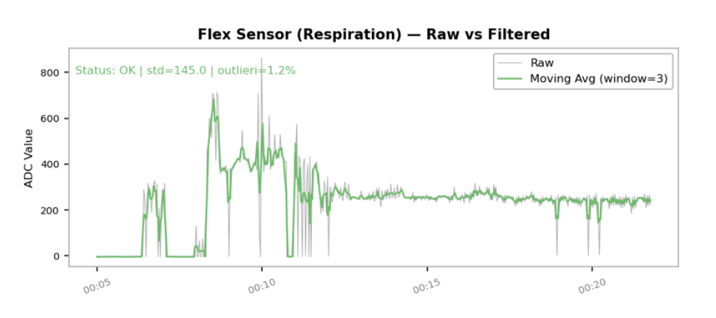
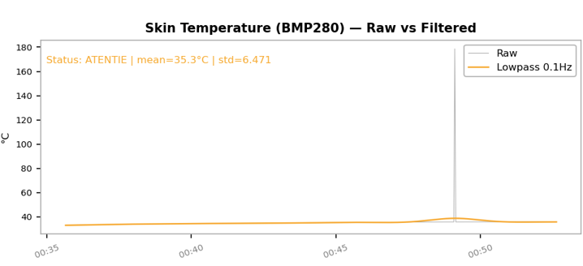
05
Signal Processing
PPG (IR)
Butterworth 0.5–3.5 Hz, order 3
Gyroscope
Median filter, kernel size 5
PPG chart
Flex Sensor
Moving average, window 3
Temperature
Butterworth lowpass 0.1 Hz, order 3
Signal Processing & Features
10 / 17

Slide 11
Feature Extraction
05
21 features per 30-second window · StandardScaler · weighted by physiological relevance
PPG / Cardiac
×1.8
×1.5
×1.0
×1.0
×1.6
×1.2
bpm_mean
bpm_std
bpm_min
bpm_max
hrv_simple
spo2_est
Motion
×2.5
×2.2
×2.0
×0.5
×1.0
motion_level
acc_jerk
gyro_energy
motion_variation
dominant_pos
Respiration
×1.8
×1.4
×1.2
×1.0
resp_rate
resp_variability
resp_amplitude
apnea_flag
Temperature
×0.8
×0.5
temp_mean
temp_variation
Acoustic
score only
score only
snore_events_count
snore_intensity
Preprocessing Pipeline
Raw features → StandardScaler (zero mean, unit variance) → Multiply by weights → K-Means input.
contact_valid_ratio excluded (data leakage risk)
Signal Processing & Features
11 / 17

Slide 12
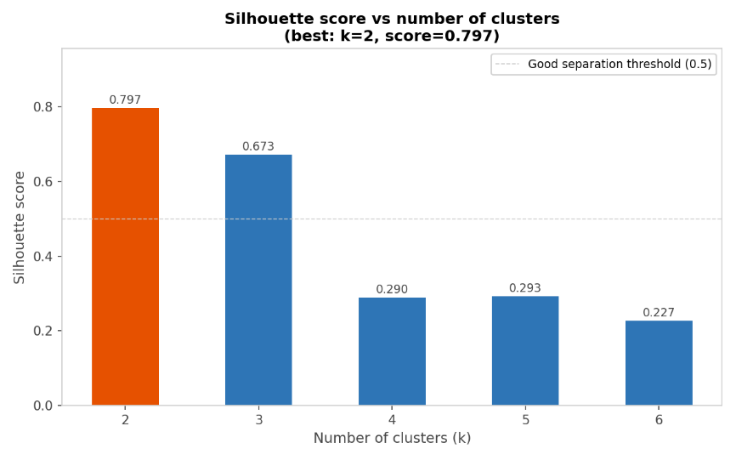
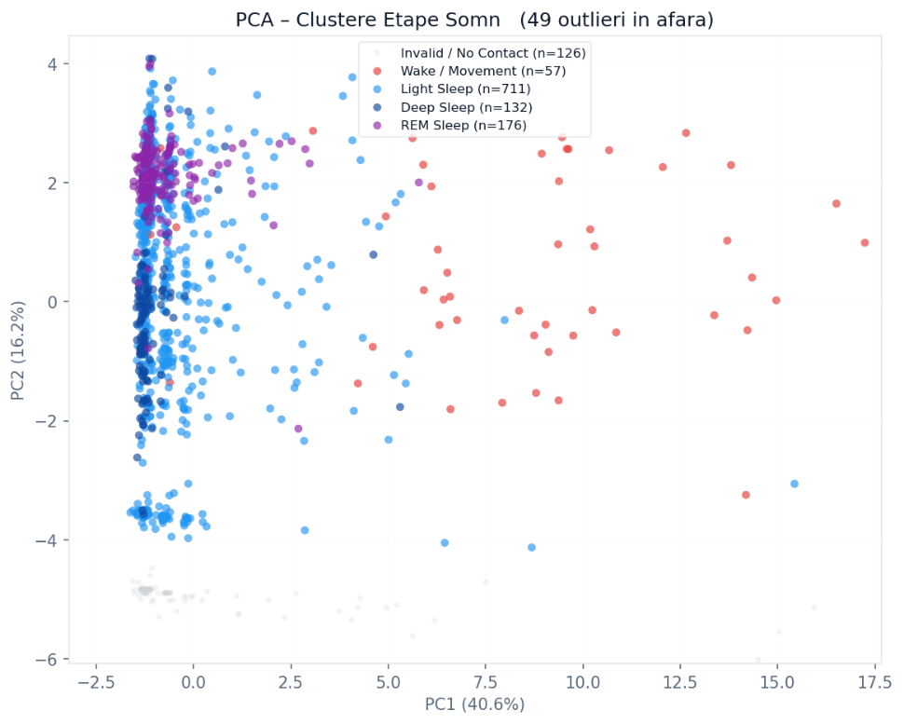
06
Sleep Stage Classification
1
2
3
4
K-Means (k=4)
Physiological Labeling
KNN (k=5)
Smoothing
Unsupervised clustering into 4 groups.
Wake: motion ≥ P95
Trained on K-Means labels. Distance-weighted Euclidean in 21D. Outputs per-class probabilities.
3-epoch majority vote (90s)
REM: bpm ≥ P65 AND bpm_std ≥ P55
Deep cap: 25%, REM cap: 30%
Silhouette: k=2 best (0.797)
k=4 used for clinical relevance (0.290)
Deep: bpm ≤ P40 AND motion ≤ P50
Light: all remaining windows
Sleep Stage Classification
12 / 17

Slide 13
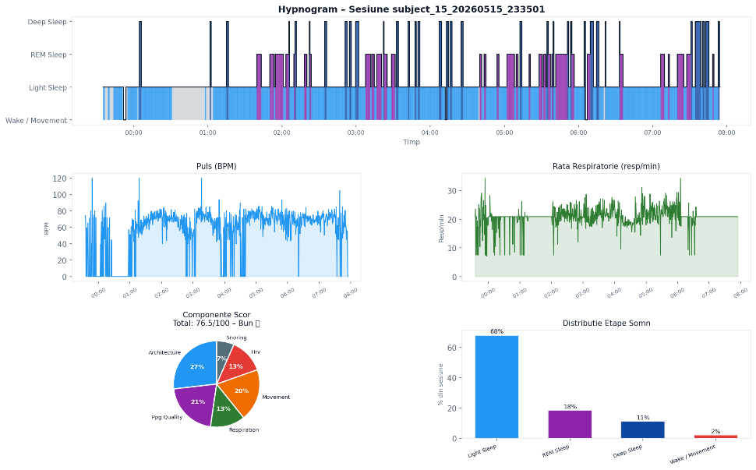
07
Results: Hypnogram Analysis
10 overnight sessions · 8 subjects · 375–602 min per session
Results & Validation
13 / 17

Slide 14
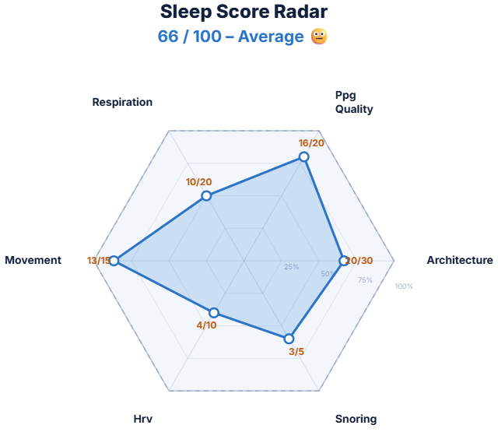
07
Sleep Quality Score
0–100 scale from 6 components · Duration penalty: up to −15 pts for sessions <6 hours
/30
Architecture
Deep ≥ 25%, REM ≥ 25%, Wake < 15%
/20
PPG Quality
BPM 45–70, SpO₂ ≥ 95%
/20
Respiration
RR 10–18, apnea < 2% of windows
/15
Movement
Median motion < 0.05g
/10
HRV
/5
Snoring
85–100 Excellent
70–84 Good
RMSSD 30–100 ms
0 events = full
55–69 Average
40–54 Poor
Results & Validation
14 / 17

Slide 15
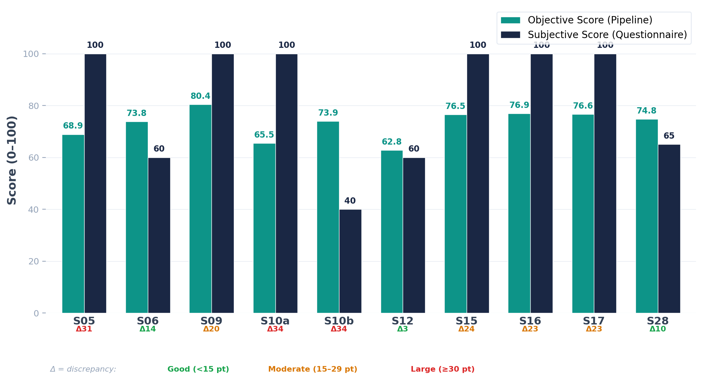
07
Subjective vs Objective Comparison
Results & Validation
15 / 17

Slide 16
08
Key Findings & Limitations
Key Findings
Limitations
→
Motion features: most reliable for sleep staging
—
No ground truth (PSG) for epoch-level validation
→
HRV (RMSSD) + respiratory rate: strongest stage differentiation
—
Silhouette score k=4: 0.290 (overlap between stages)
→
S12 (OSA subject): 52 apnea + 257 snoring events correctly flagged
—
Single-core ESP32-C3 limits PPG to ~12.5 Hz effective
→
Subjects unaware of apnea events detected by sensors
—
Sensor displacement during sleep affects signal quality
→
Scores: 62.8 – 80.4 across valid sessions
—
Small sample: 10 sessions, 8 subjects
Personal contributions:
Complete hardware assembly from off-the-shelf components (<100 EUR)
ESP32-C3 firmware with multi-sensor acquisition and boot calibration
Flask/SQLite backend + real-time monitoring dashboard
Full Python pipeline: signal processing, 21-feature extraction, K-Means + KNN classification, sleep quality scoring
10 overnight recording sessions with 8 subjects + questionnaire validation
→
→
→
→
→
Key Findings & Limitations
16 / 17

Slide 17
08
Conclusions & Future Work
The system demonstrates that open-source, low-cost sleep monitoring with full raw data access is achievable with current off-the-shelf components.
FUTURE WORK
01
Dual-core MCU
02
Rigid Housing
Continuous 25 Hz PPG for frequency-domain HRV
Custom 3D-printed enclosure for stable sensor contact
03
Better Respiratory Sensor
04
Cross-session Training
Inductive/impedance-based instead of flex sensor
KNN evaluated on held-out data for real accuracy
05
PSG Validation
Simultaneous recording for ground truth benchmarking
Thank you!
Conclusions & Future Work
17 / 17

Slide 18
References
[3] R. B. Berry et al., "The AASM Manual for the Scoring of Sleep and Associated Events, Version 2.6," American Academy of Sleep Medicine, Darien, IL, 2020.
[1] R. Stickgold, "Sleep-dependent memory consolidation," Nature, vol. 437, pp. 1272-1278, 2005.
[11] M. de Zambotti, N. Cellini, A. Goldstone, I. M. Colrain, and F. C. Baker, "Wearable sleep technology in clinical and research settings," Med. Sci. Sports Exerc., vol. 51, pp. 1538-1557, 2019.
[14] M. Marino et al., "Measuring sleep: accuracy, sensitivity, and specificity of wrist actigraphy compared to polysomnography," Sleep, vol. 36, pp. 1747-1755, 2013.
[17] J. Allen, "Photoplethysmography and its application in clinical physiological measurement," Physiol. Meas., vol. 28, pp. R1-R39, 2007.
[19] Task Force of the European Society of Cardiology and the North American Society of Pacing and Electrophysiology, "Heart rate variability: standards of measurement, physiological interpretation and clinical use," Circulation, vol. 93, 1996.

