Slide 1
Debian and Ubuntu Software Packaging Workshop
Alexander Dutton
Developer, Oxford University Computing Services
@alexsdutton – alexander.dutton@oucs.ox.ac.uk

Slide 2
Aims
A gentle introduction to packaging software for Debian and Ubuntu
  I am not an expert
  I've only recently started doing this stuff
Focus on Python
  Because that's what I know
  Notwithstanding some generic usefulness

Slide 3
We'll look at…
Producing a simple package
What all those files (e.g. debian/control, debian/compat) mean, and what should be in them
Packaging Python things in particular
Overriding some of the package build and installation steps
Setting up an apt repository and publishing packages
Things that might catch you out.

Slide 4
Why?
Reproducible deployments
  Less bespoke
  Easier to test updates
  Bring colleagues up to speed more quickly
Improved understanding of the Linux/Debian way of doing things
CV points

Slide 5

The workshop bit
If you've got your
own installation,
awesome.
Otherwise, grab
a piece of paper
and log in to the
box provided.
This talk is up at https://github.com/alexsdutton/packaging-workshop

Slide 6
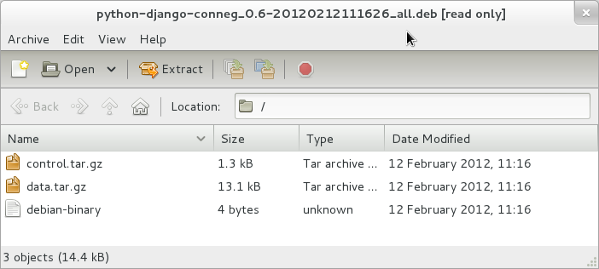
What is a Debian package?
A .deb is just an ar archive
Containing two .tar.gz archives and a version number:

Slide 7
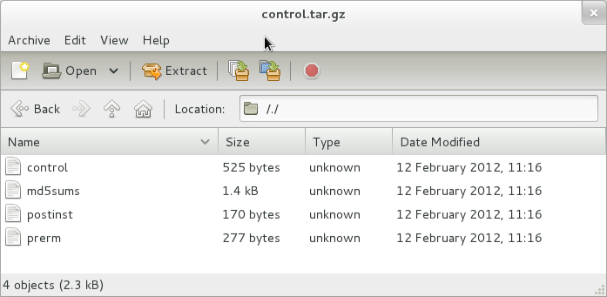
control.tar.gz
Package metadata:

Slide 8
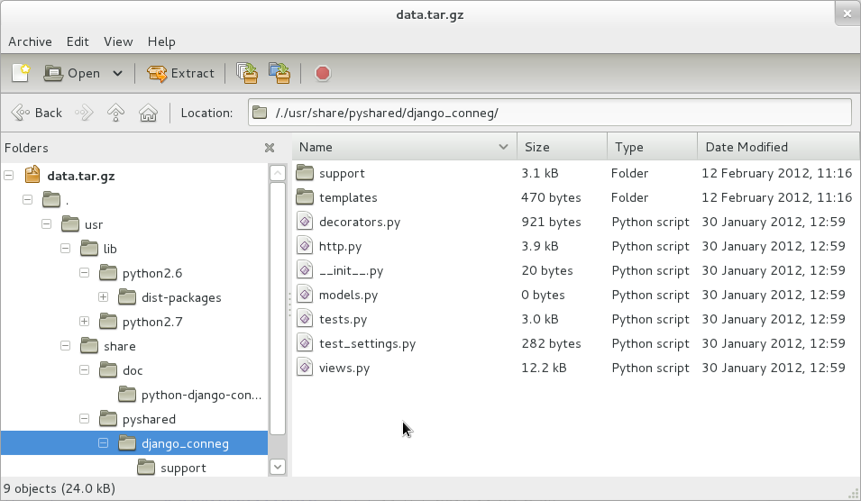
data.tar.gz
Extracted onto filesystem when installed

Slide 9
So how do we get there?
You could build it by hand
  But that probably won't scale
  And you'll reinvent lots of wheels along the way
Instead, use the Debian packaging toolchain

Slide 10
Caveats
Ignoring non-native packages for now
This is a little Python-centric
  Shout if I've assumed too much.

Slide 11
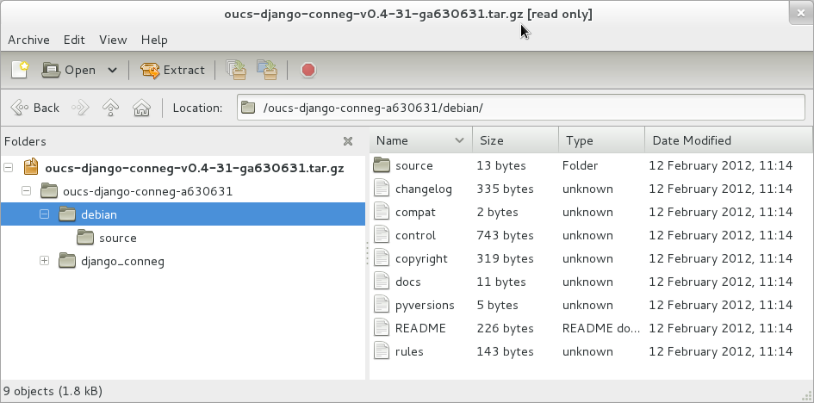
Layout of a native package
(tarball downloaded from GitHub at https://github.com/oucs/django-conneg/downloads)

Slide 12
debian/
Needs to contain:
  control (metadata; dependencies; description)
  changelog (lists changes for each released version)
  copyright (license information in structured format)
  rules (a makefile; mostly delegating to debhelper)
  source/format
    For us, contains “3.0 (native)”
    For non-native, should contain “3.0 (quilt)”

Slide 13
What happens
Call dpkg-buildpackage
debian/rules is used to generate the package layout in a directory with the same name as the package
  in our case, debian/python-django-conneg
This all gets wrapped up into a .deb which is deposited in the parent directory
Optionally sign using GPG, install, or push to a repository

Slide 14
debian/control
Contains metadata about the package
  build dependencies
  install dependencies
  package names
  description
  targeted architectures
  suggested packages
Used by tools when building your package
http://www.debian.org/doc/manuals/maint-guide/dreq.en.html#control

Slide 15
debian/control
Source package name
Source: python-django-conneg
Section: python
Priority: extra
Maintainer: Alexander Dutton <alexander.dutton@oucs.ox.ac.uk>
Build-Depends: debhelper (>= 7.0.50~),
python-all,
python-support,
python-django (>= 1.3)
Standards-Version: 3.9.1
X-Python-Version: >= 2.6
Package: python-django-conneg
Section: python
Architecture: all
Depends: ${misc:Depends},
${python:Depends},
python-django (>= 1.3)
Description: Class-based views for returning content-negotiated responses
django-conneg provides a simple and extensible framework for producing
views that content-negotiate in Django.
Source pkg. details
You
Packages that need to be installed to build this package
Binary package name (the one that gets installed)
Either 'all' (arch independent), 'any' (arch dependent; build for all), or a list of architectures (e.g. 'amd64, i386')
Binary pkg. details
Installed dependencies
Short description (first line)
Long description (indented one space)

Slide 16
debian/changelog
Source package name
Version
Distribution
python-django-conneg (0.6) unstable; urgency=low
* Fixed renderer priority handling
-- Alexander Dutton <alexander.dutton@oucs.ox.ac.uk> Thu, 26 Jan 2012 09:31:38 +0000
python-django-conneg (0.5) unstable; urgency=low
* Initial Release.
-- Alexander Dutton <alexander.dutton@oucs.ox.ac.uk> Mon, 19 Dec 2011 14:14:33 +0000
Description of changes
Very particular format (see link below)
Used to obtain version number
Best to use dch to create (and dch --create for a new package)
http://www.debian.org/doc/manuals/maint-guide/dreq.en.html#changelog

Slide 17
debian/copyright
Format-Specification: http://www.debian.org/doc/packaging-manuals/copyright-format/1.0/
Upstream-Contact: Oxford University Computing Services <infodev@oucs.ox.ac.uk>
Source: https://github.com/oucs/django-conneg
Files: *
Copyright: 2012 University of Oxford <infodev@oucs.ox.ac.uk>
License: BSD
This one is simple
http://dep.debian.net/deps/dep5/ has the low-down on how these things are written
Required if you want to get your packages into Debian. If internal, te amount you care is up to you.
http://www.debian.org/doc/manuals/maint-guide/dreq.en.html#copyright

Slide 18
debian/rules
#!/usr/bin/make -f
%:
dh $@ --with python2
override_dh_auto_test:
django-admin test --settings=django_conneg.test_settings --pythonpath=.
A makefile!
Most targets delegated to dh (debhelper)
Various helper addons available
  Run dh -l for a list of those installed
http://www.debian.org/doc/manuals/maint-guide/dreq.en.html#rules

Slide 19
Makefiles
Target names
  Not indented; suffixed with a colon
Commands
  Almost the same syntax as shell commands
  Indented with a single tab
Normally invoked as e.g. make install
  Invokes install target
#!/usr/bin/make -f
%:
dh $@ --with python2
override_dh_auto_test:
django-admin test --settings=django_conneg.test_settings --pythonpath=.

Slide 20
Overriding things in debian/rules
debhelper makes it relatively easy to override stages of the package creation process
See man debhelper for a list of stages
Prefix “override_” to override; possibly call the original afterwards

Slide 21
Overriding example: symlinks
dh_link creates symlinks in the installed package
  uses a file called debian/<package>.links
We can override it with a override_dh_link target
Silly example (duplicating functionality of dh_link):
#!/usr/bin/make -f
%:
dh $@ --with python2
override_dh_auto_test:
django-admin test --settings=django_conneg.test_settings --pythonpath=.
override_dh_link:
# Link to jQuery provided by libjs-jquery package
ln -s ../../../../libjs/jquery/jquery-min.js \
debian/python-django-conneg/usr/share/pyshared/django_conneg/static/js/jquery.js
# Call the original dh_link to process debian/python-django-conneg.links
dh_link

Slide 22
Other interesting files
debian/<package>.<something> is a theme
debian/<package>.install used to copy files into the target tree
  <source pattern> [whitespace] <target directory>, e.g.
  conf/* etc/mypackage/
debian/<package>.dirs used to create empty directories
debian/<package>.init installed as initscript in /etc/init.d/
debian/{pre,post}{inst,rm}
  Scripts which are to be run before or after installation or removal
  Useful for doing things like adding users or creating databases

Slide 23
Exercise!
Download and unpack python-libmount:
  https://github.com/oucs/python-libmount/tarball/master
Run dpkg-buildpackage
Watch your terminal scroll like crazy
Take a look inside debian/python-libmount/
Notice the files in the directory above (e.g. python-libmount_0.9_all.deb)
Use dpkg --contents <filename> to see what's inside the .deb

Slide 24
What just happened?
dh_python2 (remember that --with python2?) did the following:
  noticed the setup.py in the root of the project
  used it to install a copy in debian/python-libmount/usr/share/pyshared/
  added links from /usr/lib/python2.X/dist-packages to …/pyshared
  added something to the post-install script to byte-compile the Python files once they've been copied onto the target machine
Aren't you glad you don't have to do this by hand?

Slide 25
Another exercise
Let's package a really simple shell script
  Download dev8d-cookie from https://github.com/alexsdutton/dev8d-cookie/tarball/master
  Follow the instructions in the cunningly-named INSTRUCTIONS.txt

Slide 26
Repositories
Briefly…
reprepro is a tool for maintaining APT repositories
Workflow:
  Packages and their metadata dropped into an incoming directory
  reprepro runs periodically from crontab, indexes them and removes them from incoming
Add repository to /etc/apt/sources.list, after which an apt-get update will discover new packages, which can be installed as any other.
http://www.debian-administration.org/articles/286 is a good guide.

Slide 27
reprepro repository layout
conf/
  distributions
    Codename: mydistribution
    Architectures: source amd64 i386
    Components: main
    Description: Some text
    SignWith: <GPG KEY ID>
  incoming
    Name: default
    IncomingDir: incoming
    TempDir: tmp
    Allow: mydistribution otherdistribution>mydistribution
    Cleanup: on_deny on_error
  uploaders
    allow * by unsigned
incoming/
db/
pool/

Slide 28
Repositories
Ideas:
  Get your CI server building packages and pushing them into a snapshot repo
  Restrict access using Apache or SSH authorized_keys to keep your repo private
  Combine with puppet or similar for nicely managed deployments
  Dedicated account on repo box for managing repo; checks signature on incoming packages; uses passphrase-less GPG key for signing packages

Slide 29
Where now?
The new maintainers' guide is imposing and huge, but useful
  http://www.debian.org/doc/manuals/maint-guide/
Debian has teams around similar types of packages
  Join mailing lists, read team-specific documentation, ask questions
  http://wiki.debian.org/Teams#Packaging_teams
Look at pre-existing packages for clues on how to do things
  http://anonscm.debian.org/viewvc/
Realise there's so much to learn. Cry.

Slide 30
Contact
alexander.dutton@oucs.ox.ac.uk
alexsdutton on Twitter
alex@jabber.ox.ac.uk if you do GTalk/Jabber/XMPP
This talk is CC0. Do with it as you please.

