Slide 1

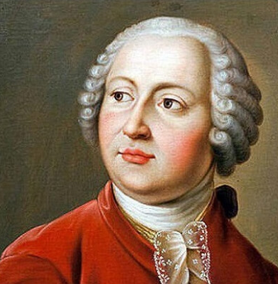
M. V. Lomonosov

Slide 2
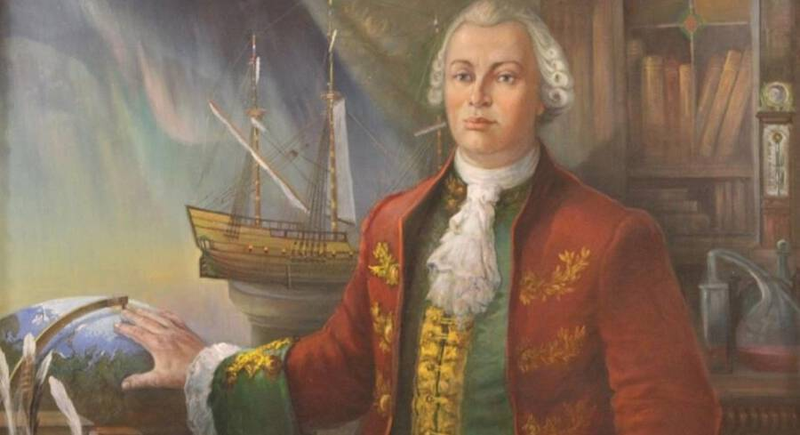
Mikhail Vasilievich Lomonosov is the first major Russian natural scientist. A vivid example of a "universal man": an encyclopedist, physicist and chemist (he entered science as the first chemist who gave physical chemistry a definition very close to the modern one, and outlined an extensive program of physicochemical research; his molecular-kinetic theory of heat largely anticipated modern understanding of the structure of matter and many fundamental laws, including one of the beginnings of thermodynamics).

Slide 3
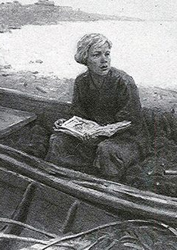
Birth
He was born on November 8, 1711 in the village of Mishaninskaya, Kurostrovsky parish, Dvinsky district, Arkhangelsk province (Arkhangelsk region) in a wealthy family. Mikhail started helping his father from the age of ten. Together they went fishing in the White Sea and to the Solovetsky Islands. The frequent dangers of swimming tempered the physical strength of the young man and enriched his mind with a variety of observations. The influence of the nature of the Russian north is easy to see not only in the language of M. V. Lomonosov, but also in his scientific interests.

Slide 4
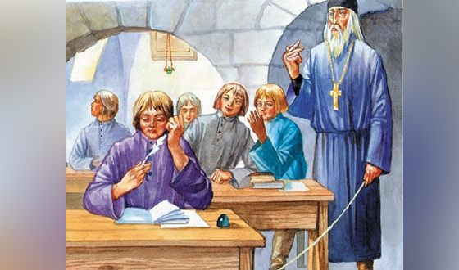
Education
Mikhail Lomonosov was taught to read and write by the sexton of the local Dmitrov church. At the age of fourteen, young Lomonosov wrote competently and clearly. Lomonosov's life in his native home became unbearable, filled with constant quarrels with his stepmother. Lomonosov's passion for books especially hardened his stepmother. After learning that his father wanted to marry him, Lomonosov decided to leave for Moscow. He pretended to be ill, the wedding had to be postponed.

Slide 5
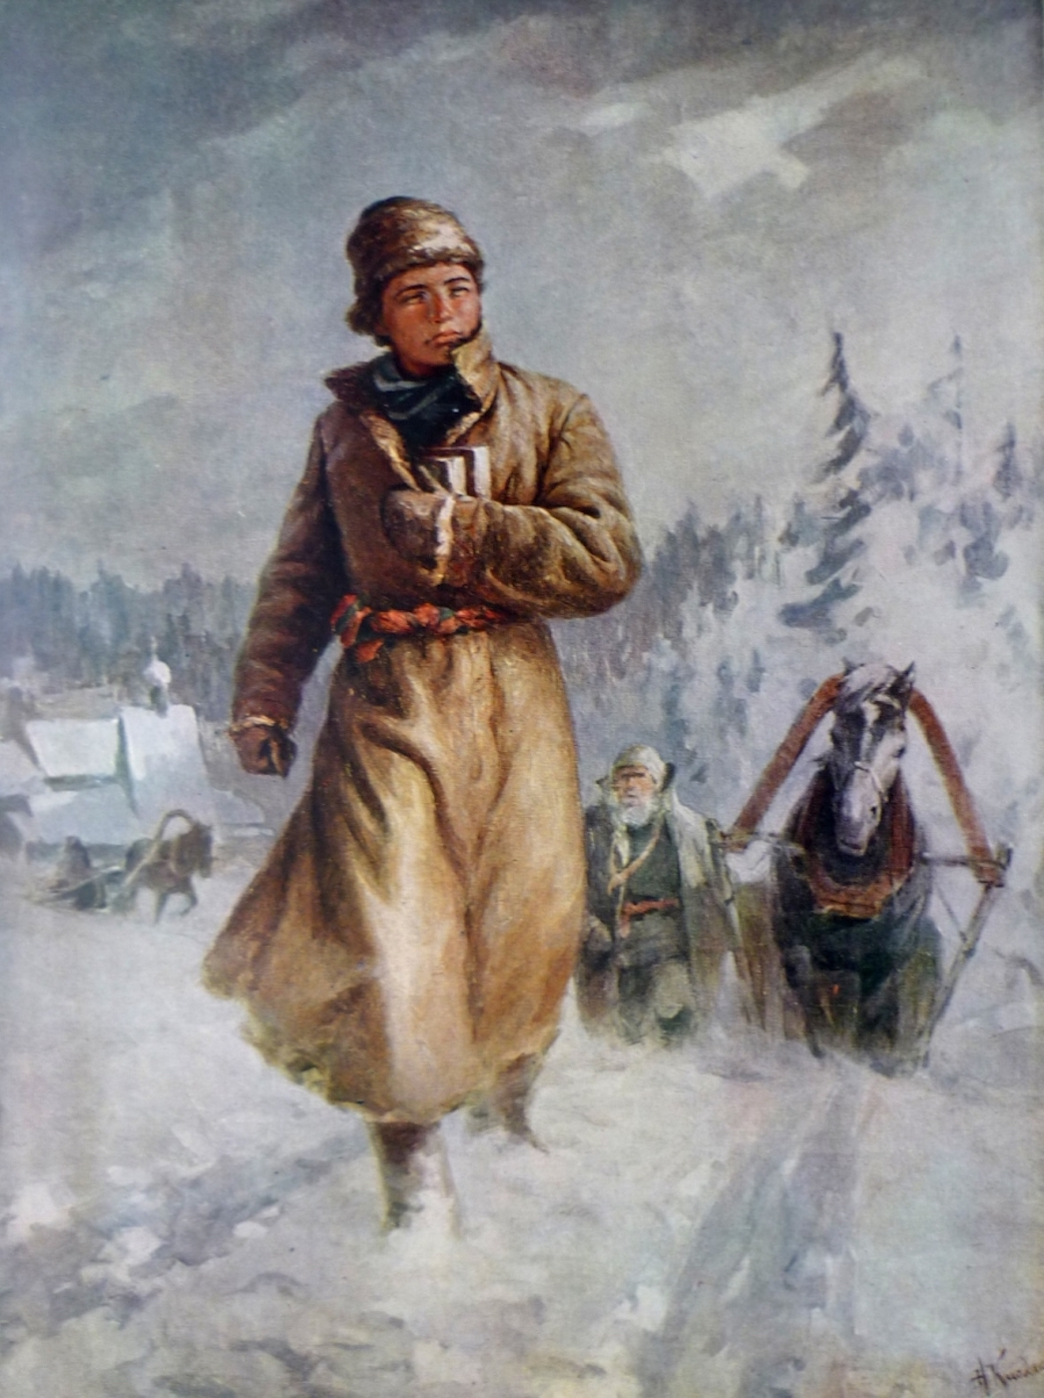
The trip to Moscow looked like an escape, since the future scientist left home at night, secretly, without saying goodbye to anyone. For a long time he was considered a fugitive. The journey to Moscow took three weeks, and in early January 1731 Lomonosov arrived in Moscow.
Lomonosov has established himself as a diligent student. In the library he read chronicles, patristics and other theological books. Modern researchers note Lomonosov's deep acquaintance with a variety of genres of ancient Russian literature.

Slide 6
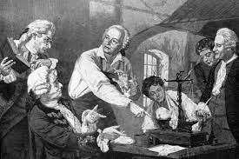
Study abroad
In February 1736, the president of the Academy of Sciences, Johann Korf, appealed to the Cabinet of Ministers with a proposal to send several talented young people to Freiberg (Saxony) to teach them chemistry and mining there. Having moved to Germany, Lomonosov settles in the house of the widow of a German brewer, whose daughter he later married. Lomonosov studied abroad for five years: about three years at the University of Marburg, under the guidance of the famous Christian Wolf, and about a year in Freiberg, with Henkel; he spent about a year traveling, was in Holland.
After a relatively independent and free university life in Marburg, Russian students were completely subordinated to the strict and pedantic J. F. Genkel. Genkel began his education with classes in mineralogy and metallurgy. Teaching was based mainly on practical classes: visits to mines and metallurgical plants were accompanied by explanations of production processes. Here Lomonosov got acquainted with the construction of mines, ways to strengthen mines, lifting machines. Later, in his book "The First Foundations of Metallurgy, or ore Affairs", Lomonosov widely used the knowledge and experience acquired in Freiberg.

Slide 7
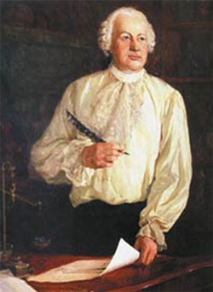
Professor
On July 25, 1745, by a special decree, 34-year-old Lomonosov was awarded the title of professor of chemistry. His dissertation was called “About metallic luster". According to the table of ranks, he became an official of the VII class and received a noble status. At the same time, Lomonosov intensively conducts his studies in the field of mineralogy, physics and chemistry, prints a long series of scientific treatises in Latin.

Slide 8
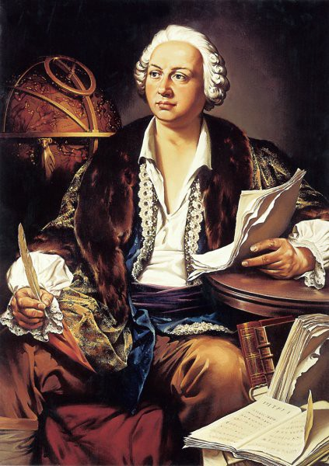
Activities in the field of sciences
M. V. Lomonosov considered chemistry to be the main field of his activity, but as his legacy shows, this discipline, entering into interaction with other branches of natural science at different stages of his work, remained inextricably linked with them in the context of all the diversity of his research, which, in turn, were interconnected with each other. Such logical unity is a consequence of his understanding of the unity of nature and the existence of a few fundamental laws underlying the entire holistic diversity of phenomena. This logical unity is demonstrated not only by his works relating to the natural sciences and philosophy — it can be traced between them and his poetic creativity.

Slide 9
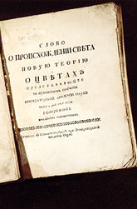
Molecular kinetic theory of heat
One of the outstanding scientific achievements of M. V. Lomonosov is his molecular kinetic theory of heat. M. V. Lomonosov draws the attention of the scientific community to the fact that neither the expansion of bodies as they heat up, nor the increase in weight during firing, nor the focusing of sunlight with a lens can be qualitatively explained by the theory of hydrogen. The connection of thermal phenomena with changes in mass partly gave rise to the idea that mass increases due to the fact that material hydrogen penetrates into the pores of bodies and remains there. Refuting one theory, M. V. Lomonosov offers another, in which, with the help of Occam's razor, he cuts off the superfluous concept of heat.

Slide 10
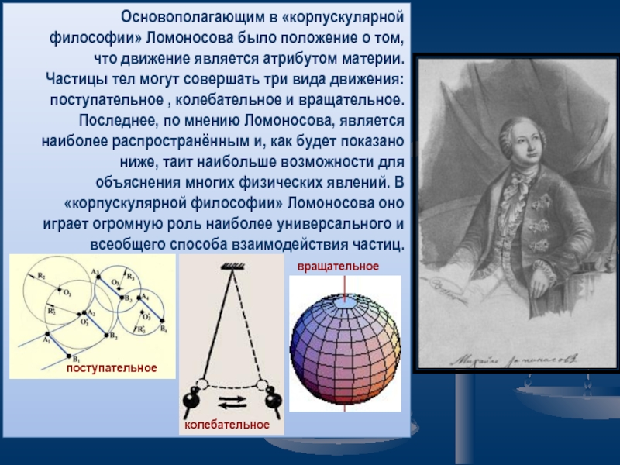
"Rotifer movement"
M. V. Lomonosov claims that all substances consist of corpuscles - molecules that are "collections" of elements - atoms. With his corpuscular-kinetic theory of heat, M. V. Lomonosov anticipated many hypotheses and propositions that accompanied the further development of atomistics and theories of the structure of matter. In his theses, logical constructions and proofs, the following analogies can be observed with the ideas that became relevant more than a hundred years later: atoms are spherical rotating particles — the next step was taken only with the electron hypothesis. The conclusions of the mechanical theory of heat, confirming it itself, for the first time substantiated the hypothesis about the atomic-molecular structure of matter - atomistics received objective scientific evidence.

Slide 11

The Science of glass
The glass production of that time had at its disposal a very meager assortment of reagents, which, of course, affected the coloring of products: what was produced by the St. Petersburg Glass Factory was mostly colorless, or painted in blue and green. The scientist worked with glasses and other silicate melts while he was still studying mining and metal technology in Germany. Empirical glassmaking technology was then used only by practitioners who did not possess any scientific methods. M. V. Lomonosov and his classmate Dmitry Vinogradov, the creator of Russian porcelain, were the first to declare the need for knowledge of chemistry to create glasses. M. V. Lomonosov was able to prove the need for laboratory and production personnel. A lot of variously colored glasses were obtained by M. V. Lomonosov with a very limited set of elements used as inclusions that affected the chromaticity.

Slide 12
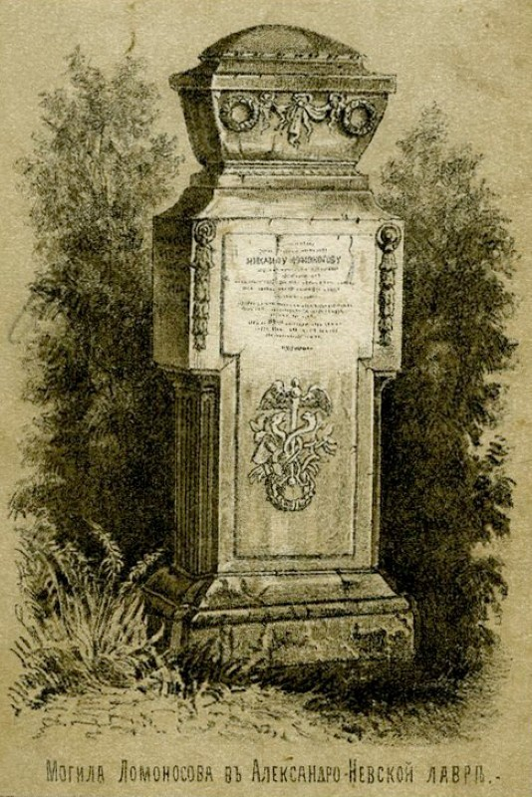
Death
Lomonosov died on April 4, 1765 at the age of 54 from pneumonia. Shortly before Lomonosov's death, Empress Catherine II visited him. Lomonosov was buried on April 8, 1765 at the Lazarevskoye Cemetery of the Alexander Nevsky Lavra. The tombstone of M. V. Lomonosov, erected by Chancellor M. I. Vorontsov, is a stele made of Carrara marble with a Latin and Russian epitaph and allegorical relief.

