Slide 1
Harbourfront Volunteer Program
BUS 4045: Capstone Project, Client Sponsor: Karen Sinotte
.
Alexei Marcilio, alexei.Marcilio@gmail.com
03.01.15

Slide 2



About Alexei
2006-2013 Manager of CRM at Bayer Healthcare
MBA in The Hague Netherlands
Salesforce Certified
Always enjoyed hands on Analytics

Slide 3
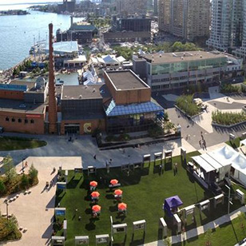
Harbourfront Centre
Harbourfront Centre is an Arts & Cultural non-profit organization established in 1972
Over 4,000 events annually
16 million visitors each year
Over 7,000 volunteer shifts
Over 450 Volunteers Annually
Diverse group of Volunteers – different ethnicities, ages, and professions

Slide 4

Executive Summary
What’s a Typical Volunteer?
What correlates with Hours and Tenure?
Examined all 2015 Volunteers
Used Tableau, T-Tests and SAS Data Miner
Most Volunteers Toronto Female Students (U of T)
Older Non Students ~ Work Longer Hours and >Tenure
Distance ~ Fewer Hours
Four Clusters Found ~ Made Recommendations

Slide 5


Problem and Approach
Problem ~ Onboarding Costly ~ Who are our Volunteers?
What correlates with Hours and Tenure?
Examined all 2015 Volunteers
Tableau used to Visualize
T-Tests to Find Differences (M vs F, Young vs Old, etc)
SAS Data Miner to Segment Volunteers

Slide 6
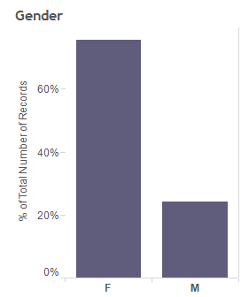
Results: Volunteer Profile
Most are Female (70%)
Most are Students ~ U of T
Mean Age is 25 ~ skewed right
Geo Map hints Distance is a factor
Age seems to relate to Hours and Tenure

Slide 7
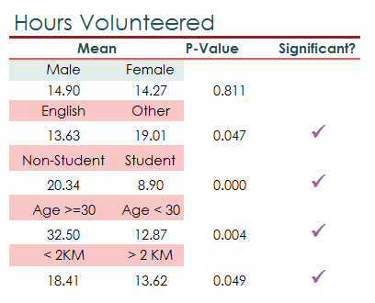
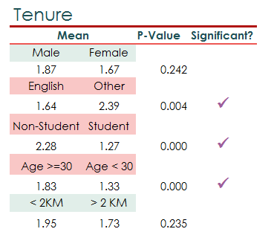
Results: T-Tests

Slide 8
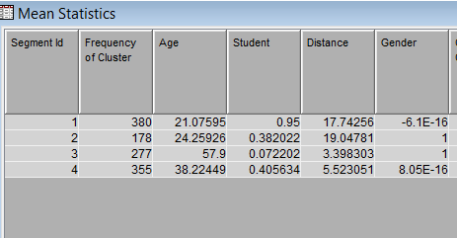
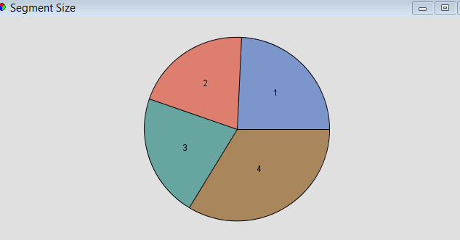
Results: Cluster Analysis
Young Students Female
Young Males, mostly not students
Old Males Not Students
Middle Age Females – about 41% students

Slide 9

Results: Cluster Analysis
Young Students Female
Young Males, mostly not students
Old Males Not Students
Middle Age Females – about 41% students

Slide 10

Conclusions & Recommendations
Most Young Students yet work fewer hours
Encourage Elderly Volunteers –
Local Retirement Homes
Examine Student Credit Policy
Many Students once complete do not return
What Motivates Segments? No one size fits all.
“We miss you” ~ keep them in the loop

Slide 11

Thank you!
Contact us:
Alexei.Marcilio@gmail.com

