Slide 1
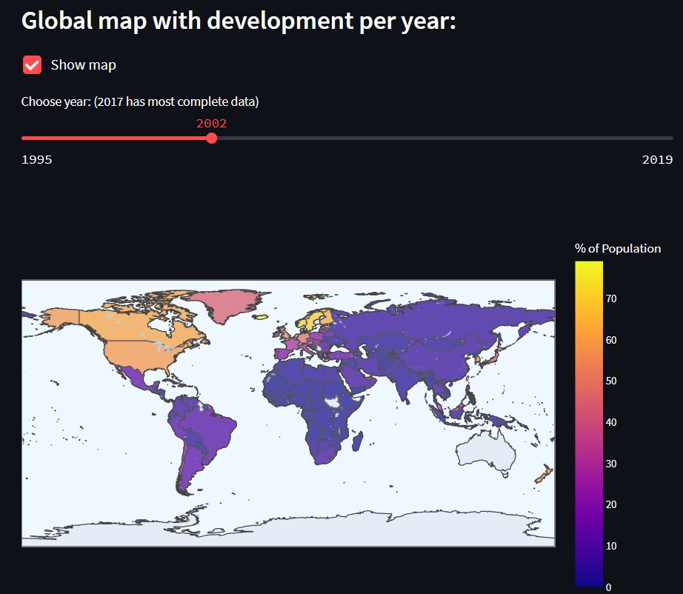
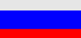
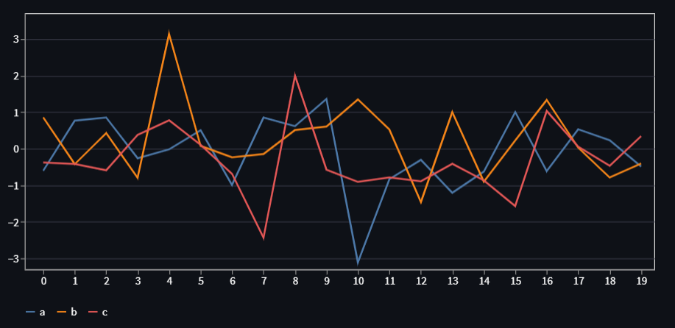
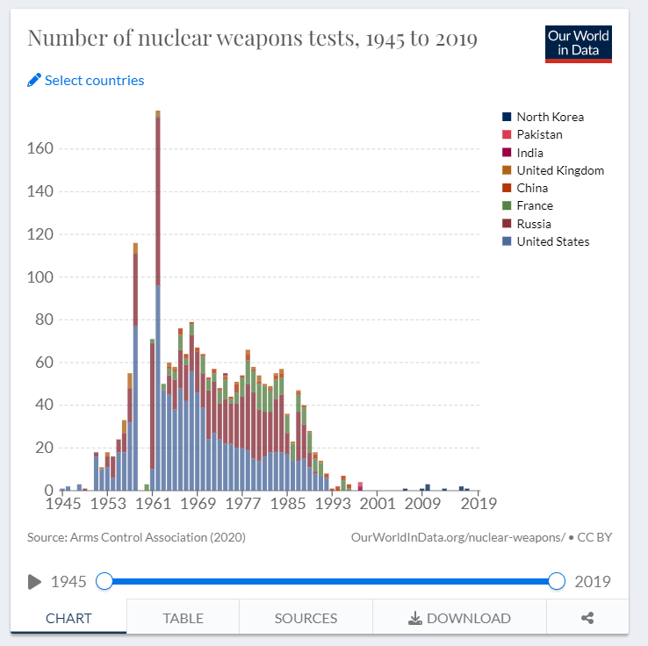
Global map with development per year:
Scale/Color= STOCKPILE
TESTS
4
Possesses
Pursues
Considers
Does not consider
No data
2
Tests
5-10J Intervall
WK, Events, Sowjetunion,
Tschernobyl,
Irak1/2,
Abwürfe
Ost/West
Layer
Wirtschaftsdaten
Korrelation
Heatmap
Scatterplot
Select year:
Possession:
Select countries:
All countries
Selected year
Tests:
All countries

Slide 2

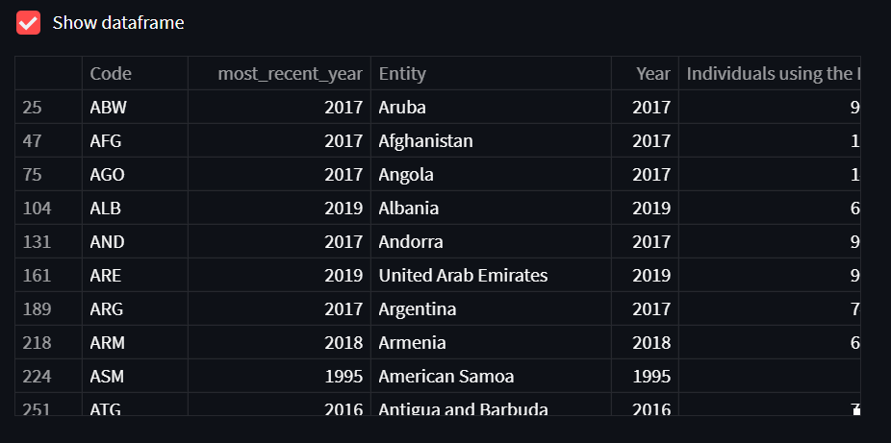
Complete data:
Source:
Max Roser, Bastian Herre and Joe Hasell (2013) - "Nuclear Weapons". Published online at OurWorldInData.org. Retrieved from: 'https://ourworldindata.org/nuclear-weapons' [Online Resource]

Slide 3
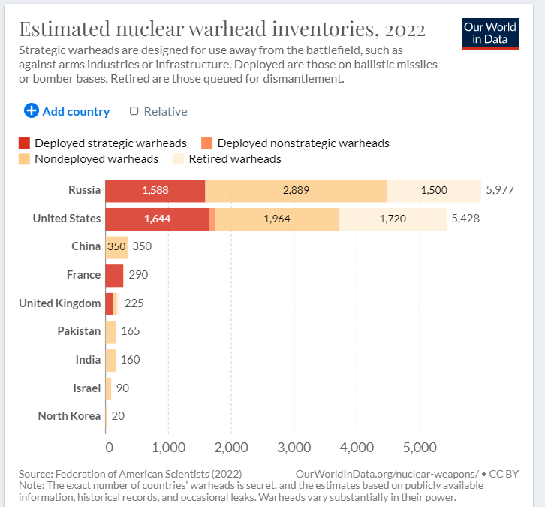

Slide 4


