Slide 1
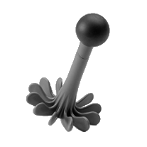
Part II (insight)
Message morsing
or
*
Potato mashing
+
3 s or response
0.5 s
Part I (pre-insight)
2.5 s
Part III (post-insight)
0.5 s
A. “I know what this is”
B. “I have an assumption what this is”
C. “I have rather no assumption what this is”
D. “I don’t
know what this is”
+
+
Informed condition Matching keywords and response A or B
Naive condition Non-matching keywords and response C or D
3 s or response
3 s or response
0.5 s
0.5 s

