Slide 1
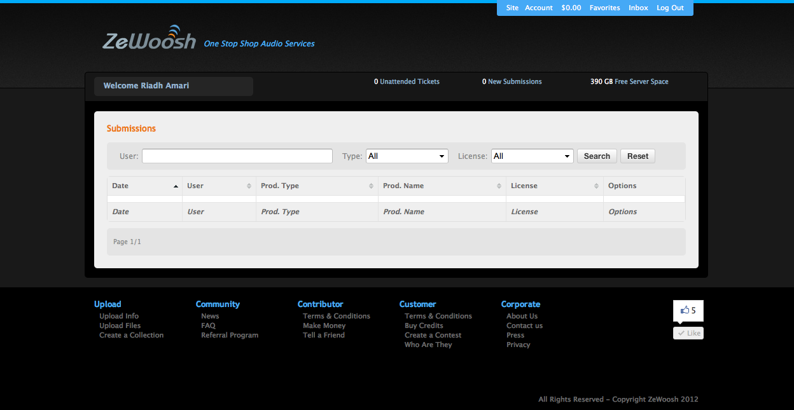
Add a link to display the pending purchase

