Slide 1
Phenotypes in WES (WECARE1 ?) and Ampliseq (WECARE 1 + 2 ?)
Selecting factors that will be included into model
Demographics: age, familial history, number of pregnancies
Reference time: time to event in CBC (or lack of it in UBC)
Tumour: stage, hormonal receptors, pathology
Treatment: X-ray, chemo & hormonal

Slide 2
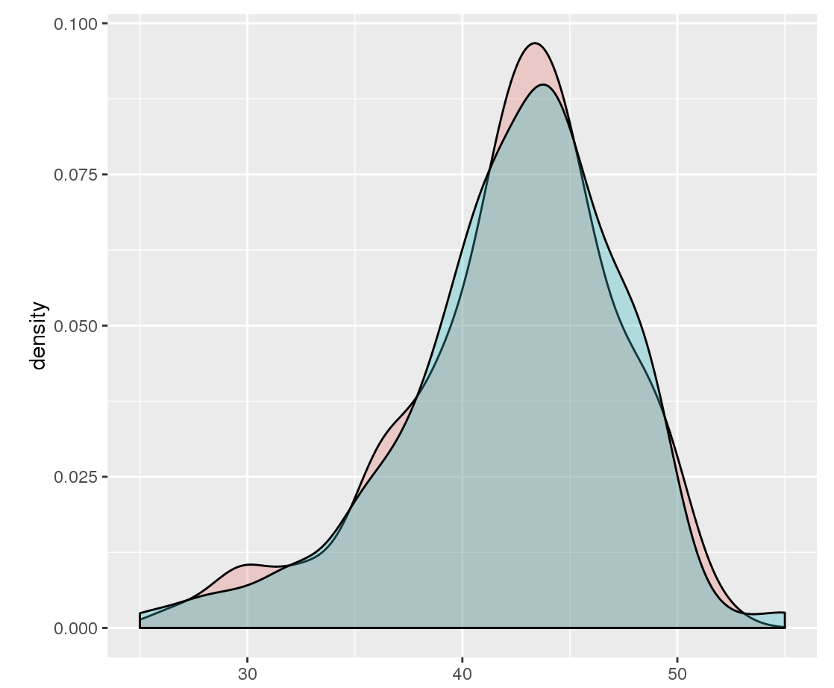
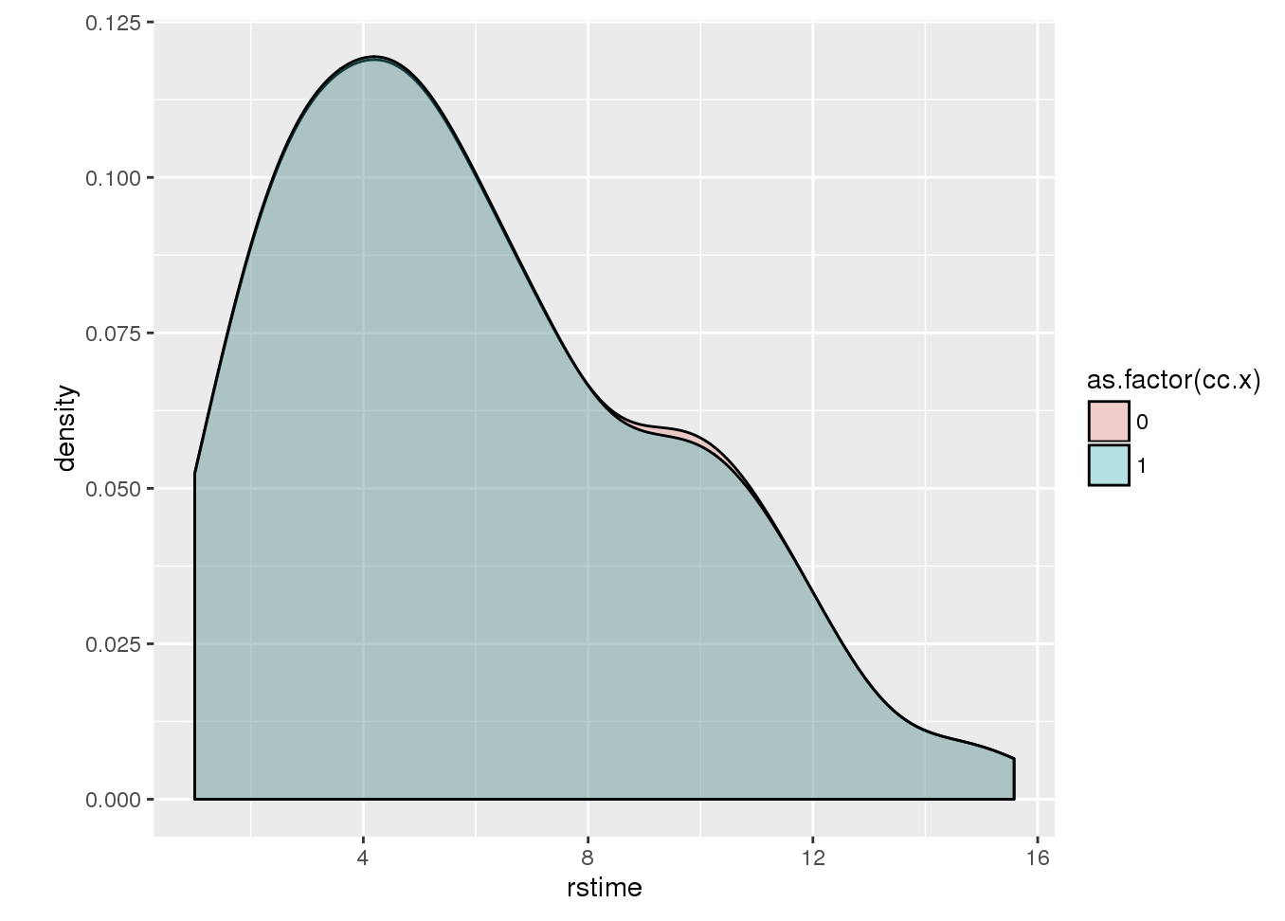
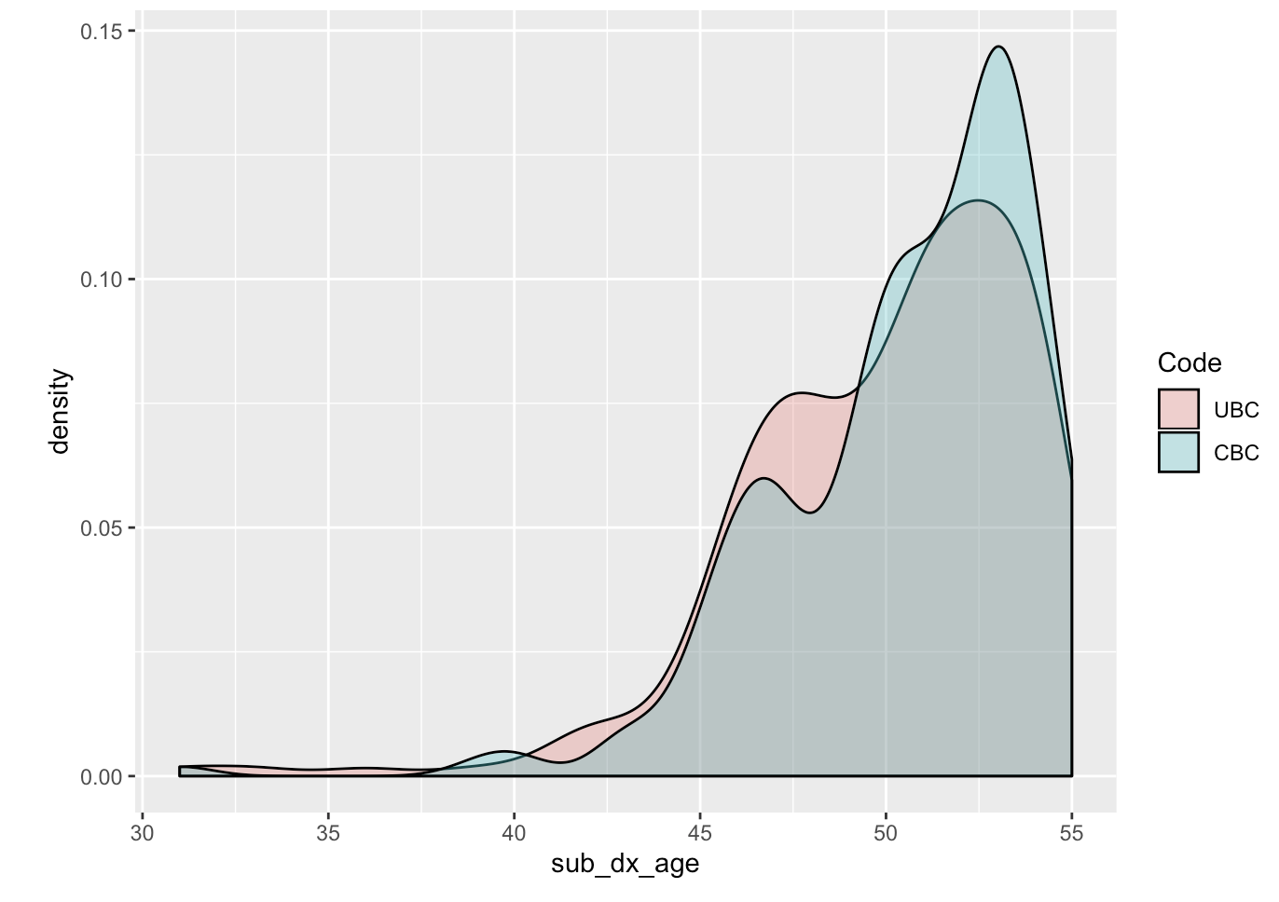
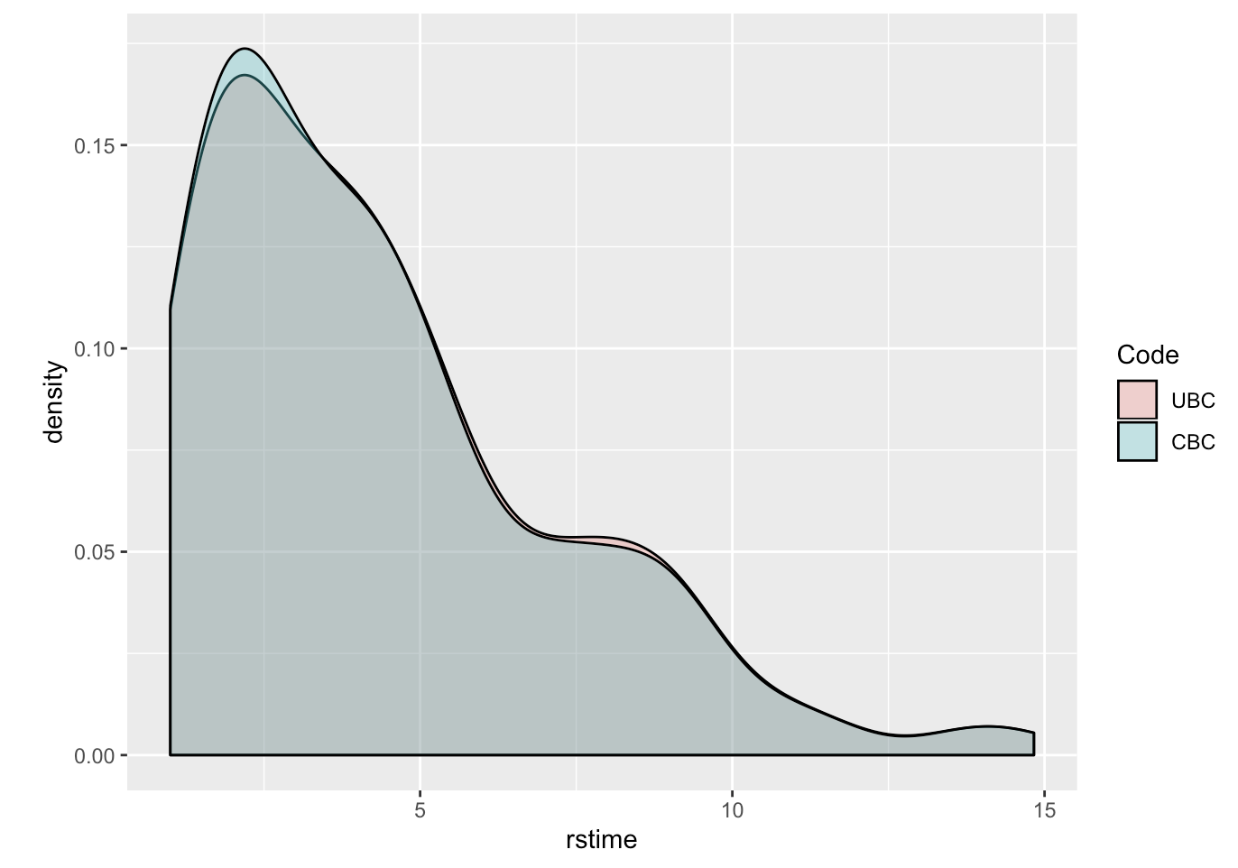
Age at (first) diagnosis
Reference time
WES
Ampliseq
Controls matched to cases by design

Slide 3
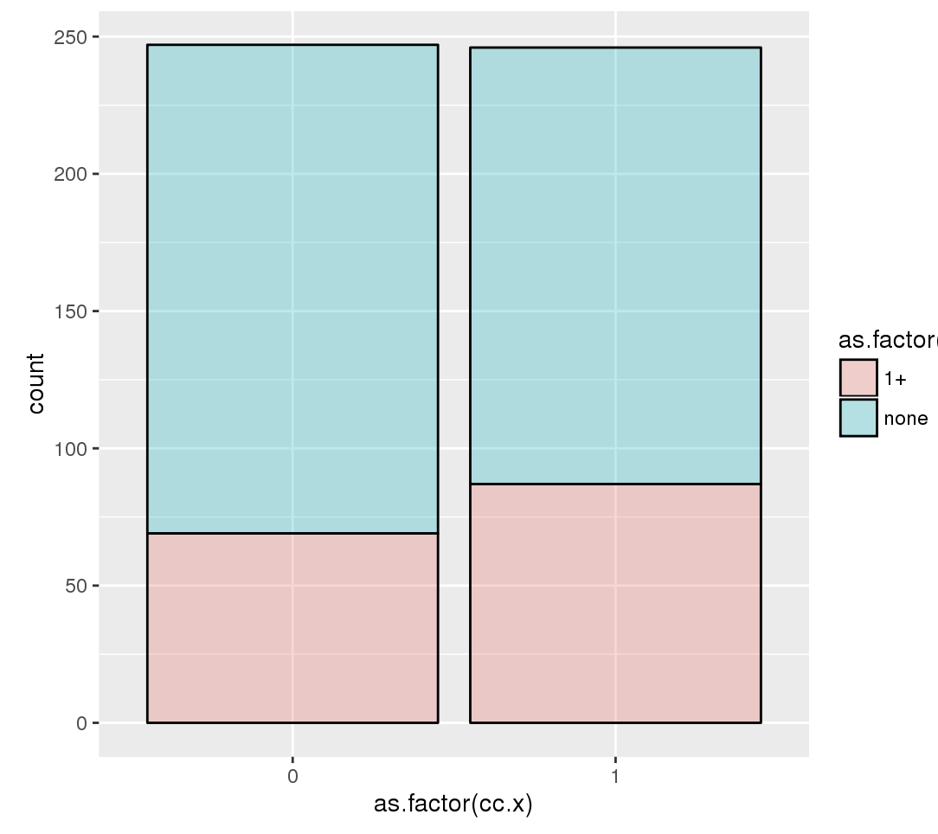
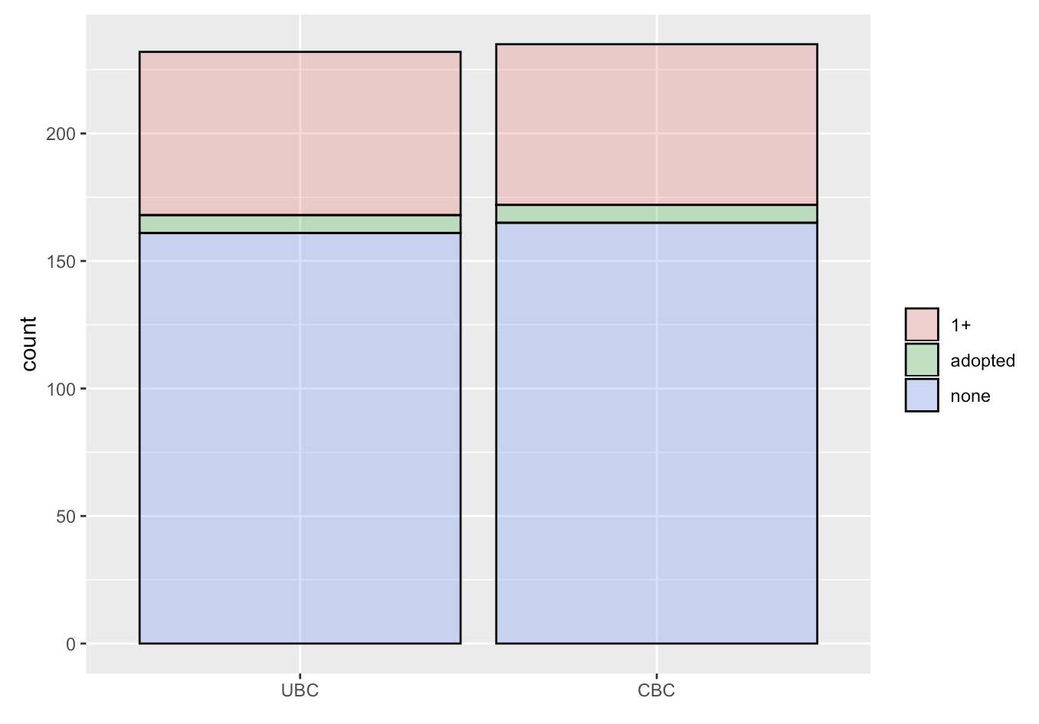
Family history
Inverted for consistency
>100 CBC samples with familial history, age < 55 and no BRCA1/2 PALB2
Candidates for long read WGS ? Select those who had 2+ ftp-s?
WES
Ampliseq

Slide 4
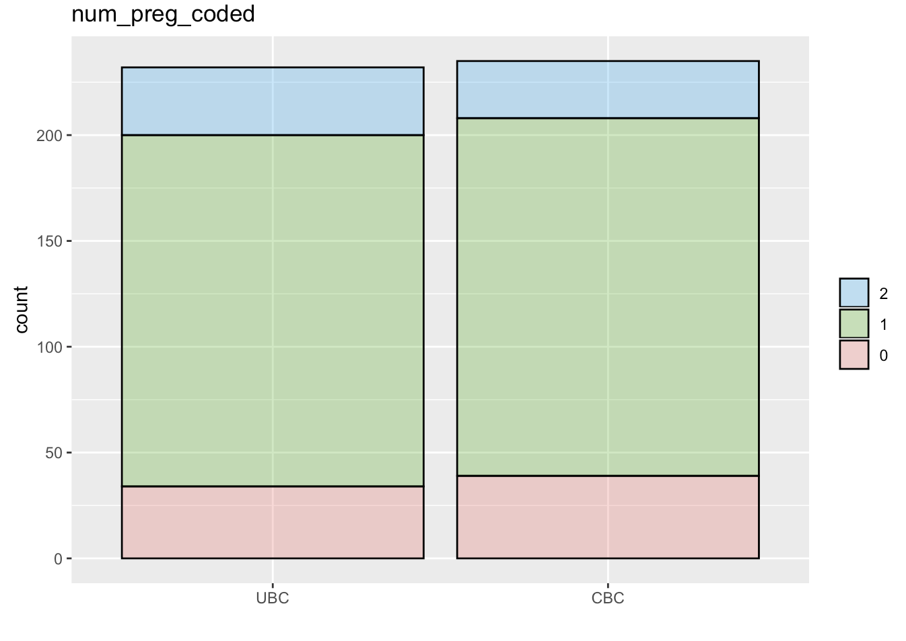
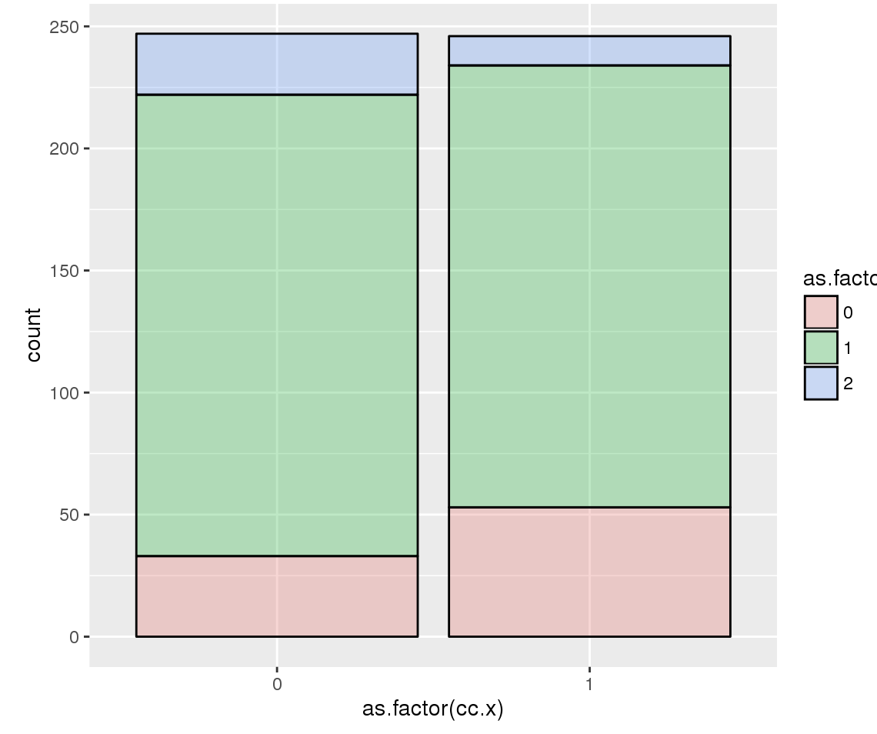
Number of (full time) pregnancies
Difference is significant in WES dataset, Included in the model
WES
Ampliseq

Slide 5
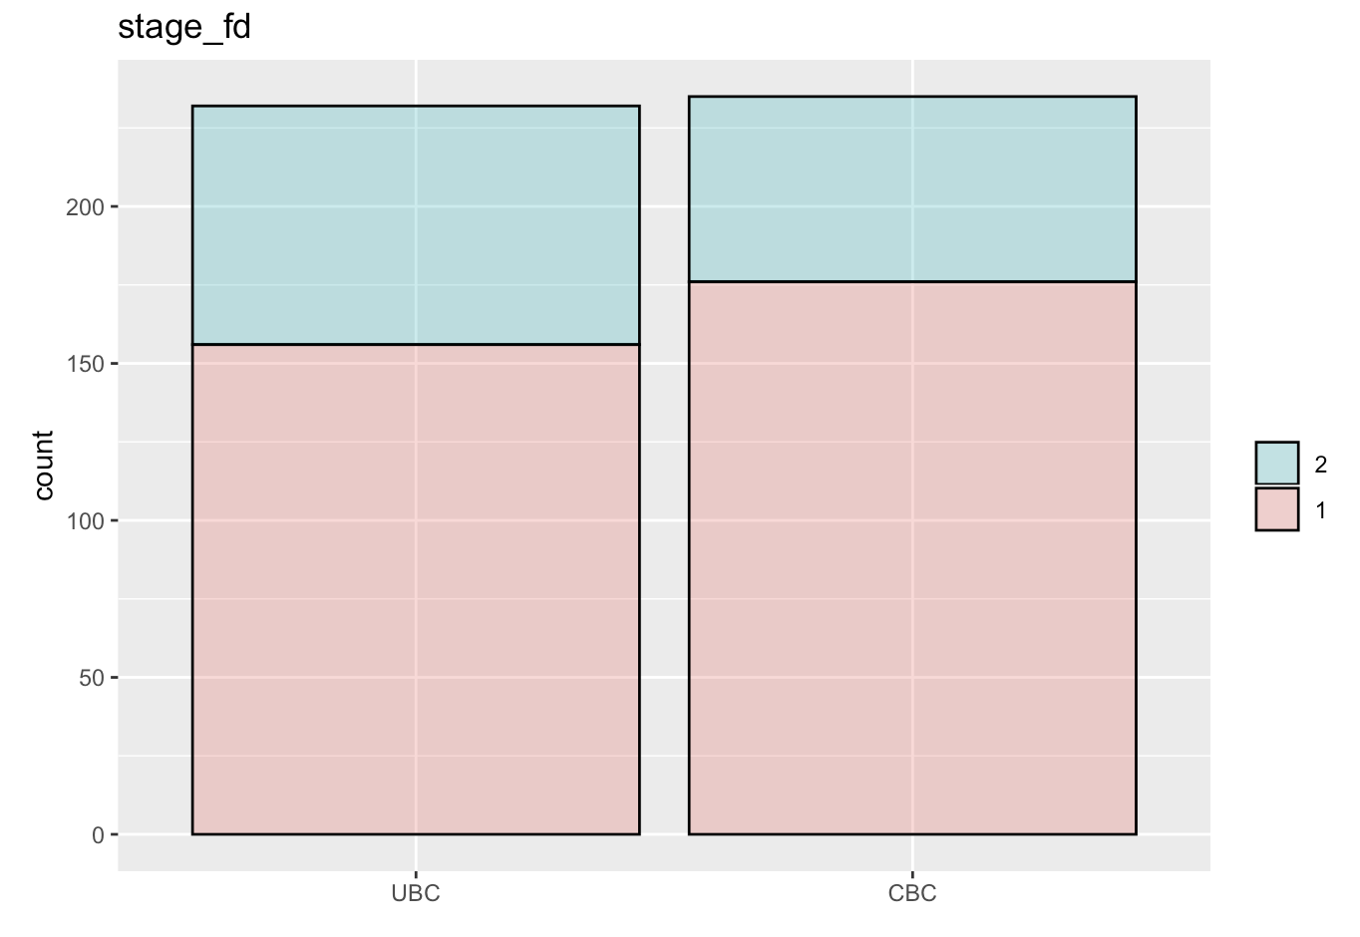
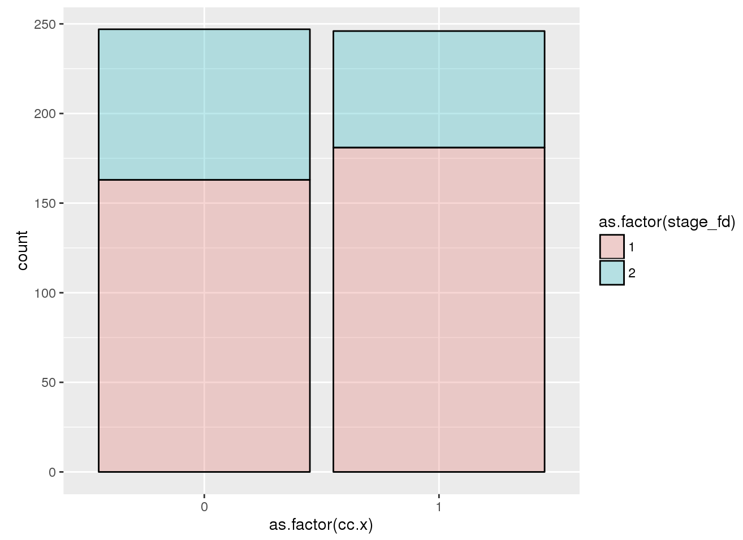
Stage (at 1st diagnosis)
WES
Ampliseq

Slide 6
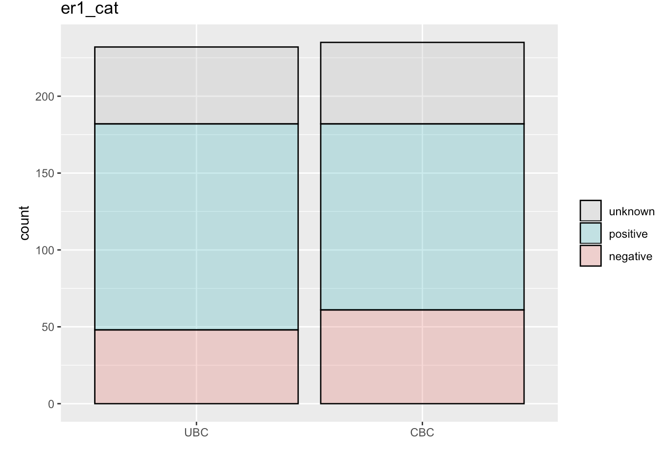
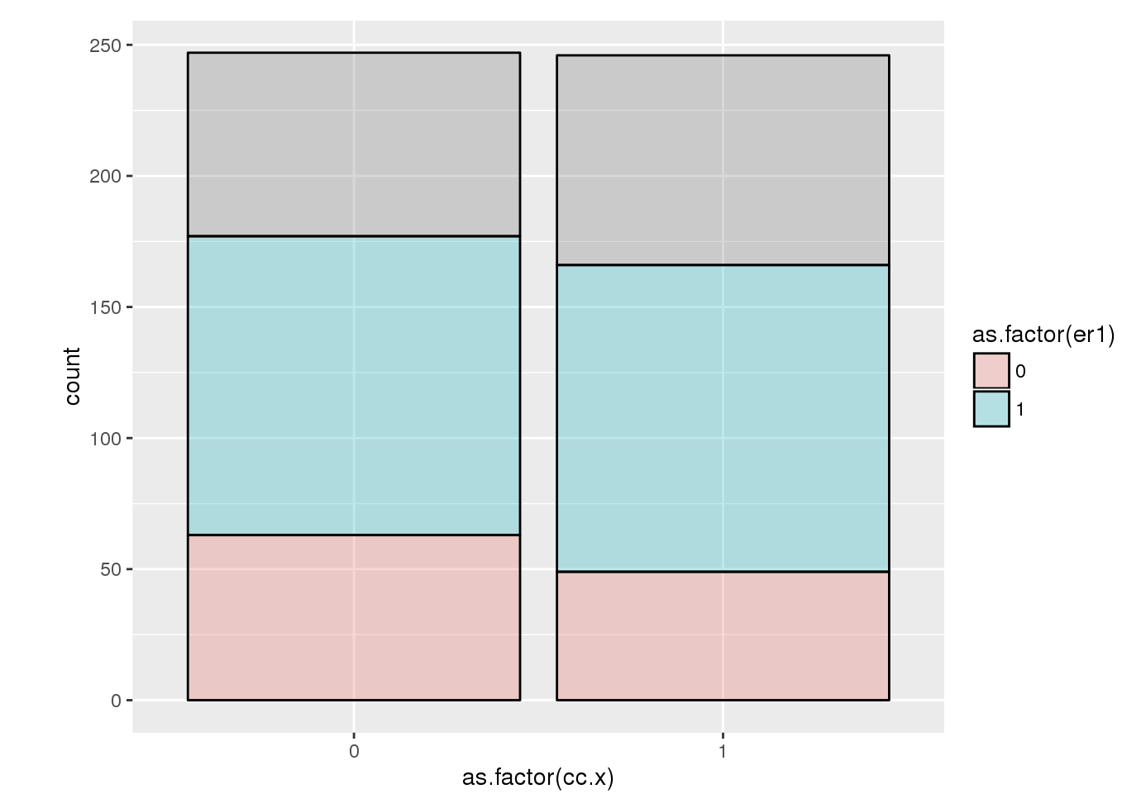
Oestrogen Receptors
WES
Ampliseq

Slide 7
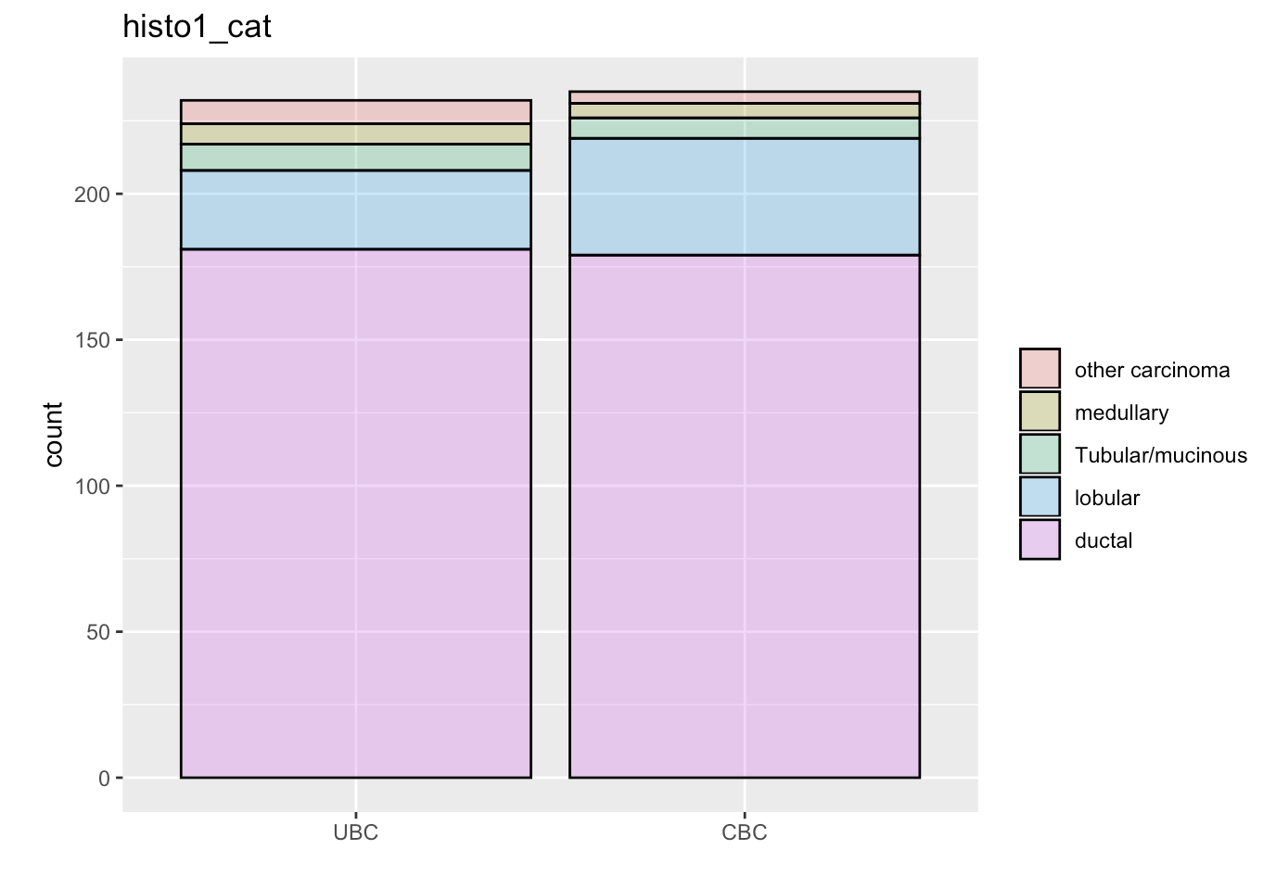
Pathology : histo-cat / lobular ?
No grade in WES
WES
Ampliseq

Slide 8
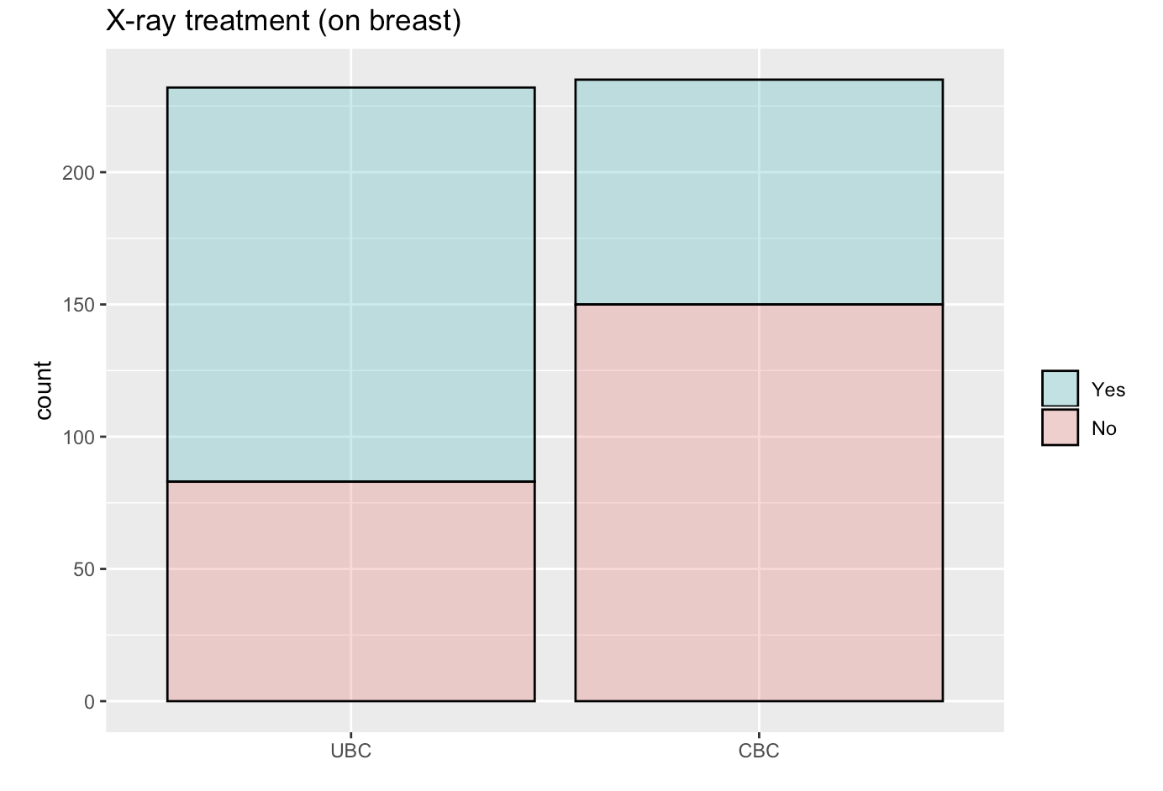
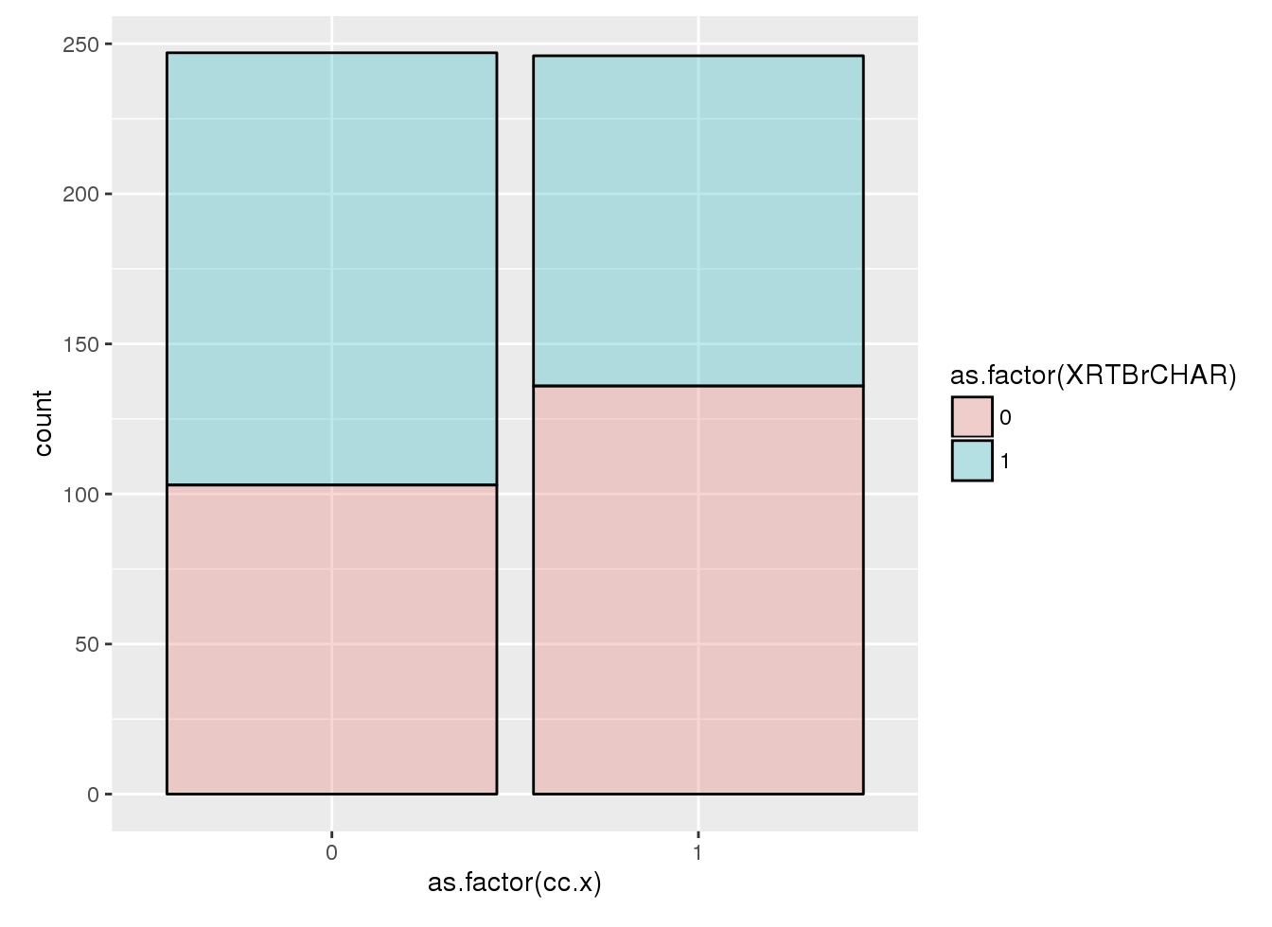
UBC
CBC
Breast irradiation
RT+ RT+
RT-
RT+ RT-
RT+
Differences are highly significant in both datasets by design
(the counter-matching enriched controls by RT+ve patients because RT-ve cases had no RT-ve controls)
Not included in the model
WES
Ampliseq

Slide 9
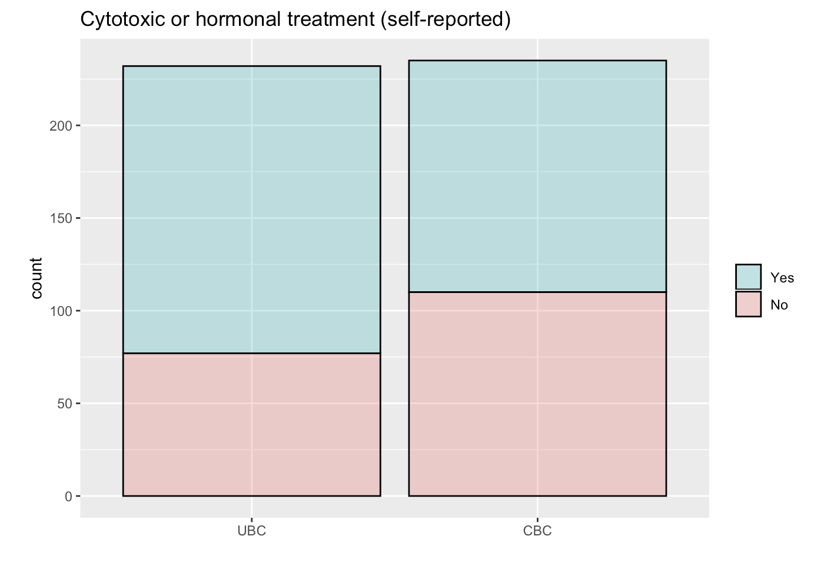
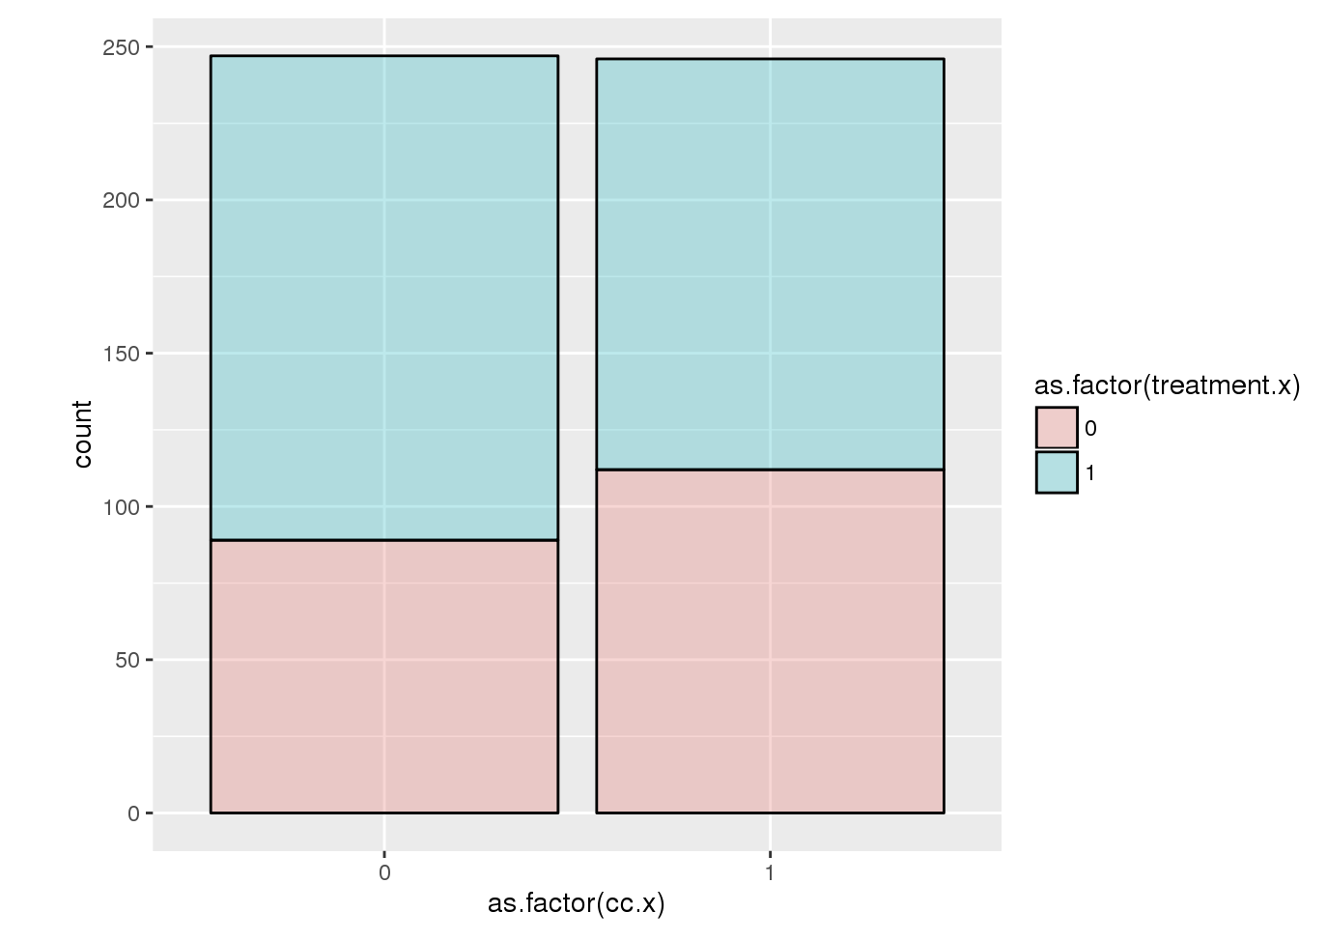
Treatment (cytotoxic or hormonal)
Differences are significant in both datasets
Included in the model
WES
Ampliseq

Slide 10
Selected covariates for the models
SKAT (UBC vs CBC)
Phenotype ~ Genotype
+ Age + Time to event
+ Num Pregnancies + Treatment (chemo or hormonal)
+ 2 top eigenvectors
POLR (NFE < UBC < CBC)
Phenotype ~ Genotype + 2 top eigenvectors

Slide 11
Age at (first) diagnosis
Cases matched to controls by design
WES
Ampliseq

Slide 12
Reference time
Cases matched to controls by design
WES
Ampliseq

