Slide 1
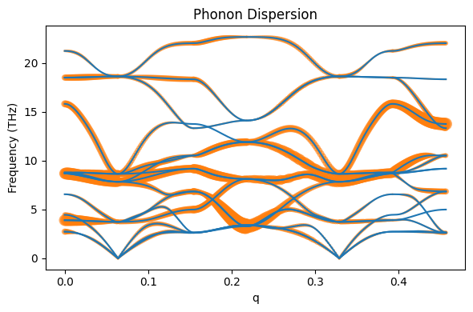
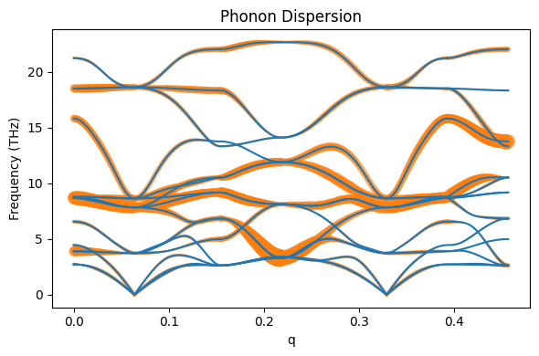
No weighting
Weighted (mass)

Slide 2
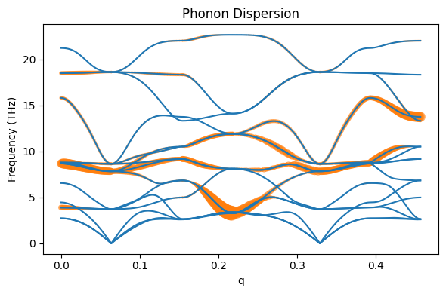
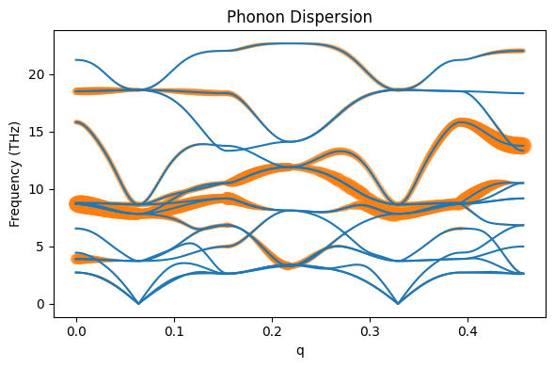
Start-ts
(Start+fin)/2 - ts
X
G
M
R
G
X
M

